Slide 1
Lecture 3: Feature Modeling
Gregory Gay
TDA 594/DIT 593 - November 8, 2022

Slide 2
Today’s Goals
Feature Modeling
Feature Diagrams
Propositional Logic
Analysis of Feature Models
Notes:
Last class, we introduced the concept of domain modeling, and the core idea that we can model variability and customizability in a product by examining variation point and feature selections. We introduced a format called feature diagrams to visually depict variability in a system. Today, we’re going to focus more on feature modeling both in visual form and analysis of these models based on propositional logic. Propositional logic enables us to use automated tools such as SAT solvers to test interesting properties, such as checking validity of feature models and feature selections, detecting dead features, and comparing feature models.

Slide 3
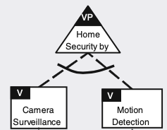
Reasoning about Variability
Variation Point
Where one product can differ from another.
Ex: Which features are supported by this security alarm?
Feature
Options that can be chosen at each variation point.
Ex: Motion detection, camera
Notes:
As a quick review, Variation point: the variation point describes where differences exist in the final systems (e.g. systems may differ with respect to the operating systems they rely on, with respect to whether they support a particular feature or not, which algorithm a feature uses, etc.) For example, we may have a security alarm product line that can perform different types of detection. Which are supported by a concrete alarm? This is essentially where you make a choice between the different possibilities that exist to satisfy a variation point , what we call features

Slide 4
Features and Products
Any end-user-visible characteristic or behavior of a system is a feature.
(often, functionality a user can directly interact with)
A concrete product is a valid feature selection.
Fulfills all variability and feature dependencies.
Notes:
A feature is a end-user-visible - that’s key - characteristic or behavior of the system (2). Features are used in product-line engineering to specify and communicate commonalities and variabilities, the differences, of the products between stakeholders and designers, and to guide structure, reuse, and variation across all phases of the development life cycle. The product portfolio of a product line is defined by its features and their relations. A specific product is identified by a subset of features, called a feature selection. A product of a product line is specified by a valid feature selection (a subset of the features of the product line). A feature selection is valid if and only if it fulfills all variability and feature dependencies.

Slide 5
Feature Modeling
A specification of variation points and features in a hierarchical form.
Represented visually using feature diagrams.
Also represented as propositional logic for analysis.
Enables understanding of dependencies and what valid products can be built using a platform.
Notes:
Modeling the possible variability is a crucial step in product-line development. A common approach is to express variability in terms of common and optional features, a process called feature modeling. A feature model documents a product line’s variability. It specifies the set of valid products that we can create, based on the constraints between features at a single variation point or across multiple variation points, specified in a hierarchical manner. Feature models take two forms. First is a graphical form, called a feature diagram, where we create an expanding hierarchy of variation points and the features to fill them, expressed along with additional constraints between these features. This allows us to quickly understand how our common platform can create a variety of real products, and to quickly understand what products represent a valid configuration of the feature model. Besides introducing the graphical language of feature diagrams, we also connect the graphical representation to a formal representation that is the basis of engineering tools that can quickly be used to answer questions about our planned product line - are particular configuraton is valid, are there constraints that are specified incorrectly, what code connects to particular features, and so on.

Slide 6
Feature Diagrams
Notes:
10 min break or adjust

Slide 7
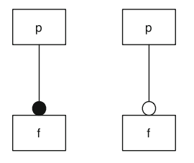
Feature Diagrams
Tree where nodes represent features.
Shows parent-child relationship.
F can only be selected when P is selected.
Parent tends to be more general, child is more specific.
Parent - Sensor, Child - RADAR
Mandatory Feature
Optional Feature
Notes:
Feature diagrams are a standard visual representation, whose semantics are specified by a translation into propositional logic. Feature diagrams define a feature model as a hierarchy of features and constraints among them. It is a tree whose nodes are labeled with feature names. Different notations convey parent–child relationships between features and their constraints. If a feature f is a child of another feature p, f can be selected only when p is also selected. Typically, a feature diagram includes mutual relations between features. For example, the parent feature denotes a more general concept and the child a specialization. For example, the parent might be “Sensor” - a abstract concept, and a child might be “RADAR” a specific kind of sensor.
On the left, The parent node is labeled with p, the child node with f. If a feature f is a child of another feature p, f can be selected only when p is also selected. Mandatory and optional features are distinguished by a small circle on the child node—a filled bullet denotes a mandatory feature, whereas an empty bullet denotes an optional feature.

Slide 8
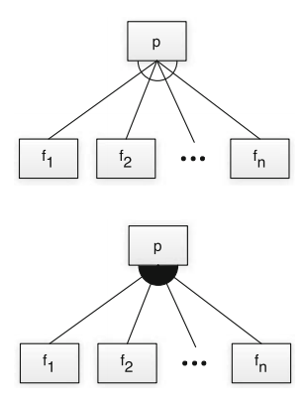
Feature Diagrams
Alternative (mutually exclusive choice): Choose exactly one
Mandatory Feature
Optional Feature
Or: Choose at least one
Notes:
Specific graphical elements define additional constraints, if the child features of a common parent cannot be selected independently. The top and bottom right show graphical notations for disjunctive combinations. On the top right, the edges between a parent feature and a group of child features are connected via an empty arc. This graphical element denotes a choice of exactly one feature out of the group (that is, choose one from {f1 ... fn}). In propositional logic, it is an xor statement, choose exactly one. This construct is called alternative or mutually exclusive choice. Typical examples of exclusive disjunctions of features are different implementations of the same functionality or different technical platforms such as the choice of the supported operating system. The bottom right shows child features connected via a filled arc. This graphical element denotes an unrestricted choice of one or more features out of a feature group. It is chosen if, at least, one feature of the collection has to be selected, but there are no other restrictions. Mathematically, it denotes an inclusive disjunction (an or statement).

Slide 9
Cross-Tree Constraints
Cross-tree Constraints are predicates imposing constraints between features.
DataDictionary ⇒ String
(Storing a data dictionary requires support for strings)
MinimumSpanningTree ⇒ Undirected ∧ Weighted
(Computing a Minimum Spanning Tree requires support for undirected and weighted edges)
Constraints over Boolean variables and subexpressions.
(i.e., (NumProcesses >= 5))
Notes:
The notational elements of feature diagrams support a natural description of a wide range of variability options, but not all. More general restrictions are needed in the form of propositional logic constraints. Typical constraints are implications between features located in different parts of the feature hierarchy, for example, to express that a certain algorithm requires a special data structure or that a certain function is not available for a certain operating system. Those additional constraints may span large parts of the feature diagrams and so we call them cross-tree constraints. for example, For embedded data management, storing an explicit data dictionary requires the support of the String data type to store attribute names (2), or For a graph library, a typical cross-tree constraint would be that the computation of minimal spanning trees requires undirected, weighted edges to be supported (4). LArgely, we will focus on named Boolean features as an introduction, but non-Boolean features or attributes of features may also be of interest. For example, in a system supporting parallelization, the number of supported processes may lead to different products, and we might have constraints defined over the number of processes

Slide 10
Example - Website Configuration
SPL that provides website functionality.
One feature - adjusts layout based on the device.
What other aspect of the site could be features?
Consider visual appearance and personalized content.
Website Configuration
Visual Appearance
Layouts
Mobile
Tablet
Desktop
Notes:
Let’s do another example together. Let’s say that we want to build a platform that can control the visual appearance of our website. For example, it might present different layouts on a desktop, mobile phone, and a tablet. So, one feature is a layout selector, with the options tablet, desktop, and mobile. What other features might this product line have? Think about a website that changes its functionality or appearance under different circumstances. Or one that allows personalization of the content. What are the different options that can result in different configurations of the site? (discuss)
Appearence: - images - full quality, low quality, text-only - color scheme - light mode, dark mode
Content: - cookies - all, only essential, none - advertising - targeted, non-targeted, none - languages - english, swedish, norwegian
- account features - logged in, not logged in -> change password, personalized content, edit account details

Slide 11
Example - Website Configuration
Website Configuration
Content Personalization
Visual Appearance
Layouts
Dark Mode
Mobile
Tablet
Desktop
Notes:
Appearence:
- images - full quality, low quality, text-only
- color scheme - light mode, dark mode

Slide 12
Example - Website Configuration
Website Configuration
Content Personalization
Visual Appearance
Account Features
Languages
Advertising
Cookies
Swedish
English
Essential
None
All
Change Password
Edit Account Details
Standard
None
Targeted
Personalized Content
Notes:
Content:
- cookies - all, only essential, none
- advertising - targeted, non-targeted, none
- languages - english, swedish, norwegian
- account features - logged in, not logged in -> change password, personalized content, edit account details

Slide 13
Activity - Smart TV OS
Your company is developing a product line of smart televisions, with different feature configurations.
Identify the features of this product line.
Model the domain with a feature diagram.
Consider existing products on the market (e.g., Samsung TVs). Maybe check an electronics website (elgiganten, etc.).
Notes:
Now, I’d like you to try an example. You don’t have to get this completely done, but try to do a little bit. OK? You work at a company that is developing an operating system for smart televisions. You have decided to develop this as a software product line, so that you can easily provide different feature sets for different physical products.
Analyze the domain and identify a set of features.
Model the domain with a feature diagram.
To analyze the domain, you may draw on your own experiences with such products, or may search the internet for examples of such products (e.g., looking at Samsung, Sony, or other manufacturer websites or at shopping websites).

Slide 14
Activity - Smart TV OS
Which features will many (or few) customers want?
Which features might distinguish your product from others on the market?
Don’t try to capture all features, but an interesting subset (aim for 15-25).
Capture dependencies between features using visual structures and cross-tree constraints.

Slide 15
Activity - Smart TV OS
Notes:
Which features will many (or few) customers want?
Which features might distinguish your product from others on the market?
Don’t try to capture all features, but an interesting subset (aim for 15-25).
Capture dependencies between features using visual structures and cross-tree constraints.

Slide 16
Possible Solution
TV OS
Media Upscaling => 4K
Connectivity
Screen Resolution
Media Upscaling
Control
Eithernet
WiFi
Bluetooth
480p
720p
1080p
4K
Remote
Mobile Phone
IR
Bluetooth Remote
Bluetooth Remote => Bluetooth
Notes:
This is open ended, so there will be a range of answers and not a single correct one. But, here is one option you might have come up with.
go over, point out cross-tree constraints

Slide 17
Possible Solution
TV OS
Screen Casting
Media Apps
App Store
Connection Ports
AirPlay
ChromeCast
Video
Audio
HDMI
VGA
Composite
SVT
Netflix
Spotify
Pandora
Composite => 480P
Screen Casting => Connectivity
Media Apps => Connectivity
App Store => Connectivity
Notes:
This is open ended, so there will be a range of answers and not a single correct one. But, here is one option you might have come up with.
go over, cross-tree constraints, open circle = only one, closed circle = at least one

Slide 18
Let’s take a break!
Notes:
5 minutes to refresh

Slide 19
Propositional Logic and Feature Model Analysis
Notes:
10 min break or adjust

Slide 20
Propositional Logic
Mandatory: If parent is selected, the child must be.
mandatory(p, f) ≡ f ⇔ p
Optional: Child may only be chosen if the parent is.
optional(p, f) ≡ f ⇒ p
Mandatory Feature
Optional Feature
Notes:
Feature diagrams can be directly mapped to propositional formulas, defining a formal semantics of feature diagrams that we can analyze to prove our system will meet our requirements. In formulae, all feature names are interpreted as propositional variables. If the feature has been selected, the variable evaluates to true. If it is not selected, it evaluates to false. In the examples here, p, f and f_i are features. P is the parent of F. A mandatory feature definition mandatory(p,f) between a parent feature p and a child feature f corresponds to a logical equivalence. That is, whenever the parent feature is selected, so too must the child and vice versa - the double arrow (in the graphical version, this is denoted by a filled bullet at the child feature f). An optional feature, denoted graphically by an empty bullet, is written as optional(p,f) and corresponds to implication. The implication states that the parent p may be chosen independently from f, but the child f can only be chosen if p is selected

Slide 21
Propositional Logic
Alternative: Choose exactly one
alternative(p, {f₁,...,f_{n}}) ≡ ((f₁ ∨ … ∨ f_{n}) ⇔ p) ∧_{(fi,fj)} ￢(f_{i} ∧ f_{j})
Or: Choose at least one
or(p, {f₁,...,f_{n}}) ≡ ((f₁ ∨ … ∨ f_{n}) ⇔ p)
Notes:
The alternative constraint defines a one-out-of-many choice (xor) and is denoted by an empty arc in graphical feature diagrams. The definition alternative has as first parameter the parent feature p and as second parameter a non-empty set {f1,...,f_n} of child features. Mapped to propositional logic, this is a disjunction, in which, at least, one child feature is selected when the parent is chosen (first half of equation, go over). Additionally (second half of equation), we ensure for each pair of child features that no two child features are selected together -maintaining the exclusive choice - that adds an AND for all pairs of features saying they won’t be there together. An unrestricted choice or “or”, denoted by a filled arc in feature diagrams, defines a some-out-of-many choice. Again, the definition choice(p,{f1,...fn}) has as second parameter a non-empty set of child features. Mapped to propositional logic, the selection of p is equivalent to a disjunction of the child features, where we choose at least one - the first half of the alternative constraint. Now, these examples have been between a parent and child, but can be expressed between any pair of features. We can also define arbitrary propositional formulae between any two features.

Slide 22
Propositional Logic
Cross-tree constraints already expressed in logic.
Form a single formula capturing how products are configured by joining each node relationship and cross-tree constraint using AND (∧)
φ = P
∧ (Q ⇒ P)
∧ (R ⇒ P)
∧ (Q ⇒ R)
P
Q
R
Q => R
Notes:
Additional cross-tree constraints can be expressed as propositional formulas, as well. In fact, they are often already specified as propositional formulas in the corresponding graphical notations, like in the examples we showed - in terms of implication, and, or, and so on. Therefore, we can directly reuse them in the logic representation as well. All formulas for cross-tree constraints are connected via conjunction (by AND), which restricts the set of possible products we can build.
This means that we have a formula for each relationship between nodes in the graphical model and for each cross-tree constraint. We can join these together into a single formula that describes the entire model. The corresponding propositional formula of the feature constraints and the cross-tree constraints are conjoined using AND, resulting in one propositional formula that represents the semantics of the whole feature diagram. This formula can then be used in various ways to analye our product line and the products we can build.
(go over formula)

Slide 23
Analyses of Feature Models
Is a feature selection valid?
Is the feature model consistent?
Do our assumptions hold (testing)?
Which features are mandatory?
Which features can never be selected (dead)?
How many valid selections does model have?
Are two models equivalent?
Given partial selection, what must be included?
What selections give best cost/size/performance?
Notes:
Analyzing feature models is a good starting point for analyzing a product line, because it is well understood and comparably simple. These analyses not only provide support for reasoning about feature models themselves, but also provide a foundation for analyzing the code of a software product line later. All the analyses discussed today are concerned with the feature model (in domain analysis) and feature selections (in requirements analysis in application engineering). Among many others, feature model analyses can provide answers to the following questions: • Is a given feature selection valid for a given feature model? • Is the given feature model consistent (that is, is there at least one valid feature selection)? • Do the following assumptions hold for my feature model (testing)? • Which features are mandatory? • Which features can never be selected (dead features)? • How many valid feature selections does a given feature model have? • Are two feature models equivalent (that is, do they define the same feature selections)? • Given a partial feature selection, what other features must be included (or excluded)? • Given a partial feature selection, what features should be selected to produce the product with lowest cost, lowest size, best security, or highest performance? All of these questions can be answered with analyses of feature models and feature selections, and can be automated with tool support. Each can be encoded as a Boolean satisfiability problem that can be answered automatically with SAT solvers,

Slide 24
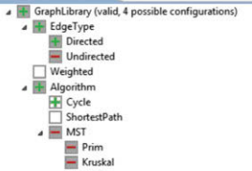
Valid Feature Selection
Translate model into a propositional formula φ.
Assign true to each selected feature, false to rest.
Assess whether φ is true.
If yes, valid selection.
Notes:
A question that we can answer easily is whether a given feature selection is valid for a given feature model. To this end, we translate the feature model into a propositional formula φ (phi). A feature selection is valid if and only if the interpretation of the formula, in which we assign true for every selected feature and false otherwise, is a valid solution to the formula. In other words, we substitute every variable corresponding to a selected feature by true and every other variable by false; the selection is valid if the overall formula, φ, is true. The operation is computationally very cheap (linear in the size of φ). A typical application of this analysis is during the requirements-analysis phase of application engineering - where we are building a concrete product. When a user selects features, we can give immediate feedback whether the current selection is valid. We don’t even need a SAT solver - just plug in what we did to the formula. For example, this is implemented already in the configuration dialog of FeatureIDE (sorry for the blurry screenshot). Next to the root feature, FeatureIDE indicates whether the current selection is valid. in addition, the red “-” shows features we cannot select given our current selections (undirected can’t be chosen because we chose directed, MST can’t be chosen because we selected directed and it needs undirected)

Slide 25
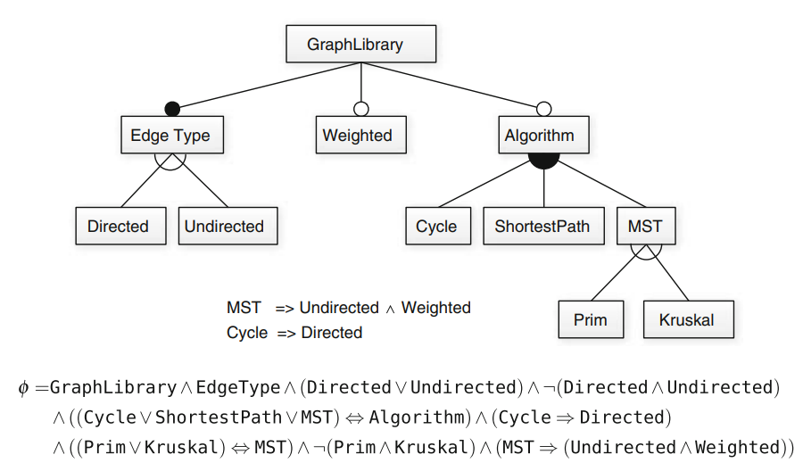
Example - Graph Library
φ = GraphLibrary
∧ (EdgeType ⇔ GraphLibrary)
∧ (Weighted ⇒ GraphLibrary)
∧ (Algorithm ⇒ GraphLibrary)
∧ (((Directed ∨ Undirected) ⇔ EdgeType) ∧ ￢(Directed ∧ Undirected))
∧ ((Cycle ∨ ShortestPath ∨ MST) ⇔ Algorithm)
∧ (((Prim ∨ Kruskal) ⇔ MST) ∧ ￢(Prim ∧ Kruskal))
∧ (MST ⇒ (Undirected ∧ Weighted))
∧ (Cycle ⇒ Directed)
Notes:
Here, we show a subset of the feature model of our graph example and its corresponding propositional formula φ (phi). (go over graph (required edge type, weights/algo options, algorithm is OR, edge type and MST type are XOR, two cross-tree constraints (cycle, MST)). This graph translates into this propositional formula, which incorporates the choice types and cross-tree constraints (go over)

Slide 26
Example - Graph Library
φ = GraphLibrary
∧ (EdgeType ⇔ GraphLibrary)
∧ (Weighted ⇒ GraphLibrary)
∧ (Algorithm ⇒ GraphLibrary)
∧ (((Directed ∨ Undirected) ⇔ EdgeType) ∧ ￢(Directed ∧ Undirected))
∧ ((Cycle ∨ ShortestPath ∨ MST) ⇔ Algorithm)
∧ (((Prim ∨ Kruskal) ⇔ MST) ∧ ￢(Prim ∧ Kruskal))
∧ (MST ⇒ (Undirected ∧ Weighted))
∧ (Cycle ⇒ Directed)
φ = T
∧ (T ⇔ T)
∧ (F ⇒ T)
∧ (F ⇒ T)
∧ (((T ∨ F) ⇔ T) ∧ ￢(T ∧ F))
∧ ((F ∨ F ∨ F) ⇔ F)
∧ (((F ∨ F) ⇔ F) ∧ ￢(F ∧ F))
∧ (F ⇒ (T ∧ F))
∧ (F ⇒ F)
φ = T
∧ (T ⇔ T)
∧ (F ⇒ T)
∧ (F ⇒ T)
∧ (((T) ⇔ T) ∧ T)
∧ ((F) ⇔ F)
∧ (((F) ⇔ F) ∧ T)
∧ (F ⇒ (F))
∧ (F ⇒ F)
Selection:
{GraphLibrary, EdgeType, Directed}
Notes:
To check whether {GraphLibrary, EdgeType, Directed} is a valid selection, we substitute all variables of φ with the corresponding assignment (click) (match with formula)
Ok, we can clearly clean this up and simplify, but we basically want to step one by one and make sure each clause evaluates to true.
Let’s do some quick cleaning by evaluating all simple AND/OR expressions, then check the rest (go over, click)
Ok - not too bad. Let’s go over these.
(F ⇒ T) is OK, as is (F ⇒ F) . This would only be bad if True implied False. We can have neither. We can have GraphLibrary without Weighted. We can’t have Weighted without GraphLibrary
(click) This is OK

Slide 27
Example - Graph Library
φ = GraphLibrary
∧ (EdgeType ⇔ GraphLibrary)
∧ (Weighted ⇒ GraphLibrary)
∧ (Algorithm ⇒ GraphLibrary)
∧ (((Directed ∨ Undirected) ⇔ EdgeType) ∧ ￢(Directed ∧ Undirected))
∧ ((Cycle ∨ ShortestPath ∨ MST) ⇔ Algorithm)
∧ (((Prim ∨ Kruskal) ⇔ MST) ∧ ￢(Prim ∧ Kruskal))
∧ (MST ⇒ (Undirected ∧ Weighted))
∧ (Cycle ⇒ Directed)
φ = T
∧ (T ⇔ T)
∧ (F ⇒ T)
∧ (F ⇒ T)
∧ (((T ∨ T) ⇔ T) ∧ ￢(T ∧ T))
∧ ((F ∨ F ∨ F) ⇔ F)
∧ (((F ∨ F) ⇔ F) ∧ ￢(F ∧ F))
∧ (F ⇒ (T ∧ F))
∧ (F ⇒ T)
φ = T
∧ (T ⇔ T)
∧ (F ⇒ T)
∧ (F ⇒ T)
∧ ((T ⇔ T) ∧ F)
∧ (F ⇔ F)
∧ ((F ⇔ F) ∧ T)
∧ (F ⇒ F)
∧ (F ⇒ T)
Selection:
{GraphLibrary, EdgeType, Directed, Undirected}
Notes:
Now, we want to see if {GraphLibrary, EdgeType, Directed, Undirect} is a valid selection. We again start with substituting all variables of φ with the corresponding assignment (click) (match with formula, ) Now, again let’s clean it up by solving the subexpressions. Some of you have already spotted the problem, but let’s start with the AND/OR/NOT again.
(click) This is not an acceptable feature selection. Again, make substitutions of true and false and check the result of evaluating the complete formula assignment and see if it works

Slide 28
Consistent Feature Models
A consistent model has 1+ valid selections.
Inconsistent models do not have any valid selection.
Contradictory constraints are common.
Find any feature selection that results in φ = true
NP-complete problem, but SAT solvers can often find solutions quickly.
Notes:
The next question we attempt to answer is: Is there any valid feature selection for a given feature model? We say a feature model is consistent if it has at least one valid feature selection; otherwise, we say the feature model is inconsistent. In a model with many cross-tree constraints, such question is not trivial to answer; adding contradictory constraints by accident can easily happen. Naively, we could automatically check all possible feature selections until we find a valid one. This does not scale to larger models, and as a result, determining whether a featrure model is consistent is an NP-complete problem, meaning that there is no guaranteed efficient algorithm. In practice, we encode the question as a Boolean satisfiability problem and use a SAT solver to compute the answer. To ask whether a feature model is consistent, we simply determine whether its Boolean representation φ is satisfiable (SAT(φ)). Modern SAT solvers can solve many of these problems with great efficiency and can also output the first valid feature selection they find (that is, a solution to the formula).

Slide 29
Testing Facts about Models
A fact that should be true encoded as formula ψ.
Check whether φ ∧ ￢ψ is satisfiable.
Is there a valid feature selection for φ that does not satisfy constraint ψ?
If yes, there is a problem with the model.
Notes:
A engineer typically knows certain facts that must hold in the domain and that should also hold in the feature model to ensure the system we build is a valid one. For example, in graph library we have been using as an example, we know that feature Cycle requires the feature Directed. This fact must be embodied in the feature model; the feature model must not allow any selection to violate that dependency or there will be issues in the corresponding system. In the graph example, the constraint is pretty easily fulfilled, it is even stated directly as a cross-tree constraint in the feature model. However, especially in large models, it is really easy to forget constraints, or not even realize they should exist when you first create the model. In these cases, we may want to ensure the model meets our stated properties. If it does. it is more likely the systems we build in the application engineering phase will as well. To test a feature model, we check an assumption, encoded as a second propositional formula ψ (psi) (such as Cycle ⇒ Directed), in a feature model encoded as φ. The idea is simple: We check that the feature model implies the assumption (φ ⇒ ψ). Phrased differently, we check whether φ ∧ ¬ψ is satisfiable; if it is, the feature model is incorrect as there exists a valid feature selection in φ that does not satisfy ψ. In a practical setting, a domain expert can test a feature model by creating a list of assumptions that the feature model must satisfy and follow this process to search for violations.

Slide 30
Example - Graph Library
φ = GraphLibrary
∧ (EdgeType ⇔ GraphLibrary)
∧ (Weighted ⇒ GraphLibrary)
∧ (Algorithm ⇒ GraphLibrary)
∧ (((Directed ∨ Undirected) ⇔ EdgeType) ∧ ￢(Directed ∧ Undirected))
∧ ((Cycle ∨ ShortestPath ∨ MST) ⇔ Algorithm)
∧ (((Prim ∨ Kruskal) ⇔ MST) ∧ ￢(Prim ∧ Kruskal))
∧ (MST ⇒ (Undirected ∧ Weighted))
∧ (Cycle ⇒ Directed)
ψ = Kruskal ⇒ Weighted
ψ = Prim ⇒ Weighted
ψ = ￢(Prim ∧ Kruskal)
ψ = Weighted ⇒ MST
For each, assess whether (φ ∧ ￢ψ) is satisfiable.
Notes:
Here, we have the graph library again. To test this model, we want to state constraints that are not already encoded into our formula as a set of propositional formulae. For example, here are three facts we could assess. The first two facts state that an MST algorithm requires Weighted graphs. The third states that both Prim and Kruskal algorithms will never both be present in a graph product. To check whether these are true, (box). In this example, facts 1-3 are true and 4 is false - MST implies weighted, but not in the other direction.You can have weighted and Cycle or shortest path.

Slide 31
Dead and Mandatory Features
A dead feature is never used.
A mandatory feature is always used.
Given model φ and feature F:
There is 1+ valid selection with F if (φ ∧ F) is satisfiable.
There is 1+ valid selection without F if (φ ∧ ¬F) is satisfiable.
Feature is dead if no selection with F (¬(φ ∧ F))
Feature is mandatory if no selection without F (¬(φ ∧ ¬F))
Notes:
Two common examples of this is when we might want to know if a feature is either dead or mandatory. A dead feature is never used in any product. In contrast, a mandatory feature is always used in every product. Given φ of a feature model, there is at least one valid feature selection with feature f, iff φ ∧ f is satisfiable, and there is at least one valid feature selection without feature f, iff φ ∧ ¬f is satisfiable. A feature is dead if there is no valid feature selection with it (¬SAT(φ ∧ f)) and mandatory if there is none without it (¬SAT(φ ∧ ¬f)). To detect all dead (or mandatory) features, we simply iterate over all features. A typical application of detecting dead features is to report warnings. If a dead feature is detected, we alert the developer. This means that no possible product will ever have that feature, which makes us ask why its there in the first place. It’s likely that we made a mistake in our constraints that results in that feature never being selected. Also, an editor may issue a warning of a false optional feature if analysis reports that a feature that is modeled as optional feature (or part of a choice or alternative group) is actually mandatory in all valid feature selections. Dead and false optional features can be considered code smells of feature models that indicate possible defects. We likely made some kind of mistake in specifying the model. This is really easy to do when we evolve a model over time.

Slide 32
Example - Graph Library
No dead features.
If Undirected made mandatory, Directed and Cycle would be dead.
GraphLibrary and EdgeType are mandatory.
Notes:
Here, we have the graph library again. This model has no dead features as it is. GraphLibrary and EdgeType are mandatory (root needed no matter what, no options - edge type has filled circle so we must choose it, others at same level are optional, so can be skipped). If we make also feature Undirected mandatory by adding a constraint (φ = φ ∧ Undirected), the features Directed and Cycle would become dead features

Slide 33
Example - Graph Library
φ = GraphLibrary
∧ (EdgeType ⇔ GraphLibrary)
∧ (Weighted ⇒ GraphLibrary)
∧ (Algorithm ⇒ GraphLibrary)
∧ (((Directed ∨ Undirected) ⇔ EdgeType) ∧ ￢(Directed ∧ Undirected))
∧ ((Cycle ∨ ShortestPath ∨ MST) ⇔ Algorithm)
∧ (((Prim ∨ Kruskal) ⇔ MST) ∧ ￢(Prim ∧ Kruskal))
∧ (MST ⇒ (Undirected ∧ Weighted))
∧ (Cycle ⇒ Directed)
No dead features.
If Undirected were made mandatory, Directed and Cycle would be dead.
GraphLibrary and EdgeType are mandatory.
Notes:
Here, we have the graph library again. This model has no dead features as it is. GraphLibrary and EdgeType are mandatory (root needed no matter what, no options - edge type has filled circle so we must choose it, others at same level are optional, so can be skipped). If we make also feature Undirected mandatory by adding a constraint (φ = φ ∧ Undirected), the features Directed and Cycle would become dead features

Slide 34
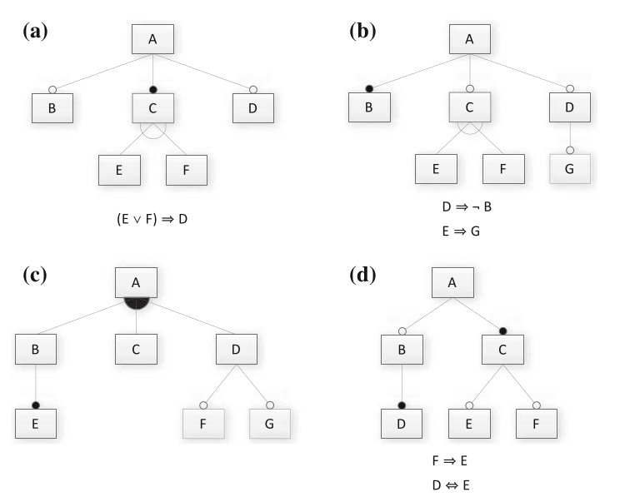
Activity
Translate model into propositional logic formula.
Provide two valid and two invalid features.
Is it consistent? If not, why not?
Notes:
(files tab in canvas, in the lectures folder - this link goes directly to it) Consider the following Feature Models.
Translate the feature model into a propositional logic formula. Note that the logical expressions next to models A, B, and D are cross-tree constraints that must be incorporated as well.
Provide two valid and two invalid feature selections (if possible).
Determine whether the feature model is consistent (are there any valid configurations?). If it is not consistent, identify one reason why.
(Do A with everyone. Then have them try)

Slide 35
Solution (A)
Translate model into propositional logic formula.
Provide two valid and two invalid features.
Is it consistent? If not, why not?
A ∧ (B ⇒ A) ∧ (C ⇔ A) ∧ (D ⇒ A) ∧ ((C ⇔ (E ∨ F)) ∧ ￢(E ∧ F)) ∧ ((E ∨ F) ⇒ D))
Valid: A, B, C, D, F ; A, C, D, E
Invalid: A, B, C, D, E, F ; A, B, C, E
Is it consistent: Yes
Notes:
(do together)

Slide 36
Solution (B)
Translate model into propositional logic formula.
Provide two valid and two invalid features.
Is it consistent? If not, why not?
A ∧ (B ⇔ A)∧ (C ⇒ A) ∧ (D ⇒ A) ∧ ((C ⇔ (E ∨ F)) ∧ ￢(E ∧ F)) ∧ (G ⇒ D) ∧ (D ⇒ ￢B) ∧ (E ⇒ G)
Valid: A, B ; A, B, C, F
Invalid: A, B, D, G ; A, B, C, E
It is consistent: Yes, but D, E, and G are dead features (because B is mandatory).
Notes:
Consider the following Feature Models. Start with Models A and B. If you have time, also try Models C and D.
Translate the feature model into a propositional logic formula. Note that the logical expressions next to models A, B, and D are cross-tree constraints that must be incorporated as well.
Provide two valid and two invalid feature selections (if possible).
Determine whether the feature model is consistent (are there any valid configurations?). If it is not consistent, identify one reason why.

Slide 37
Solution (C)
A ∧ ((B ∨ C ∨ D) ⇔ A) ∧ (E ⇔ B) ∧ (F ⇒ D) ∧ (G ⇒ D)
Valid: A, C ; A, B, C, D, E, F, G
Invalid: A, B, C; A, C, E
It is consistent: Yes (just remember that B and E need to come as a pair)
Translate model into propositional logic formula.
Provide two valid and two invalid features.
Is it consistent? If not, why not?
Notes:
Consider the following Feature Models. Start with Models A and B. If you have time, also try Models C and D.
Translate the feature model into a propositional logic formula. Note that the logical expressions next to models A, B, and D are cross-tree constraints that must be incorporated as well.
Provide two valid and two invalid feature selections (if possible).
Determine whether the feature model is consistent (are there any valid configurations?). If it is not consistent, identify one reason why.

Slide 38
Solution (D)
A ∧ (B ⇒ A) ∧ (C ⇔ A) ∧ (D ⇔ B) ∧ (E ⇒ C) ∧ (F ⇒ C) ∧ (F ⇒ E) ∧ (D ⇔ E)
Valid: A, C ; A, B, C, D, E
Invalid: A, B, C, D ; A, C, F
It is consistent: Yes, but remember that if you have F, you need E, D, and B as well.
Translate model into propositional logic formula.
Provide two valid and two invalid features.
Is it consistent? If not, why not?
Notes:
Consider the following Feature Models. Start with Models A and B. If you have time, also try Models C and D.
Translate the feature model into a propositional logic formula. Note that the logical expressions next to models A, B, and D are cross-tree constraints that must be incorporated as well.
Provide two valid and two invalid feature selections (if possible).
Determine whether the feature model is consistent (are there any valid configurations?). If it is not consistent, identify one reason why.

Slide 39
We Have Learned
A product is a valid selection of features.
Feature models capture the constraints that define whether a selection is valid.
Feature diagrams represent feature relationships visually.
Propositional logic represents feature relationships as formulae that can be used in analyses.

Slide 40
We Have Learned
Feature Models can be expressed using propositional logic formulae (φ).
Based on model and cross-tree constaints.
Valid feature selections result in (φ = true).
Can add propositions to check facts about model (e.g., dead or mandatory features)
Notes:
(read)

Slide 41
Next Time
Project Workshop
Robocode
Installing FeatureIDE, Eclipse
GitLab setup
Assignment 1 - due November 13
Assignment 2 up soon.
Domain modelling!

