Slide 1
Lecture 11: System-Level Testing
Gregory Gay
TDA594 - December 8, 2020

Slide 2
Today’s Goals
Discuss testing at the system level.
UI and Integration versus Unit Testing.
Introduce process for creating System-Level Tests.
Identify Independently Testable Functionality
Identify Representative Values
Generate Test Case Specifications
Generate Concrete Test Cases
Notes:
Something we have not talked about much is testing. Today, we are going to get into testing of systems with a lot of variability, like SPLs, with the focus on testing at the system level - through defined interfaces - versus at the individual class or unit level.

Slide 3
Software Testing
Test Input
An investigation into system quality.
Based on sequences of stimuli and observations.
Stimuli that the system must react to.
Observations of system reactions.
Verdicts on correctness.
SUT
Output
Test Oracle (Expected Output)
Verdict (Pass/Fail)
Notes:
I know some of you have taken a testing class, but not all in all likelihood. Let’s lay down some basics and some terminology. Testing is the central activity of verification, and our primary means of determining whether software works correctly and obeys all constraints we set on it. Software testing is fundamentally an invetigation conducted to assess the quality of the system being developed - the search for deviations from an expected set of behaviors.
(2) We create a series of (3) we pass input to an API, or create environmental conditions that the system must react to. We poke it and see what it does
We record observations, noting how the system reacted to the stimuli. We mark down the output, actions taken, internal state, power consumption values, anything that we can use to analyze the system behavior, then we use that to
(read 5) So, during testing, we take the system that we’re developing - the system under test - and we run test cases. We instrument the system - that is, we prepare it in such a way that we can monitor its behavior when it processes input.We record information such as the values of output and class variables, timestamps of when the system issues output or took actions, and a lot more - battery levels in mobile applications, timestamps and speed measurements, anything you can use to check the results. You compare your obervations against pre-recorded observations - what we call an oracle - and we then issue a verdict. Pass if everything matched, fail if it did not.

Slide 4
Axiom of Testing
“Program testing can be used to show the presence of bugs, but never their absence.”
- Dijkstra
Notes:
Now, the real limitation of testing, the real thing to keep in mind is that (read).
You cannot test a system exhaustively. Any system of any reasonable size will have a nearly-infinite number of input combinations. There is not enough time in the universe to exhaustively test a program. Testing is an optimization problem - given our time, our budget, what is the best we can do? Can we make the system act up? Can we find problems and make enough of an argument that the system is ready to deploy?

Slide 5
Anatomy of a Test Case
(I₁ O₁) (I₂ O₂ ) (I₃ O₃)
if O_{n} = Expected(O_{n})
then… Pass
else… Fail
Test Inputs
How we “stimulate” the system (method call, API request, GUI event)..
Test Oracle
How we check the correctness of the resulting observation (assertions).
Notes:
To test a system, to conduct that investigation, you build test cases. The two most important components of a test case are two things.
You need to come up with inputs. You need a plan on how you’re going to draw out issues.
you need some way to tell if the observed behavior was the right behavior. To know that there is a problem, you need to know what good behavior looks like. That’s where the test oracle comes in, with expectations on what should happen when we run that input. These come in many forms

Slide 6
Anatomy of a Test Case
Initialization
Any steps that must be taken before test execution.
Test Steps
Interactions with the system, and comparisons between expected and actual values.
Tear Down
Any steps that must be taken after test execution.
Notes:
When building a test case, there are also three other things we need to include (read)
We’ll look at some examples of these later in this class.

Slide 7
Testing Stages
API
GUI
CLI
We interact with systems through interfaces.
Systems built from subsystems.
With their own interfaces.
Subsystems built from units.
Classes work with other classes through methods (interfaces).
API
API
Notes:
We can break testing into independent stages that we stagger throughout the development process. These stages are largely built around different levels of granularity within the system under test. If we look at the system from the outside, it looks like this box. It has interfaces - maybe a GUI, maybe an API, maybe some kind of command line interface. However, there is also a lot going on inside. (click). The system as a whole tends to be architected, as we saw, as a set of larger indepedendent subsystems. Each of these has their own interface, and the subsystems communicate with each other through those interfaces. (click) then, within those, we have a bunch of individual, standalone UNITS (classes), all working together to produce the functionality offered by that subsystem, by calling methods in the other classes when needed - with methods forming another kind of interface. We need to test at all of these levels - class (or unit), subsystems, and the system as a whole.

Slide 8
Testing Stages
API
GUI
CLI
Unit Testing
Do the methods of a class work?
System Testing
Subsystem Integration Testing
Do the collected units work?
System Integration Testing
Do the collected subsystems work?
UI Testing
Does interaction through UIs work?
API
API
Notes:
Broadly, then, when we talk about testing, we talk about either unit testing or system-level testing, with a couple of distinct types of testing in there. (1) is where we tend to spend most of our testing time - we take small pieces of the system - units - the smallest chunk of system we can work with. Generally one class or a small cluster of classes. And we test those in isolation from the rest of the system. We take a class, and come up with tests for each of its methods. We try to isolate these units as much as possible - even faking the results passed from pieces of the system that we aren’t currently testing. Then we move up the ladder to what we collectively call system testing, which encomapsses three things. (click) Subsystem Integration Testing: We bring these units together - which have now been tested independently and we test their integration with each other - can they work together without breaking everything. Even if we’ve tested the individual units, faults can emerge from their combination, so we integrate the units together and test their combination and whether the subsystem as a whole can perform the functions that we stated in the specification. (click) Then we can test the system as a whole, through its high-level interfaces, to test the integration of the combined system to ensure that therre aren’t integration errors and that the product as a whole meets the requirements. This is System Integration Testing. (click) The third element of system testing is what we call UI testing - where we test from the direct perspective of a user, generally through a GUI. System Integration Testing and UI testing tend to have a blurry line between them, and more come down to whether tests are executed through a GUI or a program-level interface like a REST API or through the command line.

Slide 9
Unit Testing
Testing the smallest “unit” that can be tested.
Often, a class and its methods.
Tested in isolation from all other units.
Mock the results from other classes.
Test input = method calls.
Test oracle = assertions on output/class variables.
Notes:
If you have taken a testing class, you probably focused heavily on unit testing. This makes sense, as that is the bulk of your testing. Here, in the land of SPLs and complex reuse-driven systems, we are more focused on the system level. But still, let’s talk a little more about unit testing and work our way upwards. Unit testing is the process of testing the smallest isolated “unit” that can be tested. Often, a class and its methods or a small set of dependent classes that can’t be separated. There is a big emphasis here on isolation. Classes are often tightly interconnected, and when a problem occurs, it’s often hard to figure out where exactly the problem is coming from. You might even have faults in your class or a class that your class calls, and it only gets harder to isolate issues the more dependencies you have. It’s in your interest to try to test these units in as much isolation as is possible. So, what you do is you fake the results of method calls to other classes. This is called mocking, where you just return a pre-set value instead of actually calling another class. Test input for unit tests should be calls to methods with different input parameters. Our oracle then is made of assertions on either method output or the class variables that we can read the state of.

Slide 10
Unit Testing
For a unit, tests should:
Test all “jobs” associated with the unit.
Individual methods belonging to a class.
Sequences of methods that can interact.
Set and check value of all class variables.
Examine how variables change after method calls.
Put the variables into all possible states (types of values).
Notes:
If writing unit tests for classes, your Tests should:
(2)) - so try every method offered by the class. Then, if methods are meant to interact with each other, try those sequences of calls and make sure you get the expected results. If the sequence can be called in different orders, do that as well. (5) Look at different ways those variables change in response to method calls. Call those methods and try to corrupt the values of the class variables. Put the variables into all possible states (broad types of values).

Slide 11
Unit Testing - WeatherStation
Unit tests should cover:
Set and check class variables.
Can any methods change identifier, temperature, pressure?
Each “job” performed by the class.
Single methods or method sequences.
Vary the order methods are called.
Each outcome of each “job” (error handling, return conditions).
WeatherStation
identifier
temperature
pressure
checkLink()
reportWeather() reportInstrumentStatus()
restart(instrumentName)
shutdown(instrumentName)
reconfigure(instrumentName, commands)
Notes:
We have this WeatherStation class. It corresponds to a sensor unit in the field that gives us weather information. It has class variables - an identifier, the current temperature, and the current atmospheric pressure, and a set of public methods (check link to home base, report current weather, report instrumentStatus, restart instrument, shutdown instrument, and reconfigure an instrument). When writing unit tests for this, we want to: (2-5) Check its link to the home base. Try to restart, shutdown, adn reconfigure instruemnts. Do this in different sequences and orderings too to see if we can break something. Remember to hit (last point). Many of these methods do some error handling. Try input that triuggers that to see if it is is hit. Look at different possible return values of these as well.

Slide 12
Writing a Unit Test
public class Calculator { public int evaluate (String expression) { int sum = 0; for (String summand: expression.split("\\+")) sum += Integer.valueOf(summand); return sum; } }
Java-based unit testing (JUnit).
Choose a target unit.
Ex. Calculator to right.
Create a test class.
Unit tests are methods marked with @Test.
Notes:
So, what does a unit test look like? Usually, unit tests are code that you write, included in their own package within the project, that can be executed and perform that series of steps we just talked about - set up, execute input, checking the results with your oracle - your assertions - and cleaning up. Most languages have toolkits for writing these tests. In Java, the most popular is called JUnit - and IDEs like Eclipse have support for JUnit fairly well integrated into the development environment. Writing tests in JUnit is essentially as easy as just writing more Java code, you just need to learn some special syntax. What you usually will do is choose some target - some unit from the code base. your class or a small group of classes. Then, in the test package write a “testing class” containing a series of unit tests centered around testing that target. These tests are methods in that class marked with an annotation @Test. Here, for example, we have a Calculator class in our code with an evaluate method that takes a string representing and equation and evaluates it. Right now, it just takes strings with + and will definitely crash if you use other non-number characters, but it can be expanded later. We want to test this.

Slide 13
JUnit Test Skeleton
@Test annotation defines a single test:
@Test
public void test<Feature or Method Name>_<Testing Context>() {
//Define Inputs
try{ //Try to get output.
}catch(Exception error){
fail("Why did it fail?");
}
//Compare expected and actual values through assertions or through //if-statements/fail commands
}
Type of scenario, and expectation on outcome.
I.e., testEvaluate_GoodInput() or testEvaluate_NullInput()
Notes:
Tests are marked with the @test keyword. They are usually named with the word test, followed by the name of the method being tested, then a description for the outcome or scenario being tested - some kind of context for why you are performing this test. You will generally then define inputs, try to run the function with those inputs, and examine the outputs. There is a special call called fail that will declare the test a failure, parameterized with a string explaining why it failed. You can compare the expected and actual output through if statements and issue fail commands if they don’t match up, or you can make assertions about the results - declare properties that the results must follow. If an assertion fails, than the test fails.

Slide 14
Writing JUnit Tests
import static org.junit.jupiter.api.Assertions.assertEquals; import org.junit.jupiter.api.Test; public class CalculatorTest { @Test void testEvaluate_Valid_ShouldPass(){ Calculator calculator = new Calculator(); int sum = calculator.evaluate("1+2+3"); assertEquals(6, sum);
calculator = null; } }
public class Calculator { public int evaluate (String expression) { int sum = 0; for (String summand: expression.split("\\+")) sum += Integer.valueOf(summand); return sum; } }
Convention - name the test class after the class it is testing or the functionality being tested.
Each test is denoted with keyword @test.
Initialization
Test Steps
Input
Oracle
Tear Down
Notes:
to give an example, on the left, we have that calculator code we want to test. It has an evaluate method that takes in an expression. Then, it splits that expression based on the + sign, and for each substring, it converts it to an int and adds the value to the sum, returning that at the end.
Now, we can write a test class using JUnit.
- You create classes for testing either a particular class or unit of your system or for testing a kind of functionality at a higher level. The convention is to name it (read), followed by the word Test.
- each test is marked with the keyword @test.
-this is our initialization
- then, our test steps are to run the evaluate method on the initialized Calculator object, then to check the results.
- We execute evaluate with the input 1+2+3
- Our oracle then is the exact value 6 - we expect the result of evaluate with that input to be 6. To check the result, we use what is called an assertion - in this case assertEquals - which compares the equality of two values and issues a fail verdict if they don’t match.
- finally, to prepare for the next test, we set calculator to null. This is our tear down - any prep that needs to happen for the next test to ensure that this test does not corrupt another test.

Slide 15
Integration Testing
After testing units, test their integration.
Integrate units in one subsystem.
Then integrate the subsystems.
Test input through a defined interface.
Focus on showing that functionality accessed through interfaces is correct.
Subsystems: “Top-Level” Class, API
System: API, GUI, CLI, …
Notes:
That’s the gist of unit testing, now we move up the hierarchy to integration testing. Most software works by combining multiple, interacting units, within multiple interacting subsystems. In addition to testing units independently, we must test their integration. Then, when the individual subsystems work in isolation, we bring them together again and test the integration of the subsystems. Functionality performed across units is accessed through a defined interface. So, our tests tend to be through the interface of the subsystem or the interfaces of the system as a whole.Therefore, integration testing focuses on showing that functionality accessed through this interface behaves according to the specifications. Interfaces come in many forms. At the subsystem level, we may still be talking about method calls. or we might have an actual API - especially if we are integrating a 3rd party microservice. It mighti nteract through its own REST API, for example. Then, of course, at the system level, we may not be calling methods, though it is possible. We might be calling an API, a command line interace, some kind of messaging queue, a command line interface, or any number of other ways we can interact with a whole system.

Slide 16
Integration Testing
Subsystem made up classes of A, B, and C. We have performed unit testing...
Classes work together to perform subsystem functions.
Tests applied to the interface of the subsystem they form.
Errors in combined behavior not caught by unit testing.
Test Cases
A
B
C
Notes:
(1), However, (2). Therefore, we apply test cases not to the classes, but to the interface of the subsystem they form.
Errors in their combined behavior - errors in the interface these combined objects form - are not caught by unit testing because they only emerge when you combine these objects together, when they interact at runtime.

Slide 17
Interface Errors
Interface Misuse
Malformed data, order, number of parameters.
Interface Misunderstanding
Incorrect assumptions made about called component.
A binary search called with an unordered array.
Timing Errors
Producer of data and consumer of data access data in the wrong order.
Notes:
Interface errors are one of the most common forms of error in complex systems. These usually fall into three types. (1) A calling component calls another component and makes an error in the use of its interface, in how it is called. This might be wrong type or malformed data passed to a parameter, parameters passed in the wrong order, wrong number of parameters input. (3) Incorrect assumptions made about the called component. So, as a result, the behavior returned from the called component was not what was expected, causing the wrong outcome from the calling component. An example of this might be if you called a binary search from a component and fed it an unordered array. Well, binary search assumes you’ve already sorted the array, so it will return the wrong result. Timing errors. Producer of data and consumer of data may operate at different speeds, and may access out of data information as a result. You need to watch out for all three of these, and write tests to account for them.

Slide 18
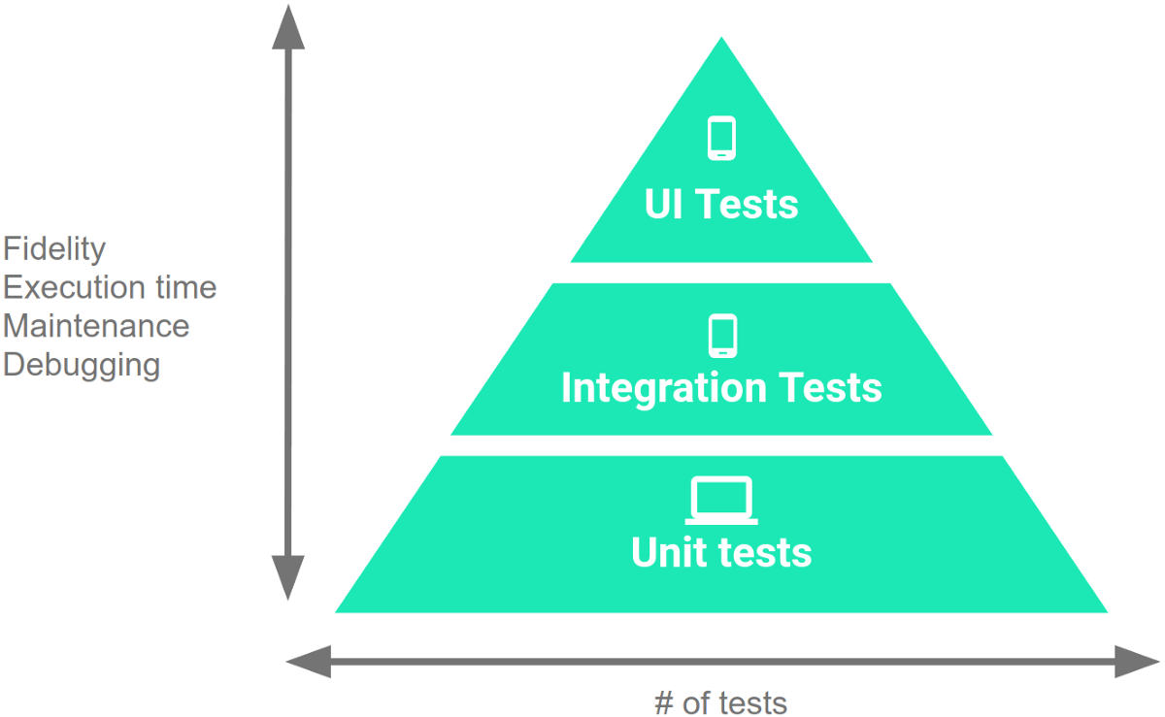
Testing Percentages
Unit tests verify behavior of a single class.
70% of your tests.
Integration tests verify class interactions in a portion of the app.
20% of your tests.
UI tests verify end-to-end journey over the app.
10% of your tests.
Notes:
These testing types are not equal in number that you write. Unit tests validate your app's behavior one class at a time. These are about 70% of your tests in a project. It is important to verify that the classes work as expected before we combine them. Then, Integration tests validate either interactions between levels of the stack within a subsystem - a cluster of classes-, or interactions between related subsystems at the system level. These tend to be about 20% of your tests. Finally, End-to-end tests or UI tests validate user journeys spanning multiple subsytems of your app. These tend to make up the remaining 10% of your number of tests.

Slide 19
Testing
70/20/10 recommended.
Unit tests execute quickly, without emulator or devices.
UI tests must run in Android, are very slow.
Well-tested units reduce likelihood of integration issues, making high levels of testing easier.
Notes:
This 70/20/10 split is what Google recommends. Thus is not set in stone, but has a logical underpinning. The reason for this is that as you work up the pyramid, from small unit tests to large complex UI tests, each test increases in fidelity but also increases in execution time and effort to create, maintain, and debug. Therefore, you should write more unit tests than integration tests, and more integration tests than UI tests. Unit tests run through the command line, on the machine you use to develop the app. They run quickly, in milliseconds. UI tests require running the full system, and if interacting with Android for example you need emulators or physical devices. You should run UI tests on multiple devices too in any case, to make sure they work in different hardware, OS, and software configurations. This dramatically increases the required execution time. UI tests are also often more complex, so they require more maintenance effort too. The good news is that this split also works out even without the speed factor. Units are tested in isolation. Well-tested units should integrate more cleanly - if there are issues, they are due to the integration itself and not a problem solely in one unit. Creating more unit tests makes the other levels easier as well. Cheaper and easier.

Slide 20
Writing Integration and UI Tests
Testing framework depends on language and interface type.
Android: JUnit (Integration - AndroidX, UI - Espresso)
RESTful API: Postman
Browser-based GUI: Selenium
Notes:
So, how do we write these. Here is is very depedent on technology - which language are you working in? What product domain? what interface type? To give some examples. (go over) Even for these three, there are a bunch of other alternatives for testing. Lets take a quick look at a couple of these though and what they look like

Slide 21
Android UI Test
Uses Espresso testing libraries to interact with Views and Intents.
(Part of AndroidX)
@Test
public void successfulLogin() {
LoginActivity activity = ActivityScenario.launch(LoginActivity.class); onView(withId(R.id.user_name)).perform(typeText(“test_user”)); onView(withId(R.id.password)) .perform(typeText(“correct_password”)); onView(withId(R.id.button)).perform(click()); assertThat(getIntents().first()) .hasComponentClass(HomeActivity.class);
}
Setup
Test Steps + Input
Test Oracle
Notes:
This is an Android UI test that uses the Espresso library within JUnit tests. We use the new ActivityScenario API to launch the LoginActivity. This creates the activity and brings it to the resumed state, where it is visible to the user and ready for input. ActivityScenario handles the synchronization with the OS. We use the Espresso view interaction library to enter text into two text fields and click a button in the UI. We use the Intents.getIntents() Espresso API to returns a list of captured intents. We then verify the captured intents using IntentSubject.assertThat() to validate the state of an Android framework object. In this case, this assertion verifies that the action we performed took us to the HomeActivity. We ended up on the correct screen. In terms of our testing components, we have (click) setup - launch an activity. (click) Test input. Enter username, password, and click the button. (click) and a test oracle to make sure we ended up on the home screen of the app.

Slide 22
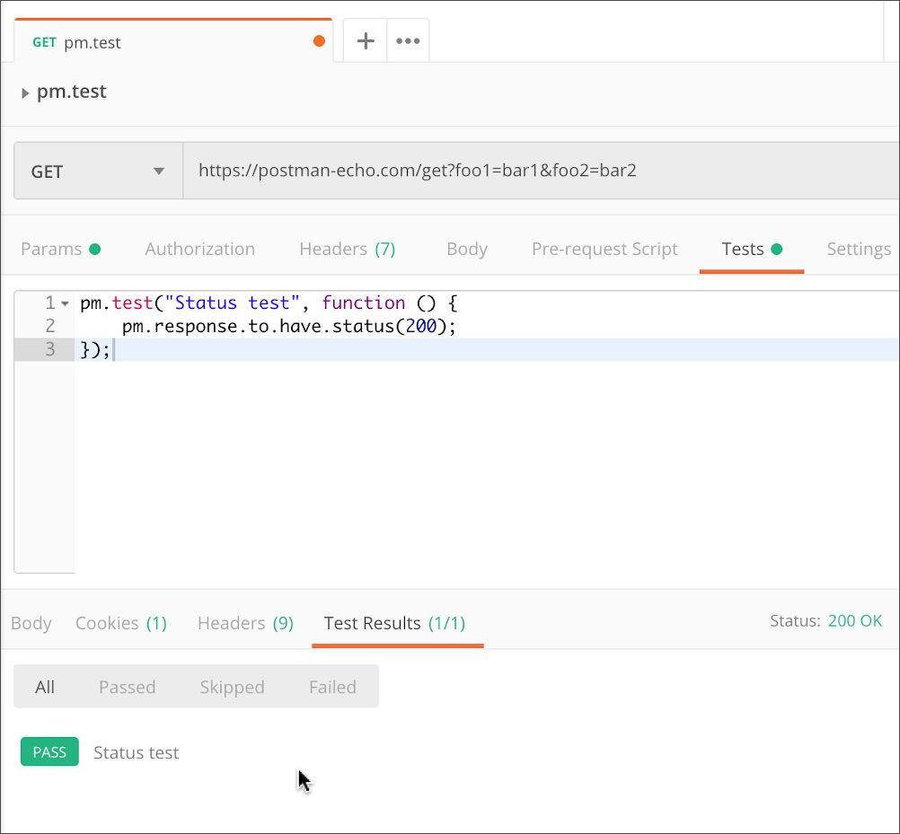
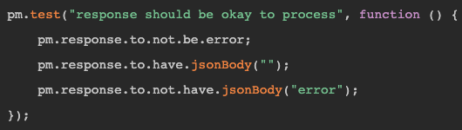
RESTful API Test - Postman
Test Step + Input
Test Oracle
Notes:
Here we have a test of a RESTful API through Postman. This has a GUI where you state the kind of request - our input - and then code the rest of the test, the oracle, in JavaScript. Here, we have input - a GET Request to this endpoint. (click) Then, the test body contains our oracle - our expectation on the output. In the case on the left, it should return status 200. In the case on the right, it should not be an errror, it should have an empty JSON body, and it should not have the word “error” for the JSON body. You don’t need to memorize all of these, but I want you to see that these all ahve the same common elements. Input, test steps, oracle, setup, teardown. What differs is how you interact, what kind of interface you are working with.

Slide 23
System-Level Tests and SPLs
Variability is a system-level concept.
Feature options tend to be entire classes or subsystems.
Unit testing during domain engineering.
Assets tested in isolation.
Many interaction errors between features, depending on chosen options.
System testing during application engineering.
Notes:
Why the focus on system-level testing here? This is because when we focus on variability, that is something we tend to implement at the system level, rather than the single unit. When we discuss features and options. Those features are not method in a class. We don’t implement variance within one class, but we might swap classes or even entire subsystems when we make these substitutions from the product portfolio. We still test at the unit level. We unit test extensively as part of domain engineering, where we test each reusable asset in isolation.. However, SPLs introduce incredible complexity into systems, and many of the particular errors emege in the interactions between the features and the particular options we choose in the full application - so we must do extensive system-level testing as part of application engineering. This is not something discussed as much in your earlier classes, which I imagine focused far more on unit testing. Here, we need to look at how units and entire subsystems interact when we introduce variance in how and which elements need to interact at runtime.

Slide 24
Creating System-Level Test Cases
Notes:
10 minute break

Slide 25
Creating System-Level Tests
Identify Independently Testable Functionality
Identify functionality that can be tested in (relative) isolation.
Identify Choices
Identify the choices you control when testing.
Identify Representative Input Values
Identify values for each choice that lead to different function outcomes.
Generate Test Case Specifications
Identify abstract test cases based on choice combinations.
Generate Test Cases
Identify concrete input/expected output pairs.
Notes:
Creating System-level tests is a five stage process.
You need to figure out what the independently testable functionality of your system or subsystem is. What features or functions are surfaced by an interface and can be tested in isolation. What can we push and observe in the software?
For each of those features, what varies? What can you control when you test? This includes both the actual input parameters - what you can pass to the functionality - and any other choices you can make. In a SPL, this includes the set of features you choose from that affect this functionality, and those choices in turn affect other choices.
For each of those features, what are the possible outcomes - each possible normal outcome or error outcome - and for each choice, what kind of input will trigger each possible outcome.
This leads you to abstract test case types, based on the combinations of choices we can make
Then, instantiate the specifications by providing concrete input instead of abstract choices to produce individual test cases with exact input and expected output pairings.

Slide 26
Independently Testable Functionality
Identify Independently Testable Functionality
A well-defined function that can be tested in (relative) isolation.
Based on the “verbs” - what can we do with this system?
The high-level functionality offered by an interface.
UI - look for user-visible functions.
Web Forum: Sorted User List can be accessed.
Accessing the list is a testable functionality.
Sorting the list is not (low-level, unit testing target)
Notes:
An independently testable feature is a well-defined function that can be tested in (relative) isolation from other functionality. This is often pretty clear in system or subsystem-level testing. You look at the “verbs” - the actions you can perform with the software. If you are working with an interface, it is the high-level functionality you can access through that interface. So, if our target is a subsystem, and even if we can access its underlying classes, we wouldn’t target those, as those are likely not operating in isolation at the time we have integrated them. We look to the interface and see what it tells us we can do. It can be much fuzzier in a GUI, when testing end-to-end journeys from a user perspective. There, you want to look at use cases or user stories if you have them. Those illustrate different paths through the system. In general, for a UI, look at what the user would see as a distinct, independent function.
For example, a web forum might be able to bring up a list of members. When it does so, it sorts them into alphabetical order. When testing this site, “list members” might be an independently testable feature. You can try that out and make sure it gives you the right outcome. Register for the forum would be another independently testable feature -you can fill out the provided form and see if your account is created. Sort member list is NOT a independently testable feature, as the user can’t cause a sort without everything else that comes up when you click on the member list link. This is a low-level functionalithy that you’ve probably already covered in unit testing.

Slide 27

Units and “Functionality”
Identify Independently Testable Functionality
Many tests written in terms of “units” of code.
An independently testable function is a capability of the software.
Can be at class, subsystem, or system level.
Defined by an interface.
Notes:
Executable tests are typically written in terms of “units” of code.Usually a class or method. (2) a verb - what does the software do? What actions can it perform? May not correspond to unit(s). (3). This is a principle we can apply to dervie test cases at any level of granularity. However, this is usually defined by an interface, and that is really what the purpose of an interface is - to define what the system can do. A system has interfaces. Look to those. Each subsystem offers an interface as well, and has responsibilities it can perform. When we perform integration testing at the subsystem level, look to that interface. Even at the class level - a class has methods, thus it has testable functionality. You can define testable functionality at different levels of granularity. But, we want to look at this from the outside. Look for an interface. That defines the verbs, the capabilities that we know the software will have, the actions we can perform with it.

Slide 28
Identify the Choices
Identify Choices
What choices do we make when using a function?
Anything we control when we test.
What are the inputs to that feature?
What choices did we make for variation points?
Are there environmental factors we can vary?
Networking environment, file existence, file content, database connection, database contents, disk utilization, …
Notes:
The outcome of a function depends on the choices we make when we test it. What do I mean by choices? This is anything we can control when we test. The parameters, variable choices, and environmental factors that influence the execution of a feature. The obvious choices are the input parameters of the function. We choose values for those. However, as we know from this class, explicitly defined parameters might not be the only thing that determines the output you get from a function. In a SPL, we make choices for different variation points. Which choices did we make? Those influence the outcome we will get for this function. Third, what other environmental factors could lead to a different outcome? There may be many of these and they are implicit parameters, as they can have a big impact on the outcome of executing this function. Things like your network connection - number of concurrent users - whether a file exists or not, what is in that file, whether we can connect to the database, what is in that database - does it already have the record we want to insert? - is the hard disk full. We want to consider any important factors that could change the outcome of this function.

Slide 29
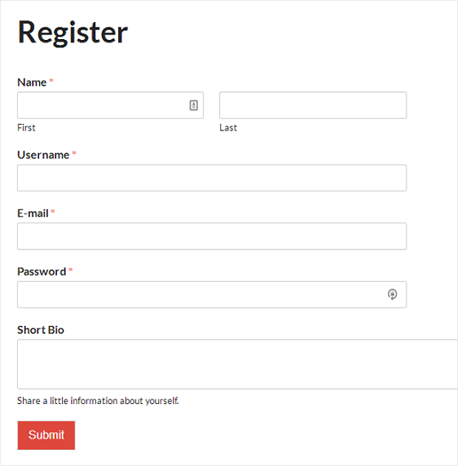
Ex: Register for Website
Identify Choices
What are the inputs to that feature?
(first name, last name, date of birth, e-mail)
Website is part of product line with different database options.
(database type)
Consider implicit environmental factors.
(database connection, user already in database)
Notes:
Say we have a user registration feature on a website. What choices do we make? First (1). It might take in (2). Now, the explicitly defined parameters might not be the only ones you have to deal with. If you’re registering users, what else might influence the outcome? How about a database to store those users? That is going to influence execution. Lets say this website is part of a product line, where we can attach different databases. This adds one more choice - which type of database are we using? Now, we should consider how that database can influence execution. Those are also choice we make when testing. What matters here? This adds more choices. In this case, we might want to consider whether we can connect to the database and whether is has this user already in it or not - those have an effect on how the test executes. So, we need to take that into account. This means that for the function “register for website”, we make 7 choices when we test (2,4,6)

Slide 30
Parameter Characteristics
Identify Choices
Identify choices by understanding how parameters are used by the function.
Type information is helpful.
firstName is string, database contains UserRecords.
… but context is important.
Reject registration if in database.
… or database is full.
… or database connection down.
Notes:
The key to identifying more choices is in understanding how the input parameters are used by the function. (2-3) But, any context for how those are used in practice and how they impact execution is invaluable for coming up with tests. If the database already contains an entry for that combination of fields, registration should be rejected. or (last two)

Slide 31
Parameter Context
Identify Choices
Input parameter split into multiple “choices” based on contextual use.
“Database” is an implicit input for User Registration, but it is not one choice.
“Database Connection Status”, “User Record in Database”, “Percent of Database Filled” influence function outcome.
The Database input results in three choices.
Test cases will be based on these choices.
Notes:
An input for a function might be split into multiple “choices” based on contextual use. The database may or may not contain a record for that user. In either case, issues may emerge based on the size of the database. The program may also have issues if a database connection cannot be established. This means that “database” - even though it is an implicit parameter to the User Registration function - is not a choice. Rather, you have three “choices” for this function based on the database, three things we can vary when testing. So, when thinking about choices, it is less important to capture just the literal input that would be passed to the function, and more important to capture each thing we can vary when testing the function. (3-5)

Slide 32
Examples
Identify Independently Testable Functionality
Class Registration System
What are some independently testable functions?
Register for class
Drop class
Transfer credits from another university
Apply for degree
Notes:
(discussion)
if low on time, skip

Slide 33
Example - Register for a Class
Identify Choices
What are the choices?
Course number to add
Student record
What about a course database? Student record database?
What else influences the outcome?
Notes:
(discussion)

Slide 34
Example - Register for a Class
Identify Choices
Student Record is an implicit input.
How is it used?
Have you already taken the course?
Do you meet the prerequisites?
What university are you registered at?
Can you take classes at the university the course is offered at?
Notes:
(discussion)

Slide 35
Example - Register for a Class
Identify Choices
Choices:
Course to Add
Does course exist?
Does student record exist?
Has student taken the course?
Which university is student registered at?
Is course at a valid university for the student?
Can student record be retrieved from database?
Does the course exist?
Does student meet the prerequisites?
Notes:
(go over). This looks like a lot, but you do want to try to capture all the factors that can influence the outcome of the function. When we create tests, we will not necessarily combine every combination of choices. Many of these we will try once. But, we first need to capture the full space of possibiltiies.

Slide 36
Let’s take a break.
Notes:
15 minute break

Slide 37
Identifying Representative Values
Identify Representative Input Values
We know the functions.
We have a set of choices.
What values should we try?
For some choices, finite set.
For many, near-infinite set.
What about exhaustively trying all options?
Test Input Data
Program
Test Output Results
Notes:
(1-2) The next step, obviously, is to come up with the input to those parameters and choices. If we want to test the software, we need to provide input and choose between the values for those choices. For some, this is easy. On that last slide, we had a lot of yes/no choices. For most cases ,we do not have exactly two options. What if an input is a number? What numbers do we choose?
What values should we pass in? How about we try every input? (discuss)

Slide 38
Exhaustive Testing
Identify Representative Input Values
2³² possible integer values for each parameter.
= 2³² x 2³² = 2⁶⁴ combinations = 10¹³ tests.
Take the arithmetic function for the calculator:
add(int a, int b)
How long would it take to exhaustively test this function?
Test Input Data
Program
1 test per nanosecond
= 10⁵ tests per second
= 10¹⁰ seconds
Test Output Results
or… about 600 years!
Notes:
Let’s take a calculator and just look at addition. Let’s just restrict the numbers to 32 bit integers. If we wanted to exhaustively test adding two numbers, how long would it take? How many inputs are we talking about?
- (read) That’s a lot right, how long we talking about time wise?
- let’s be generous and say we can run a test per nanosecond. That works out to about 10^5 tests per second, or 10^10 seconds overall. That doesn’t sound bad in seconds, but how long is that?
- (read). That’s for something as simple as addition of two integers. That’s insane, right?

Slide 39
Not all Inputs are Created Equal
Identify Representative Input Values
Many inputs lead to same outcome.
Some inputs better at revealing faults.
We can’t know which in advance.
Tests with different input better than tests with similar input.
Test Input Data
I
Program
Test Output Results
O
Notes:
We can’t exhaustively test any real program. You just can’t. Addition is the bottom of the barrel in terms of complexity. Most individual features will have quadrillions of inputs at least. Exhaustive testing just isn’t going to work out. Fortunately, you don’t need to. The fact is that not all inputs are as useful as others. Purely from the verification perspective, there are only so many outcomes of a function, and you’ll have a lot of inputs that lead to the same outcomes. Why use all of them? We can cut that down some. Then, fundamentally, testing is really something we do to find problems, and some inputs are going to be better than others and revealing those problems. We want those inputs. Sadly, we don’t know which tests will reveal faults until we run them. But, as a start, we know that two tests with inputs that are very different from each other are more likely to reveal faults than two tests with very similar input. Say you can select three tests for a program that breaks a text buffer into lines of 60 characters each. We select tests with a 40 character string and a 30 character string. Then, for a final test, we use a 100 character string. We can’t prove the 100 character buffer is a better test, but we would be more suspicious of a set of tests that is biased towards lengths less than 60. That’s a start, we’re covering a wider range of the input space. You’re more likely to hit a different outcome of a function or some weird corner case that is likely to break the whole thing..

Slide 40
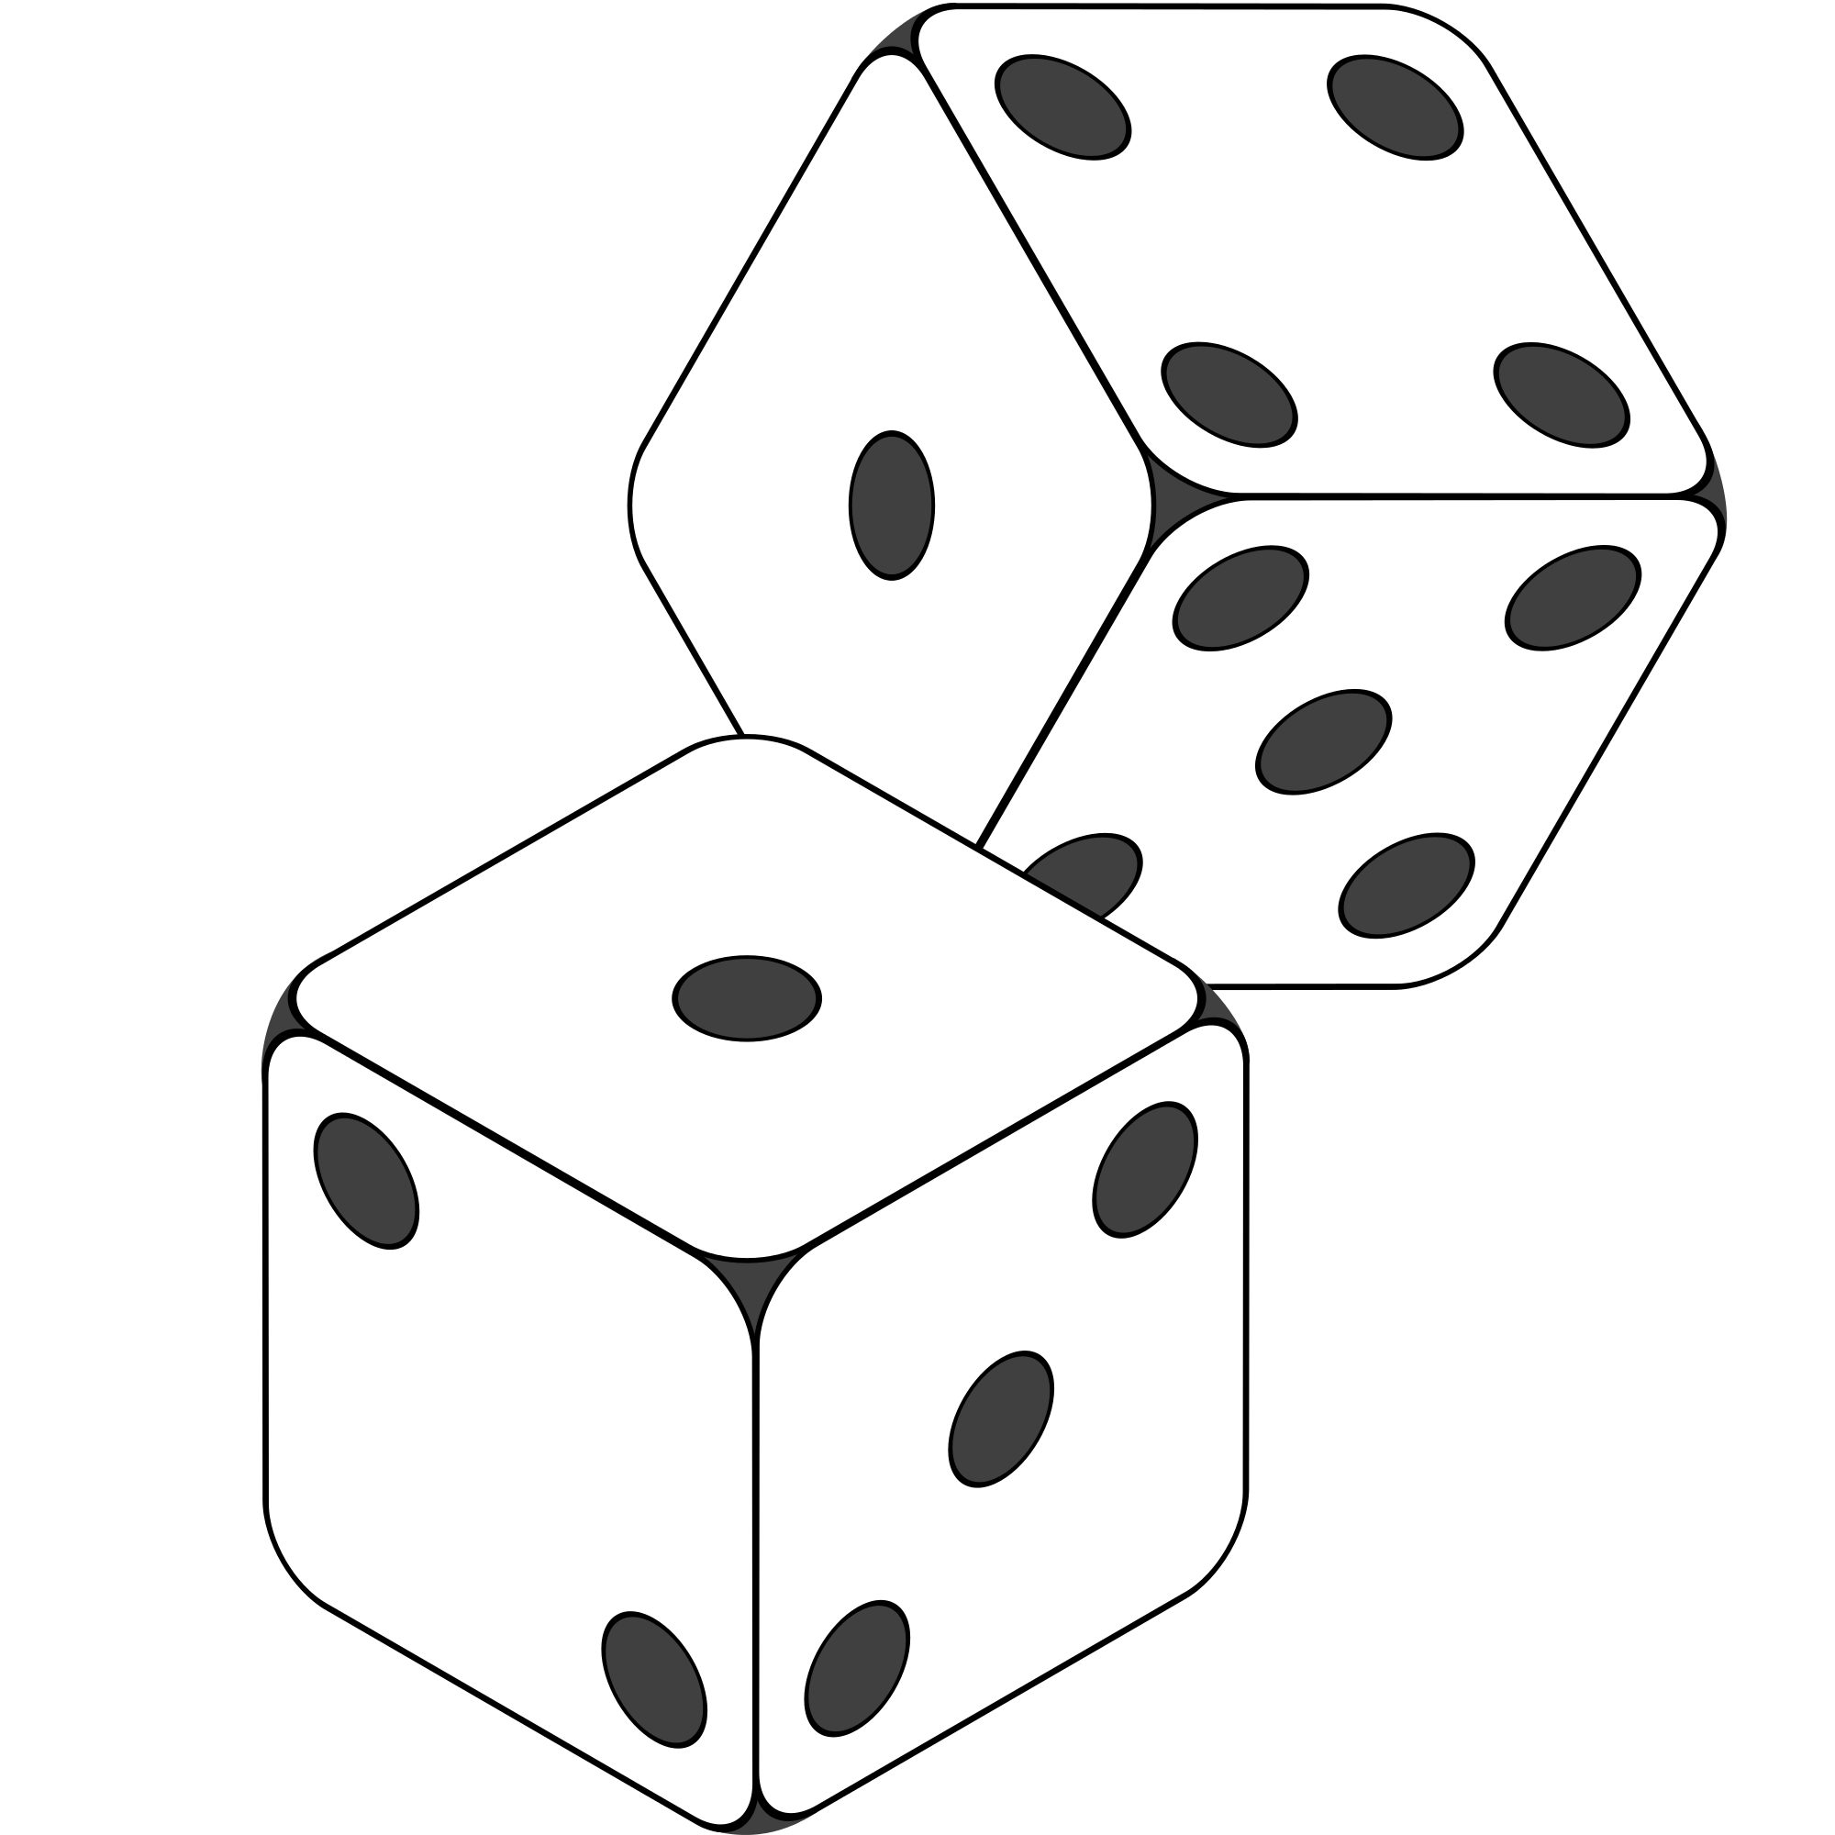
Random Testing
Identify Representative Input Values
Pick inputs uniformly from the distribution of all inputs.
All inputs considered equal.
Keep trying until out of time.
No designer bias.
Removes manual tedium.
Notes:
- So, we don’t want to test exhaustively, but we do want to hit a good span of the input space. How about we try a random sampling?
- Let’s just consider all inputs equal and try different ones. This avoids bias - we can’t say we are blind to our softwares potential limitations and allows automation - we don’t need to spend all of this time coming up with tests by hand - just spam the system with input. If it’s cheap to run tests, than we can just keep trying until we uncover bugs or run out of time.

Slide 41
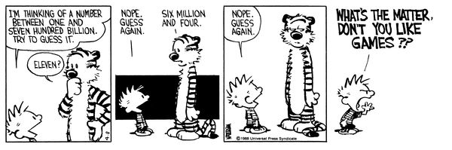
Why Not Random?
Identify Representative Input Values
Notes:
that *can be* useful - and there are some semi-random automation approaches that are quite effective. we’ll actually talk about fuzzing next week, and talk about how to do this. However, in many cases, we don’t want to just pick completely random input when we design tests by hand, and even automated approaches are not typically completely random. . You’re basically hoping to get lucky. Even if you generate thousands of random tests, you’ve only covered a tiny set of those possible inputs, and you’re likely repeating work. There’s no guarantee that you have chosen different inputs, you mgiht have hundreds clustered in a small corner of that space. So, when designing tests, what are the things we should keep in mind when choosing the input we will try for the different choices we can make?

Slide 42
Input Partitioning
Identify Representative Input Values
Consider possible values for a variable.
Faults sparse in space of all inputs, but dense in parts where they appear.
Similar input to failing input also likely to fail.
Try input from partitions, hit dense fault space.
Notes:
The next step is to take a good, long look at that input space for a variable. This is the space of all possible inputs values for a variable (click) In truth, faults are pretty sparse in the input space as a whole, but they are dense in the part of the input space in which they appear. If we try an input, and it fails, there’s a good chance that a highly similar value will also fail. (click) In practice, you can almost always divide the space into partitions - into logical group of inputs based on some criteria - maybe based on the outcome they’ll trigger. The thing is, if we do a good job of partitioning, and we come up with an input that lands in a space dense with faults, then we’re in good shape. This goes back to something I touched on a few minutes ago. We should - a a general strategy - favor different input over similar input. That’s a key idea. Try two very different things and you’re more likely to trigger a fault than trying two very similar things. Even more so if we put some thought into where those inputs come from. if we systematically go through and try a few inputs from each of those partitions, we are more likely to hit a larger range of different results than just randomly trying input. If a feature can result in different outcomes, we’re more likely to hit all of those by breaking the input space down along different line, and as a result, we’re way more likely to hit that space where faults are dense and trigger a few of them. By incorporating domain knowledge and experience, you can make sure that the tests actually cover a representative portion of that input space.

Slide 43
Equivalence Class
Identify Representative Input Values
Divide the input domain into equivalence classes.
Inputs from a group interchangeable (trigger same outcome, result in the same behavior, etc.).
If one input reveals a fault, others in this class (probably) will too. In one input does not reveal a fault, the other ones (probably) will not either.
Partitioning based on intuition, experience, and common sense.
Notes:
So, by partitioning the input domain, we can then form a set of equivalence classes - input that is essentially interchangeable. An equivalence class of tests essentially test the same scenario - they give you the same outcome, they trigger the same behavioral pattern, same usage of a feature, they do the same thing according to come criterion we define. (2-3)
Perfect partitioning of tests is hard, but we try our best with a combination of intuition, experience, and common sense.

Slide 44
Example
Identify Representative Input Values
substr(string str, int index)
What are some possible partitions?
index < 0
index = 0
index > 0
str with length < index
str with length = index
str with length > index
...
Notes:
(discuss), both variables
think about the outcomes, and how the variables work together to influence the outcome.
-bring in and walk through
Let’s go over some strategies.

Slide 45
Choosing Input Partitions
Identify Representative Input Values
Equivalent output events.
Ranges of numbers or values.
Membership in a logical group.
Time-dependent equivalence classes.
Equivalent operating environments.
Data structures.
Partition boundary conditions.
Notes:
A few of these include:
- (read) Can you group based on the output event that occurs?
-Look for ranges of numbers or values - what are the different discrete ranges of input values that can be provided that might give us different outcomes based on context?
-Look for membership in a logical group - Can we group these inputs based on how their used, what context the method uses them in, do member of this group trigger similar behavior?
-Look for time-dependent classes - does the timing of input matter to particular groupings?
- (read) the operating environment might influence system behavior
- (read) - some data structures, such as arrays, can be broken down into common groupings of input.
-(read)

Slide 46
Look for Equivalent Outcomes
Identify Representative Input Values
Look at the outcomes and group input by the outcomes they trigger.
Example: getEmployeeStatus(employeeID)
Outcomes include: Manager, Developer, Marketer, Lawyer, Employee Does Not Exist, Malformed ID
Abstract values for choice employeeID.
Can potentially break down further.
Notes:
First thing to do is start from the output, divide the output into the different outcomes I can get - then try to come up with input that produces those outcomes. This is a good first step, then we might break down further from there.It is often easier to find good tests by looking at the outputs and working backwards. Fior example, (2). The outcomes of this function include (3). Well, this is a good initial set of options for the choice employee ID. These are abstract values, and when we create a concrete test, we would then choose actual input for employee ID from each abstract category. We then might break these abstract values down further into ranges of IDs within those categories.

Slide 47
Look for Ranges of Values
Identify Representative Input Values
Divide based on data type and how variable used.
Ex: Integer input. Intended to be 5-digit:
< 10000, 10000-99999, >= 100000
Other options: < 0, 0, max int
Can you pass it something non-numeric? Null pointer?
Try “expected” values and potential error cases.
Notes:
When dividing input into input partitions, it is natural to look for how you could split the values of inputs into discrete ranges. (1) Any value from a particular input range should have a similar effect. For example, If input is intended to be a 5-digit integer between 10000 and 99999, but you just inter an integer, you mgiht first divide this into: (3) Then think a little more about other special numbers that might do something weird. For example (4) . In general, You want to hit a typical value, something from the expected range, then hit cases that fall outside of the expected range. Then consider those weird corner cases likely to trigger issues - a negative value, exactly 0, the maximum sized integer. see if those break something, or if error handling code kicks in. Then, can you pass it something non-numeric? String, some other data type that might be cast in a weird way or cause a problem? A null pointer?

Slide 48
Look for Membership in a Group
Identify Representative Input Values
Consider the following inputs to a program:
A floor layout
A country name.
All can be partitioned into groups.
Apartment vs Business, Europe vs Asia, etc.
Many groups can be subdivided further.
Look for context that an input is used in.
Notes:
(title) - idea is that there is context behind how a program uses inputs. Often ,you have different logical groups in mind when you come up with a feature. Why not break up inputs into these logical groupings? (1-3) Look at how the input is used in the program. These can likely be broken into logical groupings. (4) Often these groupings are often too broad at first, but can we break those into smaller subgroups? Apartment types. EU and non-EU members, etc. (Depends on the needs of your program, the idea is that you can look at how a variable is used and break it into logical groupings based on what it represents)

Slide 49
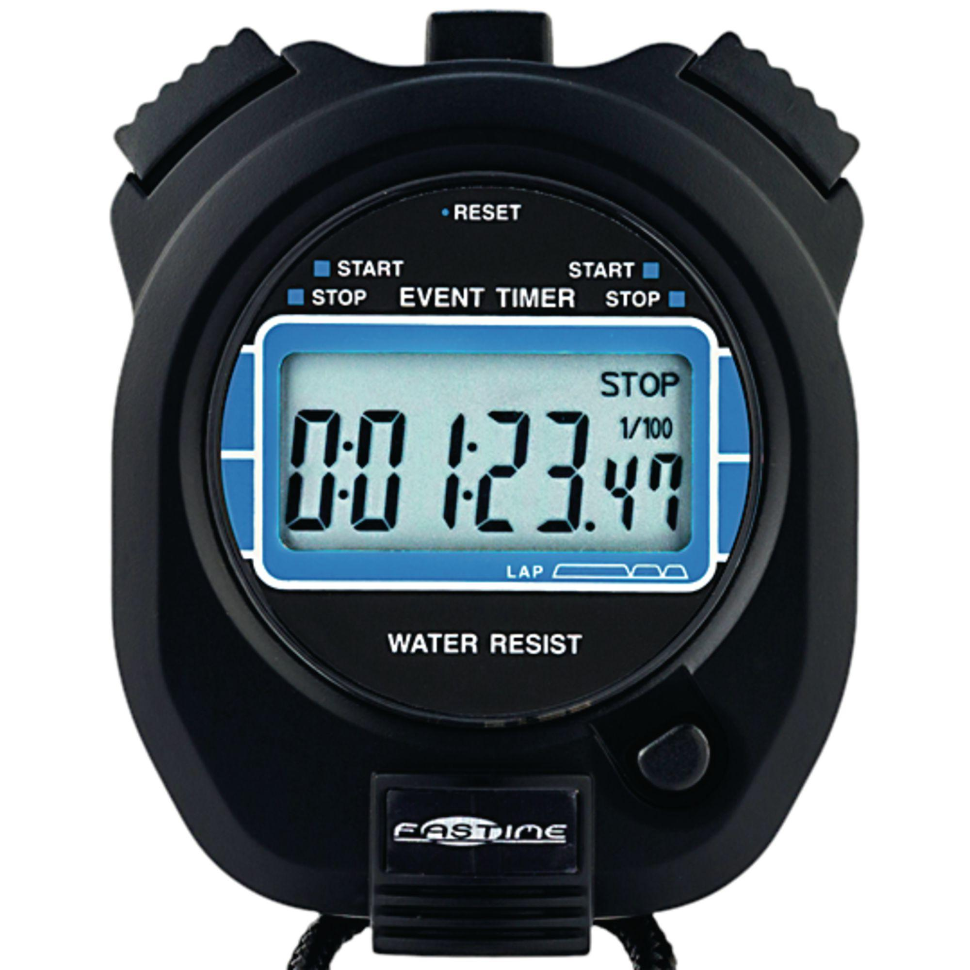
Timing Partitions
Identify Representative Input Values
Timing and duration of an input may be as important as the value.
Timing often implicit input.
Trigger an electrical pulse 5ms before a deadline, 1ms before the deadline, exactly at the deadline, and 1ms after the deadline.
Close program before, during, and after the program is writing to (or reading from) a disc.
Notes:
(1) Very hard and very crucial to get right. but also something that can be very important. For many systems, the timing of an input is an unstated, implicit input. If timing matters, you need to remember that it is part of the input, and partition it accordingly. For example, consider a pacemaker - looking for electrical impulses from the heart. (read)
Or, strange behaviors can happen when reading from a file or writing out to a file, try (read) Timing can be partitioned.

Slide 50
Operating Environments
Identify Representative Input Values
Environment may affect behavior of the program.
Environmental factors can be partitioned.
Memory may affect the program.
Processor speed and architecture.
Client-Server Environment
No clients, some clients, many clients
Network latency
Communication protocols (SSH vs HTTPS)
Notes:
Similar to timing, the environment that the program operates in can easily impact the behavior of the program. Thus, the environment can also be considered when forming value partitions. Consider the environment you’re operating in, how it can influence the input or output of the system, and how the combination of both explicit program inputs and implicit environmental variation can be partitioned.
Memory may cause problems. What if you don’t have enough? What if you have enough physical memory, but not enough free (or not enough birtual memory)
Same for processor speed or architecture. Could see race conditions, deadlock between processes, unexpected slowdown.
Try using different machine specs and vary both the processor and memory. Those choices suggest different partitionings.
Client-server environment can have huge impacts on the operation of the system.
try with different numbers of connections to clients - none, some, many (DDOS conditions)
network latency - can vary network equipment or speed
communication protocols - many options for a file upload, try each that you support

Slide 51
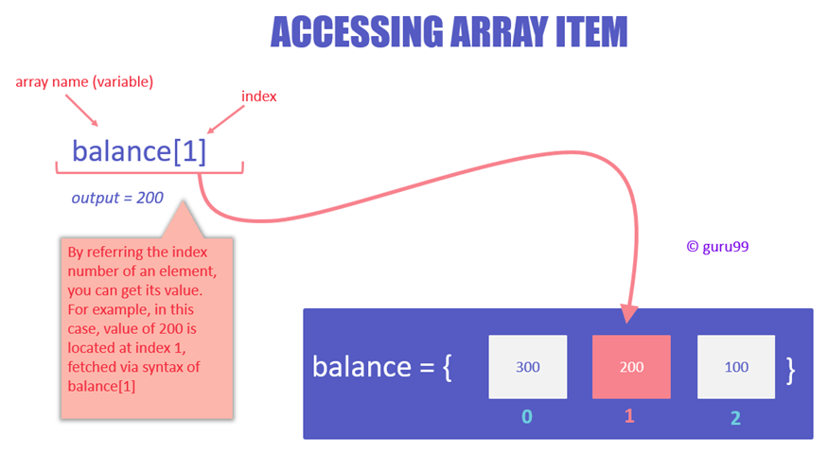
Data Structures
Identify Representative Input Values
Data structures are prone to certain types of errors.
For arrays or lists:
Only a single value.
Different sizes and number filled.
Order of elements: access first, middle, and last elements.
Notes:
(1) So, use experience with those to suggest values to try
(read) Programmers naturally think of sequences as made of up several values and it’s common to embed this assumption into the program. If presented with a single-value sequence,the program might fail.
(read) Decreases the chances that a bad program will accidentally give you a good output because of a particular input choice.
(read) This will reveal problems at partition boundaries.

Slide 52
Input Partition Example
Identify Representative Input Values
What are the input partitions for:
max(int a, int b) returns (int c)
We could consider a or b in isolation:
a < 0, a = 0, a > 0
Consider combinations of a and b that change outcome:
a > b, a < b, a = b
Notes:
(discussion) (read)

Slide 53
Revisit the Roadmap
For each independently testable function, we want to:
Partition each choice into representative values.
Choose one partition for each choice to form a complete abstract test specification.
Assigning concrete values from each partition.
Identify Representative Values
Generate Test Case Specifications
Generate Test Cases
Notes:
So, for each independently testable function and its choices, we want to:
identify the representative values for each choice. For each input choice, we want to be able to chop up the input space into different groupings.
So, we have each individual choice partitioned. For tests, we feed in a combination of decisions for each of those choices. Not just a value for one, but a value for all explicit and implicit inputs of the function. So, you create a set of abstract tests where each abstract test specification has a partition selected for each choice.
Then, we can turn those specifications into one or more concrete test cases by choosing actual concrete values for each partition selected.

Slide 54
Forming Specification
Generate Test Case Specifications
Function insertPostalCode(int N, list A).
Partition choices into equivalence classes.
int N is a 5-digit integer between 10000 and 99999.
Possible partitions: <10000, 10000-99999, >100000
list A is a list of length 1-10.
Possible partitions: Empty List, List of Length 1, List Length 2-10, List of Length > 10
Notes:
So, in coming up with equivalence partitions for these choices, you need to think about what exemplifies the space of input values. You want to make sure you hit the types of input that can be passed in. For example (go over)

Slide 55
From Partitions to Test Case
Generate Test Case Specifications
Choose concrete values for each combination of input partitions: insertPostalCode(int N, list A)
int N
list A
(3 * 4 = 12 abstract specifications)
Test Specifications:
insert(< 10000, Empty List)
insert(10000 - 99999, list[1])
insert(> 99999, list[2-10])
...
Test Cases:
insert(5000, {})
insert(96521, {11123})
insert(150000, {11123, 98765})
...
< 10000
10000 - 99999
> 99999
Empty List
(Each specification = 1000s of potential test cases)
List[1]
List[2-10]
List[>10]
Notes:
Now, we have the representative values for the individual inputs. For our test, we want to combine those. We don’t just pass in values to a single input. We pass in values to all inputs at once. To form our test specifications, our list of test types, we need to list out all of the possible combinations of input partitions for all inputs. For example,
(read)
then, we can create concrete test cases by assigning values to each abstract specification
(read)
(go over number of abstract specifications, real test cases)

Slide 56
Generate Test Cases
Generate Test Cases
substr(string str, int index)
Specification:
str: length >=2, contains special characters
index: value > 0
Test Case:
str = “ABCC!\n\t7”
index= 5
Generate Test Case Specifications
Generate Test Cases
Notes:
Now, we have our set of test case specifications. We have all these abstract combinations of input types we want to try. Now, we need to transition to concrete test cases, where we feed in actual values. This is a simple instantiation of these test specifications. There are still a few things to keep in mind, though. For one - there is a reason we do both the specifications and concrete cases, which is that if you feed in multiple tests with the same specification, only one of them might still actually trigger a fault in the code.

Slide 57
Boundary Values
Generate Test Cases
Errors tend to occur at the boundary of a partition.
Remember to select inputs from those boundaries.
Notes:
Now, no matter how you chop up the input partitions, the most errors tend to occur at the boundaries of those divisions. So, in choosing concrete values, don’t forget to try out those wrird corner cases.

Slide 58
Choosing Test Case Values
Generate Test Cases
Choose test case values at the boundary (and typical) values for each partition.
If an input is intended to be a 5-digit integer between 10000 and 99999, you want partitions:
<10000, 10000-99999, >100000
0
5000
9999
100000
150000
max int
10000
50000
99999
Notes:
(read)

Slide 59
Activity - System-Level Testing
Microservice related to Sets:
void insert(Set set, Object obj)
Boolean find(Set set, Object obj)
void delete(Set set, Object obj)
For each function, identify choices.
For each choice, identify the representative values.
Create abstract test specifications with expected outcomes.
Notes:
Go over. For each function, identify the choices you can make when testing.
For each choice, identify the representative values.
For each function, create a set of abstract test specifications from those values. For each, state the expected program output.

Slide 60
Activity - System-Level Testing
insert(Set set, Object obj)
Choices (Number of Items) and (Object Status).
One test specification might be:
Input: Set with One Item/Object Already in Set
Expected output: Object not Added
You can omit redundant test specifications.

Slide 61
Solution - Choices and Values
(Number of Items in Set)
Empty
1
2 +
100 + (may be slower - make sure it still works)
(Object Status)
In set already
Not in set
Null pointer
Notes:
jsut one, you may have additional ones. Any volunteers?

Slide 62
Solution - Test Specifications
Insert | Empty/ Object not in Set | obj in container
 | One element / Object not in Set | obj in container
 | Multiple elements / Object not in Set | obj in container
 | 100+ / Object not in Set | obj in container
 | (any choice) / Object in Set | Error or no change
 | (any choice) / Null Object | Error
Exists | One element / Object in Set | True
 | Empty / Object not in Set | False
 | 100 + / Object in Set | True
 | 100 + / Object not in Set | False
 | (any choice) / Null Object | Error
Delete | One element / Object in Set | obj no longer in set
 | One element / Object not in Set | no change (or error)
 | (any choice) / Null Pointer | error
 | 100 + / Object in Set | obj no longer in set
 | Empty / Object not in Set | no change (or error)
Notes:
go over, partial set, but highlight some

Slide 63
We Have Learned
Unit testing centered around a single class.
System-level tests centered around integration of components, through an interface.
Identifying independently testable functionality.
Identify choices that influence function outcome.
Partitioning choices into representative values.
Combining choice values into test specifications.
Choosing concrete values for specifications.
Notes:
(read)

Slide 64
Next Time
System-level testing and feature interactions
Handling infeasible combinations.
Selecting a valid subset of representative values.
Assignment 3 due tomorrow!
Questions?
Assignment 4 posted. Due December 20.

