Slide 1
Lecture 5:
Analysis of Feature Models
Gregory Gay
TDA/DIT 594 - November 17, 2020

Slide 2
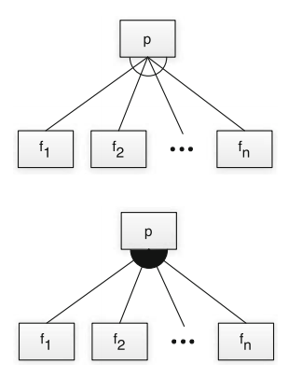
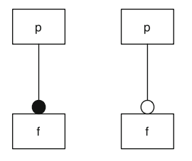
Feature Diagrams
Mutually Exclusive Choice: Choose exactly one (xor)
Mandatory Feature
Optional Feature
Choose at least one (or)
Notes:
Last time, you were introduced to the concept of feature models and two ways to examine them. feature diagrams are a standard visual representation, whose semantics are specified by a translation into propositional logic. Feature diagrams define a feature model as a hierarchy of features and constraints among them. It is a tree whose nodes are labeled with feature names. Different notations convey parent–child relationships between features and their constraints. On the left, The parent node is labeled with p, the child node with f. If a feature f is a child of another feature p, f can be selected only when p is also selected. Mandatory and optional features are distinguished by a small circle on the child node—a filled bullet denotes a mandatory feature, whereas an empty bullet denotes an optional feature. Typically, a feature diagram includes mutual relations between features. For example, the parent feature denotes a more general concept and the child a specialization. On the top right, the edges between a parent feature and a group of child features are connected via an empty arc. This graphical element denotes a choice of exactly one feature out of the group (that is, choose one from {f1 ... fn}). In propositional logic, it is an xor statement, choose exactly one. This construct is called alternative or mutually exclusive choice. The bottom right shows child features connected via a filled arc. This graphical element denotes an unrestricted choice of one or more features out of a feature group. It is chosen if, at least, one feature of the collection has to be selected, but there are no other restrictions. Mathematically, it denotes an inclusive disjunction (an or statement).

Slide 3
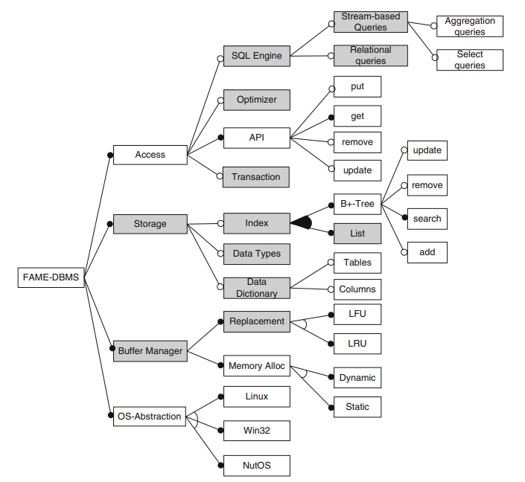
Example - Data Management
Notes:
go over Sample feature diagram for embedded data management, covers 65 features
black circle, mandatory, empty circle optional, empty fan xor, filled fan at least one
so, OS is only one, storage index is at least one
must have API, may optionally have an SQL enginer

Slide 4
Propositional Logic
Cross-tree Constraints are predicates imposing constraints between features.
DataDictionary ⇒ String
(Storing a data dictionary requires support for strings)
MinimumSpanningTree ⇒ Undirected ∧ Weighted
(Computing a Minimum Spanning Tree requires support for undirected and weighted edges)
Constraints over Boolean variables and subexpressions.
(i.e., (NumProcesses >= 5))
Notes:
The notational elements of feature diagrams support a natural description of a wide range of variability options, but not all. More general restrictions are needed in the form of propositional logic constraints. Typical constraints are implications between features located in different parts of the feature hierarchy, for example, to express that a certain algorithm requires a special data structure or that a certain function is not available for a certain operating system. Those additional constraints may span large parts of the feature diagrams and so we call them cross-tree constraints. for example, For embedded data management, storing an explicit data dictionary requires the support of the String data type to store attribute names (2), or For a graph library, a typical cross-tree constraint would be that the computation of minimal spanning trees requires undirected, weighted edges to be supported (4). LArgely, we will focus on named Boolean features as an introduction, but non-Boolean features or attributes of features may also be of interest. For example, in a system supporting parallelization, the number of supported processes may lead to different products, and we might have constraints defined over the number of processes

Slide 5
Propositional Logic
Mandatory: If parent is selected, the child must be.
mandatory(p, f) ≡ f ⇔ p
Optional: Child may only be chosen if the parent is.
optional(p, f) ≡ f ⇒ p
Mandatory Feature
Optional Feature
Notes:
Feature diagrams can be directly mapped to propositional formulas, defining a formal semantics of feature diagrams that we can analyze to prove our system will meet our requirements. In formulae, all feature names are interpreted as propositional variables. If the feature has been selected, the variable evaluates to true. If it is not selected, it evaluates to false. In the examples here, p, f and f_i are features. P is the parent of F. A mandatory feature definition mandatory(p,f) between a parent feature p and a child feature f corresponds to a logical equivalence. That is, whenever the parent feature is selected, so too must the child and vice versa - the double arrow (in the graphical version, this is denoted by a filled bullet at the child feature f). An optional feature, denoted graphically by an empty bullet, is written as optional(p,f) and corresponds to implication. The implication states that the parent p may be chosen independently from f, but the child f can only be chosen if p is selected

Slide 6
Propositional Logic
Alternative: Choose exactly one
alternative(p, {f₁,...,f_{n}}) ≡ ((f₁ ∨ … ∨ f_{n}) ⇔ p) ∧_{(fi,fj)} ￢(f_{i} ∧ f_{j})
Or: Choose at least one
or(p, {f₁,...,f_{n}}) ≡ ((f₁ ∨ … ∨ f_{n}) ⇔ p)
Notes:
The alternative constraint defines a one-out-of-many choice (xor) and is denoted by an empty arc in graphical feature diagrams. The definition alternative has as first parameter the parent feature p and as second parameter a non-empty set {f1,...,f_n} of child features. Mapped to propositional logic, this is a disjunction, in which, at least, one child feature is selected when the parent is chosen (first half of equation, go over). Additionally (second half of equation), we ensure for each pair of child features that no two child features are selected together -maintaining the exclusive choice - that adds an AND for all pairs of features saying they won’t be there together. An unrestricted choice or “or”, denoted by a filled arc in feature diagrams, defines a some-out-of-many choice. Again, the definition choice(p,{f1,...fn}) has as second parameter a non-empty set of child features. Mapped to propositional logic, the selection of p is equivalent to a disjunction of the child features, where we choose at least one - the first half of the alternative constraint. Now, these examples have been between a parent and child, but can be expressed between any pair of features. We can also define arbitrary propositional formulae between any two features.

Slide 7
Today’s Goals
Analysis of Feature Models
Introduction to Boolean Satisfiability (SAT)
SAT Solvers
Notes:
So, today and continuing through next class, we’e going to use this notion of propositonal logic. Propositional logic enables us to use automated tools such as SAT solvers to test interesting properties, such as checking validity of feature models and feature selections, detecting dead features, and comparing feature models. Today and next class, we will look at some of the things you can do with these models to make sure your system is specified correctly as these models grow in complexity and as you impose more constraints on features. Today, (go over).

Slide 8
Analysis of Feature Models
Notes:
Just start with a question - want you to start thinking about this. (read)
This isn’t something with one answer, or even a right answer. It’s something we’ll keep returning to

Slide 9
Variability-Aware Analysis
Verification techniques do not extend to SPLs.
More product variations than atoms in the universe.
Sometimes, can restrict to subset (HP printers).
Variability-Aware Analyses can examine whole product line (or reasonable subset).
Notes:
Variability raises new challenges for establishing correctness or any kind of functional or nonfunctional guarantees about programs. Testing, type checking, static analysis, verification, or performance measurement are well-established for individual systems, but they do not scale to product lines due to the huge configuration space with a explosion of feature selections. Instead of a single product, a product line gives rise to dozens, thousands, or billions of potential products that we might want to analyze based on our selection of features. Analyzing every product in isolation, using traditional analysis methods in a brute-force fashion, will not scale: For a product line with n optional features, there are up to 2n products for distinct feature combinations. Already with 33 optional and independent features, we could create a product line with more products than people on the planet (2^33); and from a product line with 265 optional and independent features, we could derive more products than there are estimated atoms in the universe (2^265). Industrial product lines often have even more features; for example, HP’s product line of printer firmware has roughly 2,000 features and the Linux kernel has over 10,000 features. These numbers rule out any brute-force strategy for product-line analysis. In some cases, you can get away with testing a small subset of products. HP’s developers derive and test firmware only for about 100 current printer models. While way more feature combinations are possible, they don’t physcally make most of those. When testing, we can alway focus on certain combinations - we’ll talk abiout testing of product lines later in this class. However, we can’t always take the selective view. For example, instead of choosing from a small set of preconfigured products, users of the Linux kernel can freely select from the 10,000 features they want to include in their kernel. In such a scenario, the Linux developers cannot predict which products need testing; users may select any product and expect it to work properly. We need methods to analyze a whole product line (or to attain a reasonable coverage) instead of analyzing all products individually. These analyses, which explicitly consider variability in the analysis, are called variability-aware analysis. We will introduce mechanisms that are specific to product-line variability and illustrate how to extend existing mechanisms such as type checking, model checking, and static analysis to cover entire product lines.

Slide 10
Analyses of Feature Models
Is a feature selection valid?
Is the feature model consistent?
Do our assumptions hold (testing)?
Which features are mandatory?
Which features can never be selected (dead)?
How many valid selections does model have?
Are two models equivalent?
Given partial selection, what must be included?
What selections give best cost/size/performance?
Notes:
Analyzing feature models is a good starting point for analyzing a product line, because it is well understood and comparably simple. These analyses not only provide support for reasoning about feature models themselves, but also provide a foundation for analyzing the code of a software product line later. All the analyses discussed today are concerned with the feature model (in domain analysis) and feature selections (in requirements analysis in application engineering). Among many others, feature model analyses can provide answers to the following questions: • Is a given feature selection valid for a given feature model? • Is the given feature model consistent (that is, is there at least one valid feature selection)? • Do the following assumptions hold for my feature model (testing)? • Which features are mandatory? • Which features can never be selected (dead features)? • How many valid feature selections does a given feature model have? • Are two feature models equivalent (that is, do they define the same feature selections)? • Given a partial feature selection, what other features must be included (or excluded)? • Given a partial feature selection, what features should be selected to produce the product with lowest cost, lowest size, best security, or highest performance? All of these questions can be answered with analyses of feature models and feature selections, and can be automated with tool support. Each can be encoded as a Boolean satisfiability problem that can be answered automatically with SAT solvers,

Slide 11
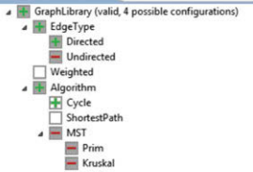
Valid Feature Selection
Translate model into a propositional formula φ.
Assign true to each selected feature, false to rest.
Assess whether φ is true.
If yes, valid selection.
Notes:
A question that we can answer easily is whether a given feature selection is valid for a given feature model. To this end, we translate the feature model into a propositional formula φ (phi). A feature selection is valid if and only if the interpretation of the formula, in which we assign true for every selected feature and false otherwise, is a valid solution to the formula. In other words, we substitute every variable corresponding to a selected feature by true and every other variable by false; the selection is valid if the overall formula, φ, is true. The operation is computationally very cheap (linear in the size of φ). A typical application of this analysis is during the requirements-analysis phase of application engineering - where we are building a concrete product. When a user selects features, we can give immediate feedback whether the current selection is valid. We don’t even need a SAT solver - just plug in what we did to the formula. For example, this is implemented already in the configuration dialog of FeatureIDE (sorry for the blurry screenshot). Next to the root feature, FeatureIDE indicates whether the current selection is valid. in addition, the red “-” shows features we cannot select given our current selections (undirected can’t be chosen because we chose directed, MST can’t be chosen because we selected directed and it needs undirected)

Slide 12
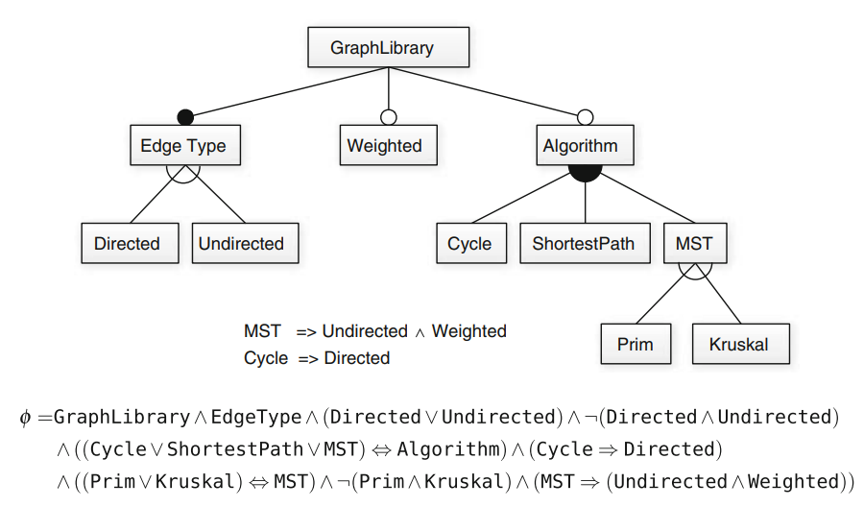
Example - Graph Library
Notes:
Here, we show a subset of the feature model of our graph example and its corresponding propositional formula φ (phi). (go over graph (required edge type, weights/algo options, algorithm is OR, edge type and MST type are XOR, two cross-tree constraints (cycle, MST)). This graph translates into this propositional formula, which incorporates the choice types and cross-tree constraints (go over)

Slide 13
Example - Graph Library
Selection:
{GraphLibrary, EdgeType, Directed}
φ = T ∧ T ∧ (T ∨ F) ∧ ￢(T ∧ F) ∧ ((F ∨ F ∨ F)⇔ F) ∧ (F ⇒ F) ∧ ((F ∨ F) ⇔ F) ∧ ￢(F ∧ F) ∧ (F ⇒ (F ∧ F))
φ = T ∧ T ∧ (T) ∧ ￢(F) ∧ (T) ∧ (T) ∧ (T) ∧ ￢(F) ∧ (T)
Notes:
To check whether {GraphLibrary, EdgeType, Directed} is a valid selection, we substitute all variables of φ with the corresponding assignment (click) (match with formula, )(F ⇒ F, if first half is false, second is too). Ok, there is a lot here that we can now simplify to make this clearer, so let’s clean it up by solving the subexpressions (click) Ok, this looks a bit cleaner. Does this work? (go over, all are true) (click) This is an acceptable feature selection. Again, no SAT solver, we can make substitutions of true and false and check the result of evaluating the complete formula assignment. Let’s try another

Slide 14
Example - Graph Library
Selection:
{GraphLibrary, EdgeType, Directed, Undirected}
φ = T ∧ T ∧ (T ∨ T) ∧ ￢(T ∧ T) ∧ ((F ∨ F ∨ F)⇔ F) ∧ (F ⇒ F) ∧ ((F ∨ F) ⇔ F) ∧ ￢(F ∧ F) ∧ (F ⇒ (F ∧ F))
φ = T ∧ T ∧ (T) ∧ ￢(T) ∧ (T) ∧ (T) ∧ (T) ∧ ￢(F) ∧ (T)
Notes:
Now, we want to see if {GraphLibrary, EdgeType, Directed, Undirect} is a valid selection. We again start with substituting all variables of φ with the corresponding assignment (click) (match with formula, ) Now, again let’s clean it up by solving the subexpressions (click) Ok, cleaner. Does this work? (go over, NOT all are true - violate the constraint on both odirected and undirected being true at once) (click) This is not an acceptable feature selection. Again, make substitutions of true and false and check the result of evaluating the complete formula assignment and see if it works

Slide 15
Consistent Feature Models
A consistent model has 1+ valid selections.
Inconsistent models do not have any valid selection.
Contradictory constraints are common.
Find feature selection that results in φ = true
NP-complete problem, but SAT solvers can often find solutions quickly.
Notes:
The next question we attempt to answer is: Is there any valid feature selection for a given feature model? We say a feature model is consistent if it has at least one valid feature selection; otherwise, we say the feature model is inconsistent. In a model with many cross-tree constraints, such question is not trivial to answer; adding contradictory constraints by accident can easily happen. Naively, we could automatically check all possible feature selections until we find a valid one. This does not scale to larger models, and as a result, determining whether a featrure model is consistent is an NP-complete problem, meaning that there is no guaranteed efficient algorithm. In practice, we encode the question as a Boolean satisfiability problem and use a SAT solver to compute the answer. To ask whether a feature model is consistent, we simply determine whether its Boolean representation φ is satisfiable (SAT(φ)). Modern SAT solvers can solve many of these problems with great efficiency and can also output the first valid feature selection they find (that is, a solution to the formula). SAT solvers use algorithms that efficiently search the state space for a valid assignment, avoiding dead ends. Let’s talk about that process a bit.

Slide 16
Boolean Satisfiability (SAT)
Find assignments to Boolean variables X₁,X₂,...,X_{n} that results in expression φ evaluating to true.
Defined over expressions written in conjunctive normal form.
φ = (X₁ ∨ ￢X₂) ∧ (￢X₁ ∨ X₂)
(X₁ ∨ ￢X₂) is a clause, made of variables, ￢, ∨
Clauses are joined with ∧
Notes:
I’ve mentioned this SAT solver thing a couple of times. What is it? Boolean Satisfiability refers to the process of identifying a satisfying assignment that makes a Boolean formula resolve to true. The problem is defined over formula written a set of m clauses in conjunction, c1 ^ c2 ^ c3, where each clause Ci is formed by the disjunction of Boolean variables, x1,x2,...xn, or their negations. This form of the conjunction (AND) of clauses and the disjunction (OR) of literals (variables and their negation) is called Conjunctive Normal Form (CNF). In SAT the problem asks if there exists a truth assignment such that the expression is true.

Slide 17
Conjunctive Normal Form
Variables: X₁,X₂,X₃,X₄,X₅
Clauses (using only ∨ (or) and ￢ (not)):
(￢X₂ ∨ X₅), (X₁ ∨￢X₃ ∨ X₄), (X₄ ∨ ￢X₅), (X₁ ∨ X₂)
Expression φ joins clauses with ∧ (and)
(￢X₂ ∨ X₅) ∧ (X₁ ∨￢X₃ ∨ X₄) ∧ (X₄ ∨ ￢X₅) ∧ (X₁ ∨ X₂)
Notes:
What this means is if you have a bunch of variables OR-ed together then you have a clause. If you have several clauses AND-ed together, then you have a formula or an expression that is referred to as CNF formula. Here's an example. Suppose we have the following variables: X1..X5. We can create some clauses by ORing variables and their negations, (3). That was simple, now join all these clauses together with AND operators and you will have a formula that looks like this (5).

Slide 18
Boolean Satisfiability
Find assignment to X₁,X₂,X₃,X₄,X₅ to solve
(￢X₂ ∨ X₅) ∧ (X₁ ∨￢X₃ ∨ X₄) ∧ (X₄ ∨ ￢X₅) ∧ (X₁ ∨ X₂)
One solution: 1, 0, 1, 1, 1
(￢X₂ ∨ X₅) ∧ (X₁ ∨￢X₃ ∨ X₄) ∧ (X₄ ∨ ￢X₅) ∧ (X₁ ∨ X₂)
(￢0 ∨ 1) ∧ (1 ∨￢1 ∨1) ∧ (1 ∨ ￢1) ∧ (1 ∨ 0)
(1) ∧ (1) ∧ (1) ∧ (1)
1
Notes:
Here's what we are concerned about. We are interested in finding out if there exists a Boolean assignments for each variable such that the formula evaluates to true. An example of a satisfying assignment for this formula would be: 1, 0, 1, 1, 1. When we substitute each of the values of into we get (4-end) The result is that the expression is true. That sounds simple doesn't it? Well it's not. This problem can be NP-Complete, and NP-Complete problems get harder and harder as the problem becomes larger. So when the number of variables in the formula increase, the problem gets more difficult.

Slide 19
Transformation Rules
De Morgan’s Laws
￢(X ∨ Y) ≡ ￢X ∧ ￢Y
￢(X ∧ Y) ≡ ￢X ∨ ￢Y
Distributivity
X ∨ (Y ∧ Z) ≡ (X ∨ Y) ∧ (X ∨ Z)
X ∧ (Y ∨ Z) ≡ (X ∧ Y) ∨ (X ∧ Z)
Double Negation
￢￢X ≡ X
Notes:
Now, to get the expressions into conjunctive normal form, we often need to do a little bit of transformation. That is not too bad. This just requires some knowledge about Boolean expressions - maybe a little review from an earlier class. (go over)

Slide 20
Transformation Rules
X ⇔ Y
X is equivalent to Y
≡ (X ⇒ Y) ∧ (Y ⇒ X)
(X ⇒ Y) ≡ (￢X ∨ Y)
If X is true, Y is also true.
If X is false, Y can be either true or false.
≡ (￢X ∨ Y) ∧ (￢Y ∨ X)
Notes:
MAny of the model expressions we looked at a little early had equivalence or implication in them. How do we get that into conjunctive normal form. Again, we just have to do a little bit of reformatting into a better format. This is again pretty easy if we think about what these expressions mean (go oveR) Nice and friendly for SAT solving.

Slide 21
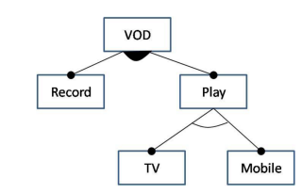
Transformation into CNF
VOD ⇔ TRUE ≡ VOD
mandatory(p, f) ≡ f ⇔ p
optional(p, f) ≡ f ⇒ p
alternative(p, {f₁,...,f_{n}}) ≡
((f₁ ∨ … ∨ f_{n}) ⇔ p) ∧ ∀(f_{i},f_{j}) ￢(f_{i} ∧ f_{j})
or(p, {f₁,...,f_{n}}) ≡ ((f₁ ∨ … ∨ f_{n}) ⇔ p)
VOD ⇔ (Record ∨ Play)
((Mobile ∨ TV) ⇔ Play) ∧ ￢(Movile ∧ TV) ≡
(Mobile ⇔ Play ∧ ￢TV) ∧ (TV ⇔ Play ∧ ￢Mobile)
VOD ∧ (VOD ⇔ (Record ∨ Play)) ∧ (Mobile ⇔ Play ∧ ￢TV) ∧ (TV ⇔ Play ∧ ￢Mobile)
Notes:
Let’s go through an example of translating a model into CNF. Here we have a simple feature model. Recall our logic rules for the visual representations (go over box) What are the formulae that describe this model? (click) first, VOD is always chosen, as it is the root and is mandatory. Therefore, VOD is equivalent to TRUE, or simply VOD by itself. (click) Here, we have an OR - filled circle - choose at least one. So, VOD is equivalent to Record or play. (click) Now, we have an alternative - choose exactly ONE (go over formula), or a little more simply for our clean transformation rules. (click) So, our formula ANDS these together. Let’s get this into CNF now.

Slide 22
Transformation into CNF
VOD ∧ (VOD ⇔ (Record ∨ Play)) ∧ (Mobile ⇔ (Play ∧ ￢TV)) ∧ (TV ⇔ (Play ∧ ￢Mobile))
(VOD ⇔ (Record ∨ Play))
≡ (VOD ⇒ (Record ∨ Play)) ∧ ((Record ∨ Play) ⇒ VOD)
≡ (￢VOD ∨ (Record ∨ Play)) ∧ (￢(Record ∨ Play) ∨ VOD)
≡ (￢VOD ∨ (Record ∨ Play)) ∧ (￢Record ∨ VOD) ∧ (￢Play ∨ VOD)
(Mobile ⇔ (Play ∧ ￢TV))
≡ (Mobile ∨ TV ∨ ￢Play) ∧ (￢Mobile ∨ Play) ∧ (￢Mobile ∨ ￢TV)
(TV ⇔ (Play ∧ ￢Mobile))
≡ (TV ∨ Mobile ∨ ￢Play) ∧ (￢TV ∨ Play) ∧ (￢TV ∨ ￢Mobile)
Notes:
Go over. For 2nd/3rd clauses, keep in mind the AND instead of the OR, play and !TV instead of record OR play.

Slide 23
DIMACS Format
1
Map feature names to integer IDs.
VOD = 1
Record = 2
Play = 3
TV = 4
Mobile = 5
2
3
4
5
Notes:
Now, many solvers use a format called DIMACS. This is not too complicated. We first need to map feature names to integer identifiers. We can use any arbitrary integer we want, as long as we apply it consistently. Let’s do that for our model. (go over 1-5)

Slide 24
DIMACS Format
1
VOD ∧
(￢VOD ∨ (Record ∨ Play)) ∧ (￢Record ∨ VOD) ∧ (￢Play ∨ VOD) ∧
(Mobile ∨ TV ∨ ￢Play) ∧ (￢Mobile ∨ Play) ∧ (￢Mobile ∨ ￢TV) ∧
(TV ∨ Mobile ∨ ￢Play) ∧ (￢TV ∨ Play) ∧ (￢TV ∨ ￢Mobile)
1 ∧
(￢1 ∨ (2 ∨ 3)) ∧ (￢2 ∨ 1) ∧ (￢3∨ 1) ∧
(5 ∨ 4 ∨ ￢3) ∧ (￢5 ∨ 3) ∧ (￢5 ∨ ￢4) ∧
(4 ∨ 5 ∨ ￢3) ∧ (￢4 ∨ 3) ∧ (￢4∨ ￢5)
2
3
4
5
Notes:
Now, we substitute the feature names with the integer IDs in the CNF expression. Remember that we had our formula, made up of four constraints ANDed together. Now, we take that and substitute in the ID numbers.

Slide 25
DIMACS Format
1
-1 ∨ 2 ∨ 3
-2 ∨ 1
-3 ∨ 1
5 ∨ 4 ∨ -3
-5 ∨ 3
-5 ∨ -4
4 ∨ 5 ∨ -3
-4 ∨ 3
-4∨ -5
1 ∧
(￢1 ∨ (2 ∨ 3)) ∧ (￢2 ∨ 1) ∧ (￢3∨ 1) ∧
(5 ∨ 4 ∨ ￢3) ∧ (￢5 ∨ 3) ∧ (￢5 ∨ ￢4) ∧
(4 ∨ 5 ∨ ￢3) ∧ (￢4 ∨ 3) ∧ (￢4∨ ￢5)
Each clause is stored in a row, with ∧(AND) omitted.
Negation (￢) translated into negative (-)
Notes:
Third, we store each clause in its own row and omit the AND symbols. Fourth, negation signs are translated into negative signs.

Slide 26
c comments
p cnf 5 10
1
-1 2 3
-2 1
-3 1
5 4 -3
-5 3
-5 -4
4 5 -3
-4 3
-4-5
Remove disjunction signs (∨)
Add DIMACs header
Comments
Indicates CNF format
Number of variables
Number of CNF clauses
1
-1 ∨ 2 ∨ 3
-2 ∨ 1
-3 ∨ 1
5 ∨ 4 ∨ -3
-5 ∨ 3
-5 ∨ -4
4 ∨ 5 ∨ -3
-4 ∨ 3
-4∨ -5
Notes:
Fifth, we remove the disjunction (OR) signs.

Slide 27
Using a SAT Solver
Identify assignment that results in true outcome.
VOD ∧ (￢VOD ∨ (Record ∨ Play)) ∧ (￢Record ∨ VOD) ∧ (￢Play ∨ VOD) ∧ (Mobile ∨ TV ∨ ￢Play) ∧ (￢Mobile ∨ Play) ∧ (￢Mobile ∨ ￢TV) ∧ (TV ∨ Mobile ∨ ￢Play) ∧ (￢TV ∨ Play) ∧ (￢TV ∨ ￢Mobile)
A satisfying assignment: (1, 1, 1, 1, 0)
Returns satisfying assignment.
May return all satisfying assignments found.
If not satisfiable, may offer information on why.
Notes:
Great. Now that we have this model, we can use a SAT solver to try to satisfy it. As I mentioned, the basic idea is to find out if the expression is solvable. Is there an assignment to the boolean variables that results in the entire expression - every clause - evaluating to true. If yes, this will return the first assignment it finds that satisfies the expression. (2-3) Depending on the SAT solver, it may also compute all possible soutions it can find within the time bounds and other constraints you give it. If it is provably not satisfiable - so, we didn’t just get a timeout, but also figured out that is CANNOT be solved - the solver may also return information on why it is not satisfiable, if the problem can be summarized down to specific clauses.

Slide 28
Let’s take a break!
Notes:
5 minutes to refresh

Slide 29
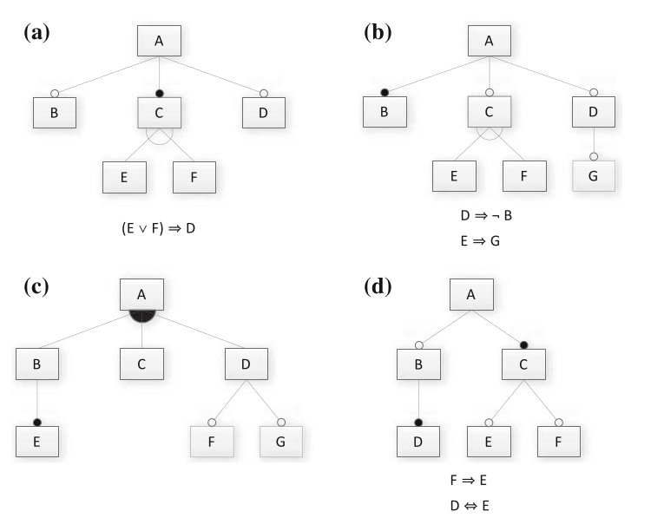
Activity
https://bit.ly/3lzq7wl
Start with A/B.
Do C/D if time.
Translate model into propositional logic formula.
Provide two valid and two invalid features.
Is it consistent? If not, why not?
Notes:
(files tab in canvas, in the lectures folder - this link goes directly to it) Consider the following Feature Models. Start with Models A and B. If you have time, also try Models C and D.
Translate the feature model into a propositional logic formula. Note that the logical expressions next to models A, B, and D are cross-tree constraints that must be incorporated as well.
Provide two valid and two invalid feature selections (if possible).
Determine whether the feature model is consistent (are there any valid configurations?). If it is not consistent, identify one reason why.

Slide 30
Solution (A)
Translate model into propositional logic formula.
Provide two valid and two invalid features.
Is it consistent? If not, why not?
A ∧ (B ⇒ A) ∧ (C ⇔ A) ∧ (D ⇒ A) ∧ ((C ⇔ (E ∨ F)) ∧ ￢(E ∧ F)) ∧ ((E ∨ F) ⇒ D))
Valid: A, B, C, D, F ; A, C, D, E
Invalid: A, B, C, D, E, F ; A, B, C, E
Is it consistent: Yes

Slide 31
Solution (B)
Translate model into propositional logic formula.
Provide two valid and two invalid features.
Is it consistent? If not, why not?
A ∧ (B ⇔ A)∧ (C ⇒ A) ∧ (D ⇒ A) ∧ ((C ⇔ (E ∨ F)) ∧ ￢(E ∧ F)) ∧ (G ⇒ D) ∧ (D ⇒ ￢B) ∧ (E ⇒ G)
Valid: A, B ; A, B, C, F
Invalid: A, B, D, G ; A, B, C, E
It is consistent: Yes, but D, E, and G are dead features (because B is mandatory).
Notes:
Consider the following Feature Models. Start with Models A and B. If you have time, also try Models C and D.
Translate the feature model into a propositional logic formula. Note that the logical expressions next to models A, B, and D are cross-tree constraints that must be incorporated as well.
Provide two valid and two invalid feature selections (if possible).
Determine whether the feature model is consistent (are there any valid configurations?). If it is not consistent, identify one reason why.

Slide 32
Solution (C)
A ∧ ((B ∨ C ∨ D) ⇔ A) ∧ (E ⇔ B) ∧ (F ⇒ D) ∧ (G ⇒ D)
Valid: A, C ; A, B, C, D, E, F, G
Invalid: A, B, C; A, C, E
It is consistent: Yes (just remember that B and E need to come as a pair)
Translate model into propositional logic formula.
Provide two valid and two invalid features.
Is it consistent? If not, why not?
Notes:
Consider the following Feature Models. Start with Models A and B. If you have time, also try Models C and D.
Translate the feature model into a propositional logic formula. Note that the logical expressions next to models A, B, and D are cross-tree constraints that must be incorporated as well.
Provide two valid and two invalid feature selections (if possible).
Determine whether the feature model is consistent (are there any valid configurations?). If it is not consistent, identify one reason why.

Slide 33
Solution (D)
A ∧ (B ⇒ A) ∧ (C ⇔ A) ∧ (D ⇔ B) ∧ (E ⇒ C) ∧ (F ⇒ C) ∧ (F ⇒ E) ∧ (D ⇔ E)
Valid: A, C ; A, B, C, D, E
Invalid: A, B, C, D ; A, C, F
It is consistent: Yes, but remember that if you have F, you need E, D, and B as well.
Translate model into propositional logic formula.
Provide two valid and two invalid features.
Is it consistent? If not, why not?
Notes:
Consider the following Feature Models. Start with Models A and B. If you have time, also try Models C and D.
Translate the feature model into a propositional logic formula. Note that the logical expressions next to models A, B, and D are cross-tree constraints that must be incorporated as well.
Provide two valid and two invalid feature selections (if possible).
Determine whether the feature model is consistent (are there any valid configurations?). If it is not consistent, identify one reason why.

Slide 34
SAT Solver Process
Express in conjunctive normal form:
φ = (￢x2 ∨ x5) ∧ (x1 ∨ ￢x3 ∨ x4) ∧ (x4 ∨ ￢x5) ∧ (x1 ∨ x2)
Choose assignment based on how it affects each clause it appears in.
What happens if we assign x2 = true?
If any clauses now false, don’t apply that value.
Continue until CNF expression is satisfied.
Notes:
You will probably not appreciate how difficult solving an NP-Complete problem such as SAT is until you understand how the solvers work. How do we find the assignment. First thought - enumerate all possible 1 and 0 configurations, and verify each one. Try everything. Will this work? Yeah, no. This would work fine for small problems, but as the number of variables becomes large, enumerating all possible combinations becomes impossible. Generally speaking, if you had n variables, then this exhaustive search requires up to 2^n tests. if you had 5 variables, then there 32 possible configurations. Not bad. We can do that by hand. On the other hand, if you had 1000 variables then you need 10³⁰¹⁰²⁹ guesses to try everything. Not happening. Instead, these solvers rely on what we call complete, or exhaustive, search methods. These methods guarantee finding a solution if there exists one. However, being complete does not mean checking every possible configuration. They use clever methods to trim the search down. There are many different approaches, each with their own heuristics, but there are two main algorithms that we start with called branch and bound and DPLL (davis putnam logemann loveland (named for the creators). We’ll discuss each. But, they start with an expression in CNF a conjunction of clauses connected with AND statements where each clause is a disjunction of boolean variables - OR statements. They examine what could happen to the clauses if we assign a value to a variable (3). If that change causes any clauses to be false - making the whole expression false - we will not apply it. If it doesn’t, well, maybe we will apply it and continue until the whole thing is satisfied. There is a bit more to it than that, but that is our starting point. Let’s talk about each.

Slide 35
Branch & Bound Algorithm
Set variable to true or false.
Apply that value.
Does value satisfy the clauses that it appears in?
If so, assign a value to the next variable.
If not, backtrack (bound) and apply the other value.
Prunes branches of the boolean decision tree as values are applied.
Notes:
Our first complete search algorithm is the branch-and-bound algorithm. This algorithm is conceptually simple: set a variable in the boolean formula to a particular value, apply that value to the formula, and check to see if the value satisfies all of the clauses that it appears in. If so, assign a value to the next variable and so on. However, if setting a value unsatisfies a clause, then a backtracking step (a bound) is initiated and the other possible value is applied. This process prunes branches of the formed boolean decision tree. Although we have reduced the number of checks we performed it does not mean that the problem has become any easier. It is still hard to solve, and it is NP-Complete. However, by trying assignments carefully, we get to a solution more quickly, generally without trying everything.

Slide 36
Branch & Bound Algorithm
φ = (￢x2 ∨ x5) ∧ (x1 ∨ ￢x3 ∨ x4) ∧ (x4 ∨ ￢x5) ∧ (x1 ∨ x2)
Set x1 to false. φ = (￢x2 ∨ x5) ∧ (0 ∨ ￢x3 ∨ x4) ∧ (x4 ∨ ￢x5) ∧ (0 ∨ x2)
Set x2 to false. φ = (1 ∨ x5) ∧ (0 ∨ ￢x3 ∨ x4) ∧ (x4 ∨ ￢x5) ∧ (0 ∨ 0)
Backtrack and set x2 to true. φ = (0 ∨ x5) ∧ (0 ∨ ￢x3 ∨ x4) ∧ (x4 ∨ ￢x5) ∧ (0 ∨ 1)
Notes:
-We first set a value of false to x1. This inserts a zero into clauses two and four, but does not satisfy or unsatisfy either clause yet.
-Next, we insert a value of zero for x2. This satisfies the first clause, but unsatisifies the fourth clause (as both x1 and x2 are set to zero).
-Therefore, we stop and backtrack, assigning a new value of one to x2. This satisifies the fourth clause. We can continue this process with all variables until the complete formula is satisified. If we hit a dead end, where applying either value unsatisfies something, we will backtrack again to the assignment before that and see if we can change the outcome. So, this is almost like a depth-first search in a graph, we go as deeply as we can in the formed decision tree and backtrack when we cannot make any additional assignments without unsatisfying something.

Slide 37
DPLL Algorithm
Set a variable to true/false.
Apply that value to the expression.
Remove all satisfied clauses.
If assignment does not satisfy a clause, then remove that variable from that clause.
If this leaves any unit clauses (single variable clauses), assign a value that removes those next.
Repeat until a solution is found.
Notes:
Another common complete method is the Davis-Putnam-Logemann-Loveland, or DPLL, algorithm [13]. It is basically the same as Branch and bound, but there is a slight difference which makes it more powerful. The way it works is this, select a variable or its negation. Assign the variable a value. If the result is true, and hence satisfies the clause, then remove all clauses containing that variable from the formula, creating a simplified formula. On the other hand, if the literal is false due to its negation, remove only that specific variable from the clause. So far this is sort of like branch and bound except that we are looking at it from the point of view of the clauses. We recursively do this until we find a solution. To make this even better, if a clause contained a single literal, then assign that literal a value that makes it true, and perform the same procedure. That is called unit clause elimination. You can imagine how this would have a cascading, domino effect. As more variables are eliminated from clauses the more clauses turn into unit clauses - which we identify and get rid of as soon as we see them.

Slide 38
DPLL Algorithm
φ = (￢x2 ∨ x5) ∧ (x1 ∨ ￢x3 ∨ x4) ∧ (x4 ∨ ￢x5) ∧ (x1 ∨ x2)
Set x2 to false. φ = (￢0 ∨ x5) ∧ (x1 ∨ ￢x3 ∨ x4) ∧ (x4 ∨ ￢x5) ∧ (x1 ∨ 0) φ = (x1 ∨ ￢x3 ∨ x4) ∧ (x4 ∨ ￢x5) ∧ (x1)
Set x1 to true. φ = (1 ∨ ￢x3 ∨ x4) ∧ (x4 ∨ ￢x5) ∧ (1) φ = (x4 ∨ ￢x5)
Set x4 to false, then x5 to false. φ = (0 ∨ ￢x5) φ = (￢0)
Notes:
-If we assign a value of zero to x2, the first clause is rendered true (¬x2 = ¬0 = 1). We can eliminate the first cause from the formula and x2 from clause four. This leaves the following: (read)
- As the third clause is now a unit clause, we assign x1 = 1. We can now remove both clauses one and three from the formula:(read)
- From this point, the example is trivially solved with x4 = 0 and x5 = 0

Slide 39
Let’s take a break!
Notes:
10 min break or adjust

Slide 40
Testing Facts about Models
Encode a fact that should be true as propositional formula ψ.
Check whether φ ∧ ￢ψ is satisfiable.
Is there a valid feature selection for φ that does not satisfy the constraint ψ?
If yes, there is a problem with the model.
Notes:
A domain engineer typically knows certain facts that must hold in the domain and that should also hold in the feature model to ensure the system we build is a valid one. For example, in graph library we have been using as an example, we know that feature Cycle requires the feature Directed. This fact must be embodied in the feature model; the feature model must not allow any selection to violate that dependency or there will be issues in the corresponding system. In the graph example, the constraint is pretty easily fulfilled, it is even stated directly as a cross-tree constraint in the feature model. However, especially in large models, it is really easy to forget constraints, or not even realize they should exist when you first create the model. In these cases, we may want to ensure the model meets our stated properties. If it does. it is more likely the systems we build in the application engineering phase will as well. To test a feature model, we check an assumption, encoded as a second propositional formula ψ (psi) (such as Cycle ⇒ Directed), in a feature model encoded as φ. The idea is simple: We check that the feature model implies the assumption (φ ⇒ ψ). Phrased differently, we check whether φ ∧ ¬ψ is satisfiable; if it is, the feature model is incorrect as there exists a valid feature selection in φ that does not satisfy ψ. In a practical setting, a domain expert can test a feature model by creating a list of assumptions that the feature model must satisfy and follow this process to search for violations.

Slide 41
Example - Graph Library
ψ = Kruskal ⇒ Weighted
ψ = Prim ⇒ Weighted
ψ = ￢(Prim ∧ Kruskal)
ψ = Weighted ⇒ MST
For each fact, assess whether (φ ∧ ￢ψ) is satisfiable.
Notes:
Here, we have the graph library again. To test this model, we want to state constraints that are not already encoded into our formula as a set of propositional formulae. For example, here are three facts we could assess. The first two facts state that an MST algorithm requires Weighted graphs. The third states that both Prim and Kruskal algorithms will never both be present in a graph product. To check whether these are true, (box) using a SAT solver. In this example, facts 1-3 are true and 4 is false - MST implies weighted, but not in the other direction.You can have weighted and Cycle or shortest path.

Slide 42
Dead and Mandatory Features
A dead feature is never used.
A mandatory feature is always used.
Given model φ and feature F:
1+ valid selection with F if (φ ∧ F) is satisfiable.
1+ valid selection without F if (φ ∧ ¬F) is satisfiable.
Feature is dead if no selection with it (¬(φ ∧ F))
Feature is mandatory if no selection without it (¬(φ ∧ ¬F))
Notes:
Next, we might want to know if a feature is dead or mandatory. A dead feature is never used in any product. In contrast, a mandatory feature is always used in every product. Given φ of a feature model, there is at least one valid feature selection with feature f, iff φ ∧ f is satisfiable, and there is at least one valid feature selection without feature f, iff φ ∧ ¬f is satisfiable. A feature is dead if there is no valid feature selection with it (¬SAT(φ ∧ f)) and mandatory if there is none without it (¬SAT(φ ∧ ¬f)). To detect all dead (or mandatory) features, we simply iterate over all features. A typical application of detecting dead features is to report warnings in a feature model editor. If a dead feature is detected, we alert the developer. This means that no possible product will ever have it, which makes us ask why its there in the first place. It’s likely that we made a mistake in our constraints that results in that feature never being selected. Also, an editor may issue a warning of a false optional feature if analysis reports that a feature that is modeled as optional feature (or part of a choice or alternative group) is actually mandatory in all valid feature selections. Dead and false optional features can be considered code smells of feature models that indicate possible defects. We likely made some kind of mistake in specifying the model. This is really easy to do when we evolve a model over time.

Slide 43
Example - Graph Library
No dead features.
If Undirected made mandatory, Directed and Cycle would be dead.
GraphLibrary and EdgeType are mandatory.
Notes:
Here, we have the graph library again. This model has no dead features as it is. GraphLibrary and EdgeType are mandatory (root needed no matter what, no options - edge type has filled circle so we must choose it, others at same level are optional, so can be skipped). If we make also feature Undirected mandatory by adding a constraint (φ = φ ∧ Undirected), the features Directed and Cycle would become dead features

Slide 44
Constraint Propagation
Constraint Propagation - hiding unavailable features after we make partial selections.
Feature selection often iterative:
Feature selected, deselected, or no decision made.
Partial feature selection:
Set of selected features (S ⊆ F)
Set of deselected features (D ⊆ F, with S ∩ D = ∅)
Notes:
As a user chooses features during feature selection, some features may no longer be selectable (they would invalidate the feature model) and others become required. A good editor can provide tool support to infer feature selections by automatically disabling or hiding unavailable features and selecting implied features automatically. This mechanism is called constraint propagation.
So far, we specified feature selections as a set of features and assumed that all features not within the set are deselected. In contrast, in a partial feature selection, we have not yet made a decision about all features, this is normal, as product configuration and derivation is often an incremental process. Therefore, there are three possibilities: a feature is selected, a feature is deselected, or no decision has been made. As a consequence, we specify a partial feature selection with two sets: the set of selected features (S ⊆ F) and the set of deselected features (D ⊆ F, with S ∩ D = ∅).

Slide 45
Constraint Propagation
Partial feature selection
pfs(S,D) = ∀(s∊S) s ∧ ∀(d∊D) ￢d
Partial selection is valid if (φ ∧ pfs(S,D)) satisfiable
Feature F deactivated if (φ ∧ pfs(S,D) ∧ F) is not satisfiable.
Feature F activated if (φ ∧ pfs(S,D) ∧ ￢F) is not satisfiable.
Notes:
Determining which features must be selected or deactivated given a partial feature selection is similar to detecting dead or mandatory features. We encode a partial feature selection with the sets S and D as predicate pfs(S,D): (2) for all features in selected, s = true and for all features in D, d = false. A partial feature selection is valid, iff φ ∧ pfs(S,D) is satisfiable. We say a feature
f is deactivated or no longer selectable, iff φ ∧ pfs(S,D) ∧ f is not satisfiable - no longer a valid selection with that feature enabled. Conversely, we say a feature is activated or must be selected, iff φ ∧pfs(S,D)∧¬f is not satisfiable - no longer a selection without that feature after making a partial choice.

Slide 46
Example - Graph Library
Selecting Cycle activated Directed.
Directed and Undirected are mutually exclusive, so Undirected is deactivated.
Notes:
Lets say we selected Cycle (click). Due to the implication Cycle ⇒ Directed, the selection is propagated automatically to feature Directed. Choosing Cycle means that Directed is activated, it MUST be chosen in any remaining valid configurations. (click) Since features Directed and Undirected are mutually exclusive, the selection is further propagated to deactivate feature Undirected.

Slide 47
Number of Valid Selections
Upper bound counted recursively:
count root(c) = count(c)
count mandatory(c) = count(c)
count optional(c) = count(c) + 1
count and(c₁,..., c_{n}) = count(c₁) ∗ ... ∗ count(c_{n})
count alternative(c₁,..., c_{n}) = count(c₁) + ... + count(c_{n})
count or(c₁,..., c_{n}) = (count(c₁) + 1) ∗ ... ∗ (count(c_{n}) + 1) − 1
count leaf = 1
Notes:
A question that often gets asked for a SPL is: How many valid feature selections does a feature model allow? Phrased differently: How many distinct products are part of this product line? From a feature diagram without cross-tree constraints, a simple recursive algorithm calculates the number (go over) Essentially, function count is a recursive function that traverses the tree structure of a feature diagram from the root to the leaves. Depending on the type of feature, count is defined differently. This is implemented by pattern matching: for example, count optional(c) adds one to the number of valid feature selections and proceeds recursively with the subfeatures of the feature in question; count alternative(c1,..., cn) sums the valid feature selections of the alternative subfeatures of the feature in question. The recursion terminates when the features at the leaves of the tree are reached (count leaf).

Slide 48
Example - Graph Library
count(f) = 1 //for all leaf nodes
count(EdgeType) = count(Directed) + count(Undirected) = 1 + 1 = 2
count(MST) = count(Prim) + count(Kruskal) = 1 + 1 = 2
count(Algorithm) = (count(Cycle) + 1) ∗ (count(ShortestPath) + 1) ∗ (count(MST) + 1) − 1
= (1 + 1) ∗ (1 + 1) ∗ (2 + 1) − 1 = 11
count(GraphLibrary) = count(Mandatory(EdgeType)) ∗ count(Optional(Weighted)) ∗ count(Optional(Algorithm)) = 2 ∗ (1 + 1) ∗ (11 + 1) = 48
Notes:
Ignoring the two cross-tree constraints, the simplified feature valid feature selections: (go over from bottom to top, empty = xor, filled = at least one)

Slide 49

Number of Valid Selections
This provides upper bound.
Constraints lower the number of actual valid selections.
Generally, do not need exact number.
Upper bound used for estimating worst-case scenarios.
Notes:
For feature models with cross-tree constraints, the exact number is not easy to determine. A single cross-tree constraint can already eliminate a huge number of valid feature selections. That recursive calculation, then, is an upper bound. The actual number will generally be far less. For small feature models, we can simply count the solutions (for example, in a brute-force fashion, or with a SAT solver). However, we don’t often NEED to know the exact number. Most tools only provide approximations, such as an upper bound ignoring cross-tree constraints or an information on a small lower bound (“more than 1,000 valid feature selections”), which are cheap to compute and sufficient for many practical tasks. Computing the upper bound is mainly useful for planning and estimation purposes on how hard a task could be.

Slide 50
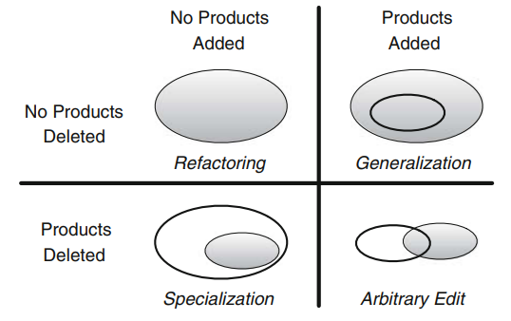
Comparing Feature Models
Notes:
Given two feature models φ_1 and φ_2, what is their relationship? Does φ_1 define the same set of feature selections (products) than φ_2? Is φ_1 a generalization of φ_2 (meaning that the set of products of φ_1 includes those of φ_2 plus more)? conversely, is φ_2 a specialization of φ_1, a subset of the products of φ_1? These questions about the relationship between two feature models may arise early in feature modeling. When a designer edits a feature model, they wants to know if their changes have altered the set of existing valid products. Enlarging the set of products may be acceptable, but eliminating products (particularly those that have been advertised) is often not. However, except for trivial cases such as adding or removing a single feature, the relationship is not always obvious between two models or two versions of a model. Even simple feature models are of sufficient complexity to make analyzing their relationships by manual inspection difficult. we have four relationships that we might want to identify, shown here. A feature-model refactoring preserves exactly the set of valid feature selections, whereas a specialization removes feature selections without adding new ones and a generalization adds valid feature selections without removing any. All differences that both add and remove valid feature selections are classified as arbitrary edits.

Slide 51
Comparing Feature Models
Models are equivalent if formulae are equivalent.
¬(φ₁ ⇔ φ₂) is not satisfiable.
φ₁ is a specialization of φ₂ if (φ₂ ⇒ φ₁)
and φ₂ is a generalization of φ₁
SAT solver can compare two models and identify relationships.
Notes:
One approach to classify the relationship between two feature models is again based on Boolean satisfiability. Two feature models φ1 and φ2 are equivalent when their propositional formulas are equivalent, that is, φ1 ⇔ φ2, or operationalized for a SAT solver ¬SAT ¬(φ1 ⇔ φ2) . Similarly, φ1 is a specialization of φ2 and φ2 is a generalization of φ1, iff |= φ2 ⇒ φ1. (last point)

Slide 52
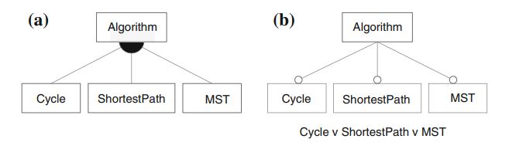
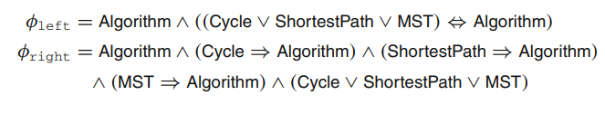
Example - Graph Library
Use SAT Solver to prove φ_{right} ⇔ φ_{left}
Notes:
we show two feature models φright and φleft (φleft is an excerpt of the graph example). The propositional formulas for both the models
are (go over) A SAT solver can prove φright ⇔ φleft, by finding that the no assignment can violate this formula.

Slide 53
Where We Stand
Feature Models can be expressed using propositional logic formulae (φ).
Based on model and cross-tree constaints.
Valid feature selections result in (φ = true).
SAT Solvers can identify valid configurations.
If none can be found, the model is inconsistent.
Enables many different model analyses.

Slide 54
Next Time
Mapping of models to code
Methods of implementing variability
Assignment 2 is up.
Domain analysis, feature model creation, model analysis.
Due November 29

