Slide 1
Lecture 13: Model-Based Testing
Gregory Gay
DIT635 - March 3, 2021

Slide 2
Models and Software Analysis
Before and while building products, engineers analyze models to address design questions.
Software is no different.
Software models capture different ways that the software behaves during execution.
Notes:
Whether you’re designing a skyscraper, or a bridge, or a rocket, from wind-tunnels and little prototype models, to navier-stokes equations, to circuit diagrams, engineers construct and analyze models to analyze what they are doing - to determine whether their solution will work.
Software is no different in this regard, and it too can be modeled.
(3) - from how its state changes when methods are called, to how particular functions should operate to how data or control are passed through the system.

Slide 3
Behavior Modeling
Abstraction - simplify a problem by identifying and focusing only on important aspects.
Solve a simpler problem, then apply to the big problem.
A model is a simplified representation of an artifact, focusing on one facet of that artifact.
The model ignores all other elements of that artifact.
Notes:
One of the key principles of all computer science disciplines is that of abstraction -simplify a problem by identifying and focusing on important aspects while ignoring all other details.
This idea has been the key to solving many, many, MANY computing problems over the years. Start cutting away at unnecessary complexity. Find a simpler, related problem to solve, figure it out, then see if your solution holds on the big problem. We often want to answer questions about the things we build - that’s the key to verification, asking questions of the software and using the answers to address that big question of “is this ready to ship?”
But, the real software is big, and scary, and complex. There are a lot of details that are not going to be relevant to the question you want to answer. Sometimes, the code isn’t even there yet to analyze. In either case, what you really want to do is to just focus on the details you need to answer that question, and that is when you’re going to build a model.
If you haven’t built the code yet, if you don’t even have a design laid out, but you just want to analyze your functional requirements - you want to know if some piece of functionality is going to work and fulfill those requirements, then those details - the code and design- don’t matter just yet. Ignore them and focus on that core behavior of the software. Focus on its functionality. Build a model. Then see if you can prove that it meets those requirements.

Slide 4
Software Models
Model is an abstraction of system being developed.
By abstracting away unnecessary details, extremely powerful analyses can be performed.
Can be extracted from specifications and design plans (or even from code)
Illustrates the intended behavior of the system.
Often take the form of state machines.
Events cause the system to react, changing its internal state.
Notes:
(1) - it takes the system and throws away all details except those explicitly needed for design. As long as the model still reflects the program, (2)
(2 )
Models can be (3), in which case they (5-7)

Slide 5
Model-Driven Development
Models often created during requirements analysis.
Allows refinement of requirement.
Can prove that properties hold over model.
Finite State Verification (next class) - used to analyze requirements, plan development, create test cases.
Can generate code from models.
Can create tests using model.
Notes:
You’ve probably heard the term model-driven development before. This is where we use models to assist in different aspects of development, including testing. Typically, models are crerated during requirements analysis. They are used to improve the requirements by analyzing the model for inconsistencies, incomplete elements, and by using verification techniques to check whether the models meet certain properties - that’ll be the focus of next class. If they meet those properties, and if the program itself follows the same interpretation of the requirements, then we are more likely to produce a correct program as well. Once the model and requirements are strong and consistent, we can use models to support aspects of development. In embedded systems development, like at Volvo locally, they will develop the model first and then generate C code from the model directly that can be flashed to the device. For testing purposes, we can also use the model to derive test cases. Those test cases can then be applied to the real program, and we can see if we get the same results. If the model and program disagree, there is likely a fault. We can even derive a model from stateful behavior in the code - like classes where the class variables determine the outcome of functionality - and create tests based on that behavior as well.

Slide 6
Model-Based Testing
Models describe what happens input applied to certain functionality.
Model structure can be exploited:
Coverage criteria used to identify important paths.
Steps taken to perform functionality in different ways or to get different outcomes.
Notes:
(1). They take types of functionality and let us reason purely in terms of that functionality. In a way, they provide structure to the requirements. Just as source code has structure, and structural coverage can let us use the structure of the code as a way to create test cases, we can also exploit the structure of a model in order to derive rerquirements-based tests for a class or system. Coverage criteria over models identify important paths through the structure of functionality - sequences of steps we might take to complete an action, to perform the functionality in different ways or to get different outcomes. These tests are a potentially rich way to assess whether the final code meets the requirements and results in the correct functionality with hte right seiquence of events.

Slide 7
Finite State Machines
Notes:
15 minute break

Slide 8
Finite Abstraction
Program execution is sequence of states transformed by actions.
Software “behavior” is a sequence of state -> action -> state transitions.
The set of all possible behaviors is often infinite.
Called the “state space” of the program.
Models of execution are simplifications of a functionality’s or class’s state space.
Notes:
A program execution can be viewed as a sequence of states where hte state is transformed by the actions. performed by the program. A computation is performed, leaving the program in a new state, then another computation is performed - based on the input - and the program enters another state.
So, (read 2).
If we abstract away the physical limits of a piece of computing hardware, (read 3). We call the whole set of states and transitions the “state space” of the program.
Models of execution are finite abstractions (simplifications) of the state space of a class or a high-level functionality of the program.

Slide 9
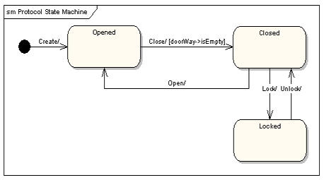
Finite State Machines
Nodes represent states
An abstract description of the current value of an entity’s attributes.
Edges represent transitions between states.
Events cause the state to change.
Labeled event [guard] / activity
event: The event that triggered the transition.
guard: Conditions that must be true to choose a transition.
activity: Behavior exhibited by the object when this transition is taken.
Notes:
Models are often constructed prior to the code and may serve as a specification of the allowed behavior of a high-level function or a particular class. They can also be extracted from the code of a class of function. In either case, the most common way to model system behavior is to take the original natural language specification, choose a function, and represent the behavior of the system when performing that function as a finite state machine.
You often see this done for systems where it is crucial to ensure that the requirements are complete and non-contradictory. So, most often, this is done for embedded systems - where you see complex, highly conditional behavior. Communication protocols often can be directly represented as state machines. Menu-driven applications can also easily be modeled at state machines, as can thread behavior and communication in systems with multiple threads and processes.
These are directed graphs where nodes represent snapshots of the system - states (3)
and edges represent how the system responds to events - they represent (4).
(5), from any state, how the system can react to events is represented by transitions to all reachable states from that point, marked with a label (6-9)

Slide 10
Terminology
Event - Something that happens at a point in time.
Operator presses a self-test button on the device.
The alarm goes off.
Condition - Boolean property, can have a duration.
The fuel level is high.
The alarm is on.
Notes:
First, let’s cover some terminology. We commonly talk about the behavior of software in terms of events and conditions, then reflect on the state of the software. What does that actually mean, though?
(read) - things that occur that trigger a response from the software. Something went wrong, an alarm is raised. A human starts the self-test, which causes the software to enter a self-test mode. These are interactions that occur at some point in time.
(read). Describe the environment or software over a period of time. An event happens and it is over, a condition is something that is true over a period of time. It can be triggered by an event, but is not an event.

Slide 11
Terminology
State - Abstract description of the current value of an entity’s attributes.
(ex: Not “X=5; Y=10”, but “Normal Operating Mode”)
The controller is in the “self-test” state after the self-test button has been pressed, and leaves it when the rest button has been pressed.
The tank is in the “too-low” state when the fuel level is below the set threshold for N seconds.
Notes:
(1). The state of an object or of the software is some description of what it is currently doing. What mode is it in? What is guiding its behavior? It is not the actual values of its variables - as that would lead to an explosion of states - but it is some descirption of what is currently happening in the system when you are at this stage of execution (examples 2-4)

Slide 12
States, Transitions, and Guards
States change in response to events (transition).
When multiple responses to an event (multiple transitions) are possible, the choice is guided by the current conditions.
Also called the guards on a transition.
We take the transition that satisfies all guards.
Notes:
(read)

Slide 13
State Transitions
Transitions are labeled in the form:
event [guard] / activity
event: The event that triggered the transition.
guard: Conditions that must be true to choose this transition.
activity: Behavior exhibited by the object when this transition is taken.
Notes:
(read)

Slide 14
State Transitions
Transitions are labeled in the form:
event [guard] / activity
All three are optional.
Missing Activity: No output from this transition.
Missing Guard: Always take this transition if the event occurs.
Missing Event: Take this transition immediately.
Notes:
(read)

Slide 15
State Transition Examples
Transitions are labeled in the form:
event [guard] / activity
The controller is in the “self-test” mode after the test button is pressed, and leaves it when the rest button is pressed.
Pressing self-test button is an event.
Pressing the rest button is an event.
The tank is in the “too-low” state when fuel level is below the threshold for N seconds.
Fuel level below threshold for N seconds is a guard.
Notes:
(read)

Slide 16
Example: Gumball Machine
[gumballs > 0]
Waiting for Quarter
user ejects quarter
user inserts quarter
Quarter Inserted
user turns crank
[gumballs -1 > 0] / dispense gumball
Out of Gumballs
Gumball Sold
[gumballs -1 = 0] / dispense gumball
Notes:
Old school mechanical devices are dead. Today, people are building software into everything from refridgerators to cars. Now, we want to bring gumball machines into the modern day. By putting CPUs in our machine, we can increase sales, monitor inventory, and add new features. How do we do this? We start by modeling the behavior of our gumball machine as a state machine. (walk through)
initial state
point out transitions and guards
Now, this isn’t detailed enough to serve as source code directly - there are a lot of actions unaccounted for - what should happen if a person tries to eject a quarter then there isn’t one in the machine? what if they insert two quarters? Those decisions need to be made during implementation, and should have been covered in the requirements, but this gives us an abstracted overview of what happens then the system operates - how the system reacts to events and what conditions guide those actions.

Slide 17
More on Transitions
Guards must be mutually exclusive
If an event occurs and no transition is valid, then the event is ignored.
last bill ejected [balance > 0 && balance >= needed]
Able to Purchase
last bill ejected
[balance = 0]
last bill ejected
[balance > 0 && balance < needed]
Waiting for Money
More Money Needed
Notes:
- (read) When events occur, you can only take one transition, so if multiple transitions are activated by the same event, they must have guards that decide which to take. This is a good way to tell if you’ve made a mistake in your specification - can you take more than one transiiton at once? then something is wrong, and that’ll be a bug in your code if not fixed.
-(read) for instance, what if you ejected a bill, but still had greater than the needed balance? then no transition is taken

Slide 18
Internal Activities
Special events: entry and exit.
Other activities occur until a transition occurs.
On each “time step”.
Entry and exit not re-triggered without a self-transition.
States can react to events and conditions without transitioning using internal activities.
Typing
entry / highlight all
exit / update field
character entered / add to field
help requested [verbose] / open help page
help requested [minimal] / update status bar
Notes:
(read) (walk through state example_
(read entry and exit and explain)
A similar thing you could do in a state diagram is use a self-transition, have an arrow pointing from a state back to itself. The point of a self-transition is if you want to remain in a state, but want to trigger an action in response to a particular event. These internal activities fo the same thing - allow you to respond to events without a state transition - but with one difference. A self-transiiton will trigger the exit and enter actions each time it is taken. Internal activities will not retrigger entry and exit unless you take transitions away from and back to the state.

Slide 19
Example: Maintenance Tracking
Customers send in products for maintenance.
Maintenance tracking function notes current stage of the maintenance process for each customer.
Path through process determined by a set of rules.
States = stages of process. Transitions shows paths through process.
Model only what software tracks and controls!
Notes:
As an example, we might sell products to customers, and when the product is not working, the customers might send it in for maintenance. In out system, we have a maintenance functionality that records the history of items undergoing maintenance and tracks their current status. The status is governed by a set of rules. We have some requirements describing those rules and we want ot create a state machine model of this function. Now, somne things to keep in mind before we look at the requirements. We are modeling the software function, not the actual maintenance process. So, this matters because the states should reflect only what the software does and what it keeps track of. A natural choice in this case is that the states will describe the current state of maintenance, and the transitions represent input events that change that state. The model is not omnipotent. It is supposed to reflect part of the software, so we need to design it to reflect how the software would step between different stages of a process it performs. So, as we read the requirements, let’s keep an eye out for the states of the software process. Keep in mind too, that there is a lot of subjectivity in htis. We are simplifying a process, and two people may create different models. That’s fine, as long as both account for the entire process in a reasonable and realistic way. However, as we look at examples, keep in mind that we might not always have the same answer in mind.

Slide 20
Example: Maintenance Tracking
If the product is covered by warranty or maintenance contract, maintenance can be requested through the web site or by bringing the item to a designated maintenance station.
If the maintenance is requested by web and the customer is a US resident, the item is picked up from the customer. Otherwise, the customer will ship the item.
If the product is not covered by warranty or the warranty number is not valid, the item must be brought to a maintenance station. The station informs the customer of the estimated cost. Maintenance starts when the customer accepts the estimate. If the customer does not accept, the item is returned.
No Maintenance
Waiting for Pick Up
Request - No Warranty
Wait for Acceptance
Wait for Returning
Notes:
Read over
If we look over this closely, we can identify states
- no maintenance - nothing is going on right now
- What about waiting for shipping? Probably not - that’s not something the software is aware of. We just care about what the software is handling. Customers will ship items without alerting us.
- Request is made without warranty - we send out the total then, we wait for a response. If they don’t like it, we then return the item to them.

Slide 21
Example: Maintenance Tracking
Repair at Station
If the maintenance station cannot solve the problem, the product is sent to the regional headquarters (if in the US) or the main headquarters (otherwise). If the regional headquarters cannot solve the problem, the product is sent to main headquarters.
Maintenance is suspended if some components are not available.
Once repaired, the product is returned to the customer.
Repair at Regional HQ
Repair at Main HQ
Wait for Component
Repaired
Notes:
- Try repairing it at the station
- If that fails (regional/main)
- wait
- return
This is open to some interpretation, obviously - but you should be sure to cover all states that the system can exhibit. Be as detailed as possible, but remember to restrict yourself to what the software can actually do - what info it tracks and can influence. The software can’t know, for instance, that a customer has shipped an item to it unless we explicitly note that the customer could do something like log a tracking number. The next step is to link up these states with all of the transitions that we can extract from this text. What does this look like?

Slide 22
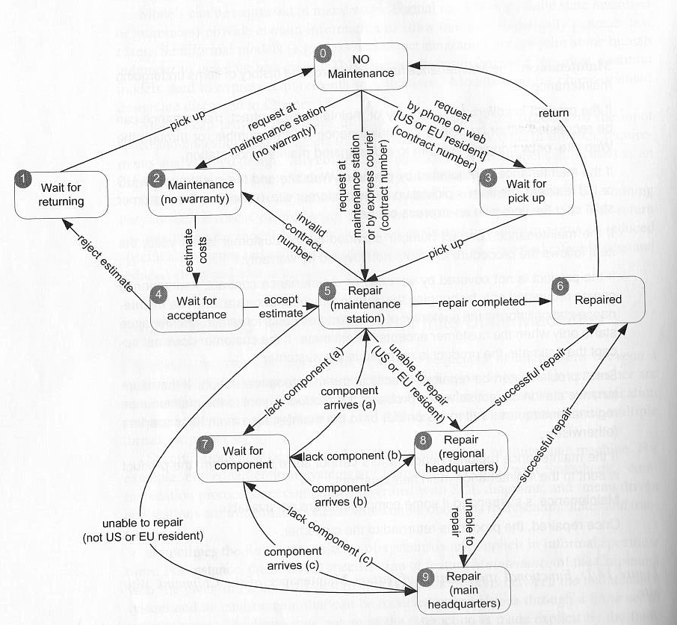
Example: Maintenance Tracking
Notes:
go over

Slide 23
Example - Computer Model
Model
ModelID
Slots
selectModel(modelID)
deselectModel
addComponent(slot, component)
removeComponent(slot)
isLegalConfiguration()
Many classes have stateful behavior.
States are based on the class variables and how they change behavior.
Transitions = method calls
Derive model from class and create tests.
Ex: We sell computers on our website. Model class represents a model of computer.
Slot
Model
Component
Required
incorporate(model)
bind(component)
unbind()
isBound()
Notes:
Let’s do a second example, where we look at extracting a model from an existing class in the code. In this case, we have a system for a computer store. We sell various models of computer. We have a class that represents that model. It has class variables, including the model type and a set of hardware slots - where we assign a CPU, memory, etc. The methods of the class relate to setting the type of model, the contents of the slots, and checking whether the configuration selected for the slots is legal given the model we selected. We can also look at the class Slot, which has the variables Model, Component, and Required and methods relating to the links between this slot and its model and assigned component.
Many classes, like these, have stateful behavior. The states are different configurations of those class variables. Again, we do NOT want to base this on specific variable values, like Model = AX75B, but on the modes of operation - how the class variables can influence the outcome of calling the methods. Then, the transitions between states are method calls, as those are what changes the values of the class variables - what changes the state. We can derive a model from the class and use that to help us create test cases, as that will suggest certain sequences of method calls based on the stateful behavior. This allows very thorough testing of particular impoertant classes.

Slide 24
Slot Specification
Slot represents a configuration choice in all instances of a particular model of computer. A given model may have zero or more slots, each of which is marked as required or optional. If a slot is marked as required, it must be bound to a suitable component in all legal configurations. Slot offers the following services:
Incorporate: Make a slot part of a model, and mark it as either required or optional. All instances of a model incorporate the same slots.
Bind: Associate a compatible component with a slot.
Unbind: The unbind operation breaks the binding of a component to a slot, reversing the effect of a previous bind operation.
IsBound: Returns true if a component is currently bound to a slot, or false if the slot is currently empty.
Notes:
To come up with a state machine representing a class, we need information about how that class behaves. What does it do? What services does it offer? What purpose does it serve? However, the design documents and - if done - the code are quite useful in this figuring out how to represent the states of a class. Let’s start with a class description from a design document for the class Slot (read over).
We can figure states and transitions from this text. Look for descriptions of methods that behave differently, depending on the state of the object. LEt’s look at this. Any states you stand out? (click, IsBound)
(incorporate adds a slot to a model. That slot can be empty or have a component. This implies a third state, which is a slot not attached to a model at all. So, three states, not part of a model, unbound - part of a model, but without a component-, and bound- part of a model, with a component)
Now, we need transitions as well - how does that state change? through the methods. How do these methods cause state changes? (discuss)

Slide 25
Slot State Machine
isBound()
unbind()
No Model
No Component Bound
Component Bound
isBound()
incorporate (model)
bind (component)
unbind()
Do not derive too many states.
Map variables to abstract values, not a state for each possible combination of values.
Model how a method affects a class.
States only need to capture interactions between methods and the class state.
Notes:
go over
Be careful (1). For instance, if you have an integer count, you might just have zero and nonzero as states representing that count, not a state for each possible value. Some abstraction is necessary.
(3)

Slide 26
Example - Model
Model represents the current configuration of a model of computer.
A given model may have zero or more slots, each of which is marked as required or optional.
Each slot may contain a single component.
To be a legal model, the model ID must exist in the ModelDB, each slot marked as required must be filled, the configuration must match that of the ModelDB entry for the model ID, and the optional components must match those allowed for that model in the ModelDB.
Notes:
Go Over
What do you think the states should be? Remember - keep it simple (discuss)

Slide 27
Example - Model
selectModel(modelID): Sets the model ID to the value passed in, as long as the model ID is set to “no model selected”. A model ID must be set before any other services are requested.
deselectModel(): Sets the model ID to “no model selected”. If the configuration was previously judged to be legal, it is no longer legal.
addComponent(slot, component): Adds the selected component to the selected slot. If the configuration was previously judged to be legal, it is no longer legal.
removeComponent(slot): Removes the selected component to the selected slot. If the configuration was previously judged to be legal, it is no longer legal.
isLegalConfiguration(): Compares the current configuration to the entry in ModelDB. If the configuration is valid, the Model’s isLegal field is set to “true”.
Notes:
Go Over
What do you think the states should be? Remember - keep it simple (discuss)

Slide 28
Choosing States
No Model Selected
Configuring
Legal Configuration
What does the class represent?
In this case: a computer model.
What causes method results to differ?
Whether the model is legal or illegal.
Can the class be in any other states?
We may not have set the model yet. We could still be making decisions and have not determined legality.
Notes:
Go over

Slide 29
Choosing Transitions and Initial State
No Model Selected
deselectModel()
selectModel(model)
deselectModel()
Configuring
addComponent (slot,component)
remove Component(slot)
isLegalConfiguration() [legalConfig=false]
isLegalConfiguration() [legalConfig=true]
remove Component(slot)
addComponent (slot,component)
Legal Configuration
Notes:
Now, we also need transitions and an inital state.
- Initial state - what happens when we call constructor - is that we have no model.
- Now, What gets out of the NoModel state? We need to start making choices.
- Great. Now, what can we do while configuring? Well, we could go back to No Model Selected.
- We can also make changes to the configuration that don’t take us anywhere - remove a component, add a component.
- How do we get to a legal configuration? We call the isLegalConfiguration method. Now, there are two possible results depending on our choices.
- Now, can we do anything once we are legal? Sure - we could deselect model (point), we could add another component, we could remove a component. Now, we would need to make another legality check.

Slide 30
Activity - Secret Panel Controller
You must design a state machine for the controller of a secret panel in Dracula’s castle.
Dracula wants to keep his valuables in a safe that’s hard to find. So, to reveal the lock to the safe, Dracula must remove a strategic candle from its holder. This will reveal the lock only if the door is closed. Once Dracula can see the lock, he can insert his key to open the safe. For extra safety, the safe can only be opened if he replaces the candle first. If someone attempts to open the safe without replacing the candle, a monster is unleashed.
Take a short break if needed.
https://bit.ly/3bEfc0J (Problem 1)
Notes:
This software controls the entire system described above. When designing your state machine, model the state from the perspective of the software - that is, what the software is aware of, and what it can control (e.g., states like “lock revealed” or “candle removed”, and not “Dracula in the room”).

Slide 31
Activity Solution
Open
safe closed / close panel
key turned [candle in] / open safe
candle removed [door closed] / reveal lock
Wait
Lock Revealed
key turned [candle out] / release monster
Monster Unleashed
Notes:
walk through

Slide 32
Model Coverage Criteria
Notes:
15 minute break

Slide 33
Test Creation
Test cases created from models can be applied to the real program.
Events translated into method/api calls.
Output, when abstracted, should match model output.
Model coverage is one form of requirements coverage. Tests should be effective for verification.
Exercises stateful behavior thoroughly.
Coverage criteria based on states, transitions, paths.
Notes:
(go over)

Slide 34
State Coverage
Each state must be reached by test cases.
Like statement coverage - unless model has been placed in each state, faults cannot be revealed.
Num. of Covered States / Number of States
Easy to understand and obtain, but low fault-revealing power.
The software takes action during transitions, and most states can be reached through multiple transitions.
Notes:
Several coverage metrics based on covering the structure of the state machine. The first is, of course, - state coverage.
(1)
the natural analog to statement coverage - (2)
(3-4) transitions - that’s when input comes in, the next state is decided, and output is released - and (rest)

Slide 35
Transition Coverage
A transition specifies a pre/post-condition.
“If the system is in state S and sees event I, then after reacting to it, the system will be in state T.”
A faulty system could violate any of these precondition, postcondition pairs.
Coverage requires that every transition be covered by one or more test cases.
Num. Covered Transitions / Number of Transitions
Notes:
(1). A transition from state S-T on event i means that “if the system is in state S and sees event i, then after reacting to it, the system will be in state T.
State S is a precondition, T is the postcondition, and I is the input. If this input arrives and we are in S, we should be in T once the transition is over
(3), and each should be checked. What this does is exercise the stateful behavior of the software in different ways, and may reveal faults where an action leaves us in the wrong state. Transition coverage simply requires that (4-5). This subsumes state coverage
if we’ve covered all transitions, we’ve obviously hit each state.

Slide 36
Example: Maintenance
If no “final” states, we could achieve transition coverage with one large test case.
Smarter to target sections in different test cases.
Example Paths:
T1: request w/ no warranty (0->2) - estimate costs (2->4) - reject (4->1) - pick up (1->0)
T2: 0->5->2->4->5->6->0
T3: 0->3->5->9->6->0
T4: 0->3->5->7->5->8->7->8->9->7->9->6->0
T5: 0->5->8->6->0
Notes:
(1) - final - states that we cannot transition out of after reaching them (rest of 2). However, like with code coverage, this often isn’t a good idea. It’s better to have a larger number of small tests so you can examine problems in isolation if they crop up. It makes sense to break the FSM into sections and cover those, tracking what needs to be covered.
- T1
- T2
- T3
-T4
-t5

Slide 37
Example - Slot
isBound()
unbind()
No Model
No Component Bound
Component Bound
isBound()
incorporate (model)
bind (component)
unbind()
Tests are series of method calls.
incorporate(model), isBound(), unbind()
incorporate(model), bind(component), isBound()
incorporate(model), bind(component), unbind(), isBound()
Notes:
go over
Again, we could easilt do this in one test case, but it’s nice to split it up a little to look at different scenarios. Here, I chose to split into three. First, we focus on the transitions in the NoComponentBound state (click), incorporate slot into a model, then try unbind and isBound. both should have no effect here on the state, but you’ll get a different outcome than if you call those in the component bound state. Second (click) - we focus on binding a component and making sure it is bound. Third (click), bind and unbind, then make sure it is no longer bound.

Slide 38
Example - Model
No Model Selected
TC1:
selectModel(M1) [M1, 1 slots = C1]
deselectModel()
selectModel(M1)
addComponent(S1,C1)
isLegalConfiguration() //true
deselectModel()
deselectModel()
selectModel(model)
deselectModel()
Configuring
addComponent (slot,component)
remove Component(slot)
isLegalConfiguration() [legalConfig=true]
isLegalConfiguration() [legalConfig=false]
TC2:
selectModel(M1) [M1, 1 slot = C1]
addComponent(S1,C1)
isLegalConfiguration() //true
addComponent(S2,C2)
isLegalConfiguration() // false
removeComponent(S2)
isLegalConfiguration() // true
removeComponent(S1)
Valid Configuration
addComponent (slot,component)
remove Component(slot)
Notes:
Now,again you could cover the transitions with one big test case. I don’t recommend that. Instead, you should focus on smaller test cases designed around one thing at a time. Here’s we’ll focus on certain method calls and try them out in each state. This will cover the transitions and states.
1 - focused on select and deselect
2 - focus on add and remove components
Might want to break these down a little more, but you get the idea.

Slide 39
Path Coverage Criteria
Transition coverage based on assumption that transitions are independent.
Many machines exhibit “history sensitivity”.
Transitions available depend on path taken.
“wait for component” in Maintenance Tracking example.
Path-based metrics can cope with sensitivity.
Notes:
Transition coverage is based on assumption that transitions out of a state are independent of transitions into a state. Basically, that all transitions are independent. That is not always true, and some state machines have a history sensitivity where the transitions available depend on the history of previous actions - aka: the path we took to get to this point.
If we’re in a state and deciding what to transition to next, we might need information on the path taken to that point to know we’ve made the right selection.
Go back to maintenacne example - take the “wait for component” state. Once we’re in that state, we can transition to any of the repair states. Which one do we take? There is actually an order -A,B,C that must be followed. We need to take a particular path. We need that path history to know that we made the right choice. There are some path-based coverage metrics that can cope with history sensitivity. That require we take certain important paths, and that can reveal faults missed by the simpler criteria.

Slide 40
Path Coverage Metrics
Single State Path Coverage
Requires that each subpath that traverses states at most once to be included in a path that is exercised.
Single Transition Path Coverage
Requires that each subpath that traverses a transition at most once to be included in a path that is exercised.
Boundary Interior Loop Coverage
Each distinct loop must be exercised minimum, an intermediate, and a large number of times.
Notes:
(1-2). This deals with the looping issue that makes path coverage impossible. We remove cycles from paths. We need to visit all states without looping through cycles forever, as you would have to in full path coverage. - maybe draw simple example on the board
(3-4)
(5-6)
Even without looping, the number of paths can be exponentially high, so these are often impractical, but can be very powerful if they can be satisfied.

Slide 41
Single State (Transition) Path Coverage
Single State (or Transition) Path Coverage
Each subpath that traverses a state (or transition) at most once must be exercised.
Notes:
go over
Remember - each state at most once. If you have to return to a previous state, you can end the path.
(5 clicks). I am not going to go over every one, but this should give the idea. Each path that does not touch a state previouslt hit in that path must be covered. This gives a stopping criterion on subpaths, so that you do not loop forever, as you could in this case.

Slide 42
Boundary Interior Loop Coverage
Boundary Interior Loop Coverage
Each loop must be exercised 1, 2, N times.
(N = some higher number)
Notes:
(1-2). Let’s pick a loop. (bring in)
This is just like in loop coverage in code coverage. We want to make sure here that if we exercise a loop N times, it always leads to the same sequence of states

Slide 43
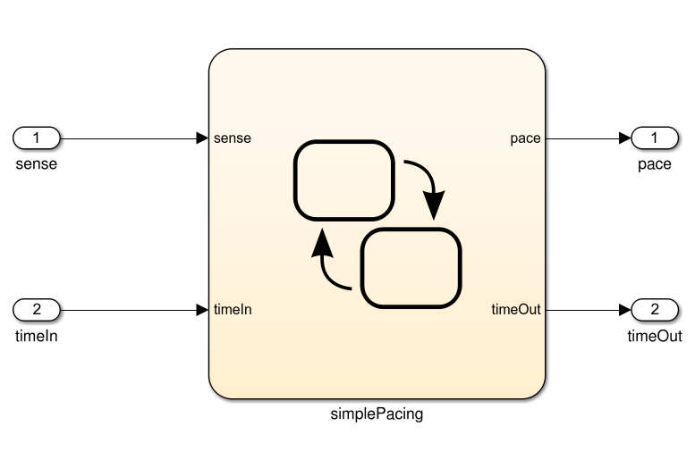
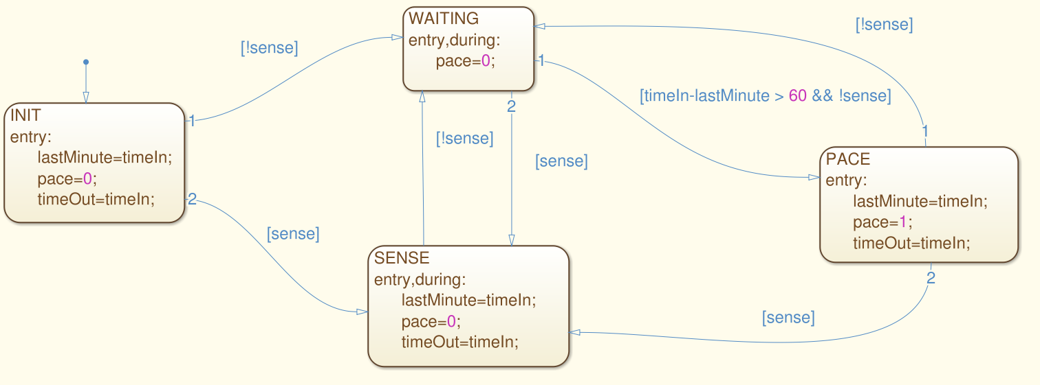
Activity
https://bit.ly/3bEfc0J (Problem 2)
For this model, derive test suites that achieve state and transition coverage.
Notes:
(go over)

Slide 44
Activity - State Coverage
[true,1], [false,2], [false, 65]
Notes:
(go over)(3 clicks). Pretty simple.

Slide 45
Activity - Transition Coverage
[true,1], [false,2], [false, 65], [true, 66], [false, 77], [true, 78], [false, 79], [false, 140], [false, 141]
[false, 1]
Notes:
Transition coverage is a little more complicated.
Start by expanding the first test (9 clicks)
Just leaves one transition. For that, we need a second test because it is a transition out of the initial state, and there is no way back to the original state.
Not the only suite, not even the best suite. That first test is really long and may be hard to understand. May want to distribute this out over both.

Slide 46
We Have Learned
Models can be used to systematically create tests.
Models have structure. We can exploit that structure.
Exercises stateful behavior of a class or functionality.
Helps identify important input.
State machines model expected behavior.
Cover states, transitions, non-looping paths, loops.
Can also verify properties over models as part of verification (next class).

Slide 47
Next Time
Finite State Verification
Optional Reading - Pezze and Young, Chapter 8
Assignment 3
Due Sunday, March 14
Questions?

