Slide 1
Lecture 6: Design Patterns for Variable and Evolving Systems
Gregory Gay
(Some slides adapted from “Head First Design Patterns”)
TDA 594/DIT 593 - November 17, 2022
Notes:
Welcome to Lecture 6 for Software Engineering Principles for COmplex Systems, TDA594.
As you may have noticed, today’s lecture is a little different. There is a career fair today, which I hope all of you are aware of and are attending. Instead of our normal lecture, we have this video lecture.
I will be happy to take your questions, if you have any, through email or during the next class. So, let’s begin.

Slide 2
Today’s Goals
Using design patterns to implement variability.
Strategy Pattern
Factory Pattern
Decorator Pattern
Adapter Pattern
Facade Pattern
Template Method Pattern
Notes:
Today, our focus is on variability implementation via design patterns. Design patterns are a load or run-time bound, language-based, composition-based approach for variability implementation. That is - we choose feature either when the program is executed or while it runs, it is implemented using language mechanisms instead of external tools, and features are encapsulated as seperate units that we merge together, rather than having code for multiple features mixed in the same place. Design patterns are descriptions of collaborating objects and classes that are customized to solve a general design problem in a particular context. They are essentially recipes for implementing certain forms of behavior in a system. Design patterns are a classic OO Design technique, and have a major place here as one of the easiest ways to implement reusable assets in a seemless and extendable way, to allow your system to evolve over time by slotting in new features and controlling how the system evolves. I’m sure you’ve discussed design patterns before. PArt of this will be review, but The goal today is to highlight six patterns - some complex, some deceptively simple - that are particularly suited to product lines and other long-term evolving systems. Design patterns are one of the major means of language-based implementation.

Slide 3
OO Design Exercise:
Building a Better Robot
Robot
shoot()
target()
move()
display()
// Other Methods
TankRobot
display() { .. }
DogRobot
display() { .. }
…
Notes:
Let’s start by going way back to our OO principles, and we’re implementing our robots. a whole product line of different mobile robots.So, anyway, we want to implement several robots. robots can target, shoot, and move. So, it seems reasonable that you might want to use inheritance so that you can add dozens of robot types and just inherit those common attributes and operations from the parent, with maybe some new operations on top. Is that ok? Could this get you into trouble?

Slide 4
Adding new robots
Robot
shoot()
target()
move()
display()
// Other Methods
TankRobot
display() { .. }
DogRobot
display() { .. }
DroneRobot
display() { .. }
Notes:
Using inheritance gives you Good reuse of operations in the initial design, but it isn’t always the answer, and might end up getting you into trouble when you go to change the system later. What if you add new robots to this product line? What if it’s a drone? They can shoot and target, great, but they move in a very different way. Not in a 2D plane, but in 3D space. Something might need to change then.

Slide 5
Why not override?
UnderwaterRobot
display() { .. }
@Override shoot() { .. }
@Override move() {.. }
Robot
shoot()
target()
move()
display()
// Other Methods
DroneRobot
display() { .. }
@Override move() {.. }
TankRobot
display() { .. }
DogRobot
display() { .. }
Notes:
One option is to override a method that you inherit with your own version. That’s often a useful trick - you inherit these methods, but the behavior isn’t the same, so you could override their behavior with your own local version of moving. How about that?
(click)
Now we add a robot submarine, one with no gun, just for exploring the water. It might still target objects for inspection, but like the drone, it moves in a 3D space and it doesn’t shoot anything. It might make sense to group it with our other robots still since we have some shared attributes, but we’re reaching a breaking point with the behavior overrides. Defeats the point of inheritance - why bother inheriting behaviors if you’re not going to use them at all? If not shared? The point is to localize functionality to that parent so a change in one place changes it everywhere. It isn’t much use if we just override everything.

Slide 6
Why not interfaces?
<<interface>>
Moving
move()
Robot
target()
display()
// Other Methods
<<interface>>
Shooting
shoot()
MallardDuck
display() { .. }
move() { .. }
shoot() { .. }
RedheadDuck
display() { .. }
move() { .. }
shoot { .. }
DroneRobot
display() { .. }
move() {.. }
shoot() {.. }
UnderwaterRobot
display() { .. }
move() { .. }
Notes:
Another option is to use Java interfaces - Here, we don’t actually implement a shared behavior, but we define a contract that states that anything that implements the interface will - at least - offer these methods with these parameters.
So, we could define interfaces for some of these behaviors - anything that implements moving can move. Anything that implements shooting can shoot.
(click) Strip out moving and shooring and add those as interfaces.
(click) implement our robots - they still all target and they might share data attributes
(click) when appropriate, have them implement the right interfaces.
- this provides assurance that if an object can move or shoot, you know how to call that behavior. Good. Is this actually a better design, though?
we know not all robots move in the same way - some might not move at all - so inheritance isn’t the right answer, but this - interfaces - just solves part of the problem. A bug point of inheritance is the idea that we don’t implement the same code in multiple places. With just an interface, we have to implement the behavior each time, and that likely means the same moving or shooting behavior appears in multiple places in the code. Maintenance, bug fixes are still going to be a nightmare.

Slide 7
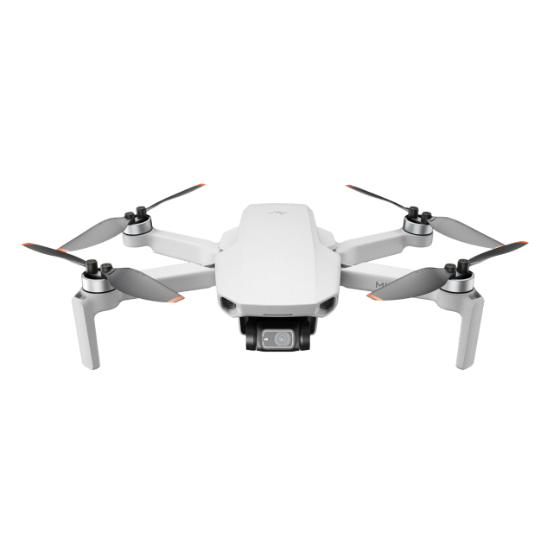
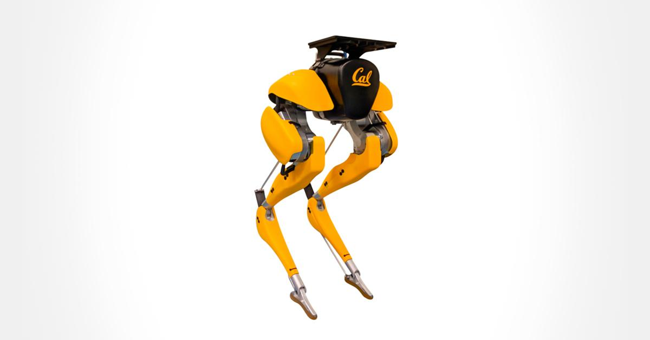


How do we fix this mess?
Apply good OO design principles!
Step 1: Identify the aspects that vary and encapsulate them.
Robot Moving
class behaviors
Notes:
(title)
So, let’s ignore these fancy tools for a second - interfaces, inheritance. Let’s focus on the core reason these tools exist - one of the biggest advantages of OO design is that we can think of the system as a bunch of independent blocks that connect together, so let’s do that. Let’s identify what changes and isolate that from what doesn’t - isolate the assets of our product line from the specific application code that uses those assets.
So, we have robots. What never changes? Let’s take that and put that into our robot class, the basis for all other robots. What does change between these variants? Well, for one thing, how they move (or don’t move as the case may be) - so, let’s separate what never changes about robots (the application side) from the changing behaviors (the product line assets) so that later you can alter or extend the parts that might change without affecting those parts that never change.

Slide 8
Step 2: Implement behaviors as classes
<<interface>>
MoveBehavior
move()
(GOOD)
Programming to an interface:
Robot d = new DroneRobot();
d.move();
Behavior called in same way for all robots. Only implement behavior once.
Principle - Program to interface, not implementation.
Robot
target()
move()
shoot()
display()
Robot
target()
display()
MoveWithWheels
move() { .. }
MoveWithWings
move() { .. }
(BAD)
Programming to an implementation:
DroneRobot d = new DroneRobot();
d.moveWithWings();
Requires knowing robot type and methods.
(BETTER… BUT NOT GREAT)
Inherit and override.
Robot d = new DroneRobot();
d.move();
Requires reimplementing the same behaviors multiple times.
Robot
MoveBehavior myMove
ShootBehavior myShoot
target()
move()
shoot()
display()
DroneRobot
flyWithWings()
target()
shoot()
display()
DroneRobot
move()
display()
move() {
myMove.move();
}
Notes:
So, we want to separate what never changes from what does. Our first inclination might be to do something like this. Create children, and just program in moving and shooting when needed, implementing whatever behavior we need independently of the parent. This isn’t quite there yet - this means that when we want a robot to move, we need to know what robot we’re working with and how to call the right method. (click) Now, of course, we could go back to stating that robot has move and shoot methods and overwriting them. This is better - we know that all robots have the same methods, so we don’t need to know which robot we’re working with. Call the move method and you’ll get the appropriate behavior. But, as we talked about earlier, this isn’t great either, as we need to reimplement the same behavior multiple times. That said, there is an important lesson here. (click 2)Program to an interface, not an implementation. Even if the result varies, always offer the same way to access the appropriate version of the same type of behavior. Offer that assurance that no matter what type of robot we have, we can call move() or shoot() and get the right result. Now, how do we do this right? (click3) So, what we want to do is to take those moving behaviors and program them once. We can give them each their own class and, since the behavior varies, we don’t want to inherit, but we can create an interface that says that any type of moving behavior will offer a method call move(); We provide a contract - here is how you move (click4) Now, in the robot, we state that there will be a moveBehavior and a shootBehavior. All children inherit those attributes, but in those children, we can assign the appropriate instance of Moving or Shooting. Now, we have separated what changes from what doesn’t. Moving behavior is implemented separately from the robot, , in one place, and no matter what robot we’re dealing with, we can access the right behavior in the same way without needing to know which robot it is or which version of moving it is. We will get the right result. That’s good OO design.

Slide 9
HAS-A can be better than IS-A
Principle: Favor composition over inheritance.
Robot
MoveBehavior myMove
ShootBehavior myShoot
target()
shoot()
move()
display()
setMoveBehavior()
setShootBehavior()
<<interface>>
MoveBehavior
move()
MoveWithWings
move() { .. }
MoveWithWheels
move() { .. }
<<interface>>
ShootBehavior
shoot()
TankRobot
display() { .. }
DogRobot
display() { .. }
DroneRobot
display() { .. }
GunShooting
shoot() { .. }
LaserShooting
shoot() { .. }
Notes:
This leads to another principle of OO programming. Inheritance is useful, but not always the answer. Often, we should favor composition over inheritance. Now, a duck has a flying behavior, it has a quacking behavior. But, instead of inheriting behavior from parent classes and making overrides, we have implemented the behaviors once and composd new versions of a class from the right building blocks. We restrict a duck to what is true of all ducks, then build a new duck from the right set of behaviors. This is the principle of composition - building a class from small independent blocks - something we have repeated over an over when talking about product lines. Inheritance can be great, but only for those things that are shared between a parent and all children. Composition is better for those aspects that vary and can change over time. Often has-a can be better than is-a.

Slide 10
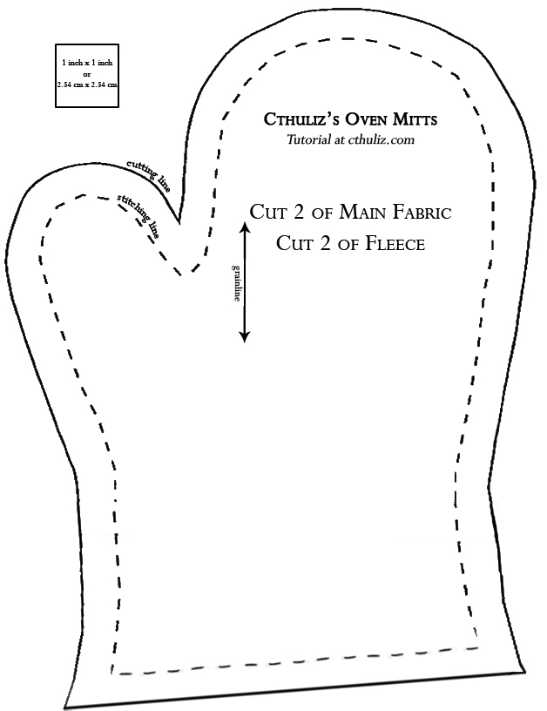
Enter... Design patterns
Don’t just describe classes, describe problems.
Patterns prescribe design
guidelines for common
problem types.
Notes:
Now, those are some of the fundamental lessons of OO development, but they can take some work to apply in practice. Fortunately, we can learn from the expereince of others. Don’t start design by listing a set of classes. Start by describing the problem you are addressing. Someone has probably solved it before. Some of these experience have been summarized as what we call design patterns. These patterns serve as a reference guide for design - for particular types of systems or development situations, they offer design guidelines.

Slide 11
Guidelines, not solutions
“Each pattern describes a problem which occurs over and over again in our environment, and then describes the core of the solution to that problem in such a way that you can use this solution a million times over, without ever doing it the same way twice.”
- Christopher Alexander
Notes:
Quote from Christopher Alexander, who popularized the concept of design patterns. (read)
Nice quote that really describes what a design pattern is. These patterns offer a head start to design - the core of a solution to a problem. They aren’t libraries of code that you can plug in. You won’t find patterns that replace your system. But they offer structure and guidance, a set of instructions, that will ideally result in a better design for your particular problem - in our case, better support for customization and expansion of available options- and better support for system evolution over time.

Slide 12
You already applied one pattern
Strategy Pattern
Defines family of algorithms, encapsulates them, makes them interchangeable.
Notes:
Behavioral pattern. Algorithms describe behaviors. You take those, implement them, and make them interchangable by ensuring they all offer the same interface. Can swap one form of flying for another at runtime, don’t need to know specifics. This allows seemless mangement of variability - just attach the right option at runtime, call as you would call any option, and it should work. You can add in new assets - new behaviors - to that set over time and make use of them by binding the appropriate class at runtime.

Slide 13
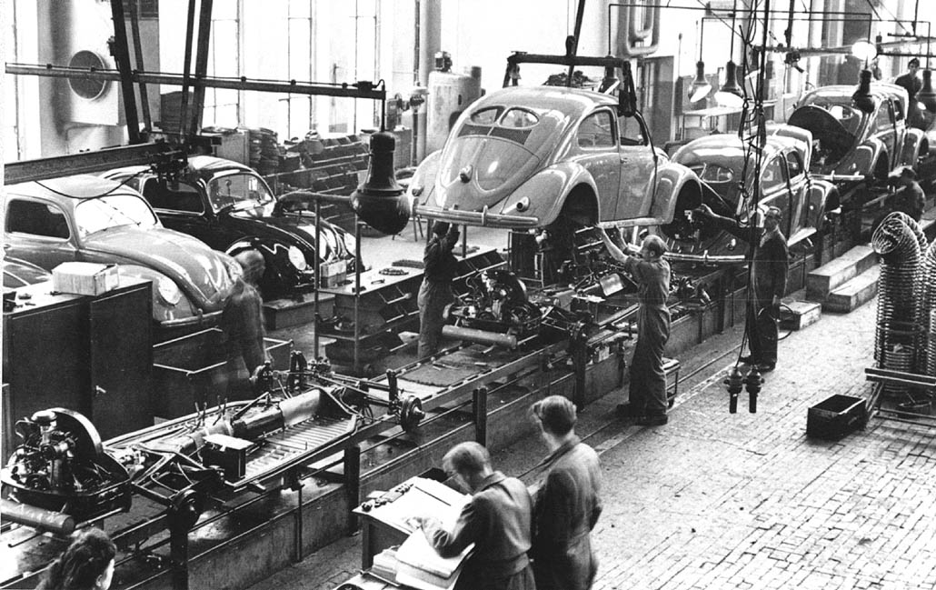
Factory Pattern - Motivation
Notes:
Our second pattern is the factory pattern. In manufacturing, you often end up creating multiple versions of the same product. This motivation should sound familiar. Say you’re building a new laptop. The process is the same for each instance of the laptop that you build, but the individual parts might differ - different RAM sticks, different hard drive capacities. You often see this same thing in restaurants - two customer might order pizza or a hamburger, but with different toppings. Same fundamental type of object - a pizza, a burger - but the details differ depending on the options chosen. Again, sound familair? As you know, These same situations happen often in software as well, and that is where the factory pattern - a creational pattern - comes in, allowing us to exploit polymorphism to create the right type of object and change what options we offer without rewriting code in several parts of the program.

Slide 14
Factory Pattern - Motivation
Robot deployRobot(){
Robot bot = new Robot();
bot.initialize();
bot.loadAmmo();
bot.setArmor();
bot.deploy();
return robot;
}
Create a robot.
Prepare that robot.
Send robot to arena.
Notes:
So, let’s say we have our robot battle similator. We can throw many types of robots into the arena to fight. Setting up a fight triggers a sequence of events where you prepare, set health and ammo - your loadout, then shoot the bot into the arena. Regardless of the type of robot, those steps remain the same (though the specifics of what happens when you call those methods will vary by class). This is like what we talked about earlier, right? Now, there’s something missing here - deciding on the type of robot.

Slide 15
First Try
Robot deployRobot(String type){
Robot bot;
if (type.equals(“insect”)){
bot = new InsectBot();
else if(type.equals(“tank”)){
bot = new TankBot();
}
// Prep methods
}
Notes:
So, first stab at this - we add an argument for setting the robot type, and use conditional statements to filter and instantiate the right type. Each type has to follow the robot interface and implement those prep methods in the last slide.
Is this going to be a problem?

Slide 16
Factory Pattern - Motivation
Robot deployRobot(String type){
Robot bot;
if (type.equals(“insect”)){
bot = new InsectBot();
else if(type.equals(“tank”)){
bot = new TankBot();
} else if(type.equals(“dog”)){
bot = new DogRobot();
}
// Prep methods
}
Notes:
Now, your set of models will never remain static forever. You’ll need to add new robot types, remove old ones. This can be a problemn, as this code is not entirely friendly to change. You’ll have to modify it over and over, while the rest of this deploy robot method, namely the prep methods, will likely stay the same. This if-then-else block, this robot selection code is likely to appear elsewhere in your system, and you’ll need to change it there as well. This isn’t a design conducive to change.

Slide 17
Factory Pattern - Motivation
Robot deployRobot(){
Robot bot = new Robot();
bot.initialize();
bot.loadAmmo();
bot.setArmor();
bot.deploy();
return robot;
}
SimpleRobotFactory
Notes:
So, we are going to take that robot instantiation code from every place it appears in the system, strip it out, and encapsulate the robot instantiation code into a special type of object that we call a factory. Factories handle the details of object creation. The deployRobot method is a client of the RobotFactory. This preserves loose coupling. The deploy robot method does not need to know the differences between robot types. It just cares that it gets a valid robot, which implements the robot interface so we can call the prep methods. So, the factory gives us a robot object, and we prepare/deploy the robot. We don’t need to know what’s on it, what type of robot it is, how it walks, what gun it uses. We don’t care - it just needs to act as we promised that a robot will act, provide the right interface.

Slide 18
The Simple Factory
RobotBattleArena
SimpleRobotFactory factory
deployRobot(String)
<<interface>>
Robot
initialize()
loadAmmo()
setArmor()
depoy()
SimpleRobotFactory
createRobot(String)
Robot createRobot(String s){
if(s.equals(“insect”))
return new InsectBot();
// Other robot types
}
InsectBot
initialize()
loadAmmo()
setArmor()
depoy()
TankBot
initialize()
loadAmmo()
setArmor()
depoy()
DogBot
initialize()
loadAmmo()
setArmor()
depoy()
Notes:
Now, we’re not quite to the pattern yet - the full factory pattern has a couple more quirks - but here is what our robot arena looks like now that we’ve stripped out object creation. The robot arena contains a factory, which is called when we need to instantiate a robot. So, we call the robot arena a client of the SimplerobotFactory. We have several types of robot that all implement the robot interface. We still have that if statement I showed you before, but the important part is that we have put that list in ONE place. If it changes, we only need to change it once. Thus, the factory can create any of these robot types, and the client knows how to use them. So far, so good.

Slide 19
Franchising the Factory
<<interface>>
Robot
initialize()
loadAmmo()
setArmor()
depoy()
RobotBattleArena
RobotFactory factory
deployRobot(String)
<<interface>>
RobotFactory
createRobot(String)
LandBotFactory
createRobot(String)
FlyingBotFactory
createRobot(String)
TankBot
prepare()
bake()
cut()
box()
BirdBot
prepare()
bake()
cut()
box()
DroneBot
initialize()
loadAmmo()
setArmor()
depoy()
InsectBot
initialize()
loadAmmo()
setArmor()
depoy()
Notes:
Not all robots are the same. Maybe we eventually decide to introduce flying robots in addition to our previous land-based robots. So, we might want to offer different hierarchies of options. We might want to let the user select a robot type - land or flying - then different specific bots from each category. In that case, we might not just want one robot Factory, we might want multiple- some of the details of creation might differ, or the options offered by each might differ, in either case, we provide an extra layer of organization. We can create a set of factories, each factory responsible for the creation of a subset of the items, the products. This means that we want to create a factory interface and spin that off into concrete factories that offer the same contract to other methods, but differ in the implementation details - each responsible for their own products. From this, we begin to see that what we are really dealing with in the factory pattern are products and creators, both of which have interfaces - contracts that they agree to follow in order to present a common interface.

Slide 20
Factory Pattern - Definition
Defines interface for creating an object, lets subclasses decide which object to instantiate. Allows reasoning about creators and products.
<<interface>>
Robot
initialize()
loadAmmo()
setArmor()
depoy()
<<interface>>
RobotFactory
createRobot(String)
BirdBot
initialize()
loadAmmo()
setArmor()
depoy()
DroneBot
initialize()
loadAmmo()
setArmor()
depoy()
FlyingBotFactory
createRobot(String)
LandBotFactory
createRobot(String)
Notes:
The factory pattern gives us a way to encapsulate the instantiations of concrete types. Lets us reason in terms of two parallel class hierarchies - creators and products - factories encapsulate object creation by letting subsclasses decide which objects to create. All creators let us pass in options, use those to instantiate an object, then pass the right object back. The object we create - the products - may differ in the result of the methods they offer, but all offer a common set of methods.

Slide 21
Factory Pattern - In Practice
Each factory manages a subset of the products.
Client
Each type of product has a defined interface.
<<interface>>
Factory
createProductA()
createProductB()
<<interface>>
ProductA
// methods
<<interface>>
ProductB
// methods
ConcreteFactory1
createProductA()
createProductB()
Concrete
ProductA1
Concrete
ProductB1
Concrete
ProductA2
ConcreteFactory2
createProductA()
createProductB()
Concrete
ProductB2
Notes:
So, what does this look like in a more general form? We have a client, who is concerned with both factories and products.
For each product type we build, we have an interface that states operations that can be assumed of that type of product. These do not have to be the same operations. Rather, we are just providing an interface for each type of product. So, if we make pizzas and sandwiches. We have an interface for pizza. We have an interface for sandwich. All pizzas follow the same interface. All sandwiches follow the same interface. Then, we have concrete product classes for each type that implement those methods of the appropriate interface. A factory interface defines creation methods for each product type, be that pizza or burger or sandwich. So, each factory is responsible for creating certain subset of concrete products, and links to the products it creates. Other factories handle other subsets of the products.

Slide 22

Benefits of Factory Pattern
Loose coupling.
Creation code is centralized.
Easy to add new products.
Lowered class dependency (depend on abstractions, not concrete classes).
Notes:
1 - we have loose coupling. We can create and interact with objects without knowing exactly which concrete class we instantiated. We program to an interface rather than to an implementation. We know we have some Product of type A. It could be any kind of pizza, but we know it is a pizza.
2/3 - Class instantiation code is in one centralized place, can change it more easily. Can more easily incorporate new classes - like new versions of pizza. That’s that idea of encapsulating what changes, and only changing it once. Same ideas, different ways of realizing it in your system, right?
4 - this last one is very much related to #1 - If we put our creation code in our pizza shop code, we have a high dependency on all of the different product classes, we directly reference each product that can be created, we need to know about all of the products that we create, we call their constructors directly. If we use factories, we lower that class dependency and can depend on abstractions, and not concrete classes - high level components should not depend on low level components, instead both levels should depend on abstractions and not need to know the details of each other. Both the high level pizza store and the low level pepperoni pizza need to interact, but they don’t need to know more than what a pizza is and how it can be interfaces with

Slide 23
The Coffee Shop Ordering System
Beverage
description
getDescription()
cost()
HouseBlend
cost()
DarkRoast
cost()
Decaf
cost()
Espresso
cost()
HouseBlendWithSoy
cost()
HouseBlendWithMilk
cost()
HouseBlendWithSoyAndMocha
cost()
HouseBlendWithMilkAndMocha
cost()
HouseBlendWithWhippedCream
cost()
Notes:
I’m tired now, so let’s talk about coffee. A coffee shop is updating the software for their ordering system, and they’ve set it up something like this. They have a base Beverage class with a description and an abstract cost method used to assess the bill. Then, for each type of drink, they created a child class with a concrete cost method. Pretty reasonable, right? There are a lot of situations like this, where we create specialized children, inherit base properties, and fill in the specifics. However, in addition to your coffee, you can also ask for condiments like milk, soy, and mocha. The coffee shop charges for each, so we need to be able to get the right total.
-So, we’re not just talking about a House Blend, we might have a House Blend with milk, with soy, with milk and mocha. If we decide that those are all special children in their own right, then we’re going to run into trouble quickly. Can you say class explosion? They’ve created a maintenance nightmare. What if the price of milk changes? Then you have to update the price returned in dozens of places. What do they do when they add a new topping? Add dozens of new classes? No, that would be an awful idea.

Slide 24
Ordering System - Take 2
Beverage
description
milk
soy
mocha
whip
getDescription()
cost()
// Getters/Setters for the condiments
Boolean for condiment.
Cost for condiments calculated in the parent, then specifics of drink added in child.
double cost(){
double total = super.cost();
total+=29;
return total;
}
HouseBlend
cost()
DarkRoast
cost()
Decaf
cost()
Espresso
cost()
Notes:
This is obviously dumb. You do see design that bad from time to time, but the point is that people *do* overrely on inheritance. It’s a powerful tool - more useful than you’d think from how much I piled on it last time - but people do misuse it. Now, when faced with this situation, a far more reasonable response is to use instance variables and inheritance to keep track of the condiments. So, take 2, this is what we have.
- Boolean values for each of the condiments.
- Instead of leaving cost abstract in the parent, we go ahead and calculate the cost for the condiments there. The children inherit and extend that parent method and add the specifics for the child class.
- Much better, right? See any problems? There are still some potential issues that we’d run into when we went to make changes to this design.

Slide 25
How Code Reuse is Achieved
Inheritance allows writing code once and reusing in the children.
Good - changes only made once (in theory).
Bad - maintenance issues and inflexible design.
Inherit all behaviors of the parent. Might have to work around inherited features in child.
Code can also be reused through composition.
Notes:
The reason we use inheritance, primarily, is so that we can write code once. All children just inherit that functionality. If we need to change that code later, we just need to make that change to the parent.. As long as the child doesn’t overwrite the method. This can be very useful, but still can lead to designs that aren’t easily maintainable or flexible, like the original stab at the coffee store. When you inherit, all children must inherit the same set of functions, the same set of variables. If you just want one function, too bad - you need to take it all, and that can lead to situations where you spend more time writing code to work around the behaviors you inherited and the side effects of that inheritance than you spend writing the new functionality added to the child.
- As we saw with the ducks and their flying and quacking, behavior can also be reused - written once and changed in one place - through composition.

Slide 26
Composition
“Attach” an object to another object to add behaviors and attributes.
All Ducks have some form of flying behavior.
Implement behavior as a class, attach at object creation.
Behavior extension done at runtime.
Dynamically change abilities of objects as system runs.
Change a class without changing code of the class.
Notes:
The idea of composition is that we can take these pieces of the system - these reusable asset object - and use them as the building blocks of something else. We can grab an object in the system and expand what it can do by attaching another object to it. We had that duck example before with the strategy pattern. We want to enable ducks to fly, but some ducks fly differently from others and some don’t fly at all. Inheritance can’t deal with that kind of situation, but we still only want to write code once and reuse it. So, we take those flying behaviors and implement each one as part of their own class. Then, we attach the appropriate one at object creation. - With inheritance, behaviors are passed statically. When we compile the code. Every time we run it, the object will have the same features. With composition, we can attach objects at runtime, even changing what features an object has as the system executes by changing the attached object. Remember those ducks - we just said that each has a FlyBehavior object as an attribute. Well, we could change which specific version of FlyBehavior is attached while the system runs, in response to the active events going on in the system. Does that make sense? That is an incredibly powerful concept. - Allows changes to a class while never changing the code of that class. You can add new functionality by writing new code, in seperate classes that we attach and call transparently. Because we don’t have to change existing code, the chances of introducing bugs are vastly reduced.

Slide 27
The Open-Closed Principle
Classes should be open for extension, closed for modification.
Add new behavior without changing existing code.
Create class with new data and operators, attach class it is intended to extend.
Allow extension without direct modification.
Do not try to apply this everywhere.
Focus on areas likely to change.
Notes:
This introduces another fundamental principle of OO design - (1). New features are great. We will eventually need them, so add away. But, we spent a lot of time testing and debugging the existing code, so don’t modify that. If it isn’t broken, don’t change that. Change will happen, but we can allow that to occur without directly modifying what we already have. Instead, take that unchanging class, attach it to a new class that builds in new data and operations. That new class can make use of anything in the class that it is holding, that it is attached to, and can add new features on top of that. Now, this is not something you want to apply everywhere. Following this principle means adding new levels of abstraction to the system, adding complexity to the code. Focus on the areas that are likely to change in the system and apply this principle there. Now, how do we apply this in practice? Let’s go back to our coffee shop and introduce the decorator pattern.

Slide 28
The Decorator Pattern
Mocha is a decorator. Type mirrors object it decorates.
DarkRoast inherits from Beverage, has cost() method.
Whip
cost()
Mocha
cost()
DarkRoast
cost()
Whip is a decorator. Type mirrors object it decorates (and anything that object decorates).
0.99
1.29
DarkRoast wrapped in Mocha and Whip is a Beverage, and can perform any Beverage function.
1.79
Through polymorphism, a Beverage wrapped in Mocha is still a Beverage.
Notes:
So, with our coffee shop, inheritance doesn’t solve the problem very elegantly. WE get class explosion, rigid designs, or we add functionality to the base class that isn’t appropriate for some of the subclasses. So, what we want to do instead is start with the beverage and decorate it with condiments at runtime. If the customer wants a dark roast with mocha and whipped cream, here is what we’re going to do. We start with our darkRoast object. Now, we will keep some level of inheritance in here. All of our base drinks will still inherit from Beverage, so we can take advantage of polymorphism to maintain loose coupling. (click) The customer wants Mocha, we we create a mocha object and wrap it around the DarkRoast. The mocha object is what we call a decorator, and its type mirrors the object it wraps, so although conceptually, mocha is a topping, design-wise, it inherits from Beverage and also has a cost method. This means that, through polymorphism, any beverage wrapped in Mocha is still a beverage, because Mocha is a subtype of Beverage. This maintains that loose coupling. Any beverage, wrapped in any condiment, is still a beverage, and the calling program doesn’t need to know which specific beverage it is. (click 2) the customer also wanted whiped cream, so we create a whip decorator and wrap the Mocha with that. Whip is another decorator, and like the last one, its type mirrors anything it might decorate. That includes Mocha, the other decorator. So, a DarkRoast wrapped in Mocha and Whip is still a beverage, and we can do anything with it that we can do with a dark roast, including call its cost method. (click 3) Now, it’s time to compute the cost for the customer. We do this by calling cost on the outermost decorator. Whip delegates computing the cost to the objects it decorages. Once it gets a cost, it will add on the cost of the Whip. So, we call cost on Whip, it calls cost on Mocha, it calls cost on DarkRoast. DarkRoast returns the price, then Mocha adds the additional fee, then Whip adds the additional fee and returns the grand total.

Slide 29
The Decorator Pattern Defined
Attaches responsibilities to an object dynamically.
Flexible alternative to subclassing.
Decorators have same supertype as decorated object.
One or more decorators can wrap an object.
Can pass decorated object in place of the original.
Decorator adds its own behavior before or after calling wrapped object.
Notes:
The Decorator Pattern attaches additional responsibilities to an object dynamically. This is a flexible alternative to inheritance when you want to extend functionality without modifying the code. Decorators provide a flexible alternative to subclassing for extending functionality. Decorators have the same supertype as the objects they decorate. And, given that use of polymorphism, by inheriting from the same supertype, we can We can pass a decorated object in place of the original object. This is a key point - The decorator adds its own behavior before or after asking the wrapped object to do the rest of the job. We get functionality from the wrapped objects, then perform any additional work that needs done without touching the code of the wrapped object.

Slide 30
The Decorator Pattern
Each Decorator offers same methods the Component offers.
Component
behavior()
// Other methods
Decorators add new behaviors to Components
ConcreteComponent
behavior()
// Other methods
Decorator
behavior()
// Other methods
Each concrete Decorator has instance variable to store wrapped component.
ConcreteDecoratorA
Component wrapped
behavior()
newBehavior()
// Other methods
ConcreteDecoratorB
Component wrapped
Object newAttribute
behavior()
// Other methods
Decorators add behavior by adding operations and attributes.
Notes:
What does this look like in code? Let’s take a look. Applying the decorator pattern is pretty simple. We have two concepts - Components, what gets decorated - and Decorators, what wraps around a component. We deal with two levels of inheritance. (click1) We create a base Component that all concrete components inherit from. This is like the Beverage and HouseBlend, Espressor, and Dark Roast. The components are what we dynamically add new behavior to. (click2) Then, we have a base Decorator that defines what all Decorators must offer. Since it inherits from Component, all Decorators will offer the methods that all Components offer, in addition to anything they add. (click3) Decorators contain an instance variable to store the object being decorated. That’s how we keep track of what is being wrapped. We can infinitely keep wrapping, we just maintain a pointer to the next layer down until we reach the center. (click4) Decorators can also add new behavior by adding additional attributes and operations. That said, new behavior is typically added by doing computation before or after calling an existing method in the component, like we did with the cost on the previous slide.

Slide 31
Ordering System - Decorator Pattern
Beverage
description
getDescription()
cost()
CondimentDecorator
Milk
Beverage beverage
cost()
Mocha
Beverage beverage
cost()
Decaf
cost()
DarkRoast
cost()
Espresso
cost()
HouseBlend
cost()
Soy
Beverage beverage
cost()
double cost(){
double total = beverage.cost();
total+=10;
return total;
}
Notes:
Let’s revisit our coffee shop ordering system, this time with the decorator pattern. (walk through) two levels of hierarchy - types of coffee, all extend beverage. Condiments are decorators. They also extend Beverage, via the CondimentDecorator generic class. their cost method calls the attached beverage’s cost method. In turn, a condiment can deocrate another condiment, as each condiment is also a beverage.

Slide 32
The Decorator Pattern
Uses inheritance to achieve type matching, but not to inherit behavior.
By composing decorator with a component, we add new behavior to component.
Adds flexibility to how we mix and match behaviors.
Can reassign decorators at runtime.
Can add new behavior by writing new decorator.
Notes:
The Decorator Pattern uses inheritance to achieve type matching, but not to inherit behavior. By composing a decorator with a component, we add new behavior. Composition adds flexibility to how we mix and match behaviors. If we rely on inheritance, behavior is determined statically at compile time. We get only the behavior the superclass gives us or that we override. With composition, we can mix and match decorators in any way we like at runtime. We can add new behavior to the system by writing a new decorator. WE can extend existing components without changing the underlying component

Slide 33
Decorator Pattern Negatives
Often results in explosion of small classes.
Results in hard to understand design.
Potential type issues.
If code does not need specific type, decorators can be used transparently.
Everything is a Beverage.
Problems if we need to know type.
DarkRoast gets a discount.
Notes:
The Decorator Pattern is very useful, but does carry two caveats to watch out for. Decorator Pattern often results in a large number of small classes. Resulting in a design that is harder to understand and find information in.An example of this is actually Java’s IO library. When reading a file, you often open an input stream, wrap it in a file input stream, then maybe wrap that in a buffered reader. That library is a pain to understand until you think of it as a decorator pattern where you wrap additional functionality around an input stream. Also, Potential type issues. If code does not need to know the specific type, decorators can be used transparently (everything is a Beverage). If code does need the type (any DarkRoast gets a discount), then bad things happen once decorators are applied)

Slide 34
Let’s take a break!
Notes:
(5 min break)

Slide 35
Working With Other Systems
We want to incorporate services or code from another system.
Their interface may be compatible with your interface.
Your Existing System
External System
Notes:
Often, you will want to bring in services or code from another system so you don’t have to write it yourself. However, their interface may not match the one your code uses. It’s like trying to fit a square peg into a round hole. Your usual course of action is to rewrite your code to work with the other system. That takes a bunch of time, and may require a huge overhaul of much of your code base. That’s obviously not what we want to do. What can we do then?

Slide 36
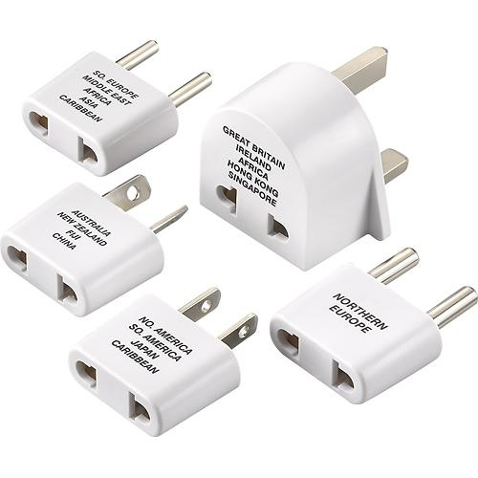

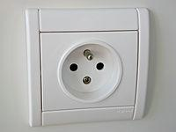
Adapters
Your Existing System
Adapter
External System
Adapter implements the interface your class expects.
And talks to the external class to service requests.
Notes:
Here’s the real world analog. Say you get to the another country and pull our your laptop charger. It doesn’t go into the outlet. Different countries, different standards for how you convey electricity. Well, you’re not going to shove it in there, so you get an adapter. (click) So, you Plug your American charger into one end, plug the other end into the outlet, and bam - it works. Some adapters are simple - they just change the shape of the plug. Others are more complex and convert one voltage type into another, but the idea is the same. You don’t change the outlet or the charger, but instead, put something in between them to make it work. (click 2) We want to do the same thing with our software. We don’t want to change our code, and we can’t change the vendor’s code (click 3) so we write a class that sits between the two and turns the adapter interface into the one we’re expecting. The adapter implements the interface your class expects and talks to the vendor interface to serve requests. It acts as a middleman, a piece of new code that enables you to use your existing system and the external code without making any changes to what you already have.Sound familiar? We just covered the Decorator Pattern, where you wrap classes to add functionality. The Adapter pattern wraps classes in a similar manner to change how you access the existing functionality. It wraps an interface around a object to change how we call the underlying functionality. This is basically a special case of decorator where we don’t add behavior, generally, but just change how we access existing behavior

Slide 37
Adapter Example
<<interface>> Robot
move()
shoot()
<<interface>>
ExplorationDrone
move()
inspect()
RobotAdapter
ExplorationDrone adaptee
move()
shoot()
TankBot
move()
shoot()
SubmarineDrone
move()
inspect()
Notes:
Now, we’re back to the robots we had at the start. We have a robot interface that says all robots move and shoot. We want to add in more types of robots, and there is code available for some unarmed exploratory drones - things that can survey and look at environments, but don’t fight. Those will do the trick. But, they aren’t quite the same as the robots we have already. They don’t shoot, they inspect objects. So, they are similar, but don’t offer the same interface. We might not be able to rewrite the drone code - they might just come in as objects from an imported library. We might not want to rewrite our robots either, they still don’t inspect. But, we can write an adapter that allows us to map the two. (click) The robotAdapter implements the interface of the type we’re adapting to. It stores a reference to the object we are adapting. Then, we implement the methods in the interface, translating to the versions we want to access in the adaptee class. This case is easy - shoot just calls inspect move can just call move - but this allows a similar idea to the Decorator pattern, we can take an existing class, wrap an adaptor around it, and modify its functionality to be compatible with our system and its needs.

Slide 38
The Adapter Pattern Defined
Converts an interface into interface client expects.
Adapter’s methods call corresponding methods from adaptee.
If adaptee changes, only the adapter needs to change.
No changes needed to classes that call adapter.
Your Existing System
Adapter
External System
Notes:
Adapter Pattern converts the interface of a class into the interface the client expects. Adapters let classes work together that despite incompatible interfaces. The pattern allows us to use a client with an incompatible interface by creating an adapter that does the conversion. This acts to decouple the client from the implemented interface, and if that interface ends up changing over time, the adapter encapsulates the change so that the client doesn’t need to be modified every time it needs to operate against a different interface. This is a big deal for code reuse, allowing us to build a system out of independent external code far more easily. Now, that example had the adapter wrapped around one adaptee - the turkey was adapted to match the interface of a duck.

Slide 39
The Adapter Pattern
Adapter implements target interface.
Client
<<interface>> Target
request()
The client sees only the target interface.
Adapter
Adaptee adaptee
request()
Adaptee
specificRequest()
Requests get delegated to Adaptee.
Adapter composed with Adaptee.
Notes:
Here is what the pattern looks like in the abstract.
- (read bubbles)
Lot of good OO principles at work here. We use object composition to wrap the adaptee with an altered interface. We can even use the adapter with any subclass of the adaptee. This pattern binds the client to an interface, not a particular implementation. We could even write several, situationally-appropriate adapters, each converting a different backend set of classes.

Slide 40
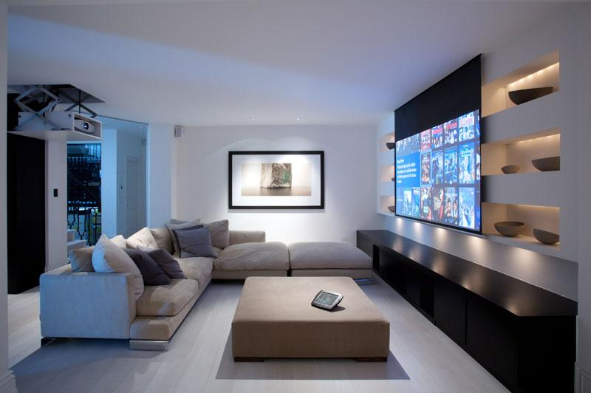
Watching a Movie
To watch a movie, we need to perform a few tasks:
Turn on the popcorn popper.
Start the popper.
Dim the lights.
Put the screen down.
Turn the projector on.
Set the projector input to blu-ray.
Put the projector on widescreen mode.
Turn the sound amplifier on.
Set the amplifier to blu-ray input.
Set the amplifier to surround sound.
Set the amplifier volume to medium.
Turn the blu-ray player on.
Start the blu-ray.
Notes:
Lets look at another situation. (read). This is a lot of work, and involves interacting with six different devices. And it doesn’t end here. When the movie is over, how do we turn everything off? Same steps in reverse order? Would it be as complex to listen to Spotify or the radio? If you upgrade the system, would we need to learn a different startup procedure? Maybe we could make this a bit easier?

Slide 41
Wrapping Classes
The Adapter Pattern converts the interface of a class into one the client is expecting.
The Decorator Pattern doesn’t alter an interface, but wraps classes in new functionality.
The Facade Pattern simplifies interactions by hiding complexity behind a clean, easy-to-understand interface.
Wrapping classes into a shared interface.
Notes:
The Adapter Pattern converts the interface of a class into one the client is expecting. The Decorator Pattern doesn’t alter an interface, but wraps classes in new functionality. There’s a third pattern, a closely related one that can help with this exact situation. The Facade Pattern simplifies interactions by hiding complexity behind a clean, easy-to-understand interface. The point of the pattern is to wrap a set of classes into one shared interface.

Slide 42
The Facade Pattern
Create a new class that exposes simple methods (the facade).
Facade calls on classes to implement high-level methods.
Client calls facade instead of classes.
Classes still accessible.
HomeTheater
Facade
startMovie()
endMovie()
startSpotify()
endSportify()
startRadio()
endRadio()
Amplifier
BluRayPlayer
Tuner
Stereo
Lights
Projector
Screen
PopcornMaker
Notes:
So, what we want to do is Create a new class HomeTheaterFacade that exposes a few simple methods., things like startMovie or startSpotify() - high level things - functionality - we might want to perform using this set of underlying classes. Facade treats the home theater components as a subsystem and call on the subsystem to implement its methods. so, rather than includingthat sequence of commands to start a movie, you take those and implement them once in a method in the facade, then never have to reuse that whole sequence again when using the system later, just call the method in the facade instead. Client code calls methods on the facade instead of the individual subsystem classes, so it acts as an interface. We no longer have to communicate directly with the amplifier or the lights, we can communicate through the facade, reducing coupling on the individual classes of the system. Facade still leaves the individual classes accessible to use directly.. If you need the advanced functionality, it’s still there and ready to be used, but the rest of the time, it simpifies our code and decouples the subsystem from the client code, easing change - if change occurs, we can change the facade instead of client code calling into the individual classes.

Slide 43
The Facade Pattern Defined
Provides a unified interface to a set of classes.
Facade defines a high-level interface that makes a subsystem easier to use.
Provides an additional method of access.
Multiple facades may provide situational functions.
Decouples client from any one subsystem.
Notes:
The Facade Pattern provides a unified interface to a set of classes in a subsystem. Facade defines a higher-level interface that makes the subsystem - the collected set of classes- easier to use.
There is no encapsulation going on here, no hiding of information. Instead, we’re just offering one more method of access. This is a nice property of the Facade pattern - we provide a simplified interface while still exposing the full functionality of the system to those who want it. Multiple facades may be defined for the same subsystem - the same classes - even to provide different situational functions. This Decouples the client from any one subsystem. Say you add a new home theater component. You just need to change the facade, rather than the code in the client system.

Slide 44
The Facade Pattern
Client
Facade
// Methods
Subsystem Classes
Notes:
In terms of the class diagram, this is dead simple. A client is associated with the Facade, which acts as a layer between the client and a potentially complicated web of subsystem classes. There isn’t much more to it than this, but the idea is a powerful one. This tells us loud and clear the intent of the pattern - putting a simplified, changable interface between your code and a complex, highly coupled set of classes. This leads us into another important design idea.

Slide 45
The Principle of Least Knowledge
Talk only to your immediate friends.
Be careful of the number of classes your class interacts with and how it interacts with them.
Only invoke methods that belong to the object, objects passed as parameters, objects created or instantiated, and attached objects.
Notes:
That is the principle of least knowledge - talk only to your immediate friends. Reduce the number of interactions between objects whenever possible. When designing a class, be careful of the number of classes it interacts with and how it comes to interact with them. This prevents us from creating designs that are highly coupled together. When you have a lot of dependencies, you’re building a fragile system that will be expensive to maintain and complex for others to understand. We Only invoke methods that belong to the object itself, objects passed in as parameters, objects the method creates or instantiates, and components of the object. The Facade Pattern maintains this idea by ensuring that the client only has one friend, the Facade. One friend is a good thing. The Facade keeps the client simple and flexible by managing the subsystem components for the client - it adds in this simple interface layer, and we only need to worry about understanding what that interface offers. We can upgrade the home theater -change how blu-rays are played - without upgrading the code in the client that does things with that theater, like watching the blu-rayss.

Slide 46
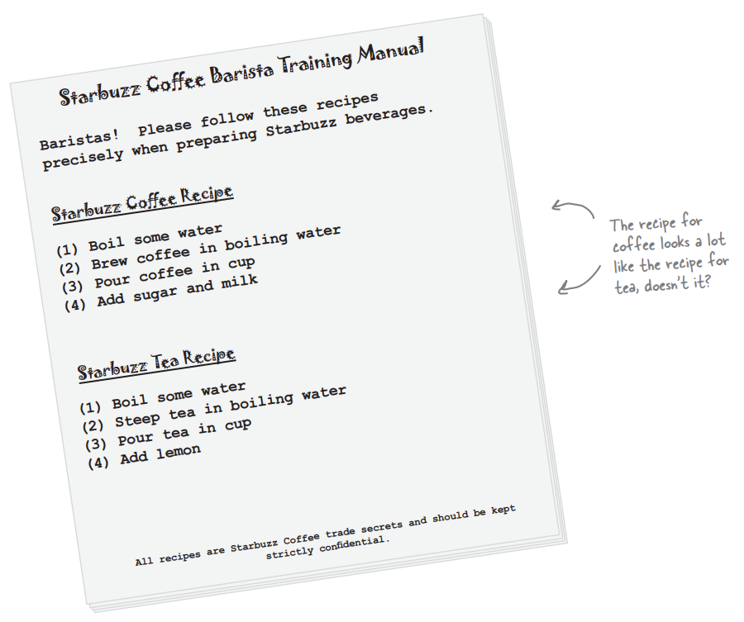
Coffee and Tea
Notes:
A little earlier, we talk an awful lot about this coffee shop. Some of us can’t live without our coffee. Well, some of us are tea maniacs instead. And, as it turns out, coffee and tea are made in a very similar way. (go over recipe)

Slide 47
Coffee and Tea (In Code)
Coffee
prepareRecipe()
boilWater()
brewCoffeeGrinds()
pourInCup()
addSugarAndMilk()
Tea
prepareRecipe()
boilWater()
steepTeaBag()
pourInCup()
addLemon()
void prepareRecipe(){
boilWater();
steepTeaBag();
pourInCup();
addLemon()
}
void prepareRecipe(){
boilWater();
brewCoffeeGrinds();
pourInCup();
addSugarAndMilk()
}
Notes:
So, let’s see how these might look in a system built to brew both. Coffee - go over. prepareRecipe just steps through each stage of the preparation process - each in its own method. Now, let’s look at tea. The second and fourth steps are different, but these are very similar processes. It’s basically the same recipe. We have some code duplication going on here. When we have duplication, that’s a good sign we need to clean up the design. First inclination - right - we should take common steps and abstract them into a base class and inherit those common steps.

Slide 48
Coffee and Tea (In Code) - Take 2
CaffeineBeverage
prepareRecipe()
boilWater()
pourInCup()
Coffee
prepareRecipe()
brewCoffeeGrinds()
addSugarAndMilk()
Tea
prepareRecipe()
steepTeaBag()
addLemon()
Notes:
Your first redesign might look like this. BoilWate and PourInCup are common, so they are implemnted in the parent and we declare an abstract method prepareRecipe that each child must implement - in addition to new behaviors unique to those children. Did we do a good job on the redesign? Are we overlooking some other commonality? Are there other ways that coffee and tea are similar, that we can take advantage of?

Slide 49
Back to the Recipes
Algorithm
Boil some water.
Use hot water to extract the beverage from a solid form.
Pour the beverage into a cup.
Add appropriate condiments to the beverage.
Steps 1 and 3 already abstracted into base class.
Steps 2 and 4 not abstracted, but are the same concept applied to different beverages.
Notes:
What else do coffee and tea have in common? Let’s look at the recipes. Both recipes follow essentially the same algorithm. (algo and bullets)
So, can we find a way to abstract prepareRecipe() too?

Slide 50
Abstracting prepareRecipe()
Coffee: brewCoffeeGrinds(), addSugarAndMilk()
Tea: steepTeaBag(), addLemon().
Steeping and brewing aren’t all that different (brew()).
Adding sugar is like adding lemon (addCondiments()).
void prepareRecipe() { boilWater(); brew(); pourInCup(); addCondiments(); }
Notes:
(go over). So, now we have a new prepareRecipe method.

Slide 51
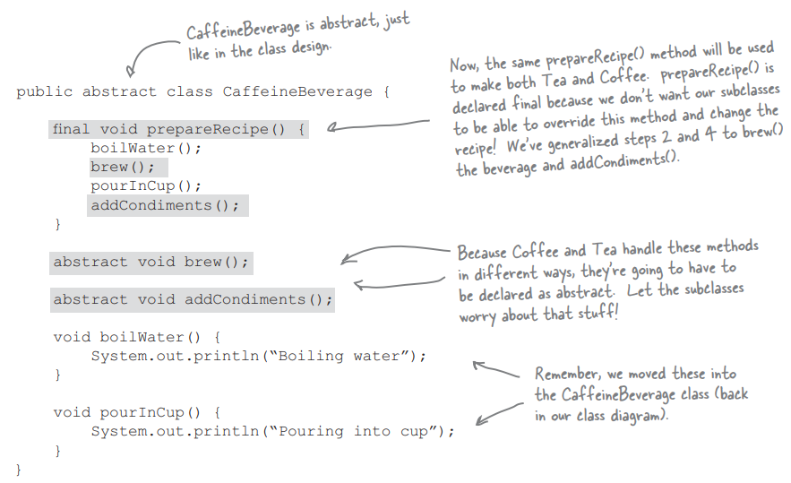
Our Redesigned Code
CaffeineBeverage
prepareRecipe()
brew()
addCondiments()
boilWater()
pourInCup()
Tea
brew()
addCondiments()
Coffee
brew()
addCondiments()
Notes:
(go over caffeinebeverage - base class, abstract brew/add, prepareRecipe protected from being overridden)
Then, we need to deal with Coffee and Tea classes. They now rely on CaffeineBeverage to handle the recipe, so they just need to handle brewing and condiments

Slide 52
What Have We Done?
Two recipes are the same, although some steps require different implementations.
Generalized recipe into a base class.
CaffeineBeverage controls the steps of the recipe. It performs common steps itself.
(encapsulating what does not change...)
It relies on subclasses to implement unique steps.
(... from what does change)
Notes:
(title) We’ve recognized that two recipes are essentially the same, although some of the steps require different implementations. We have generalized the recipe and placed it in a base class. CaffeineBeverage knows and controls the steps of the recipe. It performs common steps itself. (encapsulating what does not change...) It relies on subclasses to implement unique steps. (... from what does change)

Slide 53
The Template Method Pattern
prepareRecipe() is our template method.
Serves as a template for an algorithm.
Each step is represented by a method.
Some methods handled by the base class, others by the subclasses.
The supplied methods are declared abstract.
Notes:
We’ve just implemented the TemplateMethod Pattern. - a behavioral pattern- (1) It is a method and it serves as a template for an algorithm. In this case, an algorithm for making caffenated beverages. In the template, each step of the algorithm is represented by a method. Some methods are handled by the base class, others are handled by subclasses that we plug in. The methods that need to be supplied by a subclass are declared abstract. The Template Method defines the steps of an algorithm and allows subclasses to provide the implementation for one or more steps.

Slide 54
What Does the Template Method Get Us?
Original Implementation
Coffee and Tea control algorithm.
Code duplicated in Coffee and Tea.
Changes to algorithm require changes to the subclasses.
Classes are organized in a structure that requires more work to add a new beverage.
Knowledge of algorithm and how to implement it distributed over multiple classes.
Template Method:
CaffeineBeverage controls and protects the algorithm, implements common code.
Algorithm lives in one place and changes only made there.
Template Method allows new beverages to be added. They implement specialized methods.
CaffeineBeverage class contains all knowledge about algorithm, relies on subclasses to provide implementations.

Slide 55
The Template Method Pattern
Defines skeleton of an algorithm in a method, deferring some steps to subclasses.
Lets subclasses redefine steps of an algorithm without changing the algorithm’s structure.
A template defines an algorithm as a set of steps.
Abstract steps are implemented by subclasses.
Ensures algorithm’s structure stays unchanged.
Notes:
The Template Method Pattern defines the skeleton of an algorithm in a method, deferring some steps to subclasses. Template Method lets subclasses redefine certain steps of an algorithm without changing the algorithm’s structure. A template is a method that defines an algorithm as a set of steps. Abstract steps are implemented by subclasses. Ensures the algorithm’s structure stays unchanged. again, providing encapsulation for what does not change and letting you append what does change - in subclasses that provide part of the implementation.

Slide 56
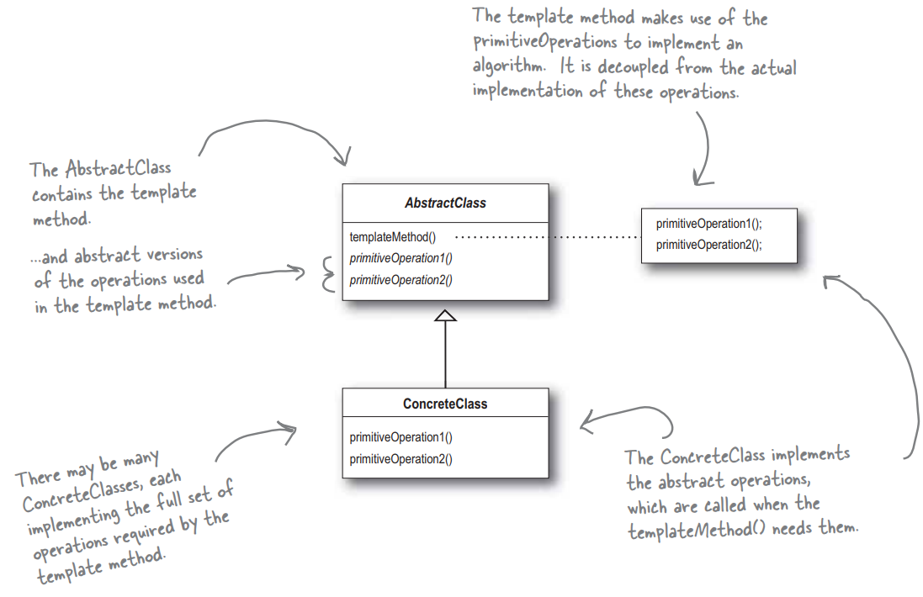
Template Method Pattern

Slide 57
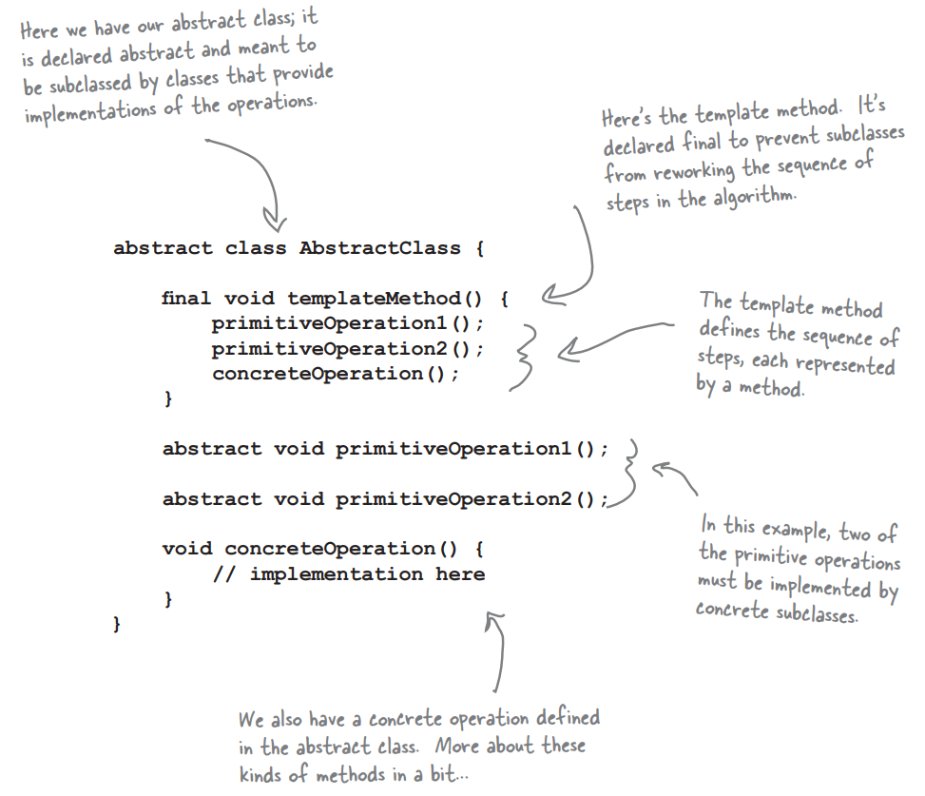
Looking Inside the Code

Slide 58
Adding Hooks
CaffeineBeverage
prepareRecipe()
brew()
addCondiments()
boilWater()
pourInCup()
wantsCondiments()
Tea
brew()
addCondiments()
Parent defines concrete default implementations (hooks).
Subclasses can override, but do not have to.
Gives subclasses ability to “hook into” the algorithm.
Coffee
brew()
addCondiments()
wantsCondiments()
getUserInput()
void prepareRecipe(){
boilWater();
brew()
pourInCup();
if(wantsCondiments()){
addCondiments();
}
}
boolean wantsCondiments(){
return true;
}
boolean wantsCondiments(){
String answer = getUserInput();
if answer.equals(“yes”)
return true;
else
return false;
}
Notes:
The parent class can define concrete methods that are empty or have a default implementation (called hooks). Subclasses can override these, but do not have to. This Gives subclasses the ability to “hook into” the algorithm if they wish. We’ve added a little conditional statement into the recipe that bases its success on a concrete method wantsCondiments. If the customer wants a condiment, only then do we add condiments. We’ve defined a method with a mostly empty default implementation - it just returns true and does nothing else. This is a hook because the subclass can override the method but doesn’t have to. The tea class does not override it - we get condiments whether we want them or not. In Coffee, we are going to override the method and ask the user if they want condiments- through an additional method that is not part of the core algorithm.

Slide 59
The Hollywood Principle
Don’t call us, we’ll call you.
Prevents “dependency rot”.
High-level components depend on low-level components, low-level depend on high level.
Allows low-level components to hook into a system, but high-level components decide when and how they are needed.
Notes:
As it turns out, this is another design principle: the hollywood principle (1). What does this have to do with OO development? Prevents “dependency rot”. When high-level components depend on low-level components, and those components depend on high-level components, etc, etc. Creates a cycle between high and low level. When you have dependency rot, it is hard to understand how a system is designed. The Hollywood Principle allows low-level components to hook into a system, but the high-level components decide when and how they are needed. This prevents a circular dependency. In other words, high-level componentes give the low-level components a “don’t call us, we’ll call you” treatment. When we design with the template method, we tell subclasses “don’t call us, we’ll call you” - CaffeineBeverage has control over the algorithm, and calls subclasses only when they are needed for an implementation of a method. The low-level subclasses are used simply to provide implementation details, and Tea and Coffee - the low-level classes - never call the CaffeineBeverage -the high level class - directly without being called first. Clients of beverages will depend on the CaffeineBeverage abstraction rather than a concrete coffee or tea, which reduces dependencies in the overall system.

Slide 60
Principles of Design
Identify aspects that vary and encapsulate them away from what doesn’t.
Program to interface rather than implementation.
Favor composition over inheritance.
Open for extension, but closed for modification.
Talk only to your immediate friends.
Don’t call us, we’ll call you.
Notes:
these patterns capture several design principles that allow evolution and variability without increasing complexity.
1 - (read). This is the big one, what almost all of OO design is based on. Take the parts of the program that will change and deparate them as much as possible from what doesn’t change much. Keep them loosely coupled, then changes won’t wreck your system.
2 - (read) - If you plan to have multiple objects that are similar, but vary a little in the details, either design a superclass or an interface that all of the specialized child classes adhere to. If you’re designing a system with multiple duck types, ensure they all offer the same types of operations using the same invocation style. Even if they make different noises when they quack, make them all quack using the same interface. That way, we can design the system to not require knowledge of the individual types.
3- although inheritance is a powerful feature, passing along a type and a set of methods - it can be rigid. The children must accept all functionality passed from the parent, and the abilities passed along are determined statically at compile time. By using composition to build a class, we dynamically extend the abiities of an object at run time by attaching other objects to it. We can still write functionmality once and change it in once place, but without the rigidity of inheritance.
4- This feeds directly into the open-closed principle. (read). We want to be able to extend the abilities of a class in the future, but we want to do so as much as possible without having to alter the existing code. The existing code has been debugged, and if we have to rewrite it to add new functionality, then we’re probably going to add new bugs into code we thought was working. 5- (read) - When designing a class, be careful of the number of classes it interacts with and how it comes to interact with them. Avoid coupling.
6- (read), The Hollywood Principle allows low-level components to hook into a system, but the high-level components decide when and how they are needed. This prevents a circular dependency. The low-level subclasses are used simply to provide implementation details, never call the high level class directly without being called first. Clients ]will depend on the high level abstraction rather than a concrete low level implementation, which reduces dependencies in the overall system.

Slide 61
Why not use a design pattern?
What are the drawbacks to using patterns?
Potentially over-engineered solution.
Increased system complexity.
Design inefficiency.
How can we avoid these pitfalls?
Notes:
(participation) Patterns aren’t a magic bullet. You can’t just plug one in, compile, and go out for coffee. You need to consider the consequences of patterns on your design.
To avoid - consider when to use and when not to use patterns. Better to be a good OO designer. Don’t overcomplicate is a simpler soution will work.

Slide 62
We Have Learned
Design patterns allow implementation and management of variability in code.
Strategy Pattern encapsulates interchangeable behaviors and uses delegation to decide which to use.
Factory Pattern encapsulates object creation so system doesn’t need to know what type of object was created.
Decorator Pattern wraps an object in another to provide new behavior without code changes.
Notes:
(1) Design Patterns take these principles and show us how to realize them within our software. They take common situations in software design and offer tips on how to build your system such that those principles hold. We’ve covered a set particularly suitable to product lines and other systems built aroudn asset reuse. (go oveR)

Slide 63
We Have Learned
Design patterns allow implementation and management of variability in code.
Adapter Pattern wraps object in a new interface.
Facade Pattern wraps a set of classes in simplified interfaces.
Template Method Pattern encapsulates pieces of algorithms so that subclasses can hook into a computation.
Notes:
(1) Design Patterns take these principles and show us how to realize them within our software. They take common situations in software design and offer tips on how to build your system such that those principles hold. We’ve covered a set particularly suitable to product lines and other systems built aroudn asset reuse. (go oveR)

Slide 64
Next Time
Modularity
Frameworks and Libraries
Assignment 2
Questions?

