Slide 1
Lecture 4: Testing Fundamentals
Gregory Gay
DIT636/DAT560 - January 28, 2026

Slide 2
Verification
Ensure that the implementation conforms to a specification.
  Under the examined conditions, does the software work as expected?
Proper V&V produces dependable software.
  Testing is the primary verification activity.
Notes:
In the first lecture, we covered broadly, the topic of verification - the practice of ensuring that an implementation matches with its specification. This is essentially a way of gathering evidence that we are building robust, dependable software. It allows us to answer the question of whether the software we built functions correctly, at least according to our understanding of how it should work. We will spend this study period focusing on verification - as a good V&V process is how we can produce software that is dependable. As it turns out, if you spend time ensuring the implementation works correctly, it ends up working correctly. Testing is the primary verification activity.

Slide 3
We Will Cover
What is testing?
  Definitions and components of a test case
  Testing stages
  Planning considerations
Notes:
This means we need to talk about what testing is. Today, we are going to continue out lay out the foundations that this class is based on, introducing the fundamentals of testing. (read)

Slide 4
Software Testing
Test Input
Experimental investigation of system quality.
Based on sequences of stimuli and observations.
  Stimuli that the system must react to.
  Observations of system reactions.
  Verdicts on correctness.
SUT
Output
Test Oracle (Expected Output)
Verdict (Pass/Fail)
Notes:
What is testing? Testing is fundamentally a scientific and systematic investigation, a set of experiments we conduct to o assess the quality of the system being developed - the search for deviations from an expected set of behaviors. (2) We create a series of (3) we pass input to an API, or create environmental conditions that the system must react to. We poke it and see what it does We record observations, noting how the system reacted to the stimuli. We mark down the output, actions taken, internal state, power consumption values, anything that we can use to analyze the system behavior, then we use that to (read 5) You compare your obervations against pre-recorded expectatins - what we call an oracle - and we then issue a verdict. Pass if everything matched, fail if it did not.

Slide 5

Bugs? What are Those?
Bug is an overloaded term.
  Does it refer to the bad behavior observed?
  Is it the source code
  mistake that led to that behavior?
  Both?
Notes:
Now - at this point, there are a lot of terms floating around for “there’s something wrong with the software”. Defect, fault, bug. Bug is a super common term, but it is also a problematic one. We need to be exact in what we’re talking about. We use the term bug when talking about bad software behavior, but what exactly is a bug? What is that referring to? (read)

Slide 6

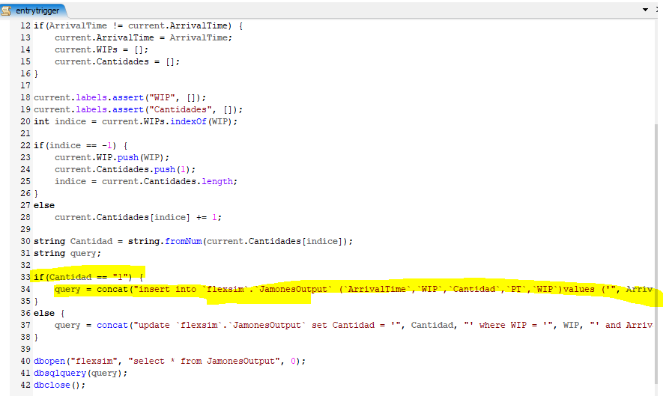
Faults and Failures
Failure
  An execution that yields an
  incorrect result.
Fault
  Problem that caused failure.
  Mistake, omission, misuse
When we observe a failure, we try to find the fault.
Notes:
Instead, to be clear about our meaning, there are two concepts that we will reason about in testing - faults and failures. (1-2) A crash, a graphical glitch, the wrong answer being printed to the screen - any observed problem. This is caused by a fault (4-5) of items in the code that led to the wrong answer, like we made bad assumptions about a method we called So, when we test, our goal is to find and fix faults. We want to witness failures, then from there, try to find the fault that caused it. Testing is intended to expose faults. To identify a fault, we generally have to witness a failure. Keep this distinction in mind - its important to differentiate the problem we witness from the code mistake that caused it.

Slide 7
Software Testing
The main purpose of testing is to remove faults:
“Testing is the process of trying to discover every conceivable fault or weakness in a work product” - Glenford Myers
Tests must reflect normal and abnormal usage.
Notes:
So, of course, the goal of testing (read)
There are many ways to design tests, but generally, you start from one of two points of view - you want to design tests that both reflect normal usage and shows that the system does what you expect - verification - and that reflects extreme events or boundary events that reflect the system’s resilence to the unexpected.

Slide 8
Testing Scenarios
Verification:
  Demonstrate that software meets the specification.
  Tests tend to reflect “normal” usage.
Robustness:
  Show that software can handle abnormal situations.
  Tests tend to reflect extreme usage or hazards.
    Large volume of data, null data, malformed data, attacks.
Notes:
This shapes the kind of scenarios we cover when designing tests and choosing our input and oracles. Tests can be used as a form of verification - to demonstrate to the developer and the customer that the software meets the specification. In this case, your tests reflect how uses will generally interact with the system. You take the requirements of the system, and develop scenarios that show each is met in the different circumstances defined. This includes error handling and normal situations. In the second case, you’re apporaching testing with the goal of tearing this system apart and showing whether it can handle misuse. In that case, you tend to force the system to react to extreme or abnormal situations - things that most users might never try, but attackers would, or corner cases, or malformed inputs, and other potential hazards like a power or network loss. Resilience is concerned with rooting out crashes, unwanted interactions with other systems, security flaws, data corruption - unsual and extreme situations. There is no clear boundary between the two goals. Both will identify faults, both can help show the requirements are met. But, you will design tests for both goals, and they’ll look a little different

Slide 9
Axiom of Testing
“Testing can be used to show the presence of bugs, but never their absence.”
- Dijkstra
Notes:
Now, the real limitation of testing, the real thing to keep in mind is that (read).
You cannot test a system exhaustively. Any system of any reasonable size will have a nearly-infinite number of input combinations. There is not enough time in the universe to exhaustively test a program. Testing is an optimization problem - given our time, our budget, what can we do to maximize our chances of discovering problems before we hand this off to the users.

Slide 10
What Goes in a Test Case?
Notes:
How do we assess quality? One popular way is to use what we call scenarios.

Slide 11
Test Suite and Test Case
A test suite is a collection of test cases.
  Executed together.
  Each test case should be independent.
May have multiple suites in one project.
    Different types of tests, different resource/time needs.
Suite
Case
Case
Case
Case
Notes:
A test suite is a deliberately built collection of test cases that are intended to execute together. However, each test case should be independent from the others. You may have multiple suites for one project, executed at different times and for different purposes. In large-scale projects, it is common to have multiple suites because the full suite takes a long time to execute. In that case, you might run that overnight or over the weekend, but have a smaller suite that runs in your CI system when code changes are checked in. It is common to have different types of tests in their own suites - like tests you run on changed code that was tested in the past already versus new code.

Slide 12
Anatomy of a Test Case
(I₁ O₁) (I₂ O₂ ) (I₃ O₃)
if O_{n} = Expected(O_{n})
then… Pass
else… Fail
Test Inputs
How we “stimulate” the system.
Test Oracle
How we check the correctness of the resulting observation.
Notes:
To test a system, to conduct that investigation, you build test cases. The two most important components of a test case are two things.
You need to come up with inputs. You need a plan on how you’re going to draw out issues.
you need some way to tell if the observed behavior was the right behavior. To know that there is a problem, you need to know what good behavior looks like. That’s where the test oracle comes in, with expectations on what should happen when we run that input

Slide 13
Anatomy of a Test Case
Initialization
  Any steps that must be taken before test execution.
Test Steps
  Interactions with the system, and comparisons between oracle and actual values.
Tear Down
  Any steps that must be taken after test execution.
Notes:
When building a test case, there are also three other things we need to include (read)
Five items - input, oracle - AKA our expected output -, initialization, test steps where we apply that input and check the results using the oracle, and tear down. Regardless of the testing framework - JUnit, Selenium, Postman, quickcheck, and so on - we have these items in some form. We will look at different realizations of this idea, but the core idea is the same across the board.

Slide 14
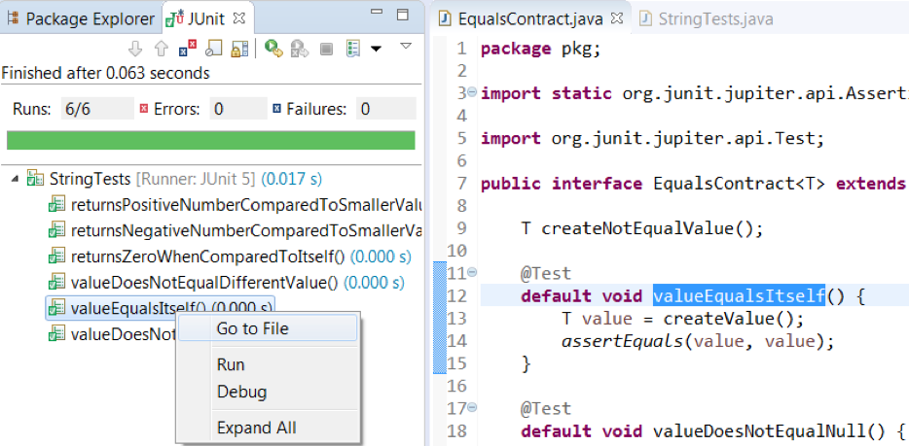
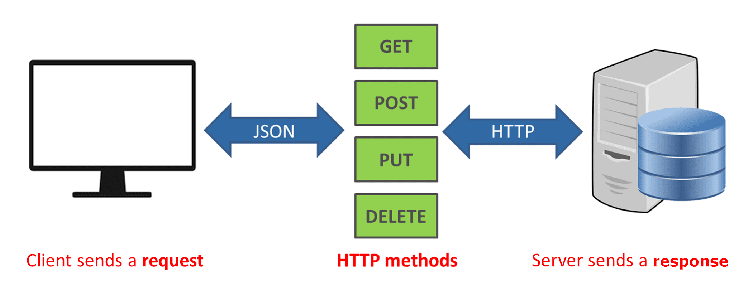
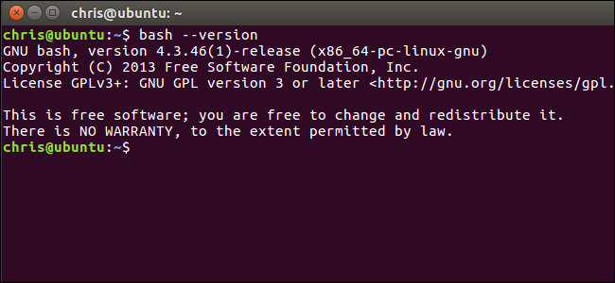

Test Input
Interactions with a software feature.
  Invoke a function through an interface.
    Method Call
    API Call
    CLI Interaction
    GUI Interaction
Notes:
What are test inputs? (1) deliberate, planned. There are many means of interacting with software, however. Most of the time, this is an activation of a software feature at some level of granularity, where we provide pre-planned information to a function surfaced by an interface. Whether that is a method call to a particular class or to the interface of an internal subsystem, a request to a REST API, an interaction through the command line or with a GUI where we click, swipe, and type into boxes.

Slide 15


Test Input
Environment manipulation
  Database with particular records
  Simulated network environment
  Create/delete files
  Available CPU/memory/disc space
Timing
  Before/at/after deadline
  Varying frequency/volume of input
Notes:
However, it’s important to remember that test input is not just calls to the program, but also deliverate manipulation of the environment around that program. It also includes things like (2-5). It also includes deliberate timing choices, like choosing to apply an action before a deadline, right at the deadline, or after that deadline to see what changes. It also includes how many times you apply and input or how often, or what kind of volume of input you include.

Slide 16
Test Execution
Human-driven
  Exploratory testing, alpha/beta testing
Automated
  Tests written as code
    Testing frameworks (JUnit)
    Frameworks for manipulating interfaces (Selenium)
  Capture/replay tools
    Re-execute UI-based tests (SWTBot for Java)

Slide 17
Sources of Test Input
Functional Testing (Black Box)
Structural Testing (White Box)
The sort function shall output an array of integers, sorted in ascending order from smallest to largest.
public int[] sort (int[] unsorted){
…
if (unsorted[x] <= unsorted[y]) {
…
}
…
}
True
False
Test Cases
Test Cases
Test Cases
Test Cases
Test Cases
Test Cases
Test Cases
Test Cases
Test Cases
Test Cases
Notes:
First, some preliminaries. As mentioned last time, When we design test cases, we want to show that the program either operates correctly, or that it meets some other desired aspect of quality - such as meeting a performance goal. To do that, we need to interact with the program - make it perform an action that will show it meets our goals. There are two fundamental sources of information that we use, what we call functional, or black box, testing and structural, or white box testing. In functional testing, we use the requirements, design documents, code comments, or other sources of program information to design test cases - that is, we use information that describes how the code should act, and we design test cases to show that it does exactly that. In structural testing, we use the code itself as a source of information. We take checklists - called coverage criteria - and they tell us to take the code and make sure it is run in specific ways, like getting a true and false outcome for each if statement - and we make sure we do so in our test cases.

Slide 18
Sources of Input
Functional (Black Box) Test Design
  Use documentation of system behavior to design tests.
    Requirements, comments, user manuals, intuition.
  Reflects what code should do, not what it currently does.
    Treated as a “black box”: input -> code -> output
  Normal form of test design.
    Complemented by structural testing.
  Tests can be designed before code is written.
    (test-driven development)
Notes:
Functional testing is the standard mode for test design. We use these requirements, documentation, bug reports, and so on to design tests based on this knowledge of what the code should do. If the tests pass, then the code is working as it should, based on our ideas of how it should function. In this mode, we treat the program itself as a box that input goes into and output comes from. We try not to be biased by what the code actually does. Again, this is how we generally design tests, and structural testing serves as a complimentary source of information to flesh out the test suite. Since we often have requirements before a line of code has been written, we can start using that information to design tests before we even begin to write code. This leads to test-driven design, a major philosophy of agile processes, where we create tests for our code before we write that code - and know we did a good job if those tests pass.

Slide 19
Sources of Input
Structural (White Box) Test Design
  Input chosen to exercise code in specific way.
    Oracles still based on requirements.
  Usually based on adequacy criteria:
    Checklists based on program elements.
    Branch Coverage - All conditional statements evaluate to true/false.
  Fill in the gaps in functional test design.
Notes:
Structural, or White box, methods are based the structure of the source code that we wrote, and we design tests to deliberately execute the code in a particular way. Rather than looking at the requirements and saying that, well, this type of input should lead to this type of outcome - where we don’t really look into the code - we instead look at the if-statement on line 10 and say that we want input that makes this if-statement evaluate to true. Typically, white box testing is based on coverage of some part of the source code as prescribed by different checklists of goals. These checklists - called adequacy criteria - suggest that you will increase your likelihood of detecting faults if you ensure that the code itself is exercised in a particular manner. The most common of these are statement coverage - which says that all lines of code need to be executed at least once, and branch coverage - that says that all conditional expresions need to evaluate to all possible outcomes. All if-statements need to evaluate to true and false, all switch statements need to hit each case, and all loops need to run at least one cycle and exit. When we do this, the oracles - the expected output - are stil based on the requirements. So, if the code does the wrong thing, we still detect it. This is important for filling in the gaps left by functional test design, which may not have forced all of the code in place to run in the first place - e.g., we may lack requirements for some code. These adequacy criteria suggest weaknesses in our test suite that we can plug by adding more test cases. These criteria also can generally be measured by tools, give a good stopping place for testing, and can serve as the basis for automated input generation.

Slide 20
Test Oracle
Comparison of observations to expectations.
  Expected output, timing, speed, energy use, ...
Calculate a pass or a fail verdict.
Can be specific to one test or more general.
Notes:
A test can be considered as a sequence of activities - a set of stimuli and observations, recorded in their order of occurrence. Any time we poke the system you watch how the system reacts. You can make observations of how the system behaves after receiving that input. You can keep track of all sorts of things - monitor anything that can be produced by or affected by the system - concrete output values, temporal properties of the execution, power and heat profiles of the software ,exceptions, data downloads and uploads, and so on. You can take down observations and use those to figure out whether there are problems. The oracle is what does this. The oracle takes in these observations and determines whether a given observation is acceptable or not, given some built-in data on what constitutes correct behavior. Oracles come in a surprising variety of forms. From a direct statement of, given input x, the result should be y to a state machine or a set of general properties. they can also be specific to a single test, stating exactly what should happen for that input or more general, applying to multiple tests or even all tests.

Slide 21
Test Oracle Components
Oracle Information
  Embedded information used to judge the correctness of the implementation, given the inputs.
Oracle Procedure
  Code that uses information and observations to calculate a verdict.
    if (actual value != expected value) { fail (...); }
    assertEquals(actual value, expected value);
Notes:
When we talk about oracles, we talk about two aspects. first is the oracle information, the Information used by the oracle to judge the correctness of the implementation, given the inputs. - set of facts known by the oracle. This might be an explicit input to output table, or a set of assertions about behavior, or even a model that executes. This is a specification, presented in a form that can be read and used by the code. Second is the oracle procedure - this is code that takes the observations of program activity, compare them to the stored information, and arrives at a verdict. commonly this is as simple as an if statement or an assert statement - do these variables have the expected values? The oracle procedure is a form of automated verification - it takes the encoded specification, and ensures that the program conforms to it.

Slide 22
Expected-Value Oracles
Simplest oracle - what exactly should happen?
int expected = 7;
int actual = max(3, 7);
assertEquals(expected, actual);
Oracle written for a single test case, not reusable.
Notes:
So, most simple example - (read).

Slide 23
Property-Based Oracles
Assert properties about results to judge correctness.
Can be reused, but less precise than “expected output”
  Know less about any one I/O pair.
@Test
public void propertiesOfSort (String[] input) {
// Tests
String[] sorted = quickSort(input);
assert(sorted.size >= 1, "This array can’t be empty.")
for (int item = 1; item < sorted.length; item++)
assert(sorted[item] > sorted[item - 1], “Items
should be sorted in ascending order”);
}
Notes:
(read) - then see if the output - in whatever form it takes - obeys those properties. Rather than stating that the specific output for this input is X, we instead assert that X is always less than Y. If they are violated, the test fails. These are a little more general than expected value oracles - they work for any input to a particular function or at that stage of a scenatio. The downside is that they only tell us if the behavior is wrong if a property gets violated. There is a loss of precision - we don’t know as much about any one input/output paid. We might miss faults by not specifying enough or the right properties.

Slide 24
Implicit Oracles
General failures:
  Crashes and exceptions.
  Buffer overruns.
  Deadlock.
  Memory leaks.
  Excessive energy usage or downloads.
  Infinite loops.
Failures that do not require expected output.
Notes:
We also have what are called implicit oracles. (read). You don’t need to sit down and write out the expected output or properties when using one of these - instead, you’re checking for a particular type of problem, something that can happen to any program and you want to ensure that YOUR program never does. These oracles can be very general - look for crashes or thrown exceptions, or can be useful for specific types of anomalies and certain testing scenarios - for instance, they may be built to detect null pointer exceptions or security issues like buffer overrun or as part of performance testing to detect slow response time, data upload or download problems, power consumption problems, those kind of non-functional properties that can be measured and checked against thresholds. This might be how you realize those quality scenarios - just check for thresholds being crossed in performance or availablilty and so on with every test you run.

Slide 25
Testing Stages
Notes:
How do we assess quality? One popular way is to use what we call scenarios.

Slide 26
Testing Stages
API
GUI
CLI
We interact with systems through interfaces.
  APIs, GUIs, CLIs
Systems built from subsystems.
  With their own interfaces.
Subsystems built from units.
  Communication via method calls.
API
API
Notes:
We can break testing into independent stages that we stagger throughout the development process. These stages are largely built around different levels of granularity within the system under test. If we look at the system from the outside, it looks like this box. It has interfaces - maybe a GUI, maybe an API, maybe some kind of command line interface. However, there is also a lot going on inside. (click). The system as a whole tends to be architected, as we saw, as a set of larger indepedendent subsystems. Each of these has their own interface, and the subsystems communicate with each other through those interfaces. (click) then, within those, we have a bunch of individual, standalone UNITS (classes), all working together to produce the functionality offered by that subsystem, by calling methods in the other classes when needed - with methods forming another kind of interface. We need to test at all of these levels - class (or unit), subsystems, and the system as a whole.

Slide 27
Testing Stages
API
GUI
CLI
Unit Testing
  Methods of a single class
System-level Testing
  System (Integration) Testing
    (Subsystem-level) Collected units
    (System-level) High-level interfaces
  Exploratory Testing
    Ad-hoc GUI testing method
API
API
Notes:
Broadly, then, when we talk about testing, we talk about either unit-level testing or system-level testing, with a couple of distinct types of testing in there. (1) is where we tend to spend most of our testing time - we take small pieces of the system - units - the smallest chunk of system we can work with. Generally one class or a small cluster of classes. And we test those in isolation from the rest of the system. We take a class, and come up with tests for each of its methods. We try to isolate these units as much as possible - even faking the results passed from pieces of the system that we aren’t currently testing. Then we move up the ladder to what we collectively call system testing, which encomapsses three things. (click) Subsystem Integration Testing: We bring these units together - which have now been tested independently and we test their integration with each other - can they work together without breaking everything. Even if we’ve tested the individual units, faults can emerge from their combination, so we integrate the units together and test their combination and whether the subsystem as a whole can perform the functions that we stated in the specification. (click) Then we can test the system as a whole, through its high-level interfaces, to test the integration of the combined system to ensure that therre aren’t integration errors and that the product as a whole meets the requirements. This is System Integration Testing. (click) The third element of system testing is what we call exploratory or GUI testing - where we test from the direct perspective of a user, generally through a GUI, performing end-to-end journies through the system from the user perspective. System Integration Testing and exploratory testing tend to have a blurry line between them, and more come down to whether tests are executed through a GUI or a program-level interface like a REST API or through the command line. There are also other specialized forms of testing within each of these distinct levels, but these are our main focus in this class

Slide 28

Testing Stages
Acceptance Testing/
AB Testing
  Give product to a set of users to
  check whether it meets their needs.
    Alpha/Beta Testing - End-users, generally on their own machine.
    Acceptance Testing - Formal customers, in a controlled environment, formal acceptance criteria
Notes:
Finally, you hand off your product to some users and ask them to try it out . This is called acceptance testing, or commonly, ab or alpha/beta testing. (3-4) This is essentially part of both verification and validation - do the users like it? does it meet their needs? But, it can also expose more errors that the other forms of testing didn’t. Users will find new and interesting ways to break your system. (last point), where you work out formal acceptance criteria with the people who have contracted with you to develop the software.

Slide 29
Automation vs Human-Driven
Unit/System Testing heavily use automation.
  Tests written as code.
  Executed repeatedly, often on check-in.
Exploratory/Acceptance Testing often human-driven
  Based on scenarios, without pre-planned input.
  Some tool support, but not often repeated exactly.
Notes:
Unit and integration testing - both subsystem and system-level - tends to be done by writing executable test cases in an appropriate framework. For example, unit testing is almost always written as small test methods. These tests should be run over and over and over again. This means that they need to be executable without human involvement. This is easy to do, and there are appropriate frameworks for writing, running, and automating execution of tests for almost every language out there. Exploratory testing and acceptance testing are more often human-driven, with some tool support for recording what you did and capturing information about failures detected during the process. Exploratory and acceptance tests are less likely to be repeated in the exact same way. However, there are tools, like what we call capture and replay tools, that can capture human interactions and repeat them. Exploratory and acceptance testing are often based on pre-planned scenarios, rather than highly-specific input, and humans fill in the gaps using their intuition, often repeating scenarios with minor changes.

Slide 30
Let’s take a break.
Notes:
10 minute break

Slide 31
The V-Model of Development
Acceptance Test Plan
Requirements Elicitation
Operation and Maintenance
System and Exploratory
Test Plan
System Specification
Acceptance Testing
Subsystem Test Plan
Architectural Design
System and Exploratory Testing
Detailed Design
Subsystem Testing
Unit Test Plan
Unit Development and Testing
Notes:
Testing is something we work on throughout every stage of development. If we take that standard timeline of a project that we’ve looked over a few times now and flesh out the testing portion, here is what we’re left with. We start early - during requirements elicitation and system specification - we form a plan for how we can perform validation - how can we get acceptance from the users? During system specification, we figure out what behaviors we should see from the system as a whole - if we’re looking at that black box
and during the early stages of design - we figure out how our system ius broken down at the subsystem level and how to bring together those independent subsystems and look at how we can test those to ensure that their integration has not caused issues. During detailed class design - we figure what classes belong to each subsystem and how to test their integration. Then, during design and development, we both design and execute tests on the individual software units - individual methods of a particular class. Finally, once code is in place, we execute all of those tests we planned earlier. We bring modules together into subsystems and test them, then we bring the subsystems together and test their integration, then we bring our product to the users and ask them to use it. If they accept it, we can finally deploy the system into operation.

Slide 32
Unit Testing
Testing the smallest “unit” that can be tested.
  Often, a class and its methods.
Tested in isolation from all other units.
  Mock the results from other classes.
Test input = method calls.
Test oracle = assertions on output/class variables.
Notes:
Unit testing is the bulk of your testing. Unit testing is the process of testing the smallest isolated “unit” that can be tested. Often, a class and its methods or a small set of dependent classes that can’t be separated. There is a big emphasis here on isolation. Classes are often tightly interconnected, and when a problem occurs, it’s often hard to figure out where exactly the problem is coming from. You might even have faults in your class or a class that your class calls, and it only gets harder to isolate issues the more dependencies you have. It’s in your interest to try to test these units in as much isolation as is possible. So, what you do is you fake the results of method calls to other classes. This is called mocking, where you just return a pre-set value instead of actually calling another class. Test input for unit tests should be calls to methods with different input parameters. Our oracle then is made of assertions on either method output or the class variables that we can read the state of.

Slide 33
System (Integration) Testing
After testing units, test their integration.
  Integrate units in one subsystem.
  Integrate subsystems.
Test input through a defined interface.
  Subsystems: “Top-Level” Class, API
  System: API, GUI, CLI, …
Notes:
now we move up the hierarchy to integration testing. Most software works by combining multiple, interacting units, within multiple interacting subsystems. In addition to testing units independently, we must test their integration. Then, when the individual subsystems work in isolation, we bring them together again and test the integration of the subsystems. Functionality performed across units is accessed through a defined interface. So, our tests tend to be through the interface of the subsystem or the interfaces of the system as a whole.Therefore, integration testing focuses on showing that functionality accessed through this interface behaves according to the specifications. Interfaces come in many forms. At the subsystem level, we may still be talking about method calls. or we might have an actual API - especially if we are integrating a 3rd party microservice. It mighti nteract through its own REST API, for example. Then, of course, at the system level, we may not be calling methods, though it is possible. We might be calling an API, a command line interace, some kind of messaging queue, a command line interface, or any number of other ways we can interact with a whole system.

Slide 34
System Testing
Subsystem made up classes of A, B, and C. We have performed unit testing...
Classes work together to perform subsystem functions.
Tests applied to the interface of the subsystem they form.
Errors in combined behavior not caught by unit testing.
Test Cases
A
B
C
Notes:
(1), However, (2). Therefore, we apply test cases not to the classes, but to the interface of the subsystem they form.
Errors in their combined behavior - errors in the interface these combined objects form - are not caught by unit testing because they only emerge when you combine these objects together, when they interact at runtime.

Slide 35
GUI Testing
Tests designed to reflect end-to-end user journeys.
  From opening to closing.
  Often based on scenarios.
GUI Testing
  Deliberate tests, specific input.
  May be automated or human-executed.
Exploratory Testing
  Open-ended, human-driven exploration.
Notes:
When we test through the GUI, we design tests to reflect end-to-end journeys through the app from the perspective of the user, from launching to closing of the app. These are often based on usage scenarios, either the quality scenarios we came up with last class or user stories from our requirements process. GUI tests can either be formal and pre-planned, designed ahead of time with deliberate actions and input, or they can come in the form of expploratory testing, which is a more open-ended, free-form brainstorming exercise where we start with a scenario and come up with actions on the fly.

Slide 36
Exploratory Testing
Tests not created in advance.
Testers check the system on-the-fly.
Testing as a thinking idea.
  About discovery, investigation, and role-playing.
  Tests end-to-end journeys through app.
  Test design and execution done concurrently.
Notes:
EXPLORATORY TESTING is a type of software testing where Test cases are not created in advance but testers check system on the fly. They may note down ideas or come up with goals about what to test before test execution. The focus of exploratory testing is more on testing as a "thinking" activity. Exploratory Testing is widely used in Agile models and is all about discovery, investigation, and learning. You can try out different roles and user types. It emphasizes personal freedom and responsibility of the individual tester.
Last class, we talked about uni testing, this is a form of scripted testing where you design test cases first and later proceed with test execution. On the contrary, exploratory testing is a simultaneous process of test design and test execution all done at the same time. Often by directly using the software and its user interfaces

Slide 37
Exploratory Testing
Tester write down ideas to give direction, then create tests while using system.
  Requires minimal planning.
  Choose next action based on current state.
Can find subtle faults missed by formal testing.
  Allows tester to better learn system functionality, and identify new ways of using features.
Notes:
The tester will create or write down a test idea to give direction, and explore the system while testing to further create critical, practical and useful tests for the successful testing of an application. This requires minimal planning. Testers continuously make a decision on her next step of action. It completely depends upon the tester's thought process.
Sometimes this testing can be more beneficial than the formal testing approach for finding some subtle defects which go missing in formal testing.
A learner will learn better through hands-on experience rather than cramming the theory. Likewise, a tester will know the application better only while exploring and learning about all the functionality it provides by itself. It is always good to have a customer and business perspective while testing to ensure successful testing of an application.
For Example, if you open a shopping website, you have a general idea that this shopping website will let you shop by selecting a product of your choice and then paying for the same.
During this process, you might learn that you can order a number of products for home trial or that you can make payment through rewards points of some banks, etc. You can extend your testing to try these featurs.
As a tester, you not only need to verify whether a system is working as expected but also check if that system is not behaving in a way which is not expected. Exploratory testing can help find these gaps.

Slide 38
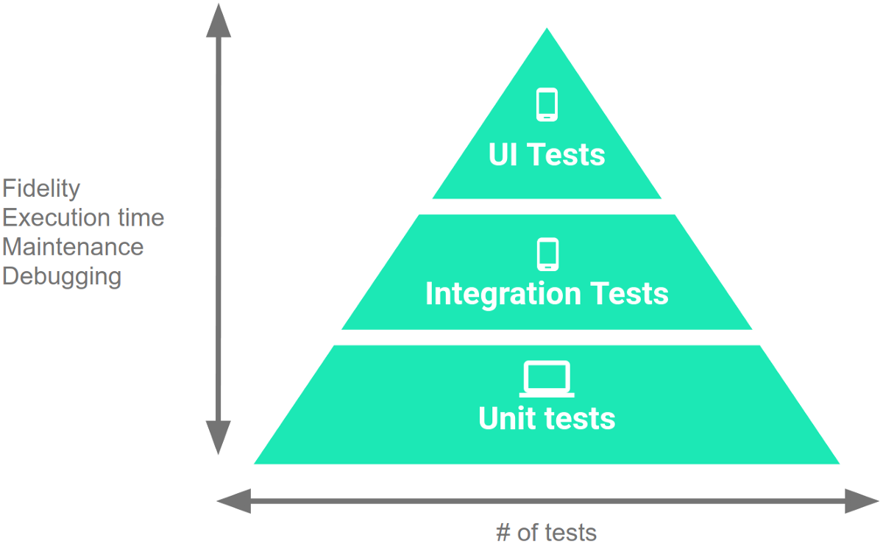
Testing Percentages
Unit tests verify behavior of a single class.
  70% of your tests.
System tests verify class interactions.
  20% of your tests.
GUI/exploratory tests verify end-to-end journeys.
  10% of your tests.
Notes:
These testing types are not equal in number that you write. Unit tests validate your app's behavior one class at a time. These are about 70% of your tests in a project. It is important to verify that the classes work as expected before we combine them. Then, system Integration tests validate either interactions between levels of the stack within a subsystem - a cluster of classes-, or interactions between related subsystems at the system level. These tend to be about 20% of your tests. Finally, End-to-end tests or GUI tests and exploratory tests validate user journeys spanning multiple subsytems of your app. These tend to make up the remaining 10% of your number of tests.

Slide 39
Testing
70/20/10 recommended.
Unit tests execute quickly,
relatively simple.
System tests more complex, require more setup, slower to execute.
UI tests very slow, may require humans.
Well-tested units reduce likelihood of integration issues, making high levels of testing easier.
Notes:
This 70/20/10 split is what Google recommends. Thus is not set in stone, but has a logical underpinning. The reason for this is that as you work up the pyramid, from small unit tests to large complex UI tests, each test increases in execution time and effort to create, maintain, and debug. Therefore, you should write more unit tests than system integration tests, and more system tests than GUI tests. Unit tests run through the command line, on the machine you use to develop the app. They run quickly, in milliseconds. They are small and simple. Integration tests require more setup, more communication, tend to include more actions and method calls. They take more time to run. GUI tests require running the full system, may require special hardware - if testing a mobile app, you run the test on the phone itself. You should run GUI tests on multiple devices too in any case, to make sure they work in different hardware, OS, and software configurations. You may also need humans in the loop. This dramatically increases the required execution time. GUI tests are also often more complex, so they require more maintenance effort too. The good news is that this split also works out even without the speed factor. Units are tested in isolation. Well-tested units should integrate more cleanly - if there are issues, they are due to the integration itself and not a problem solely in one unit. Creating more unit tests makes the other levels easier as well. Cheaper and easier.

Slide 40
Acceptance Testing
Once the system is internally tested, it should be placed in the hands of users for feedback.
Users must ultimately approve the system.
Many faults only emerge in the wild.
  Alternative operating environments.
  More eyes on the system.
  Wide variety of usage types.
Notes:
Once we’ve tested the system at all levels, it’s ready to release? Right? Well, not quite yet. we can reasonably make an argument for verification at this point - we have evidence that the specifications have been met. But, we still have the all-important question of validation. Does it meet the needs of the users?
Acceptance testing is essential. Not only should they have an opportunity for feedback, but also because all sorts of faults only emerge in the wild. Users will put your system through more scenarios than you’d ever expect, they will (read)
Acceptance testing allows users to try the system under controlled conditions.

Slide 41
Acceptance Testing Types
Alpha Testing
  A small group of users work closely with development team to test the software.
Beta Testing
  A release of the software is made available to a larger group of interested users.
Formal Acceptance Testing
  Customers decide whether or not the system is ready to be released.
Notes:
(read)
alpha - read - this is usuallythe first stage of user-involvement. You gather a very small group of interested users and almost work them into the team - you get feedback from them, bug reports, and requests - then act on them. Alpha testing can begin relatively early if you’ve building incrementally more complete builds.
beta - read - beta testing follows up later with a larger group of users. These are still interested customers - they often volunteer to test for the chance to try the software early. This is a good chance to try out the software in a larger variety of computing environments and put it under more stress.
acceptance- read

Slide 42
Test Plans
Notes:
We’ve talked about what tests are. Next class, we’ll get into writing test cases. First, though, how do we set up the testing process?

Slide 43
Test Plans
Plan for how we will test the system.
  What is being tested (units, subsystems, features).
  When it will be tested (required stage of completion).
  How it will be tested (what scenarios do we run?).
  Where we are testing it (types of environments).
  Why we are testing it (what purpose do tests serve?).
  Who will be responsible for writing test cases (assign responsibility to team members).
Notes:
Test plans are the cornerstone of the testing process. They range in length and formality from quick thought exercises to extensively-planned blueprints for the entire testing cycle. Regardless, they are what structures the process of testing a system, and coming up with a plan should be your first step in testing. This plan needs to cover the who,what,when,where, how, and why of testing. (read)

Slide 44
Why Make a Test Plan?
Guides development team.
  Rulebook for planning test cases.
Helps people outside the team understand the testing process.
Documents rationale for scope of testing, how we judge results, why we chose a strategy.
  Can be reused when making decisions in future projects.
Notes:
Making Test Plan has multiple benefits: Test Plan guides our thinking as we create detailed test cases. It is like a rule book, which needs to be followed.
Help people outside the test team such as developers, business managers, customers understand the details of testing.
Important aspects like test estimation, test scope, Test Strategy are documented in Test Plan. This is where we discuss WHY we test a certain way. This is important for understanding the outcome of a project, and can be reviewed by Management Team and re-used for other projects.

Slide 45
Analyze the Product
Must understand the product before you can test it.
  What are the needs of the users?
  Who will use the product?
  What will it be used for?
  What are the dependencies of the product?
Review requirements and documentation.
Interview stakeholders and developers.
Perform a product walkthrough (if code is running).
Slides derived from https://www.guru99.com/what-everybody-ought-to-know-about-test-planing.html
Notes:
How can you test a product without any information about it? You can’t. You must learn a product thoroughly before testing it. You should research clients and the end users to know their needs and expectations from the applicationWho will use the product? What is it used for? How will it work? What are the software/ hardware dependencies of the product?
You can use the following approach to analyze the product before building a test plan: (last three points) review of product documentation helps you to understand all the features of the website as well as how to use it. If you are unclear on any items, you might interview customer, developer, designer to get more information.

Slide 46
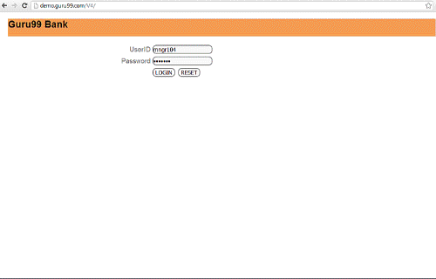
Analyze the Product
Banking Website
  What features do we want to see?
  Account creation, deletion, manipulation.
  Fund transfers
  Fund withdrawal
  Check deposit
  …?
Slides derived from https://www.guru99.com/what-everybody-ought-to-know-about-test-planing.html
Notes:
Think about what the functionality is of the product we are building

Slide 47
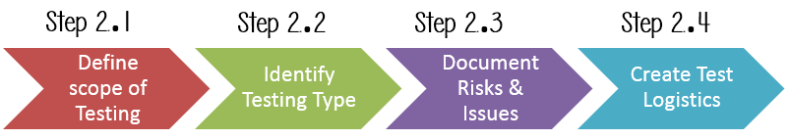
Develop the Test Strategy
Document defining:
  Test Objectives (and how to achieve them)
  Testing Effort and Cost
Slides derived from https://www.guru99.com/what-everybody-ought-to-know-about-test-planing.html
Notes:
Test Strategy is a critical step in making a Test Plan. A Test Strategy document, is a high-level document, which is usually developed by Test Manager. This document defines:
The project’s testing objectives and the means to achieve them. Determines testing effort and costs. Follows this process

Slide 48
Testing Scope
What are you planning to test?
  Software, hardware, middleware, ...
… AND… What are you NOT going to test?
  Gives project members a clear understanding about what you are responsible for.
Must take into account:
  Requirements, budget, skills of your testing team
Slides derived from https://www.guru99.com/what-everybody-ought-to-know-about-test-planing.html
Notes:
Before the start of any test activity, you need to know what is your responsibility to test. What is the scope? The extent of what you plan to test, and - importatnly - what we plan to NOT test. You must think hard about it.
The components of the system to be tested (hardware, software, middleware, etc.) are defined as "in scope" The components of the system that will not be tested also need to be clearly defined as being "out of scope."
A precise scope helps you Give everyone confidence & accurate information on the testing you are doing. All project members will have a clear understanding about what is tested and what is not
How do you determine scope your project? To determine scope, you must take into account– Precise requirements, Project Budget,, Skills & talent of your test team

Slide 49

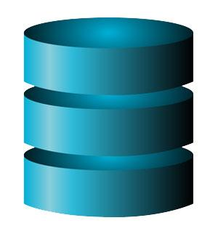
Testing Scope
Example: Banking website
  Requirements specified for functionality and external interface.
    These are in-scope.
  No requirements were specified for database or client hardware.
    We might decide these are out-of-scope.
Slides derived from https://www.guru99.com/what-everybody-ought-to-know-about-test-planing.html

Slide 50
Identify Testing Types
For the banking site:
System Testing
  Focus on verifying access points and interfaces.
  Functionality likely spread over multiple classes, many features interact
Exploratory Testing
May decide to limit:
Unit Testing
(focus on integration over individual classes)
May decide to skip:
Acceptance Testing
Which should we apply?
  Consider the project domain.
Which can we skip or limit to save money?
Slides derived from https://www.guru99.com/what-everybody-ought-to-know-about-test-planing.html
Notes:
The next step is to decide what kind of tests you plan to apply - unit, system, exploratory, GUI, acceptance, and so on.
Which Testing Types should be focused on for testing this project?
Which Testing Types should be ignored to save costs? What about for the banking site? (talk about)

Slide 51
Create Test Logistics
Who will write and execute test cases?
  What types of testers do you need?
    Skills needed for the targeted domain
  What is the budget for testing?
    How many people can you hire to test?
When will each testing activity occur?
  When to design and when to execute tests.
  Pair with appropriate stage of development.
    Unit development -> unit testing -> system testing -> ...
Slides derived from https://www.guru99.com/what-everybody-ought-to-know-about-test-planing.html
Notes:
In Test Logistics, the Test Manager should answer the following questions: Who will test? When will the test occur?
Who will test? You may not know exact names of the tester who will test, but the type of tester can be defined. To select the right member for specified task, you have to consider if her skills are the right ones for the task or not, also you need to estimate the project budget to figure out how many people you need. or, more importantly, how many you CAN hire. When will the testing occur? Test activities must be matched with associated development activities. We showed a diagram last Friday with common pairings (talk about), you need to decide roughly when to design tests and when to execute tests.

Slide 52
Define Test Objectives
What are the goals of the testing process?
  What features, system elements need to be tested?
  What quality attributes do we need to demonstrate?
  For each feature or quality, what scenarios do we want to walk through?
Does not include a list of specific tests
  But, at a high level, should detail scenarios we plan to examine by writing one or more test cases.
Notes:
The test objectives, essentially, are (1) - 2-3) and what can we show about those featurs through the process of testing (rest)

Slide 53
Define Test Criteria
When have we completed our testing objectives?
  For qualities, set appropriate thresholds.
    Availability, ROCOF, throughput, etc.
  For functionality, commonly defined using:
    Run Rate: Number of Tests Created / Number Specified
    Pass Rate: Number of Passing Tests / Number Executed
    Often aim for 100% run rate and a high pass rate (> 95%)
Slides derived from https://www.guru99.com/what-everybody-ought-to-know-about-test-planing.html
Notes:
The next step is to (title) - how do we know when we are done and have met our goals? (2) - availability, time limits for performance, etc - (3)
Some methods of defining exit criteria are by specifying a targeted run rate and pass rate. Run rate is ratio between number test cases created, finished, and executed/total test cases of test specification. For example, the test specification has total 120 TCs, but the tester only has only created 100 TCs so far, So the run rate is 100/120 = 0.83 (83%) Pass rate is ratio between numbers test cases passed / test cases executed. For example, in above 100 TCs executed, there’re 80 TCs that passed, so the pass rate is 80/100 = 0.8 (80%) Run rate is mandatory to be 100% eventually unless a clear reason is given. Pass rate is dependent on project scope, but achieving high pass rate is a goal. You might ship a product where some tests fail - there could be non-deteminism you plan to ignore, or bugs you don’t have the resources to fix, there are multiple reasons, but you generally aim for a very high pass rate still.

Slide 54
Resource Planning
Summarize resources that you have.
  Allows estimation and adjustment of testing scope, objectives, and exit criteria.
Human Resources: Managers, testers, developers who assist in testing, system administration.
System Resources: Servers, testing tools, network resources, physical hardware.
Slides derived from https://www.guru99.com/what-everybody-ought-to-know-about-test-planing.html
Notes:
The Resource plan is a detailed summary of all types of resources required to complete project task. Resource could be human, equipment and materials needed to complete a project. Resource planning is important factor of the test planning because it helps in determining the what you need to acheive the level of testing you seek, and what you can actually afford to accompish. This lets you make estimates, and alter the scope, objectives, and exit criteria accordingly. (rest)

Slide 55
Plan Test Environment
Where will you execute test cases?
  Software and hardware execution environment
  Often defined as part of continuous integration.
Need to account for:
  Requirements on both server and client-side.
  Different networking conditions (bandwidth, load).
  Different client or server-side hardware.
  Different numbers of concurrent users.
Notes:
A testing environment is the software and hardware setup on which the testing team is going to execute test cases. The test environment consists of a user environment, as well as physical environments, such as server, and front end running machines. (3)You should ask the developer some questions to understand the application under test clearly. Ask things like - What is the maximum user connection which this website can handle at the same time? What are hardware/software requirements run this website? Does the user's computer need any particular settings or software to browse the website?

Slide 56
Schedule Estimation
Break testing plans into individual tasks, each with an effort estimation (in person-hours)
  Create test specification, 170 person-hours
  Write unit tests, 80 person-hours
  Write API tests, 50 person-hours
  Perform test execution, 1 person-hour (per suite execution)
  Write test report, 10 person-hours
  …
Slides derived from https://www.guru99.com/what-everybody-ought-to-know-about-test-planing.html
Notes:
( go over, then create a schedule with rough dates, or sprint estimates, for when you will take care of each task.

Slide 57
We Have Learned
What is testing?
Testing terminology and definitions.
  Input, oracles
  Faults, failures
Testing stages include unit testing, system testing, exploratory/GUI testing, and acceptance testing.
Test planning needs to consider resources, time, scope, environment.
Notes:
- (read).

Slide 58
Next Time
Exercise session this afternoon:
  Quality scenarios
Next week: Test Design and Unit Testing
Start thinking about Assignment 1

