Slide 1
Key features Overview
Syntax
Package
Language binding
Speed

Slide 2
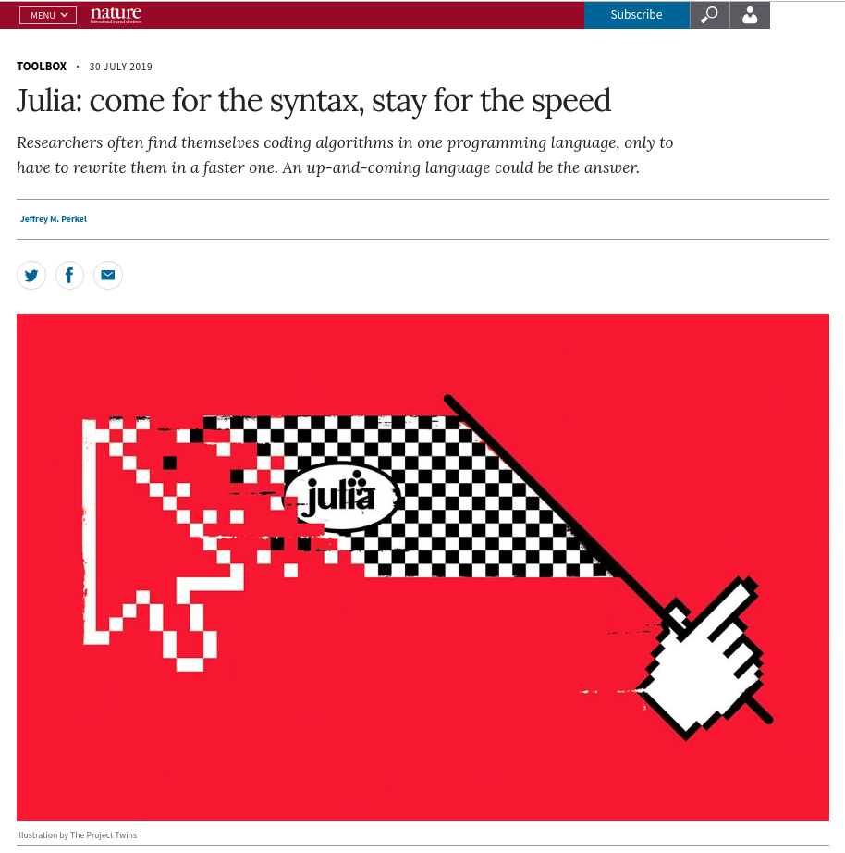
Julia Syntax
Recent article (30 July 2019) in Nature journal about Julia:
"Launched in 2012, Julia is an open-source language that combines the interactivity and syntax of 'scripting' languages, such as Python, Matlab and R, with the speed of 'compiled' languages such as Fortran and C."(Jeffrey M. Perkel)
Jeffrey M. Perkel, "Julia: come for the syntax, stay for the speed", Nature. 2019 Aug;572(7767):141-142. doi: 10.1038/d41586-019-02310-3.

Slide 3

Julia Syntax
Programming language comparison resources:
Noteworthy Differences from other Languages
Python vs R vs Julia for Data Sciences
Julia Vs R Comparison Cheat Sheet
MATLAB–Python–Julia cheatsheet
The Matrix Cheatsheet Matlab–Python-R–Julia comparison

Slide 4
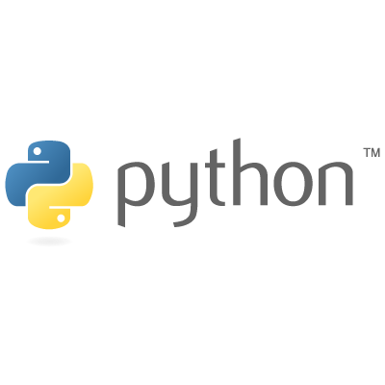


Libraries/Packages
To add a library/package:
install.packages("tidyverse") | conda install anaconda | Pkg.add(“DataFrames")
To load a library/package:
library(tidyverse) | import numpy as np import pandas as pd | using DataFrames, CSV, LinearAlgebra using Statistics, StatsBase
Control Structures
if / else if /else
if (x == a) { ... } else if (x == b) { ... } else { ... } | if x == a: ... elif x == b: ... else: ... | if x == a ... elseif x == b ... else ... end
for loop
for (i in I) { ... } | for i in I: ... | for i in I ... end

Slide 5
Matrix
To create a matrix A_{2x3}
A <- matrix(c(1,2,3,4,5,6), 2, 3) | A = np.array([[1,2,3],[4,5,6]]) | A = [1 2 3; 4 5 6]
2 x 2 matrix of zeros
A <- zeros(2,2) | A = np. zeros(2,2) | A = zeros(2,2)
2 x 2 identity matrix
A <- eye(2,2) | A = np.eye(2) | A = I
Select an element in matrix A
A[i,j] | A[i,j] | A[i,j]
Select a row in matrix A
A[i,] | A[i,:] | A[i,:]
Select a column in matrix A
A[,j] | A[:,j] | A[:,j]

Slide 6
Function
To declare
f <- function(x1, x2 = 3) { y <- x2 – x1 y } | def f(x1, x2 = 3): y = x2 – x1 return y | function f(x1, x2 = 3) y = x2 - x1 end # math notation f(x1, x2) = x2 - x1
To call
f(5,12) # position matters f(x2=12, x1=5) # order free | f(5,12) # position matters f(x2=12, x1=5) # order free | f(5,12) # position matters f(x2=12, x1=5) # if named arguments
To pass multiple arguments or keyword arguments to a function
f <- function(x1, x2 = 7, ...) { y <- func_foo(x1, x2, ...) y } | def f(x1, x2 = 7, *args, **kwargs): y = func_foo(x1, x2, args, kwargs) return y | function f(x1, x2 = 7, args...;kwargs...) y = func_foo(x1,x2,args;kwargs) end

Slide 7
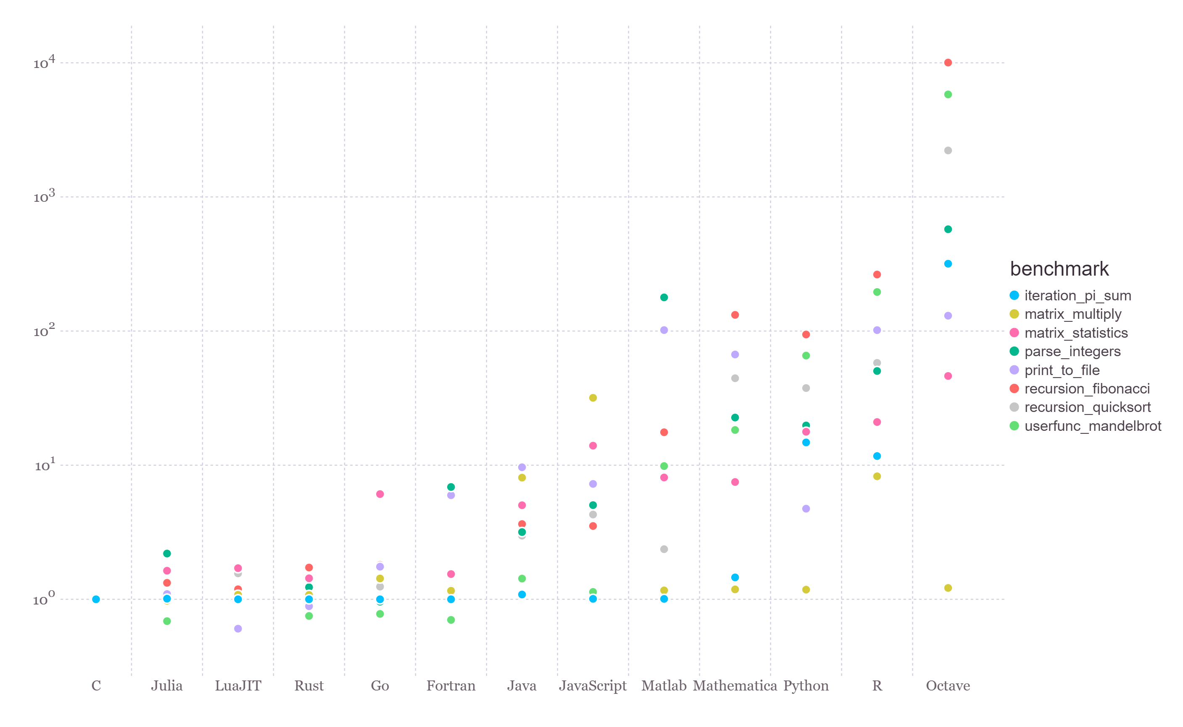
Julia Speed
"The benchmarks are written to test the performance of identical algorithms and code patterns implemented in each language."(https://julialang.org/benchmarks)

Slide 8
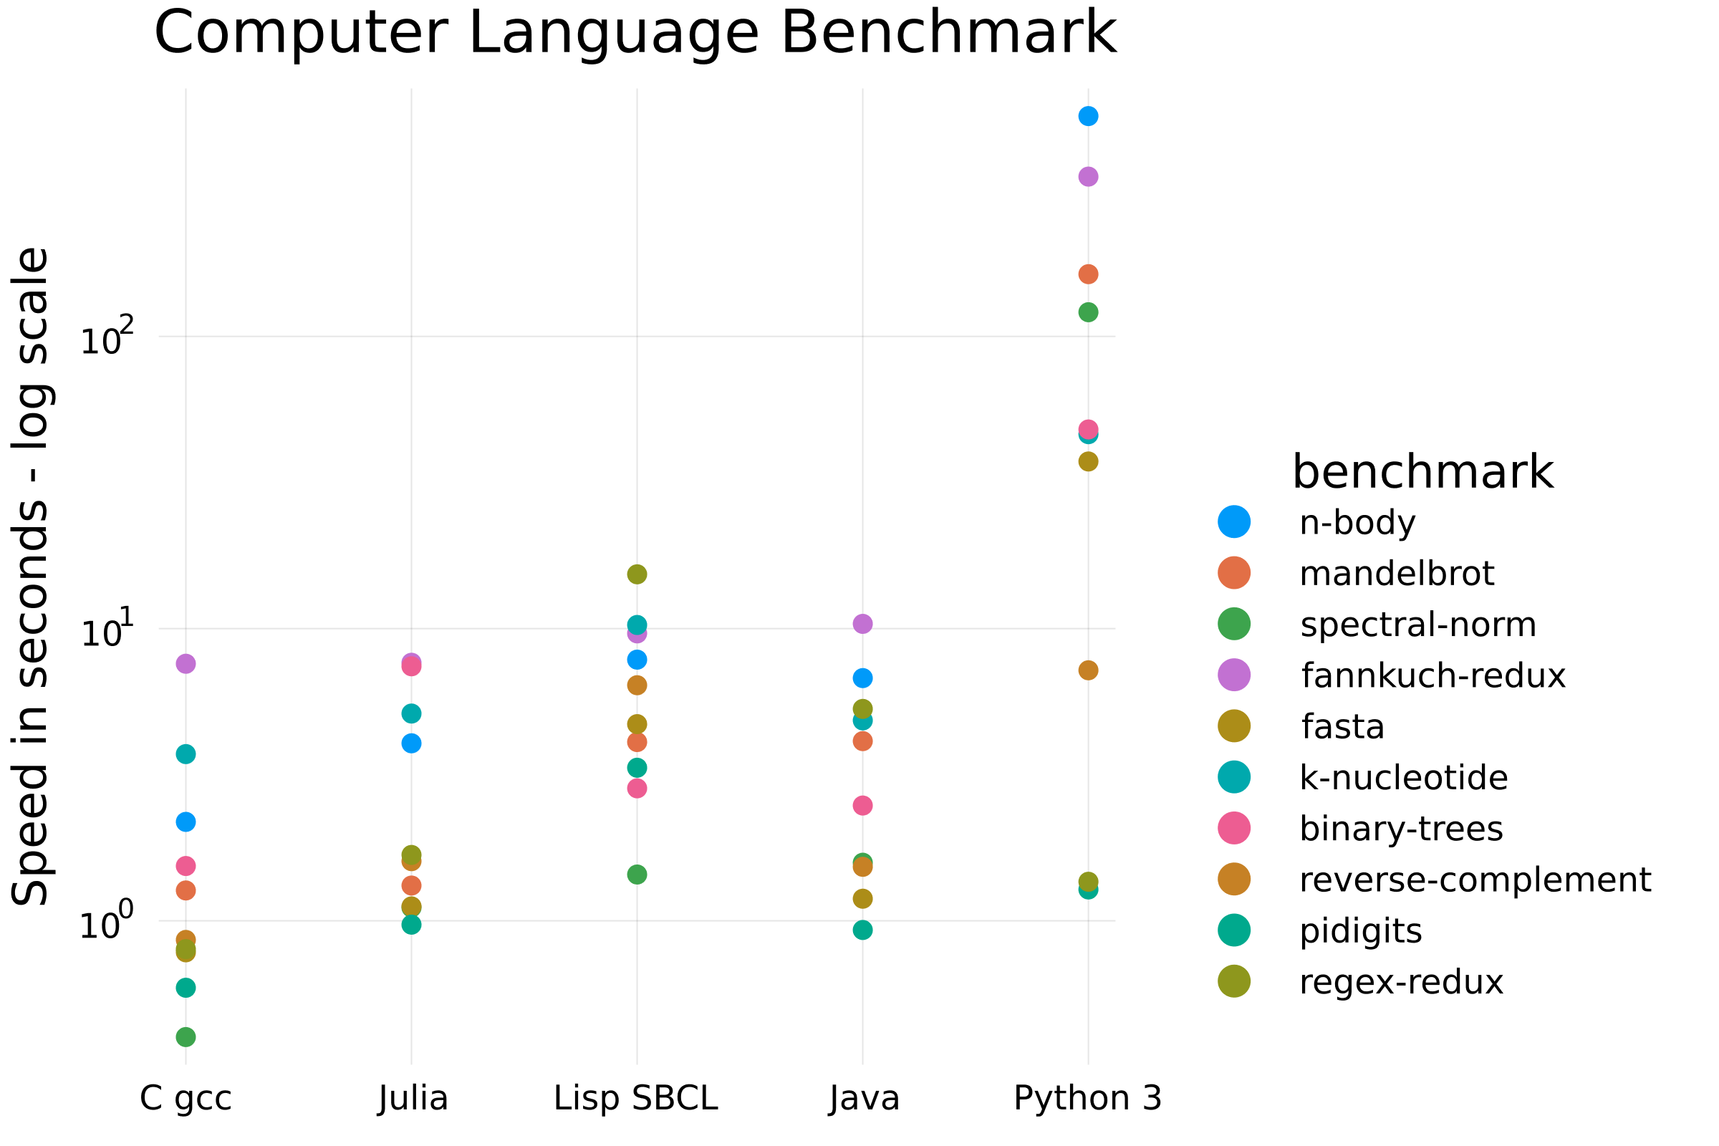
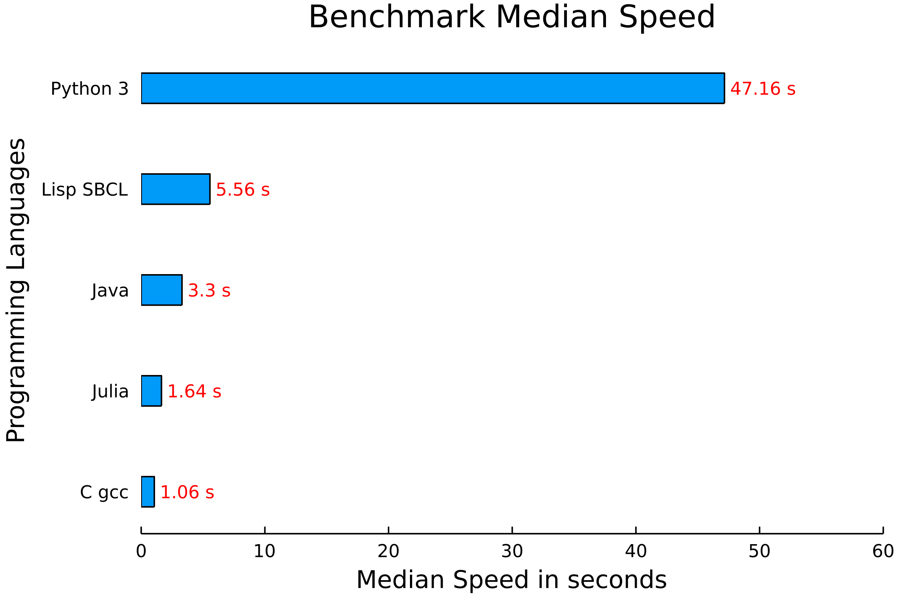
Programming languages :
Julia 1.6.0
Python 3.9.2
C gcc (Ubuntu 10.3.0-1ubuntu1) 10.3.0
Lisp SBCL 2.1.1
Java openjdk 17 2021-09-14
CPU: quad-core 3.0GHz Intel® i5-3330®
RAM: 15.8 GiB
HDD: 2TB SATA disk drive
OS: Ubuntu™ 21.04 x86_64 GNU/Linux 5.11.0-18-generic
The Computer Language Benchmarks Games

Slide 9
Julia Packages
Julia has over 6500 registered packages. They are a substantial part of the Julia ecosystem.
To explore existing packages related to your area of interest you can check out the following link: https://juliahub.com/ui/Packages
Julia comes with a built-in package manager named Pkg, but it also com with an interactive Package Mode: Example

Slide 10

Julia Packages Worth Mentioning
Statistics and Math: StatsBase (Basic functionalities for statistics), LinearAlgebra (Linear algebra operations), Distributions (Probability distributions), GLM (Generalized linear models)
Data tools: DataFrames (Essential tools for tabular data), Queryverse (A meta package for data science), CSV (For working with CSV files), XLSX (Excel file reader and writer)
Biology: Bio (Framework for computational biology and bioinformatics)
Machine Learning: Flux (ML library), TensorFlow (A wrapper around TensorFlow), Knet (Deep learning framework), FScikitLearn (Scikit-learn framework)
Plot: Plots (Julia visualizations and data analysis), PyPlot (matplotlib plotting like), Gadfly (ggplot2 plotting like), UnicodePlots (Unicode-based scientific plotting for working in the terminal)
Language binding: PyCall (For Python calling), RCall (For R calling)
Jupyter: IJulia (Julia kernel)

Slide 11
Language Binding
Even though, the package ecosystem still has room to grow. Julia has excellent foreign function interfaces. Easily call into other languages such as python with with PyCall or R with Rcall.
This means that you don’t have to wait until the Julia ecosystem is fully mature, and that you don’t have to give up your favorite package/library from another language when moving to Julia!

Slide 13
Julia Syntax
You can dowload Julia directly from the official website https://julialang.org/downloads/. Then you will have to decide which release according to you OS you want to install:
Current stable release
Long-term support (LTS) release
Upcoming release
If you have any trouble with the the installation, you may be able to solve it with further installation instructions specific to you platforms: https://julialang.org/downloads/platform.html
Once Julia is installed you will have access to the REPL (Reading-Eval-Print-Loop).

