Slide 1
Why is Julia fast and flexible

Slide 2
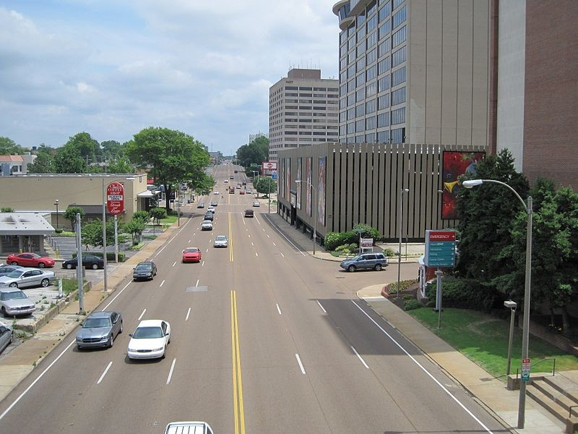
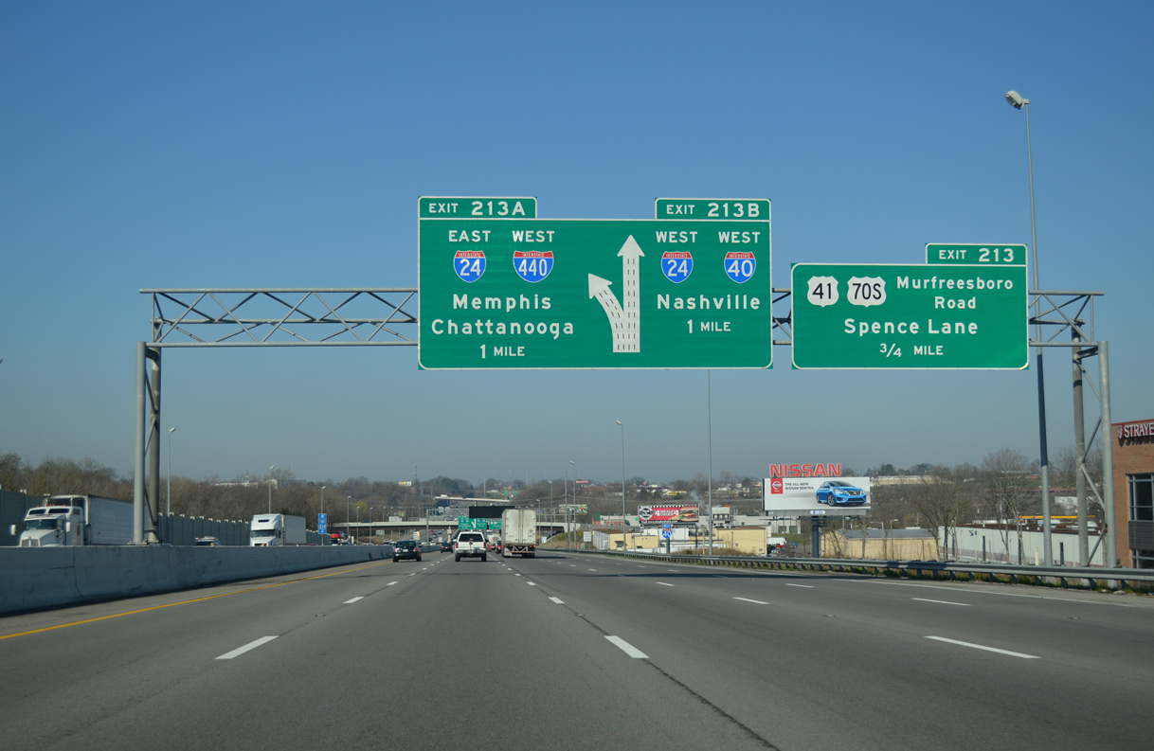
Which one is faster?

Slide 3
Interpreted Language
Interpreted line by line
Dynamic variable type
Adaptive data structure
Quick to debug and revise
Repetitive interpretation

Slide 4
Compiled Language
Compile ahead of time to machine code
Require type information
Provide compiler optimizations
Fast runtime after compilation
Extra compilation stage

Slide 5
Just In Time Compiler (JIT)
Speed of compiled code
Flexibility of interpreted code
More runtime information for compiler
Overhead of interpreter and compilation

Slide 6
Multiple Dispatch
function overload, polymorphism
Same function name, different argument by type or number of arguments
Dispatched to most efficient route for your functions.

Slide 7
Compilation Stages of Julia Code
Source Code
Macro Expansion
Julia IR
LLVM IR
Native code
AST

Slide 8
Why is Julia fast and flexible
Multiple Dispatch
Type Inference
Type Stability
JIT compilation

Slide 9
Parallel Computing
Coroutines
Most usefull in unbalanced workloads. Dynamic scheduling with producer and consumer algorithms
Multi-threading
@thread macro
Atomic operations -> avoid race condition
Distributed Computing
Code availability and loading packages
Data movement
GPU
CUDA and OpenCL support
Hands off approach: use existing library such as CuArrays or CLArrays
Hands on approach: write custom GPU kernel using CUDAnative and CUDAdrv

