Slide 1
Why is Julia fast and flexible

Slide 2

What makes a language slow

Slide 3
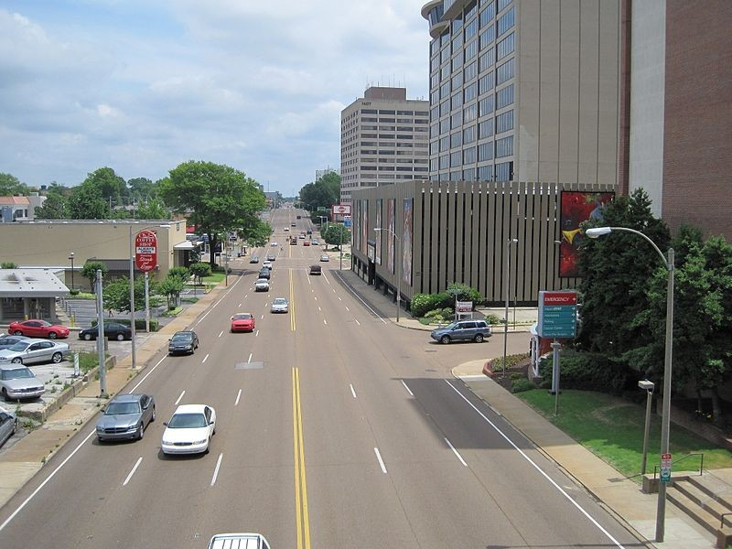
Interpreted Language
Interpreted line by line
Dynamic variable type
Adaptive data structure
Quick to debug and revise
Repetitive interpretation
Has to have interpreter installed

Slide 4
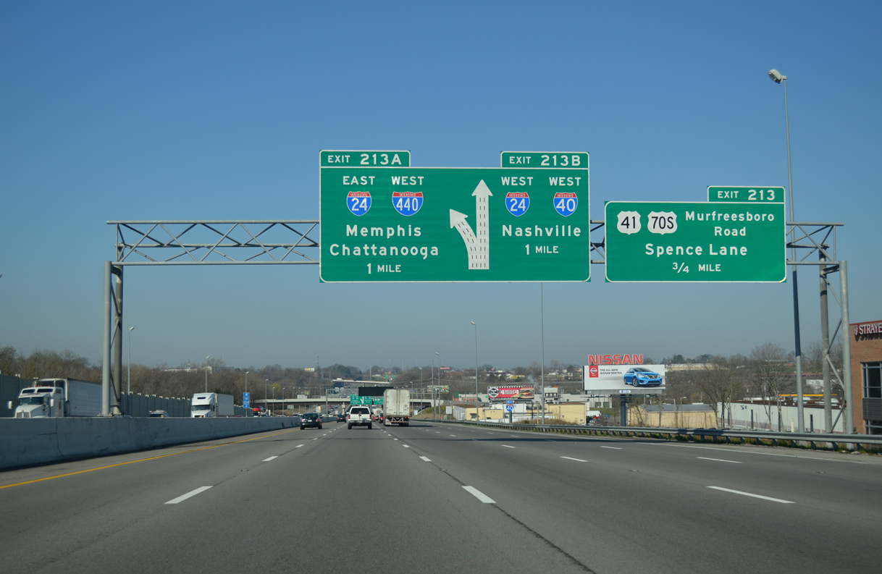
Compiled Language
Compile ahead of time to machine code
Require type information
Provide compiler optimizations
Portable and fast runtime after compilation
Extra compilation stage

Slide 5
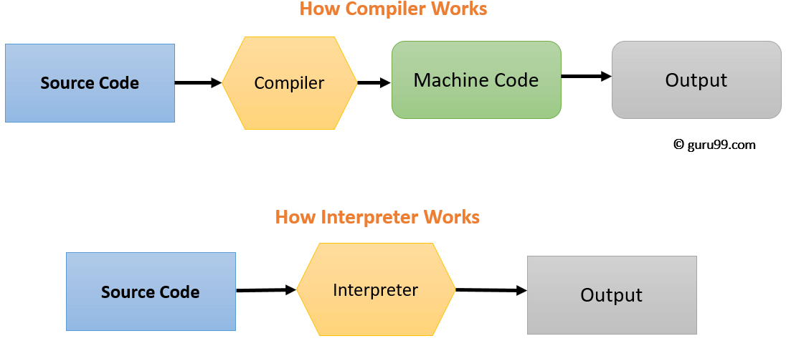
Stages of compiler and interpreter

Slide 6
Why is Julia fast and flexible
JIT compiled
Cached compilation
Type Inference
Multiple Dispatch

Slide 7
Compilation Stages of Julia Code
Source Code
AST (Macro Expansion)
IR
(SSA) IR
LLVM IR
Native code

Slide 8
Parallel Computing
Coroutines
Most usefull in unbalanced workloads. Dynamic scheduling with producer and consumer algorithms
Multi-threading
@thread macro
Atomic operations -> avoid race condition
Distributed Computing
Code availability and loading packages
Data movement
GPU
CUDA and OpenCL support
Hands off approach: use existing library such as CuArrays or CLArrays
Hands on approach: write custom GPU kernel using CUDAnative and CUDAdrv

