Slide 1


Fear Learning and Extinction using Neuron

Slide 2
What is Neuron?
NEURON is a simulation environment for modeling individual neurons and networks of neurons.
These networks can range from one to hundreds of cells. This library is what makes it possible to simulate our network.

Slide 3
What is BMTK?
The Brain Modeling Toolkit (BMTK) is a python-based software package for building, simulating and analyzing large-scale neural network models.
As useful as NEURON is, it can be daunting to learn. Luckily, this python library streamlines the process of creating a network so that with just a few lines of code you can create a network and start running simulations.

Slide 4

Why Google Colab?
Google Colab allows us to create a full lesson plan with interactive code so that you don’t have to write any.
By just pressing Run, you can see the entire simulation in action without having to touch a thing!

Slide 5
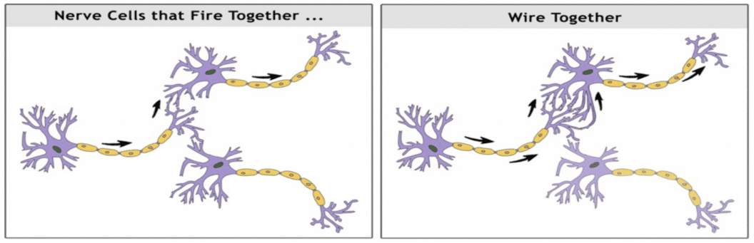
Plan Overview
To learn how fear works in the brain, we will be creating a circuit like our brain but on a smaller scale. The brain will be given two types of input, shock and tone.
The brain knows to fear shock as it is painful, but it does not know to fear tone. Although, overtime the brain will learn to associate the two since they will be done in unison.

Slide 6
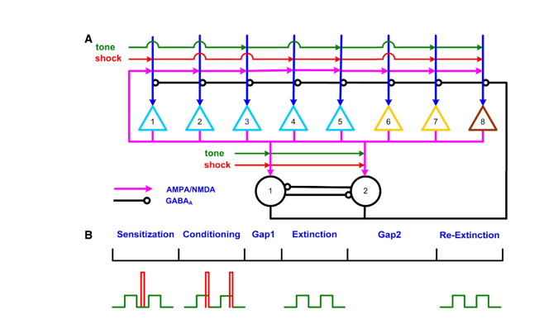
Our Network
Our network will be modeled after this image, 10 Pyramidal cells and 2 interneurons, some pyramidal cells are connected to our tone input, and some are connected to shock. All their outputs feed into each other changing and adapting the network

Slide 7
Phases
To help organize the experiment, we have phases for each step of learning/forgetting fear.
Sensitization phase:
10 unpaired tones and shocks with shocks occurring randomly in the tones
Conditioning phase:
10 paired tones and shocks (tone for first 400 ms in last 100 ms both tone and shock start)
First extinction phase:
30 tones given with no shock
Second extinction phase:
Another 30 tones given with no shock

Slide 8
What we should see
Each input combination should provide different responses from the neurons
No tone or shock (extinction): the connections should steadily decrease in weight
Unpaired tone/shock: An unpaired tone will cause steadily decreasing firing rates over time since the network will learn to ignore the tone, shock will cause high firing rates since the network is already afraid of pain.
Paired tone/shock: A paired tone and shock will cause the network to begin to wire together with high firing rates and high weight increases in order to associate the tone with the shock.

Slide 9

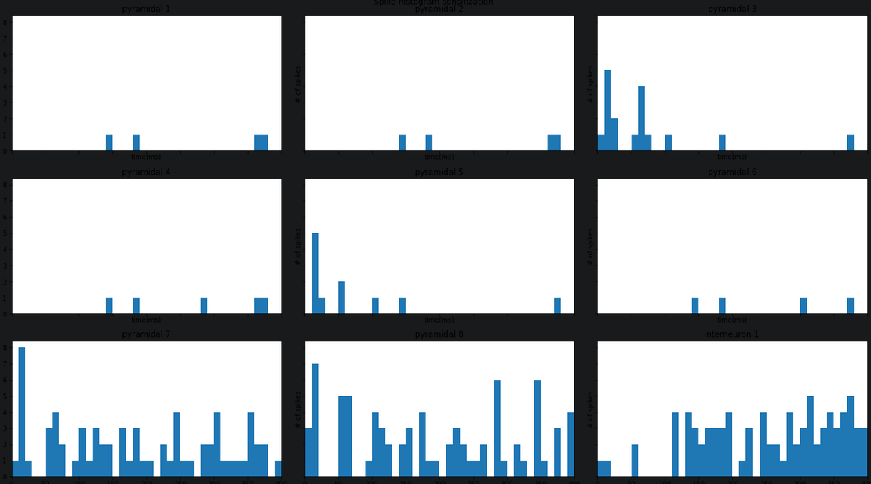

Easily Scalable
BMTK allows this experiment to scale from 10, to 20, to hundreds of cells thanks to its adaptability. All we must do is simply change a few lines of code to add more cells. Along with this, connection rules to each node allow our network to become as simple or complex as we want.
BMTK and NEURON are great ways to simulate and further understand our brain. Technologies like Colab make it so the results those tools provide can be easily presentable and teachable.

