Slide 1
Software Design Patterns
Grehg Hilston

Slide 2
Agenda
Python
Object Oriented Programming Review
Class Diagrams
Patterns
Description
UML Diagrams
Real World Example
(If Requested) Source Code Demonstration
Anti-Patterns

Slide 3
Goals
Understand a little bit more of Python
Leverage already solved problems
Build a vocabulary to simplify discussions
Minimize code changes
Write less code

Slide 4
Juypter Notebook Time
Notes:
Initialization

Slide 5
UML - Unified Modeling Language
Most popular - Class Diagrams
Use Case Diagrams
Sequence Diagrams
State Machine Diagrams…

Slide 6
Access Modifiers
Public - Visible by all
Protected - Visible by this class and subclasses
Private - Visible by this class
Always be as private as possible; limit exposure

Slide 7
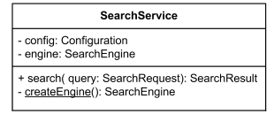
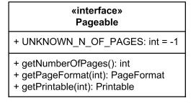
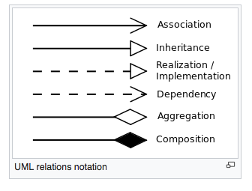
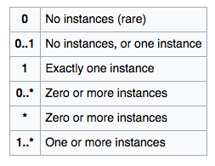

UML - Class Diagram
Class
Interface
Access Modifiers

Slide 8

Interfaces aka Protocol
“defines methods and values which the objects agree upon in order to co-operate”
Cannot be instantiated
Implementing an interface

Slide 9
Abstract Class
“Abstract classes are classes that contain one or more abstract methods.”
“An abstract method is a method that is declared, but contains no implementation. Abstract classes may not be instantiated, and require subclasses to provide implementations for the abstract methods.”
Useful for allowing developers to customize

Slide 10

Extension
Satisfies the “is a…” relationship
Extend a base class
I.e. extending its functionality

Slide 11
Composition
Satisfies the “has a…” relationship
Where one Class has an instance of another

Slide 12
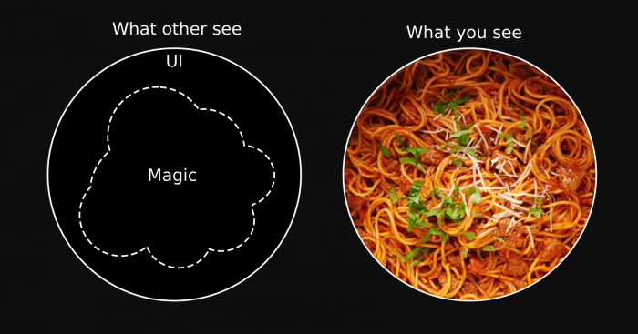
Why Do We Need Patterns?

Slide 13
Pattern Types
Creational - “Deal with creation objects while hiding creation logic”
Structural - “Deal with class and object composition”
Behavioral - “Deal with communication between objects”

Slide 14
Use Design Patterns When It Makes Sense
Cautionary story

Slide 15
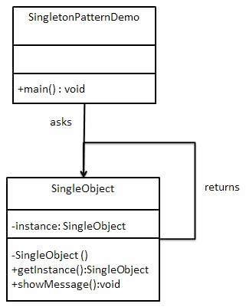
Singleton
Description: “Provides one, and only one, instance of an object.”
Use Cases:
Thread pools
Caches
Logging
Device drivers
Singleton
Singleton
Singleton
Singleton
Notes:
Example Singleton Logger, where multiple classes use it to log
https://sourcemaking.com/design_patterns/singleton

Slide 16
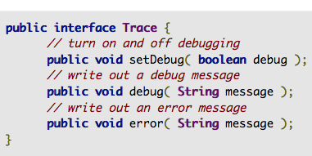

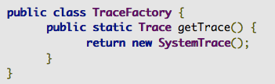
Factory
“Useful when you don’t know which implementation to use”
You have code littered with creating all SystemTraces and want to change to FileTrace
Change just the factory instead of everywhere
Notes:
https://sourcemaking.com/design_patterns/factory_method

Slide 17
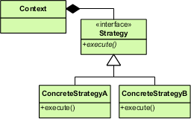
Strategy
“Easily swap out algorithms”
Use Cases:
Game logic
Different calculation implementations
Notes:
Example of game logic.

Slide 18
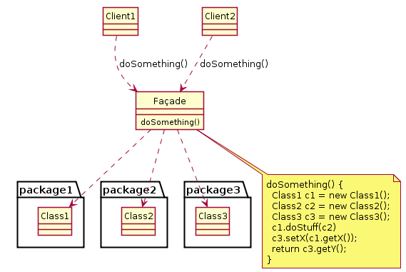
Facade
“Provides a simplified interface”
Use cases:
reduce dependencies of outside code on the inner workings of a library
Make a library more readable
Wrap poorly designed APIs in a single well-designed API
Notes:
Think “Remote Control”

Slide 19
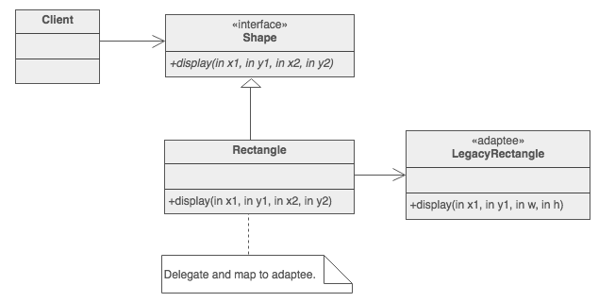
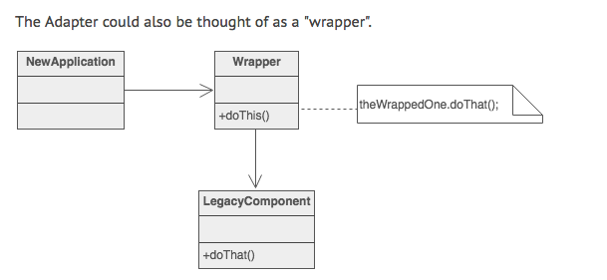
Adapter
“Wraps an existing class with a new interface”
Use Cases:
Interfacing with legacy code
Interfacing with other libraries, packages or systems
Notes:
Old Rectangle vs New Rectangle

Slide 20
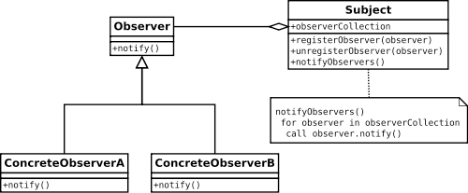
Observer / Observable
“Enables subscription based notifications to be registered to”
Use Cases:
Notify on state changes
Useful in the MVP pattern
Helpful in event handling systems
Notes:
Example: RSI companion app threading

Slide 21
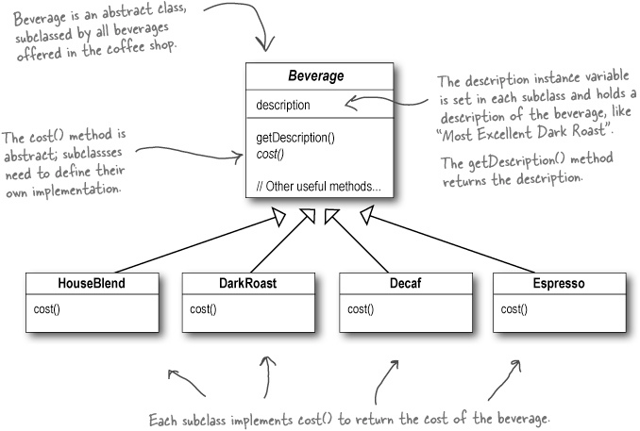
Decorator - Code Smell
Notes:
Example: Games; Handling many many optional variates

Slide 22
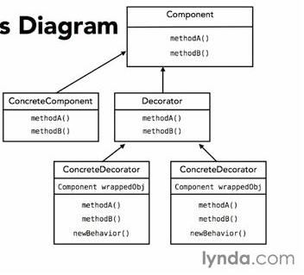
Decorator
“Simplifies many objects with optional decorations”
Use Cases
Menus
Drinks
Enemies in games

Slide 23
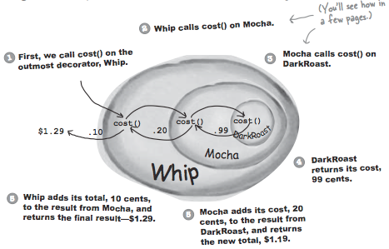
Decorator

Slide 24
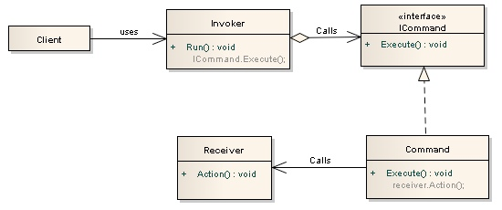
Command
“Encapsulates a command as an object”
Use Cases:
Separate invoker and receiver
Notes:
Think Coupling operations, like an operation with an undo

Slide 25
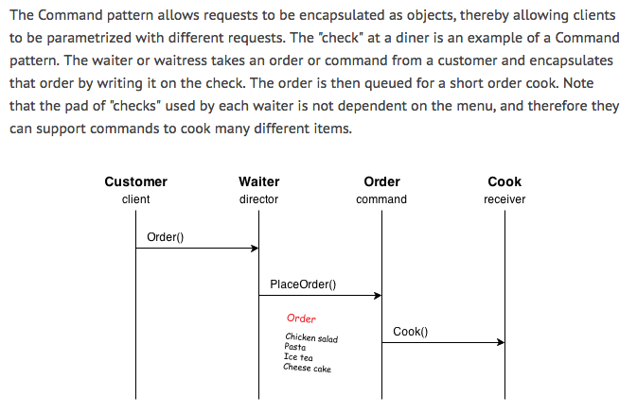
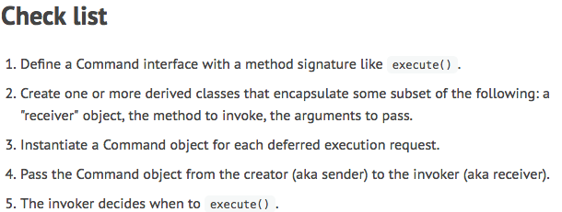
Command Example

Slide 26
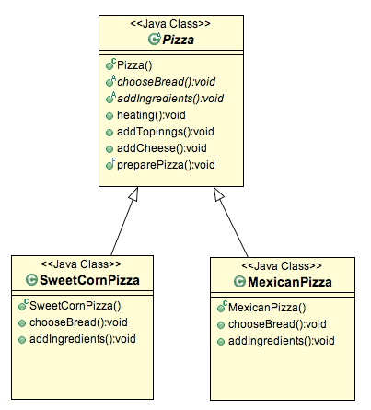
Template
“Factors out commonality between similar classes”
Use Cases
Initial design and notice similarity
Useful for writing code once

Slide 27
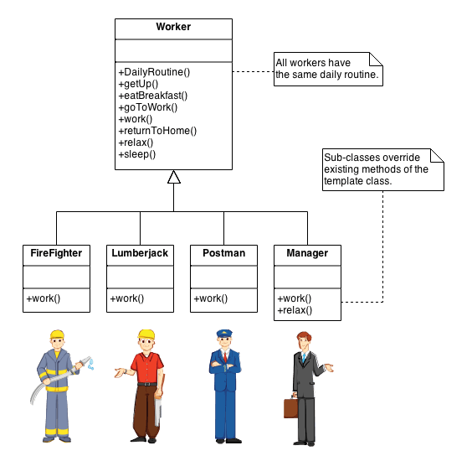
Template Example

Slide 28
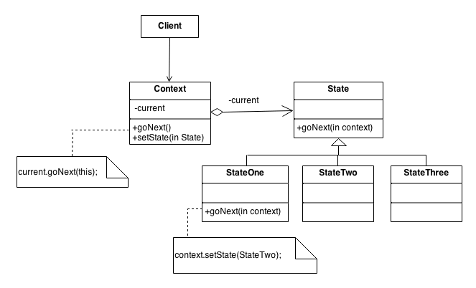
State

Slide 29
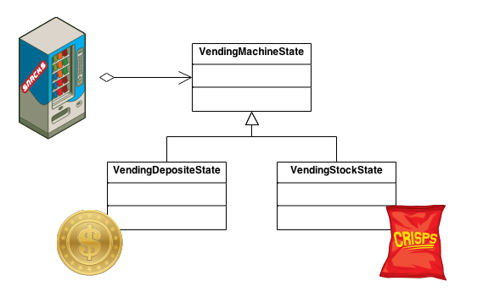
State Example

Slide 30
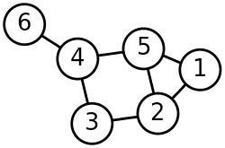
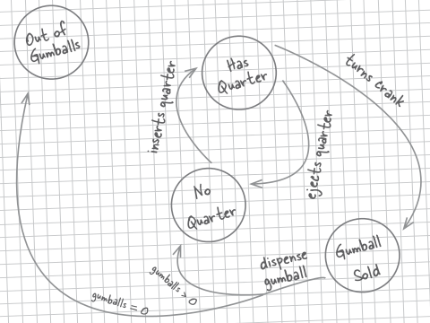
State Machine
“Allows an object to alter its behavior when its internal state changes”
Use Cases:
Useful by anything that can be modeled by a state graph
Graph = State Machine
Vertices = state
Edges = actions (each pair of vertices)
Reflexive Edges
Excellent for testing

Slide 31
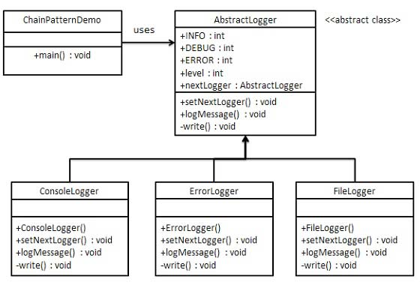
Chain of Responsibility
“Allows multiple changes at resolution”
Use Cases:
Cache implementations
Thread Pool Manager
Implementing your own logger

Slide 32
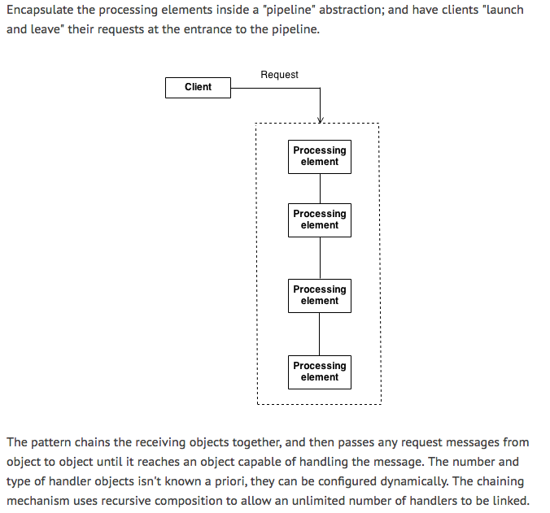
Chain of Responsibility Example

Slide 33
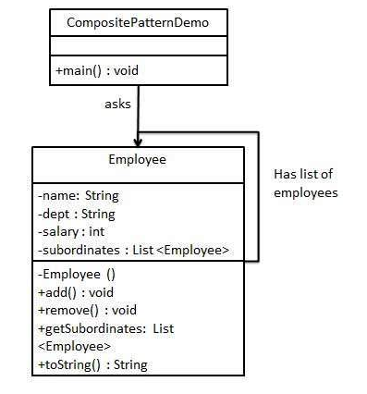
Composite
“Composite pattern is used where we need to treat a group of objects in similar way as a single object.”

Slide 34
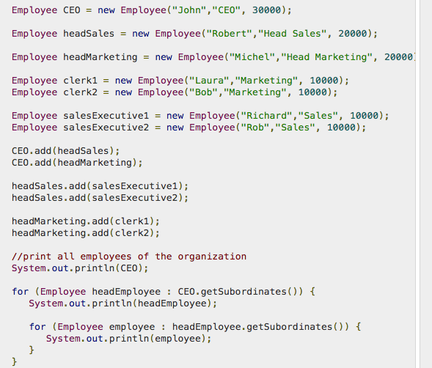
Composite Example

Slide 35
Antipatterns
God Class - One class with all responsibilities
Vendor lock in - Excessively dependent on an externally supplied component
Magic numbers

Slide 36
Backup Slides

Slide 37
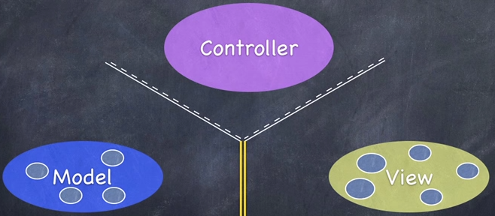
Model View Controller / Presenter
“Separation of concerns”
UI
Formatting
Backend
Use Cases:
Everything
Mobile apps
Web sites
Notes:
Example iOS app. View = UI (Handles events and calls Controller functions) Controller translates events to Model calls and formats. Model = Backend (think like API calls)

Slide 38
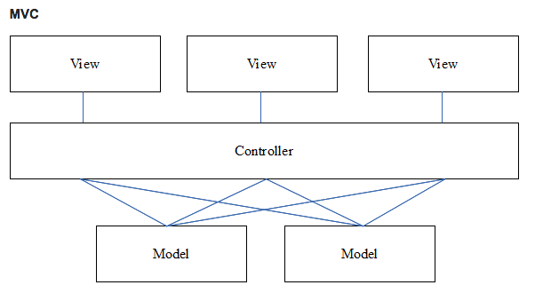
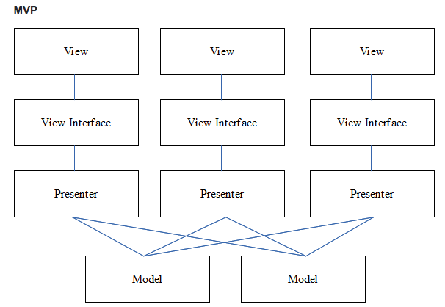
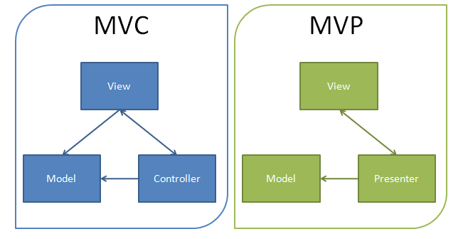
MVP vs MVC

