Slide 1
Team PLUVALI
Specifications Document
Alex Davis
Steve Kosovich
Tim Leikam
Greg Martini
Debra Parcheta
Katie Taliercio

Slide 2
Specifications:
The game will be implemented using MySQL, Django, HTML, and CSS.
The MySQL database will store user information such as username, password, email, player points, preferences and save state.
We will use Django, HTML, and CSS to implement the game code and connections between the database.

Slide 3
Specifications:
We will implement a scenario editor which will allow us and anyone to make and edit new game scenarios.
To save game progress, we will create a data string handler. This will save a string into the database which each of the string's characters corresponds to a load state.

Slide 4
Language Considerations:
Java:
pros: Would work better for Android applications, but our focus is a web game.
It would run fast, but our game should run fast anyway since it's not very complex.
cons: Browsers are moving to be plug-in free, and apparently Java would have to be considered as a plug-in. Would require Java Runtime on the device it needs to be ran on.
HTML5:
pros: Shouldn't have a problem with any browsers (apparently not all features work for all browsers yet). Should work fine for a "light" game, which ours will be. Videos, audio, etc can be added and this should still have good performance.
cons: JavaScript is the scripting language for HTML5, but we’re not necessarily sure if we will be writing scripts. Adding videos, audio, etc isn't very straightforward, but once we get a content creator going then it shouldn't be bad (if we do decide to make one).
JavaScript:
pros: Fast for the end user. Relatively easy language to use.
cons - Might have performance issues. Would most likely require us to use HTML5 anyway.
JavaScript also has potential security issues.

Slide 5
Database Considerations:
My Structured Query (MySQL):
pros: Portable across different DBMS. Designed with a focus on the web. Large amount of support and reliable databases, typically.
cons: Not as mature as other relational database management systems (Didn't start as a RDBMS but later changed to, but regardless shouldn't effect a project of our scale). Functionality can be dependent on add-ons (again shouldn't affect us).
SQLite:
pros: East start-up and great testing.
cons: No user management nor does it have very many performance optimization features.
Java Database Connectivity (JDBC):
pros: Portable across different DBMS. Solid performance.
cons: Should have a good understanding of Java
Open Database Connectivity (ODBC):
pros: Portable across different DBMS.
cons: Different drivers needed for different problems. When so many drivers are being used, an overhead of managing them is also increased (shouldn't effect a small project like this).

Slide 6
User Progress Considerations:
Data Strings:
pros: Would have easy to set up and quick load times. Not device dependent.
cons: Creating a way to have user made scenarios auto implement this system without user making the data strings (future proof).
Cookies:
pros: The browser already makes use of cookies, this wouldn't be hard for the game to as well.
cons: If user deletes cookies without intending to delete save game. User account linked to specific device.
Linked with IP Address:
pros: Each IP is unique so easy to distinguish player.
cons: Multiple people couldn't play from same network mask.

Slide 7
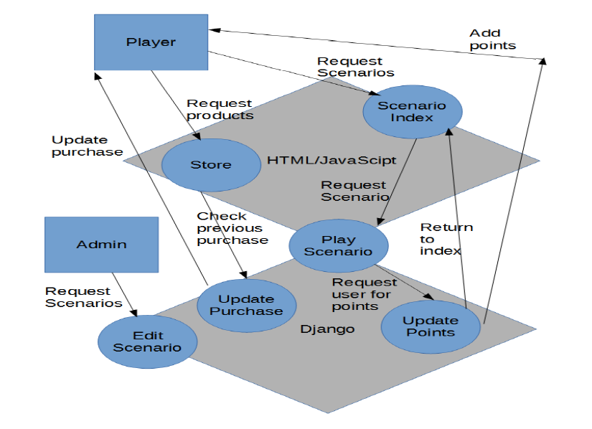
Data Flow Diagram:

