Slide 1
Team PLUVALI
Requirements document (updated)
Alex Davis
Steve Kosovich
Tim Leikam
Greg Martini
Debra Parcheta
Katie Taliercio

Slide 2

Requirements:
Build a web app game compatible with all devices desktops, phones, and tablets.
The game must focus on introducing new coping techniques to the players for use in everyday life situations
Players must be able to make their own account if they don't already have one.

Slide 3
Requirements:
  Choose-your-own-adventure style game
  The player will be able to customize their profile
  A players progress will be saved
Administrators will have certain permissions that regular players don't have, but can still play the game as a player
The game must be intuitive and easy to use, and must have the usage of pictures, symbols and icons

Slide 4
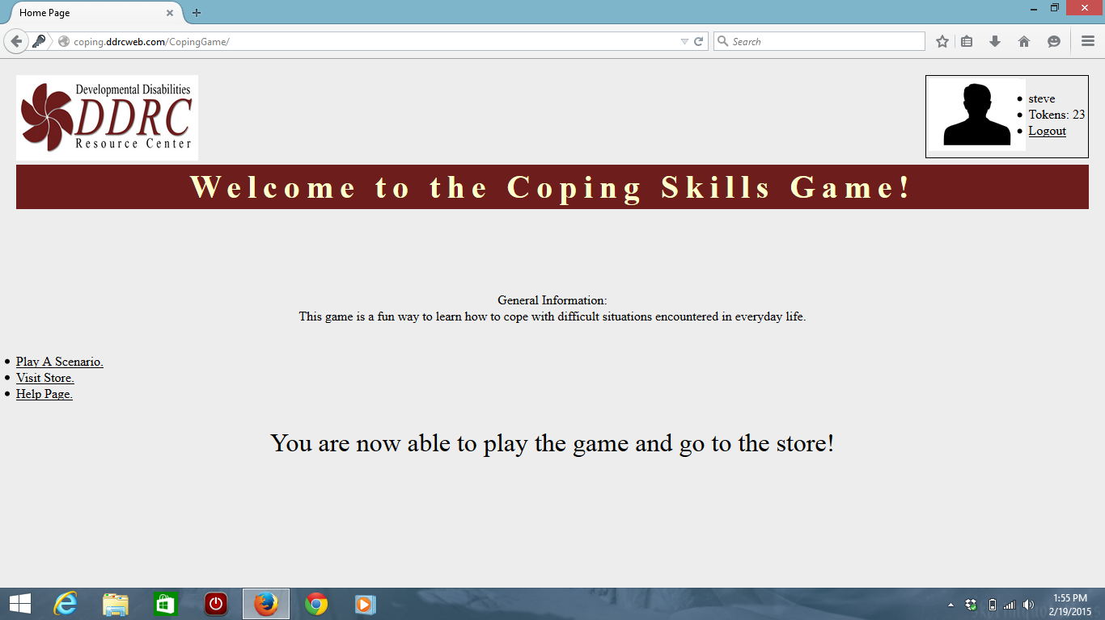
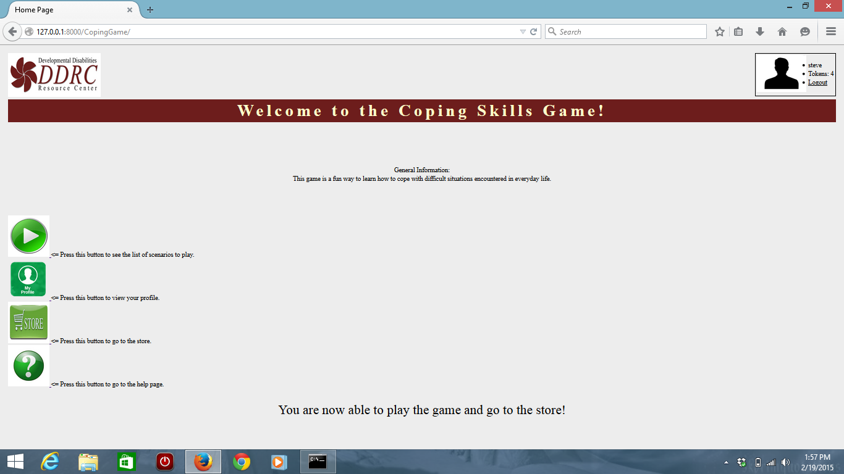
Requirements
Before:
After:

