Slide 1
Tablet Data
Yu- Jui Chen Gregory Murray Gohar Eloyan

Slide 2
Background
Influencing customers’ actions is crucial in effective marketing. Nowadays, people appear to share more than ever and look to their peers, family and friends for validation and recognition. Thus, User Generated Content ( UGC ) creates opportunities for brands to connect authentically with their customers, and becomes the keystone of any integrated content marketing strategy.

Slide 3
How do we best utilize the trend of UGC for marketing and increase profits for our company?
1. Investigate the correlation between sales and rating
2. Assess the what previous net rating effect on rating evaluation
3. Provide the marketing solution for User-Generated Content

Slide 4
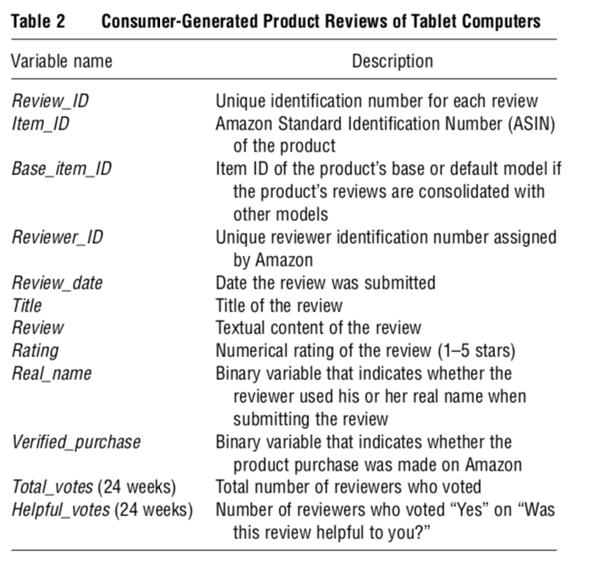
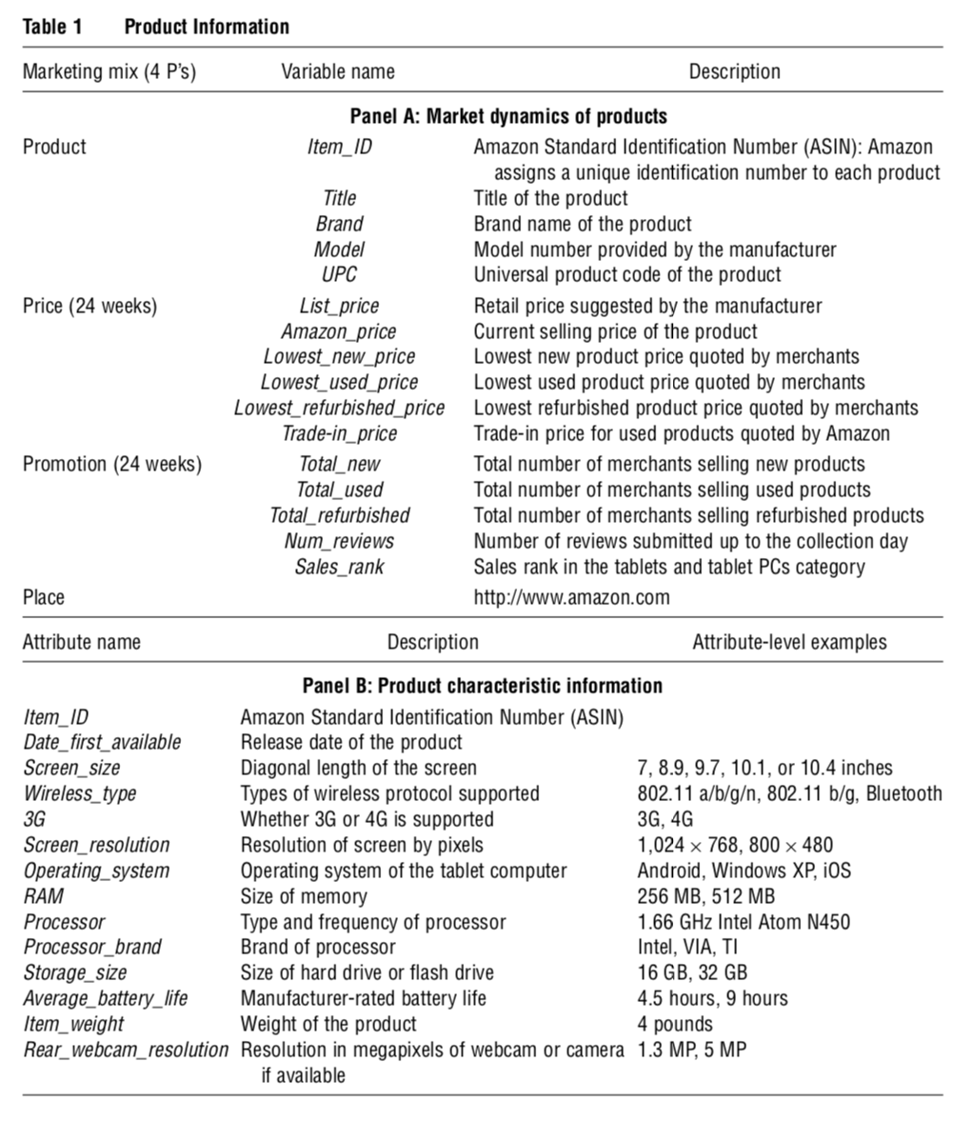
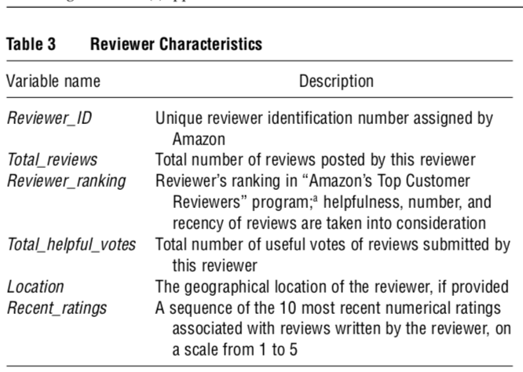
Data

Slide 5

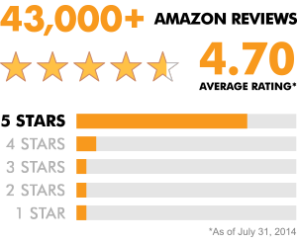
Previous Net Rating Effect on Rating

Slide 6
Definitions
Previous Net Rating: (Net Rating) The aggregate star rating for the product at the time that reviewer_{i} evaluates the rating she will assign the product as an individual,
{𝑥 ∈ ℝ | 0 ≤ 𝑥 ≤ 5}.
Rating Evaluation: (Rating) The individual rating that reviewer_{i} assigns the product, {1,2,3,4,5}.

Slide 7
Research and Hypotheses
Hypotheses:
Rating evaluations will experience a conforming effect from previous net ratings
The quantity of a reviewer’s ratings will correlate negatively with previous net ratings conforming effect on rating evaluations
Moe, Wendy W. and Schweidel, David A., Online Product Opinions: Incidence, Evaluation and Evolution (February 2011). Available at SSRN: https://ssrn.com/abstract=1525205 or http://dx.doi.org/10.2139/ssrn.1525205

Slide 8
Model Specification
What is the best way to measure the net rating impact to get most intuitive result?
Possible Approaches:
Binary Logit: Y=1 if rating-net_rating<=.75 , else 0
Ordinal Probit: Put net rating into buckets of 1, 2, 3, 4 and 5 as factor variables

Slide 9
Selected Ordinal Probit Model
1.) k parameters: Y=β₀ +β₁ X₁+…+β_{k}X_{k} +e -> 2.) j orders: y= α₀+ α₁x₁+…+ α_{j-1}x_{j-1}u
Ordinal Probit: Put net rating into buckets of 1, 2, 3, 4 and 5 as factor variables
Model 2 returns the each ordinal range. Model 1 returns parameter estimates.

Slide 10
Control vs. Experiment Group
Control group: zero reviews at evaluation period (*not large enough sample after merging with sales data)
Experiment group: everyone else
Controlling for the rating behavior of reviewer_{i} problematic due to multicollinearity

Slide 11
Dependent Variable
Rating (1, 2, 3, 4, or 5)

Slide 12
Key Independent Variables
Net Rating Bucket (1, 2, 3, 4, or 5)
Total Reviewer Reviews (E(0, 2370))
Price

Slide 13
Final Model
P(Rating=1, 2, 3, 4, 5) = Net_Rating_Bucket+log(Total_rvwr_reviews+1)+Net_Rating_Bucket*log(Total_rvwr_reviews+1)+log(Total_Item_Reviews+1)+Real_name+Verified_purchase+Recent_rating_SD+Price+TradeInValue

Slide 14
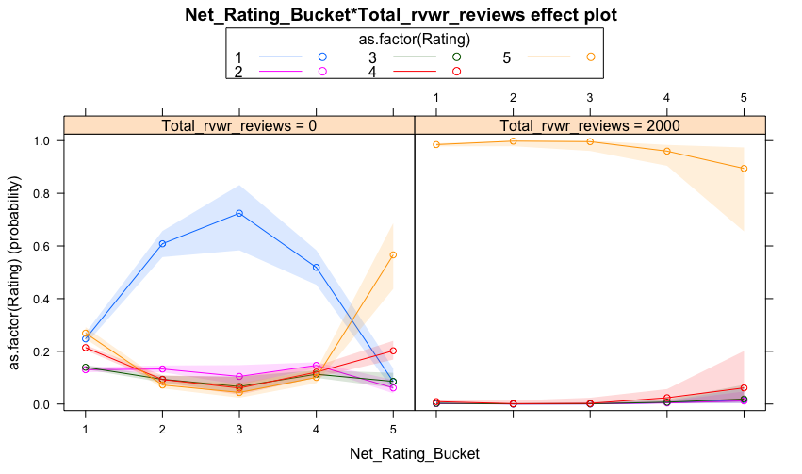

Slide 15
Reviewer Experience Effect
Inexperienced Group (<9 reviews)
vs.
General Population

Slide 16
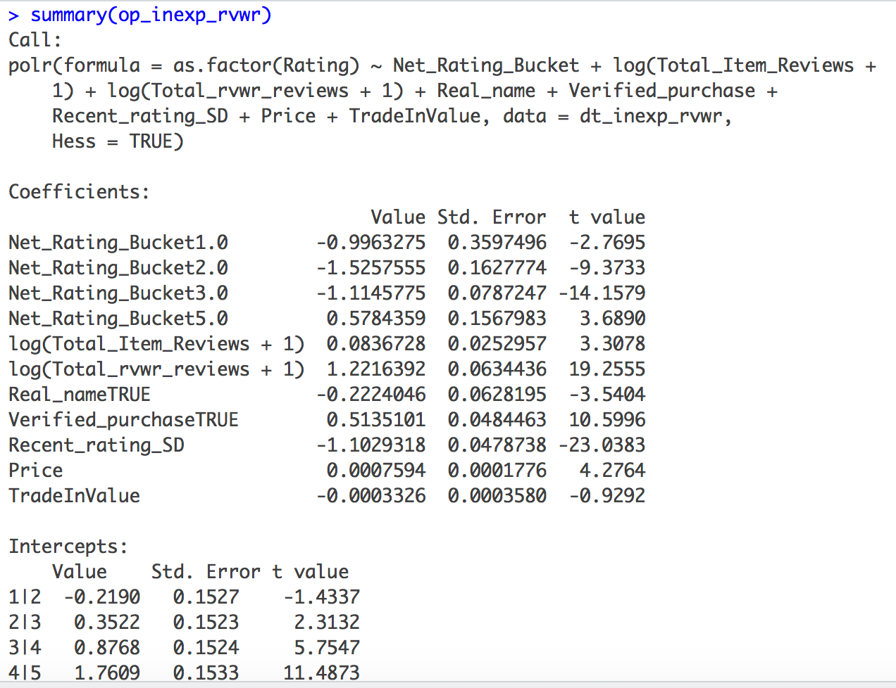
Inexperienced Group Significant Variables

Slide 17
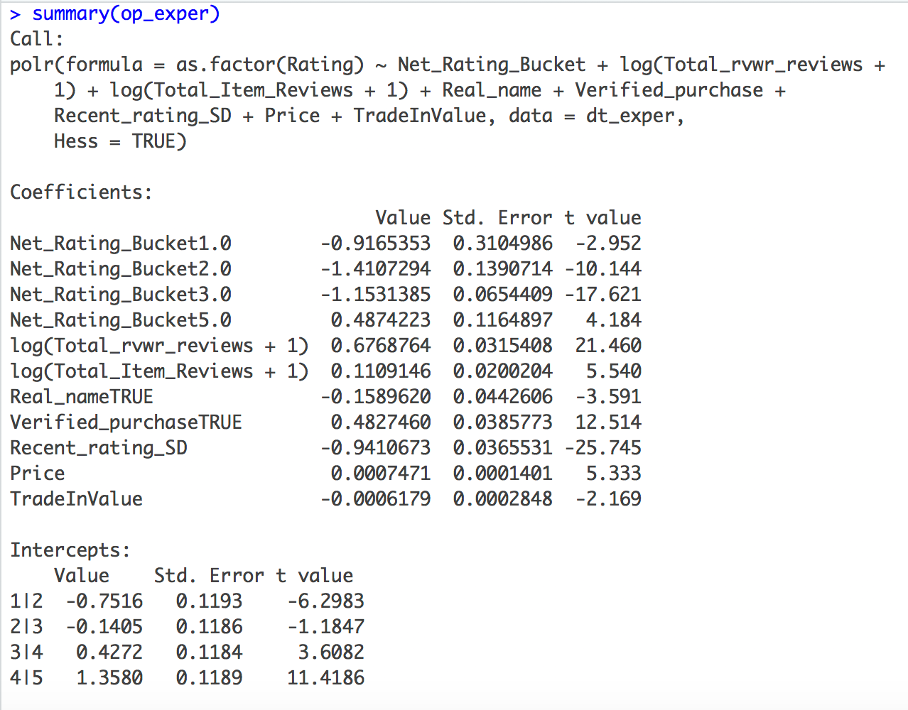
General Population

Slide 18
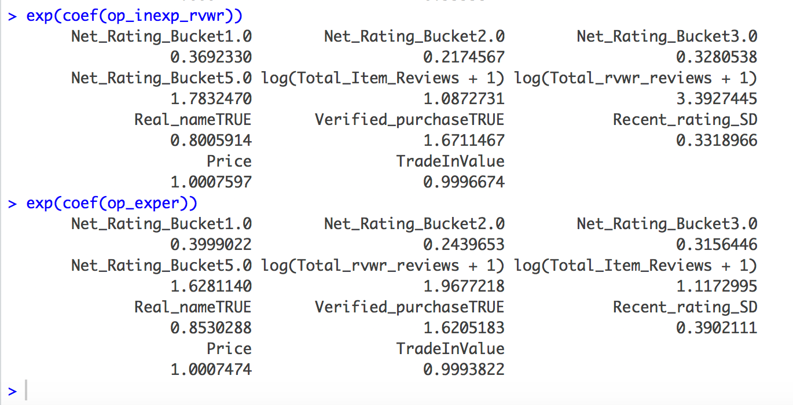

Slide 19
Challenges
Data cleaning and manipulation
Data generation process
Model specification (for clarity of results)
Evaluating controls

Slide 20
Limitations
Sample Size -> Only 24 weeks of market dynamics data
reviewers with >10reviews sample was too small
Unbalanced Data
Controlling for popularity of product
Limited the depth of study (ie: panel data was not possible)

Slide 21
Segmentation
Based on customer behavior (average ratings, average expenses on specific tablets)
Ratings provided to the products
Product price category the product that is rated belongs to

Slide 22
Data cleaning and preparation
Merged Market Dynamics data with the Product Reviews data with the Item ID and this one merged with Reviewer Information data with the Reviewer ID.
Cleaned all NA’s from Reviewer ID (after this we had 27197 obs) , since our focus are going to be those IDs.
Dropped all the columns we won’t need for the clustering
Aggregated the final data set on Reviewer ID and took mean of every other column to have those IDs as unique in our data set

Slide 23
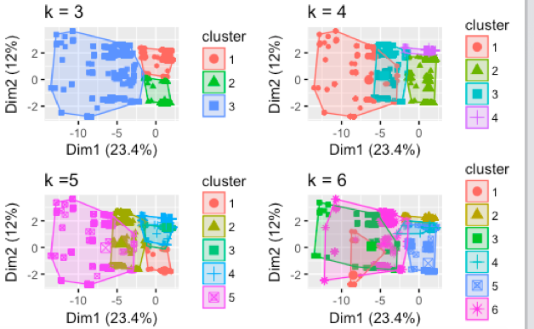
Determining the optimal number of clusters

Slide 24
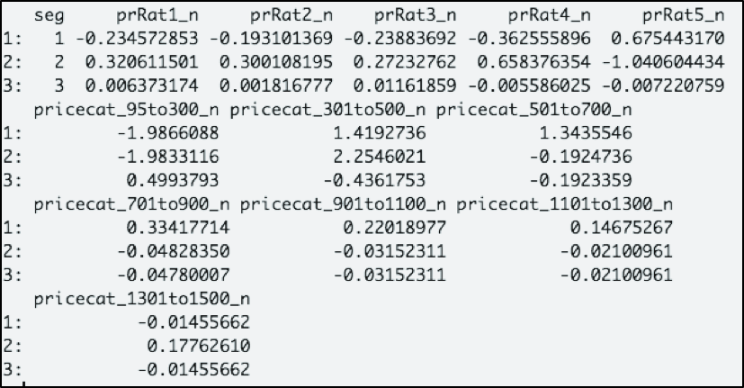




Analyzing the segments

Slide 25
K-Means Clustering
2
21731
3406
3
1
2060
The most satisfied
Happy
Complainers

Slide 26
Marketing Campaign Suggestions
We recommend selecting segments 1 and 2 as our target segments for since they are the ones who rated the tablets most favorably. We expect them to rate our product highly as well and, as shown in the previous analysis, that foundation of high ratings will engender more high ratings for our product.
Since those segments purchased tablets in the price range of $300 to $500, we are going to market them our tablets in the same price category, preferably on Amazon but also via other online mediums.

Slide 27
Thank you!

