Slide 1
Bayesian Unified Market Measurement Model
Simulations to Establish BUMM POC

Slide 2
Problems with Market Measurement Models
Digital channel measurements from MTA models are robust and accurate but almost always suffer from omitted variable bias (give undue partial credit to digital channels that should go to non-digital)
MMM’s do not suffer from omitted variable (channels) bias but have inherently low signal to noise ratio data.

Slide 3
Proposed Solution
Combine MTA and MMM models so as to mitigate each model’s weakness:
MTA digital channel priors
digital channel priors + all channels’ impression data MMM

Slide 4
Simulation Overview
MMM model framework borrows from Google’s 2017 paper https://static.googleusercontent.com/media/research.google.com/en//pubs/archive/46001.pdf

Slide 5
Step 1: MTA-derived Digital Channel Priors Simulation
Impressions for 3 channels, one “digital” and two “traditional”, are drawn from distinct normal distributions for 200 days (observations)
Parameters for each channel are drawn from distinct distributions of appropriate distribution families
Revenue for the “digital” channel for each of the 200 days is simulated according the to data generating function (DGF) from the Google MMM framework using the “digital” channel’s impressions and some fraction (~5-25%) of the “traditional” channels impressions, with Gaussian white noise added.
The simulated revenue from step 3.) and the impressions for the “digital” channel are fed into an MMM with no intercept term and only 1 channel to extract estimated parameter values for the “digital channel”

Slide 6
Step 2: Using the Priors
A second MMM model is fit using the original impressions from all 3 channels
Priors derived in step 1 are used for the “digital” channel and diffuse (un-informative) priors are used for the “traditional” channels
“Beta” parameter mean is artificially reduced by 50-90% deflation factor upon input into the model since it is known to be biased upwards
Composite (mixed) revenue from all 3 channels for 200 days is simulated according to the same DGF as in step 1 using 100% of all the channels’ impressions. Gaussian white noise is added
The revenue generated in b.) and the impressions for all 3 channels are fed into an MMM model to fit.

Slide 7
Step 3: Compare to Prior-less MMM
A third MMM model is fit methodologically identical to step 2 but without using the MTA-derived priors for the digital channel.
Revenues attributed to each channel is compared between the MTA-Prior MMM and the Prior-less MMM in terms of MAPE
mean(abs(Y_chnl_hat-Y_chnl_actual)/Y_chnl_actual)

Slide 8
Results for Digital Channel Revenue Recreation
*simulated runs drew randomly from various influential variables like noise variance, amount of MTA bias, and impressions, as well as parameters alpha, beta, k, slope
BUMM MAPE better than Priors MAPE 92% of simulated runs 56/61)
BUMM MAPE better than Regular MMM MAPE 85% of simulated runs (52/61)
See scatter plots for performance comparisons (slides 9-10)

Slide 9
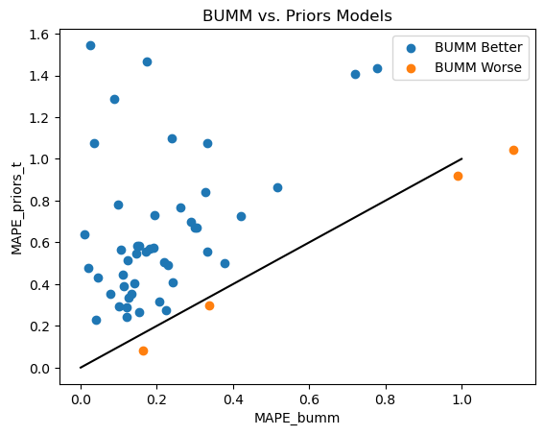

Slide 10
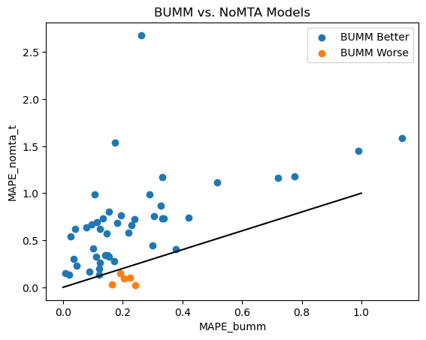

Slide 11
Conclusion
BUMM consistently performed significantly better than either of the 2 alternative models in terms of the digital channel performance in recreating revenue. When it did not perform better, the difference in performance was small to moderate.
BUMM performance can be sensitive to the beta and alpha deflation factors
Surprisingly, the traditional channels estimates only improved marginally
NEXT STEPS: Lots of exploring and assumption testing
test more use cases (and edge cases especially) and determine what factors affect BUMM performance (“why is it sometimes near perfect?”)
Scale to more channels

