Slide 1

Opioid Crisis
Presented by The Data Slackers
(Greg Poppe, Mark Flynn, Vannia Hernandez, Deep Sran)

Slide 2
Why Opioids?
We decided to choose a topic that has affected Americans in epidemic rates. The Opioid Epidemic has been at an all-time high due to number of Opioid Prescriptions given for pain. As prescription pain killers become more regulated and tougher to get, many users have decided to turn to illegal street narcotics such as heroin. We wanted to see what are some underlying factors in opioid deaths including socio-economic status, government legislation, race, income and others.

Slide 3
Factors for Opioid Crisis
How does Opioid Legislation affect the overdose rate?
Is there a relationship between Opioid Related Deaths and unemployment rate?
Is there a relationship between Opioid Related Deaths and average income?
Do Bipartisanship Politics affect Opioid Related legislation?

Slide 4
Predicated Outcomes
We believe socio-economic status, education and race will not be contributing factors in opioid overdoes. With legislation against prescription pain killers combined with the sacristy of prescription pain killers available on the street, we believe there should be a decrease in opioid related deaths.

Slide 5
Brief Summation of Factors
We were able to answer our questions by looking at data correlations between two or more data sets.
By creating various graphs, we were able to see trends in the questions we asked.
We found that with more legislation to prevent opioid abuse, there is actually more deaths in areas which have passed legislation.
We found that regardless of socio-economic factors, opioid related deaths are equal amongst race and education.

Slide 6
Data Sources
US Census
Center for Disease Control (CDC)
ProPublica

Slide 7
Data Issues
Data Cleaning was amongst the most difficult and tedious part of this project.
Data Ignore on Git Hub was another issue we ran into. We had various large data sets that we tried to push to GitHub that were difficult to figure out.
We had some problems running functions on different data types (numeric, objects, etc).
Discuss other problems that arose

Slide 8
Opioid Legislation
Brief intro
Jupyter: how the data was cleaned and manipulated
Graph

Slide 9


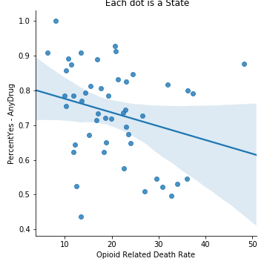




Slide 10
Opioids and Education
Brief intro
Jupyter: how the data was cleaned and manipulated
Graph

Slide 11
Opioids and Unemployment
Brief intro
Jupyter: how the data was cleaned and manipulated
Graph

Slide 12
Opioids and Bipartisanship
Brief intro
Jupyter: how the data was cleaned and manipulated
Graph

Slide 13
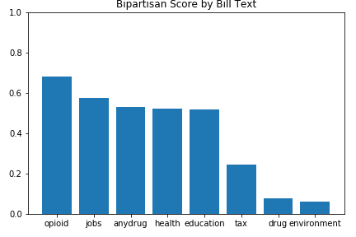

Slide 14
Opioids and Income
Brief intro
Jupyter: how the data was cleaned and manipulated
Graph

Slide 15
Interesting Factors
Have each member discuss 1-2 things that stood out to them using a graph or Jupyter

Slide 16
Our Findings
Answer the questions we asked at the beginning in detail
Discuss what our findings mean

Slide 17
Final Thoughts
What were the most difficult issues we ran into
What would we like to have researched if we were given more time

Slide 18
Q/A

