Slide 1


Opioid Crisis
Presented by The Data Slackers
(Greg Poppe, Mark Flynn, Vannia Hernandez, Deep Sran)
Notes:
Deep: Introduction

Slide 2
Why Opioids?
We decided to choose a topic that has affected Americans in epidemic rates. The Opioid Epidemic has been at an all-time high due to number of Opioid Prescriptions given for pain. As prescription pain killers become more regulated and tougher to get, many users have decided to turn to illegal street narcotics such as heroin. We wanted to see what are some underlying factors in opioid deaths including socio-economic status, government legislation, race, income amongst others.
Notes:
Deep: Why this topic?

Slide 3
Factors for Opioid Crisis
How does Opioid Legislation affect the overdose rate?
How does Education and Age factor into Opioid Related Deaths?
Is there a correlation between Opioid Related Deaths and socio-economic factors?
Do Bipartisanship Politics affect Opioid Related legislation?
Notes:
Deep: Why did we choose these factors: wanted to see what correlations can be made that affect the opioid death rate

Slide 4
Predicted Outcomes
We believe socio-economic status, education, access to healthcare and race will be contributing factors in opioid related deaths. With legislation against prescription pain killers combined with the sacristy of prescription pain killers available on the street, we believe there should be an increase in opioid related deaths.
Notes:
Deep: What are some of the predictions we made?

Slide 5
Brief Summation of Factors
We were able to answer our questions by looking at data correlations between two or more sets of data.
By creating various graphs, we were able to see trends in the questions we asked.
We found that with more legislation to prevent opioid abuse, there are actually more deaths in areas which have passed legislation.
We found that socio-economic factors play a role in opioid related deaths.
Notes:
Greg: Quickly touch on some of the factors we discovered in our data analysis (does not have to be elaborate as we will touch on each on later slides)

Slide 6
Data Sources
US Census
How much data (row, etc) Census Data
https://api.census.gov/data.html
https://www.census.gov/developers
American Community Survey
Detail Tables (31,000 x 438) We used 53 variables out of the 31,000
Populations of over 65,000 were counted
Center for Disease Control (CDC)
ProPublica
Opioid Database
http://opioid.amfar.org/about/download
Notes:
Greg: Census and ProPublica / Mark: CDC and Opioid Database

Slide 7
Data Issues
Data Cleaning was amongst the most difficult and tedious part of this project.
Data Ignore on Git Hub was another issue we ran into. We had various large data sets that we tried to push to GitHub that were difficult to figure out.
We had some problems running functions on different data types (numeric, objects, etc).
Plotting some of the data onto a heat map proved to be difficult.
Notes:
Mark, Greg, Vannia: Discuss some of the issues you faced in gathering, cleaning, plotting and analyzing the data

Slide 8

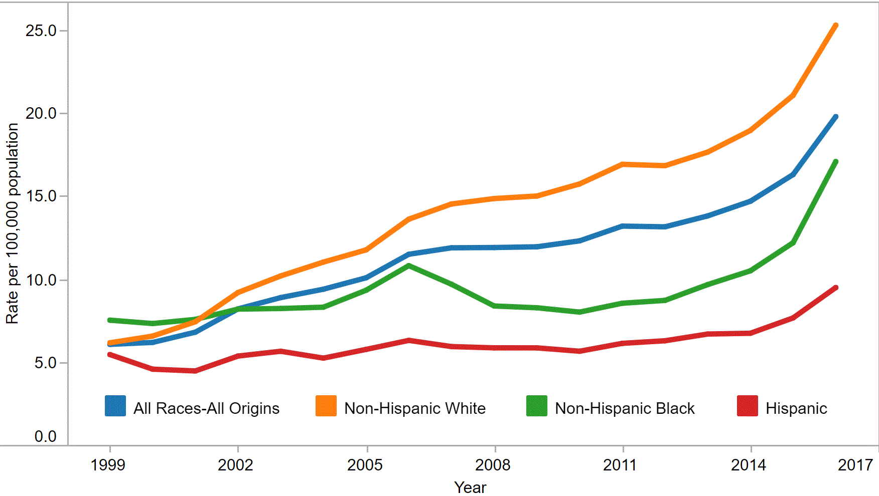




Slide 9
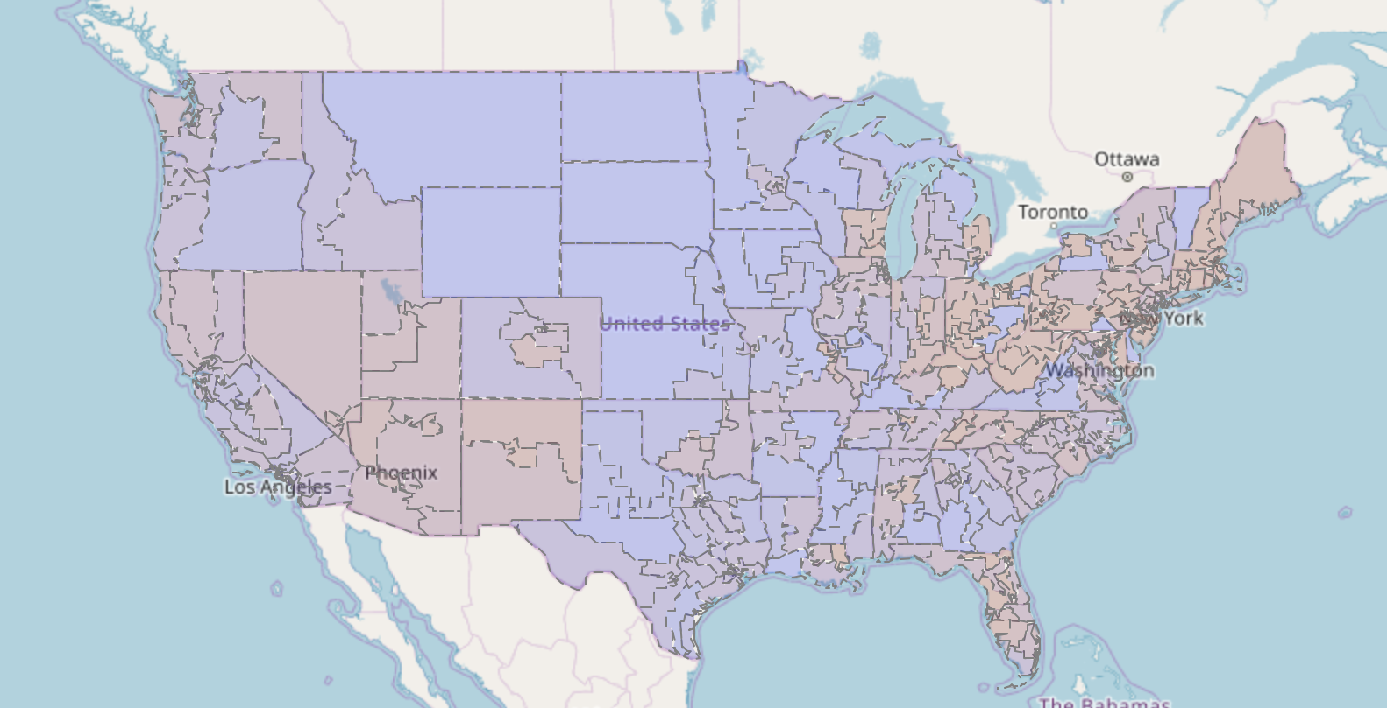

Drug Related Death Rate 2016
Notes:
Vannia: What are the most affected distracts for drug related deaths? Explain in detail the high risk areas.

Slide 10
Opioid Legislation
In this section we analyzed Bills and Acts in all districts of America and the relative outcome to the opioid death rate.
One of the ways we cleaned the data was by searching legislation using keywords such as ‘opioids,’ ‘drugs,’ and others.
We noticed a trend where distracts enacted legislation to combat the opioid crisis.
Notes:
Greg: Talk about how you decided on if legislation was used to combat opioids?

Slide 11
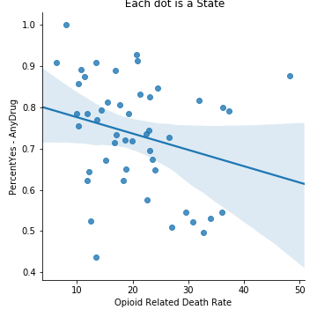
Notes:
Greg: What was the outcome of said legislation on the overall opioid death rate? Was it what you expected?

Slide 12
Opioids and Bipartisanship
By searching Bills and Acts brought to the floor, we wanted to see how much bipartisanship voting is done by certain keywords.
We determined if a piece of legislation received bipartisan support was to see how many votes were casted either for or against a bill then divide that number by the total number of votes. The closer the number is to 1 is how much bipartisan support it received.
The graph shows various keywords in legislation and bipartisan support.
Notes:
Greg: Explain how you determined Bipartisanship and why decided to look into identity politics when discussing opioids?

Slide 13
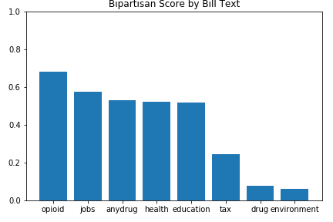
Notes:
Greg: What trend did you notice in legislation using keywords?

Slide 14
Opioids vs. Education & Age
We wanted to determine if education and age plays a role in the amount of opioid related deaths
We also wanted to track any major changes in this correlation over the years of 2013-2016
On the following charts we plotted this information to determine the correlation and progression over time
Notes:
Mark: Discuss what we wanted to achieve by looking at education and age

Slide 15
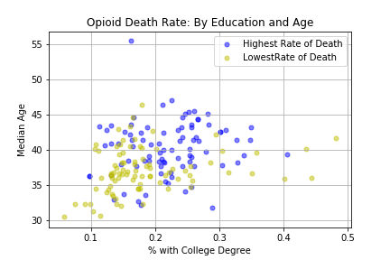
Notes:
Mark: What does this graph show?

Slide 16
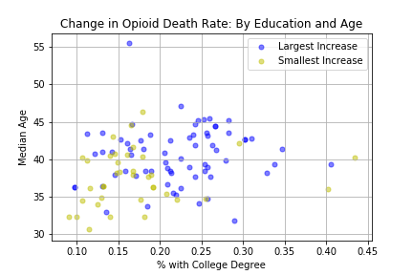
Notes:
Anyone: What trends have emerged from 2013-2016?

Slide 17

Opioids vs. Education & Ethnicity
In this section we expanded on our education correlation by comparing it along with ethnicity
We also wanted to track any major changes in this correlation over the years of 2013-2016
On the following charts we plotted this information to determine the correlation and progression over time

Slide 18
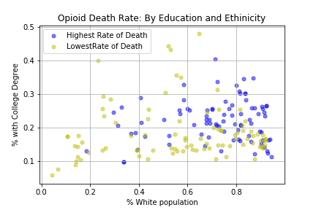

Slide 19
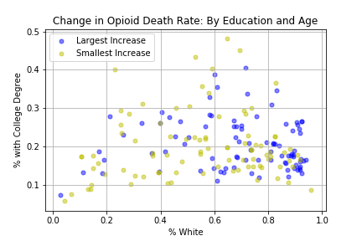

Slide 20

Opioids vs. Healthcare
In this section we wanted to determine the correlation between healthcare and opioid related deaths
We also wanted to see if our previously established correlation of having a larger white population to more opioid related deaths holds true in this scenario as well

Slide 21
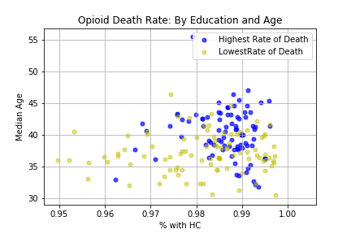

Slide 22
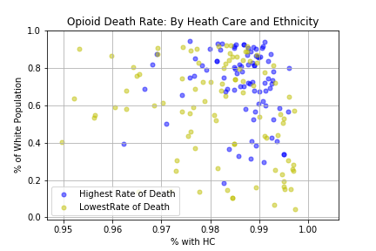

Slide 23
Opioids vs. Education & Poverty
We wanted to determine if the amount of education combined with income played a role in opioid related deaths.
Living either above or below the poverty line plays a factor.
We wanted to see if any previous correlations hold true with regards to poverty.
Notes:
Greg, Vannia

Slide 24
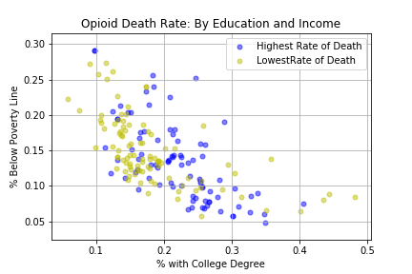

Slide 25
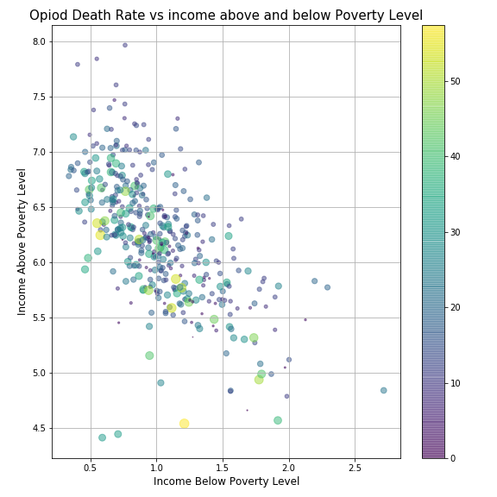

Slide 26
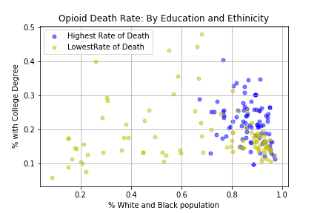

Slide 27
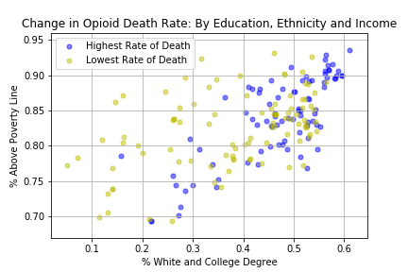
Notes:
Here we notice again when a population is predominately white there is a higher opioid related death rate

Slide 28
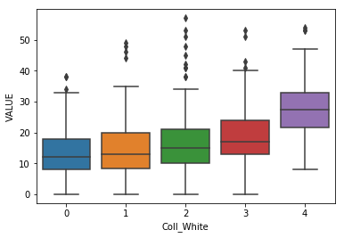
Opioid Death Rate vs. White Population and Education
Notes:
Greg: Explain the significance for this chart

Slide 29

Student T-Test
We ran a T-Test and conclude that the means were significantly different.

Slide 30
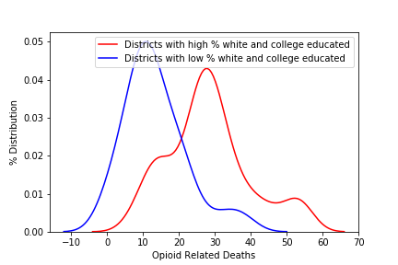

Slide 31
Summation
There are a variety of issues that factor into opioid related deaths across the United States of America. It is difficult to point to one factor or another as the root cause of this epidemic. It is clear this crisis has reached just about every community regardless of socio-economic status; however trends do show certain areas and demographics are plagued by this epidemic more than others.
Through our research and data analysis we have uncovered that populations with educated white Americans living above the poverty line seem to most affected by opioid related deaths.
Notes:
What did we take away from the project? What data/ correlation did you find particularly interesting?

Slide 32
Final Thoughts
Notes:
Each member can discuss what they found most difficult, what they took away from the project, what they would do with more time and data.

Slide 33
Q/A
Notes:
Open for questions

