Slide 1

Rattle Snake - Documentation
Graphical User Interface to pilot sensors and devices

Slide 2
VERSION of this document
Version | Date | Author | Validator | Comments
1.0 | 18/11/21 | G. Sainton |  | First version of the document

Slide 3
About Rattle snake
Rattle Snake is a software developed to pilot the devices around the PIVOT test bench.
Rattle Snake is the property of Institut de Physique du Globe de Paris – Université de Paris.

Slide 4
DeVICES linked to RATTLE SNAKE
To date 3 devices are plugged to this software:
A piezoelectric motor – Newport 8642
An interferometer – Attocube IDS 3010
A power supply – Agilent E3631 A
Please note that the interferometer use is possible because IPGP bought the right to use the DLL (associated with their Wave viewing software).

Slide 5
Installation
Operating System: Rattle Snake only work for Windows OS since the library provided by one of the instrument are DLLs
Rattle Snake is developed in Python 3.
Each devices needs some specific installation (python library, drivers…).
Rattle Snake is also linked to Wave Export to convert the streaming from the interferometer to a CSV file.

Slide 6
Environment 1/3
All the python environment and the useful libraries are managed by Anaconda (install Anaconda)
Rattle Snake (RS) was developed with Python version 3.8.8 with the graphical library PyQt5 and the plot library PyQtGraph
Newport 8642
pyusb library
Specific library already in the RS package
Attocube IDS 3010
Specific library already in the RS package
Agilent E3631 A
pyvisa library

Slide 7
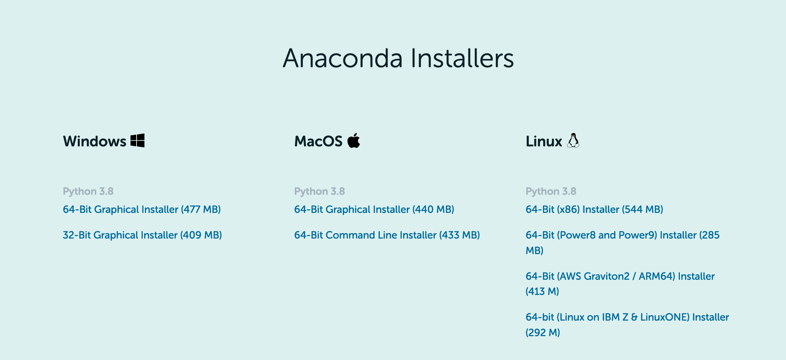
Environment 2/3 - install Anaconda
https://www.anaconda.com/products/individual
Select the installer (botton of the page)
Follow the instructions

Slide 8
Environment (3/3) – Install other libraries
2 ways:
Graphical, using the Anaconda interface
Command lines
Command lines:
conda install pyqt5
Conda install pyqtgraph
conda install pyusb
Conda install pyvisa

Slide 9
GIT repository
All the sources of Rattle Snake are saved in a repository:
https://pss-gitlab.math.univ-paris-diderot.fr/sainton/rattlesnake
One can download or clone the repository
To clone :
In a git terminal: git clone https://pss-gitlab.math.univ-paris-diderot.fr/sainton/rattlesnake

Slide 10
RUN RATTLE SNAKE
In the directory Rattle Snake, there is a file named rattlesnake.bat
Double-click on it
One can create a shortcut on the desktop, in the bottom bar…
In command line in a terminal, user can also write
$python rattlesnake.py

Slide 11
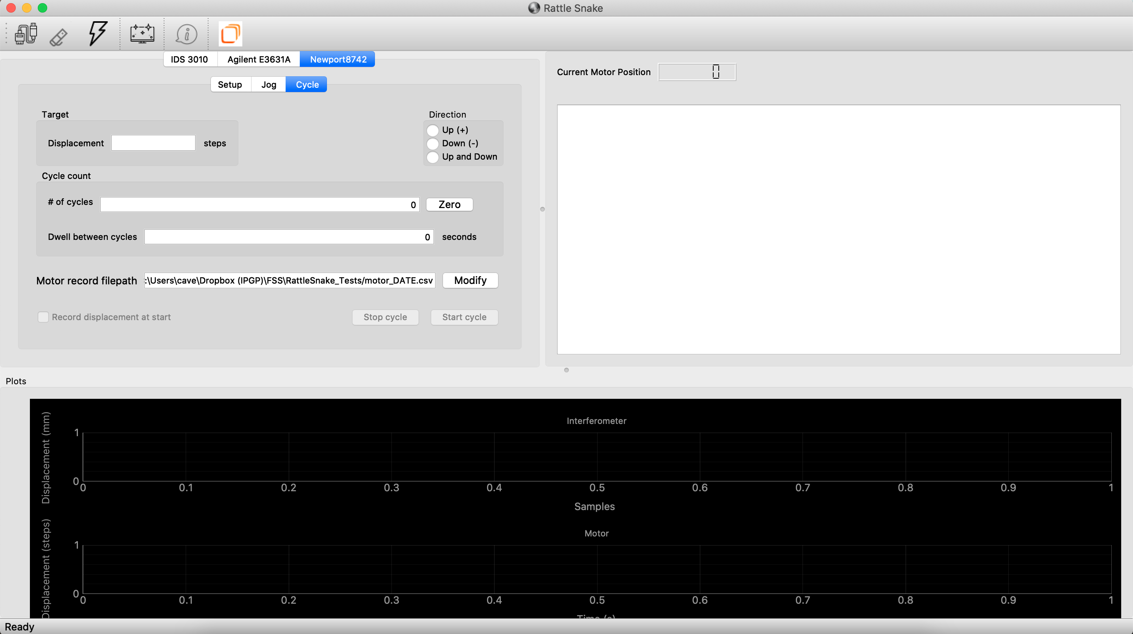
Rattle snake: Interface at start

Slide 12
Rattle snake - Action bar
To connect the motor
To connect the interferometer
To connect the power supply
To clean the console
To open wave export

Slide 13
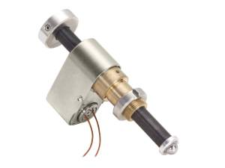
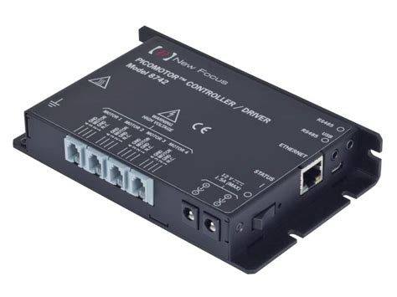
NEWPORT 8742
- Internet Site: https://www.newport.com/p/8742
- User manual : PDF

Slide 14
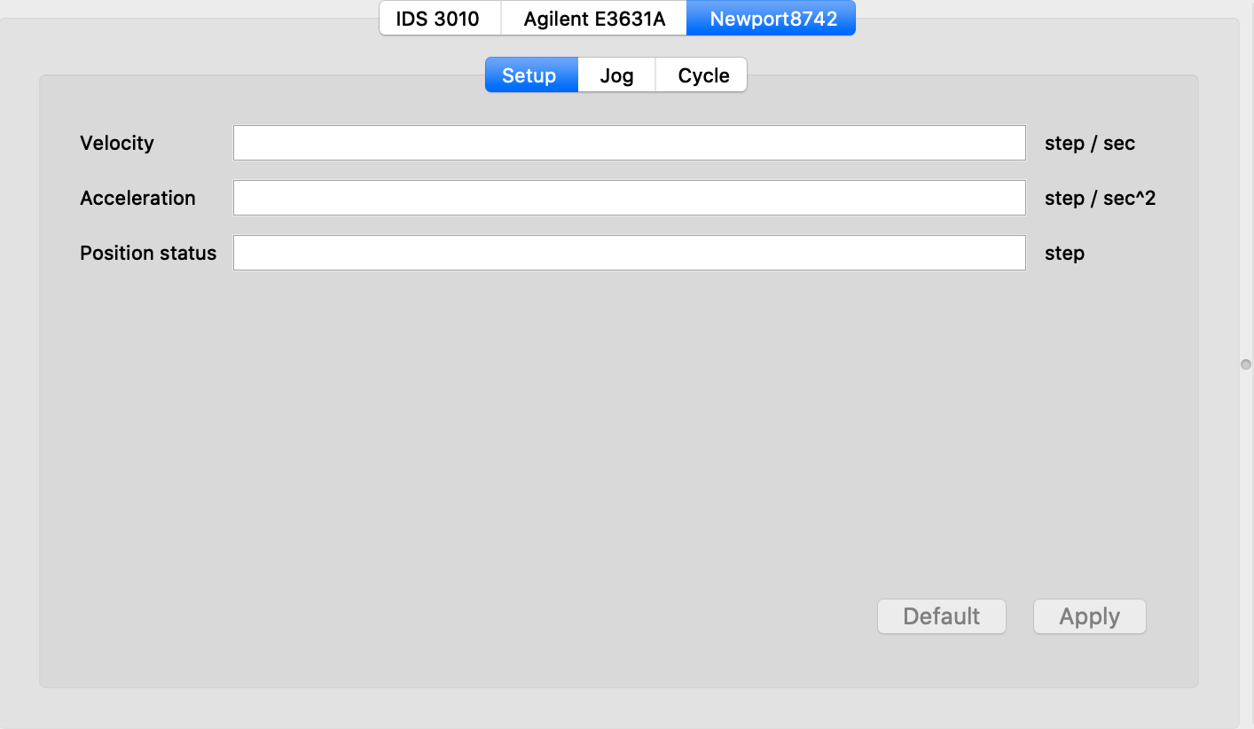
Newport 8742 – Setup panel
Default velocity at start
Default acceleration at start
Default position at start
Value | min | max | default | unit
Acceleration | 1 | 200000 | 100000 | steps/sec²
Velocity | 1 | 2000 | 2000 | steps/sec
Position | -2147483648 à +2147483647 |  | 0
Cancel changes, back to defaults
Apply changes,

Slide 15
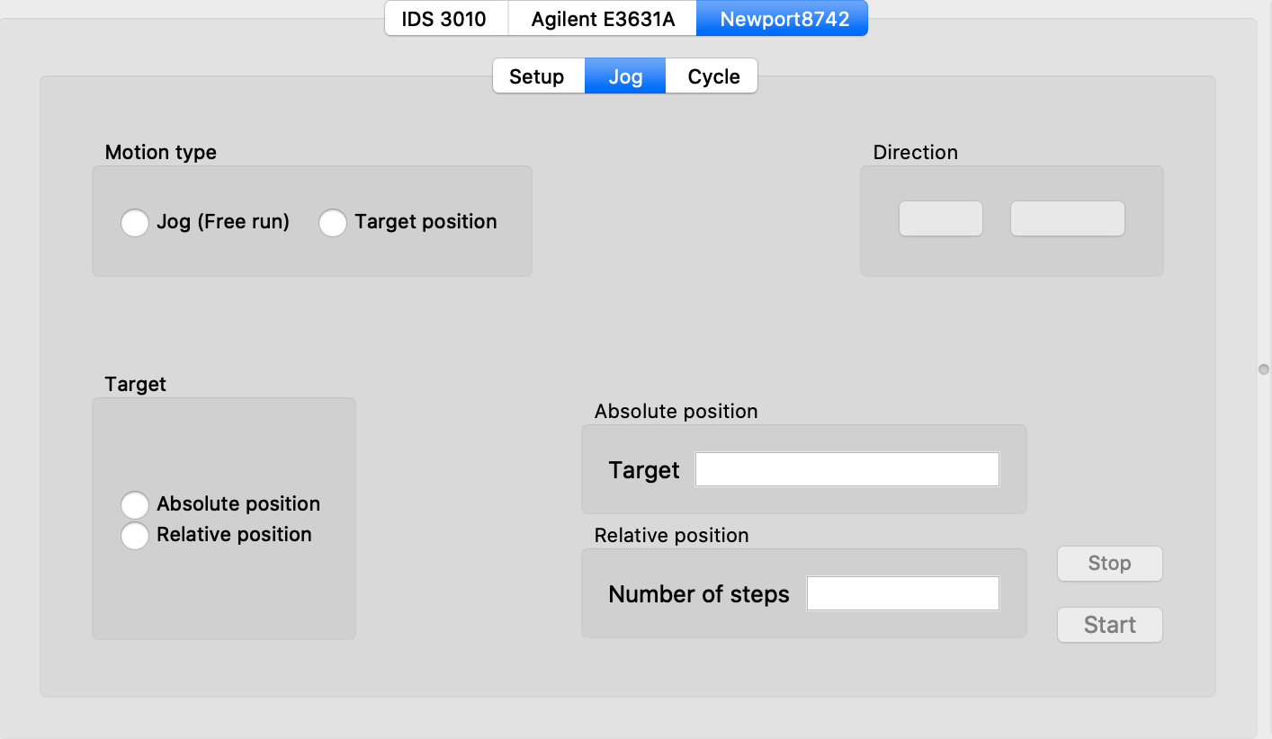
NEWPORT 8742 – JOG Tab
JOG : Continuous move depending on the direction set until user stop the motor
+
-
TARGET : move to a given position, relavive or absolute
Absolute position : in TARGET mode, user need to set the target position
Relative position : in TARGET mode, user need to set the number of steps and the direction
Send the command to the motor
Send the stop command to the motor

Slide 16
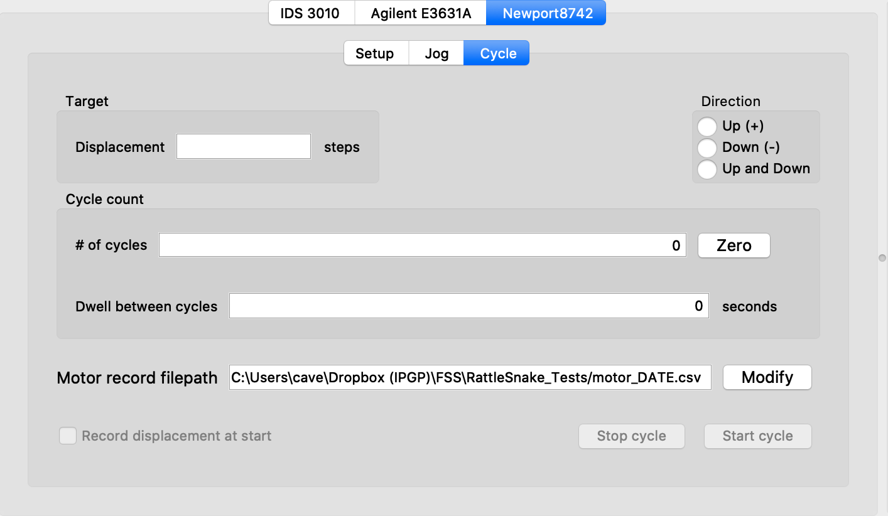
NEWPORT 8742 – CYCLE Tab
Move per step of the cycle
Number of repetition
Dwell time between two steps
Direction:
Up: only clockwise move
Down: only anticlockwise move
Up and down : Up phase then Down phase
Motor record filepath: select the path to save the data => open the preference window

Slide 17
NEWPORT 8742 – OUTPUT FILE
Data are automatically saved in the file according to the filepath.
In the filename, DATE is replace by the date while starting the cycle.
Content of the file:
Date Time, position
Date Time format = YYYY_MM_DD_hh_mm_ss_sssss

