Slide 1
SEIS Team

Slide 2
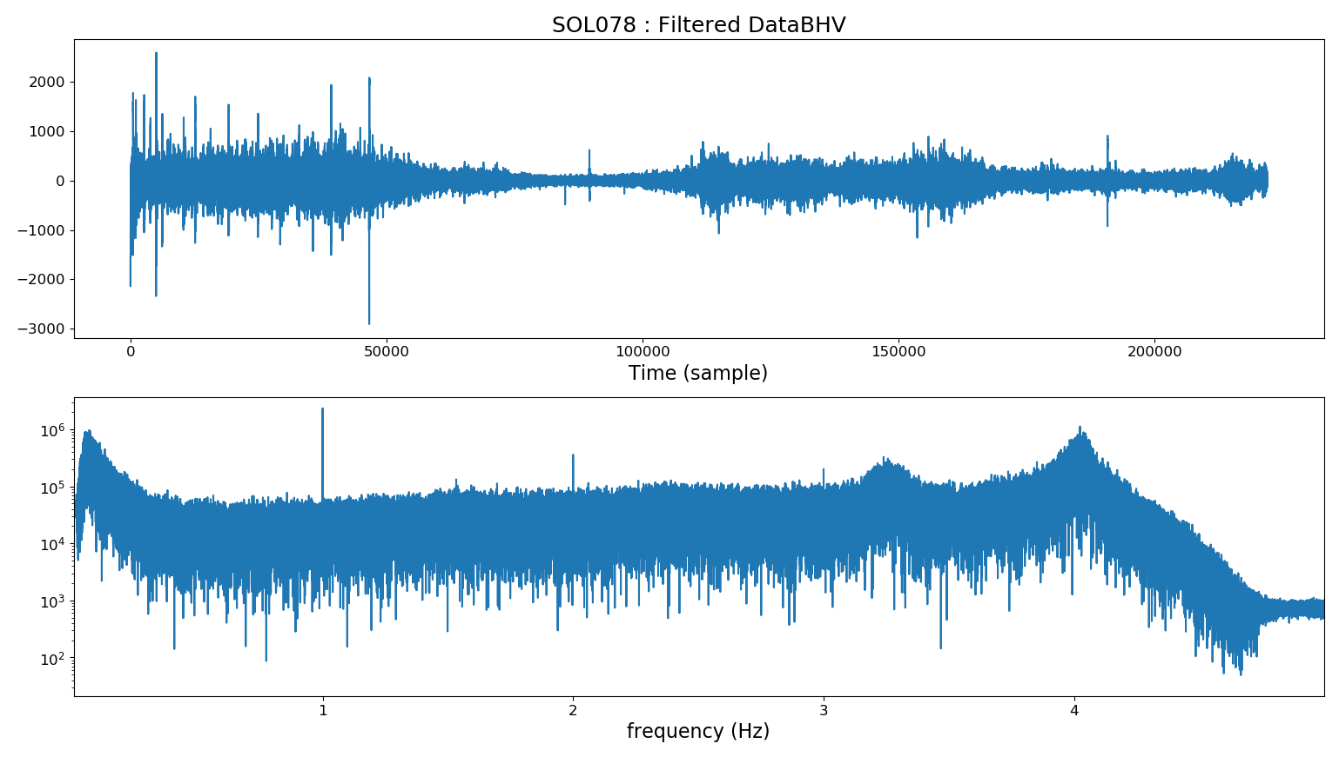
Removing Tic Noise on SEIS data
Method (code from Lognonné/Kenda):
Select a length T (second) to stack the signal over
High pass the signal at 1/T
Compute a Stack signal over a moving window of length T
Remove the Stack signal on No-High Passed data over the same moving window
NP = fs*T
Raw data : 03.BHV (VBB fe=10sps)
T = 20s
Spectrum

Slide 3
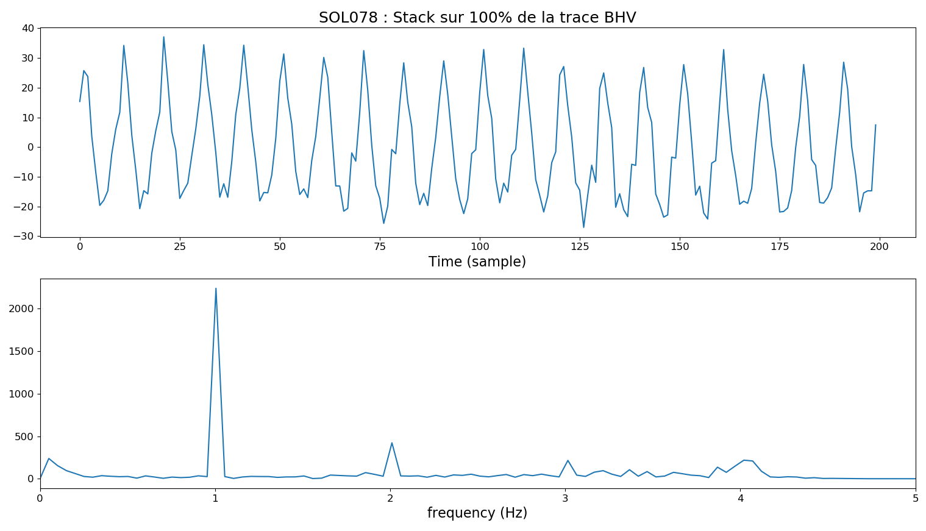
Removing Tic Noise on SEIS data
Computed Stack Signal (T=20s on 10sps VBB data) :

Slide 4
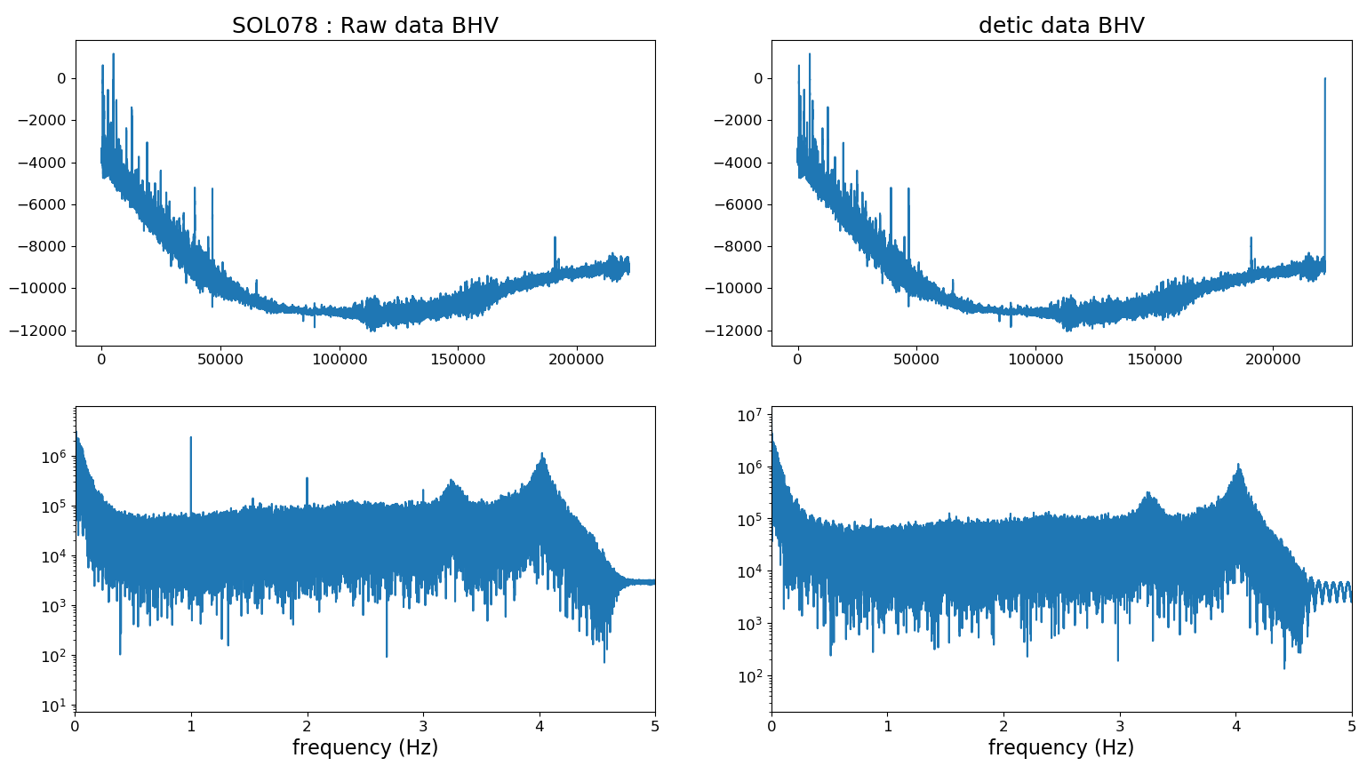
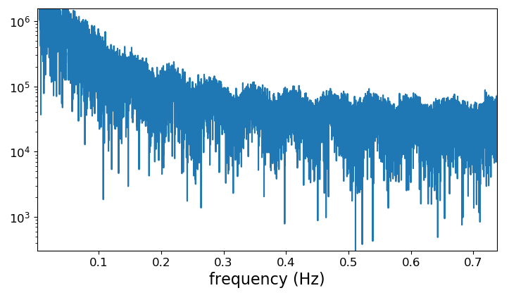
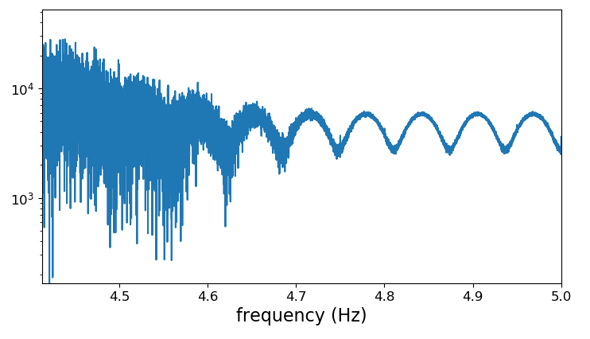
Removing Tic Noise on SEIS data

Slide 5
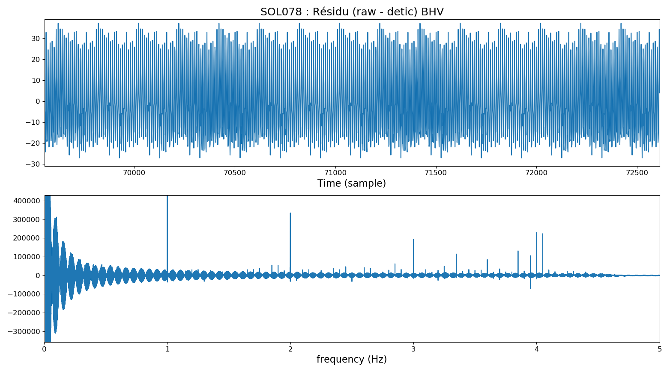
Removing Tic Noise on SEIS data
Residue (Raw – De-Tic Data) for T=20s on 10sps VBB data :

Slide 6
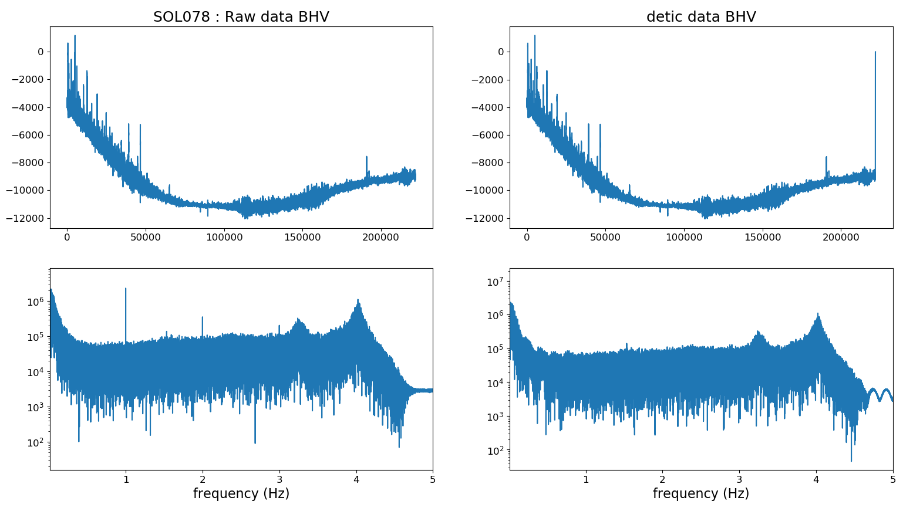
Removing Tic Noise on SEIS data
T=10s on 10sps VBB data :

Slide 7
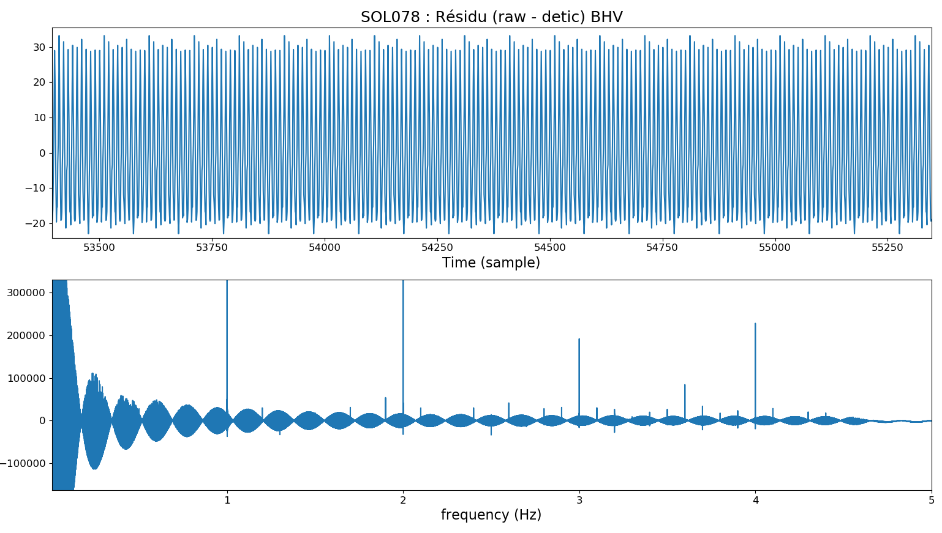
Removing Tic Noise on SEIS data
T=10s on 10sps VBB data :

Slide 8
Removing Tic Noise on SEIS data
Δfs
Δfs = frequency step for Stack
Δfd = frequency step for Data
Δfd
0
Hz
fe/npts
1/T
Width of interference signal :
R = remainder(Δfs/Δfd,1)
Width = Δfs/R
To avoid this interference signal R must be = 0.
We can compute the number of points to remove or the number of points to add.

Slide 9
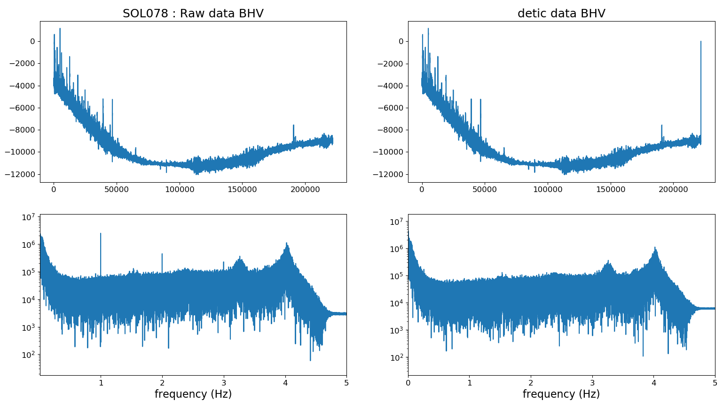
Removing Tic Noise on SEIS data
Same results with T=10s on 10sps VBB BHV data for SOL 78 but after removing 57 samples at the end :

Slide 10
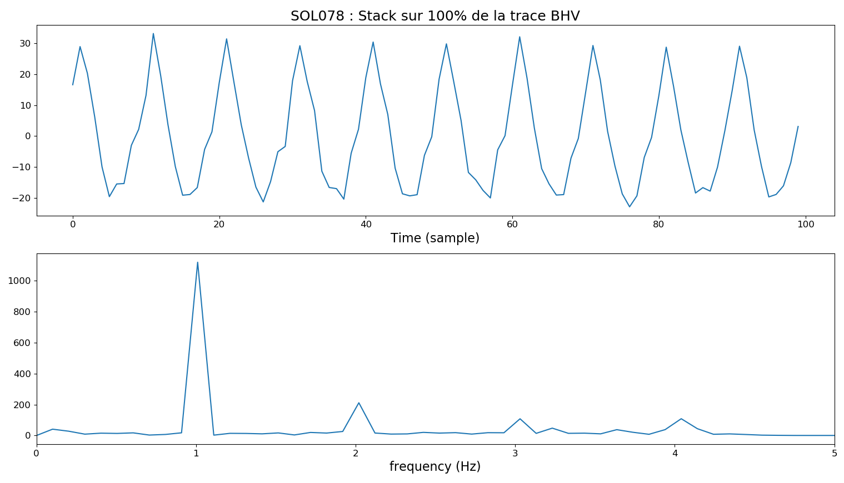
Removing Tic Noise on SEIS data
Same results with T=10s on 10sps VBB BHV data for SOL 78 but after removing 57 samples at the end :

Slide 11
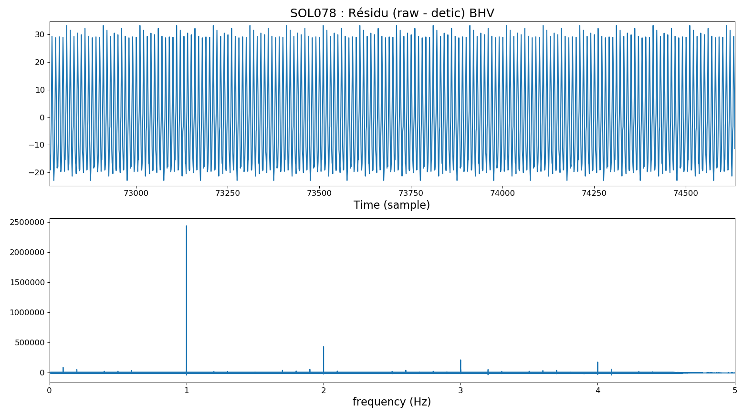
Removing Tic Noise on SEIS data
Same results with T=10s on 10sps VBB BHV data for SOL 78 but after removing 57 samples at the end :

Slide 12
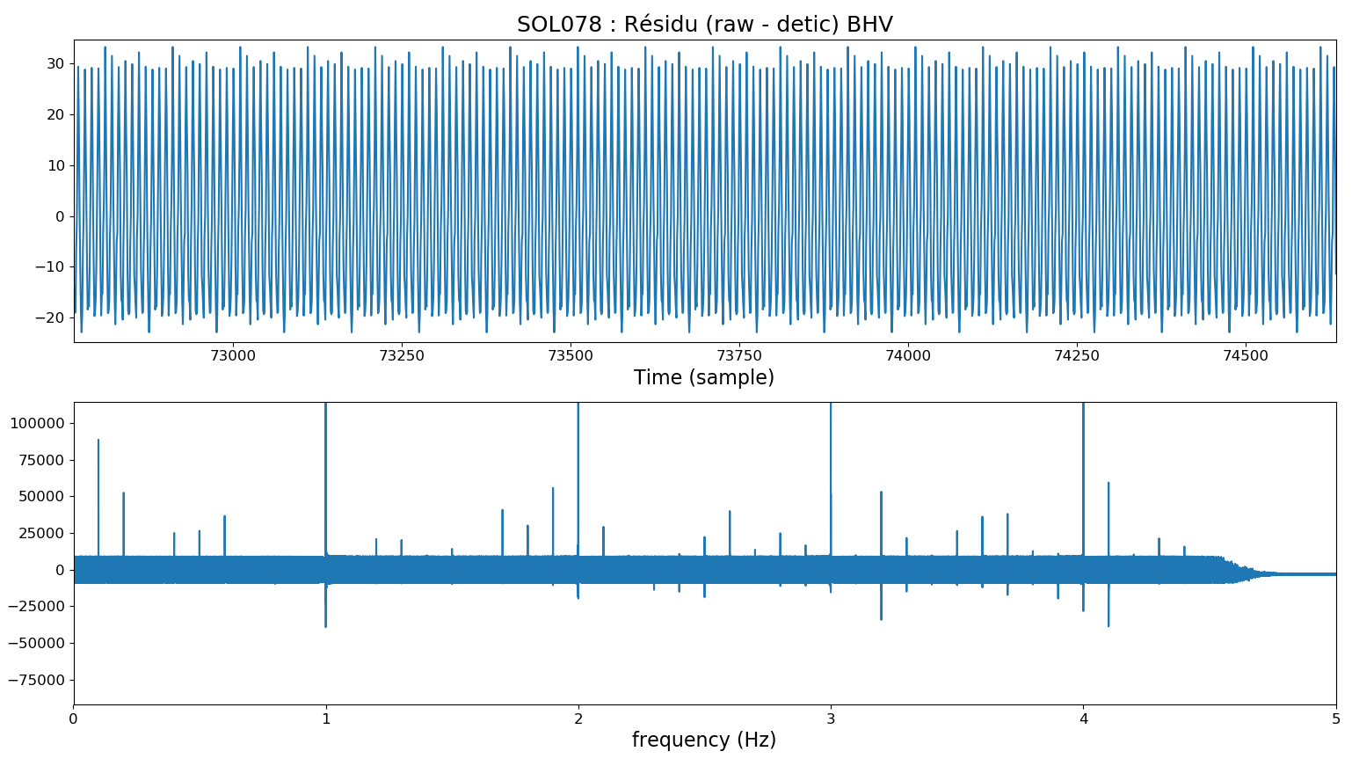
Removing Tic Noise on SEIS data
An other issue : Zoom on the previous figure.
We only want to change the signal at 1Hz, 2Hz, 3Hz, ...
The best would be T=1s → But it doesn't work

Slide 13
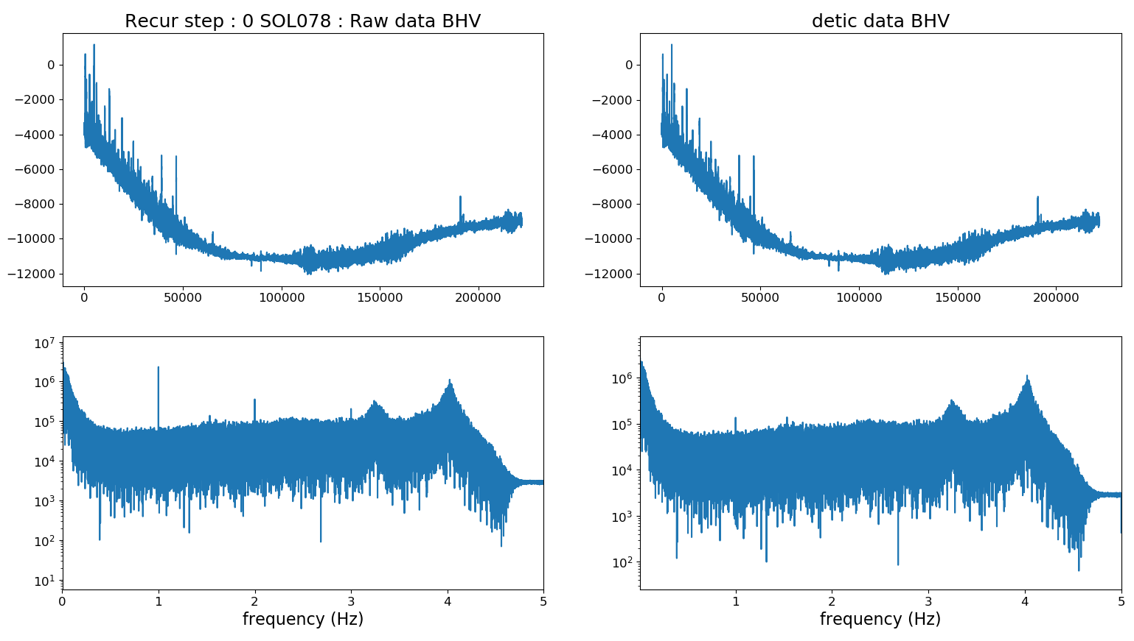
Removing Tic Noise on SEIS data
The same but with T=2s on 10sps VBB BHV data for SOL 78 and after adding 2 zeros at the end :
1Hz residual

Slide 14
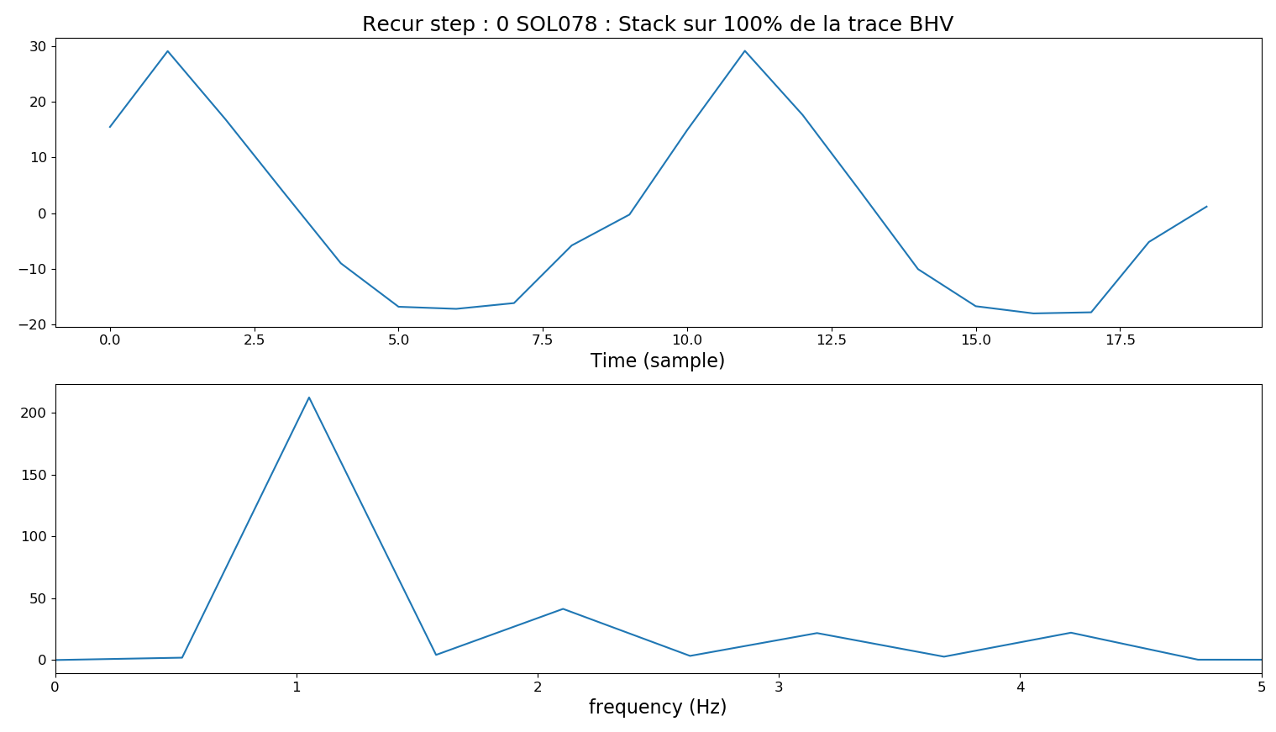
Removing Tic Noise on SEIS data
The same but with T=2s on 10sps VBB BHV data for SOL 78 and after adding 2 zeros at the end :

Slide 15
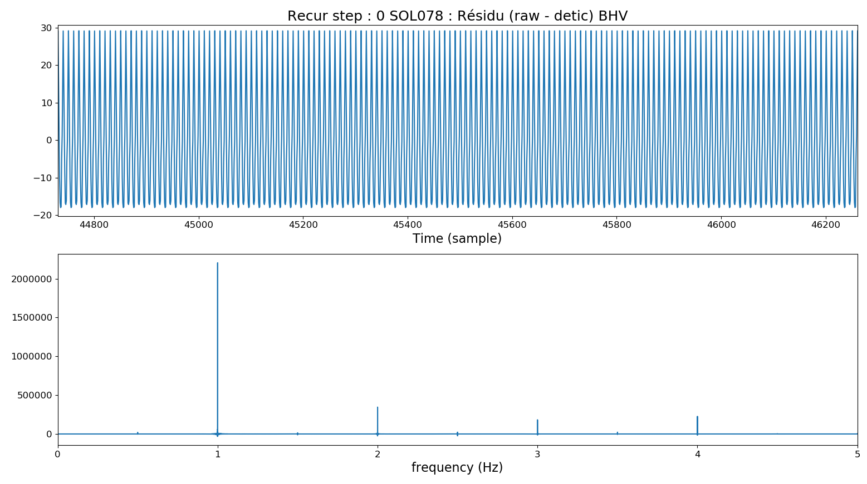
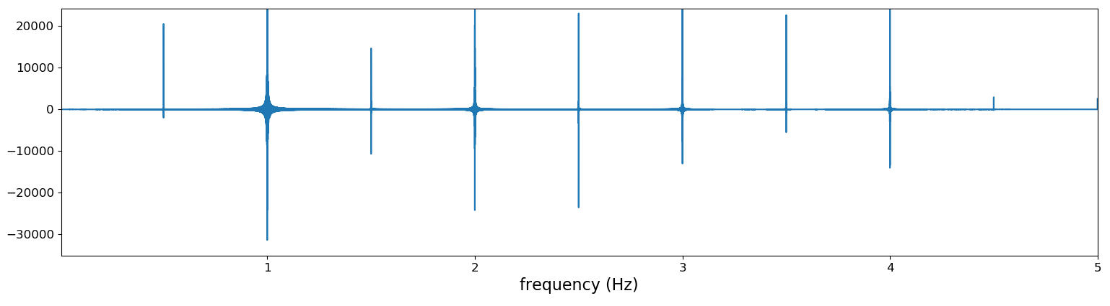
Removing Tic Noise on SEIS data
The same but with T=2s on 10sps VBB BHV data for SOL 78 and after adding 2 zeros at the end :
Zoom

Slide 16

Removing Tic Noise on SEIS data
As with T=2s the 1Hz signal remain we can repeat the same process recursively.
After one another step the 1Hz signal is removed.

Slide 17
Removing Tic Noise on SEIS data
Summary :
The method from Lognonné/Kenda works for remove the tic noise but according to the number of points in the trace the processed data have a periodic residual coming from an “interference signal”.
To avoid that we can remove some points at the end of the trace or add some zeros before the processing.
The choice of the length of the stack window (T) have an impact on the spectrum of the processed data because all n*(1/T) frequencies are changed. However we only want to change 1Hz, 2Hz, 3Hz, … and not 1 + (1/T) Hz …
The best choice for T would thus be T=1s but it doesn’t work if we apply the process only one time.
We could maybe apply the process several time in a recursive way to solve this issue.
For instance, the recursive procedure has succeeded for T=2s in two step.

