Slide 1
Greg Simpson
Galvanize Data science fellow

Slide 2
Motivation and Background
Long career in software
Many Big name companies; several small companies
Lots of different roles
Plenty of success
GPS-OCX ground station contract win
Too many “less than successes”
Looking for something new to keep me interested

Slide 3


After Galvanize

Slide 4
3 GOALS for Capstone
Combine
HealthCare Domain
Data Science
IBM Watson Tools

Slide 5
HealthCare Domain
Breast Cancer Study from the University of Wisconsin
Publicly available data
700 records
10 features – cell characteristic measurements
1 actual result
2 – benign
4 – malignant
Goal is to compare the results of your classifier against the actual result

Slide 6
3 GOALS for Capstone
Combine
HealthCare Domain
Data Science
IBM Watson Tools

Slide 7
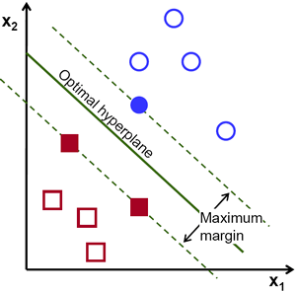
Support Vector Machine (SVM)
Hyperplane
best separates two classes of points with the maximum margin.
https://www.quora.com/What-does-support-vector-machine-SVM-mean-in-laymans-terms

Slide 8
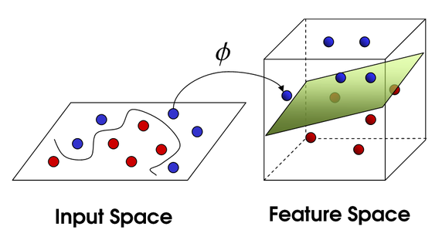
Kernels Project Data to Increase Separation

Slide 9
3 GOALS for Capstone
Combine
HealthCare Domain
Data Science
IBM Watson Tools

Slide 10
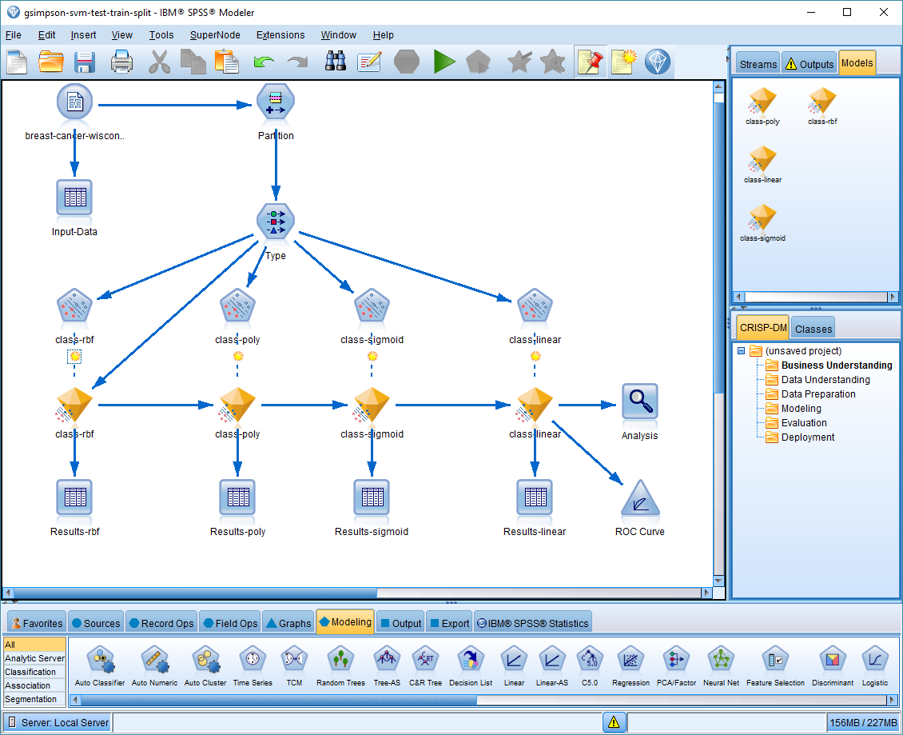
SPSS Stream Screen Shots

Slide 11
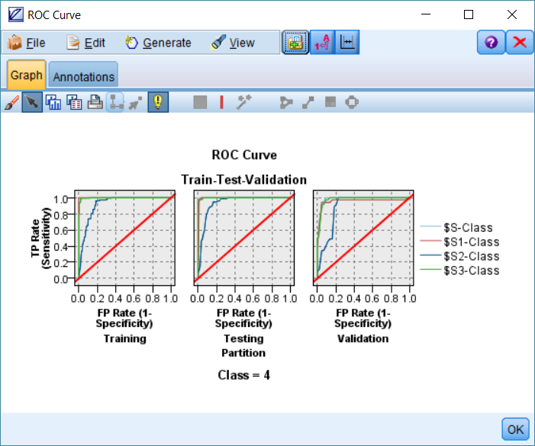
SPSS Stream Screen Shots

Slide 12
Model Results
Train (correct / incorrect)
Polynomial : 100% / 0%
Test (correct / incorrect)
Rbf (Radial basis function) : 96.89% / 3.11%
Validation (correct / incorrect)
Linear : 92.41% / 7.59%

Slide 13
Which one to choose
The prediction accuracy obtained from the unknown set more precisely reflects the performance on classifying an independent data set. An improved version of this procedure is known as cross-validation.
http://www.csie.ntu.edu.tw/%7Ecjlin/papers/guide/guide.pdf
Validation (correct / incorrect)
Linear : 92.41% / 7.59%

Slide 14
Questions and Contact
Greg Simpson
gsimpson@pobox.com
303.907.2233

Slide 15
IBM Watson Tools
IBM SPSS Modeler
http://www-03.ibm.com/software/products/en/spss-modeler
Covers 3 main phases
Data ingestion and manipulation
Easy, fast, repeatable
Simple data partitioning into Train-Test-Validation data sets
Modeling
Icon based configurations
Parallel and serial capabilities
Display
Not the strongest
Other tools are better

Slide 16
Data Science
SVM Classifier
Support Vector Machine
supervised learning models analyze data used for classification and regression analysis.
Existing data is mapped so that the examples of the separate categories are divided by a clear gap that is as wide as possible (called a hyperplane). New examples are then mapped into that same space and predicted to belong to a category based on which side of the gap they fall on.
https://en.wikipedia.org/wiki/Kernel_method
Kernels
Mathematical functions used to project data to increase separation
RBF, Polymomial, Sigmoid, Linear

