Slide 1


Slide 2
Greg Simpson SupportVectorMachine-CancerClassification
Galvanize Data science fellow
IBM Data scientist (soon)

Slide 3
Motivation and Background
Long career in software
Many Big name companies; several small companies
Lots of different roles
Plenty of success
GPS-OCX ground station contract win
Too many “less than successes”
Looking for something new to keep me interested

Slide 4


After Galvanize

Slide 5
3 GOALS for Capstone
HealthCare Domain
Data Science Methods
IBM Watson Tools

Slide 6
HealthCare Domain
Breast Cancer Study from the University of Wisconsin
Publicly available data
700 records
10 features – cell characteristic measurements
1 actual result
2 – benign
4 – malignant
Goal is to compare the results of your classifier against the actual result

Slide 7
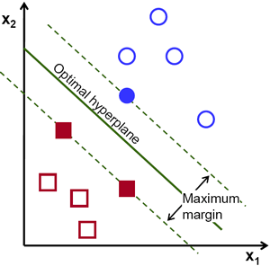
Support Vector Machine (SVM)
Hyperplane
best separates two classes of points with the maximum margin.
https://www.quora.com/What-does-support-vector-machine-SVM-mean-in-laymans-terms

Slide 8
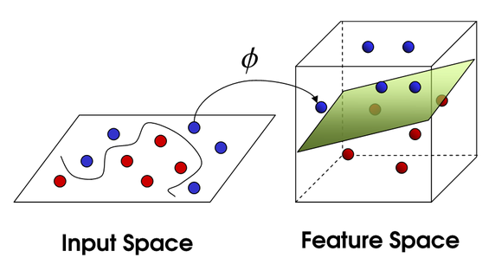
Kernels Project Data to Increase Separation

Slide 9
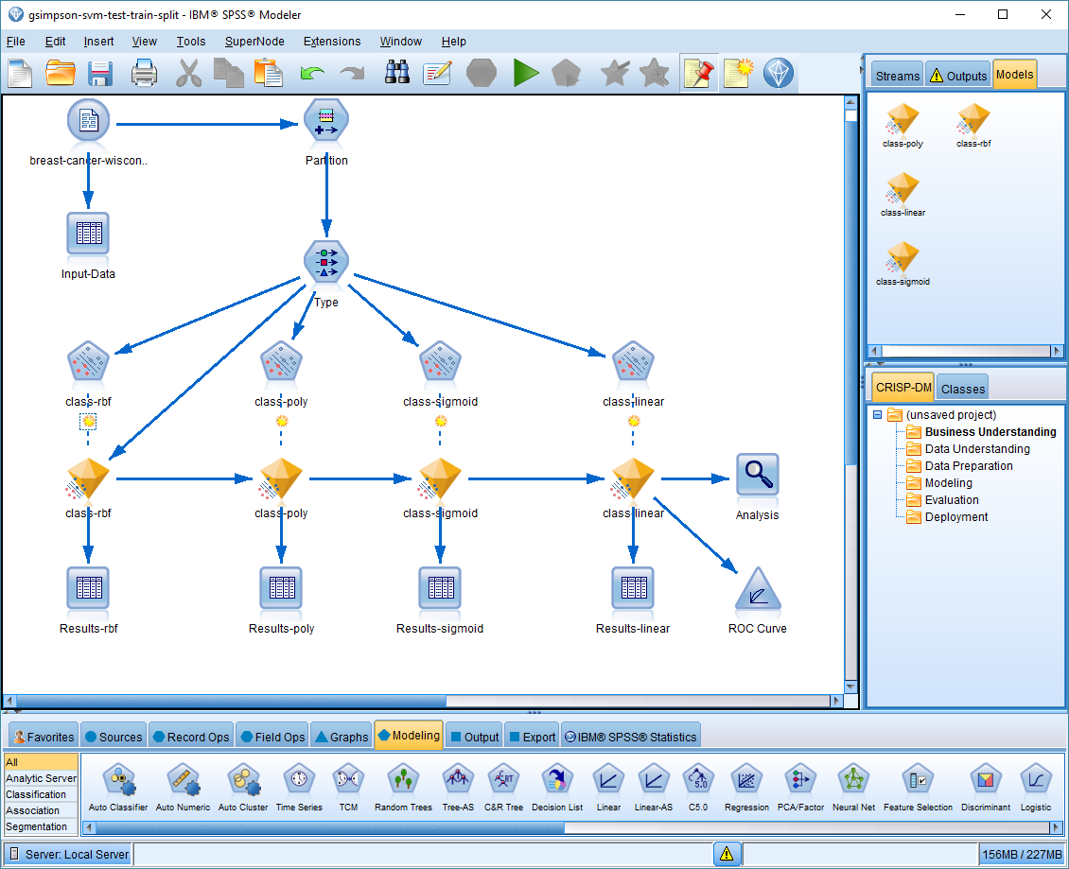
IBM SPSS Stream Screen Shot

Slide 10
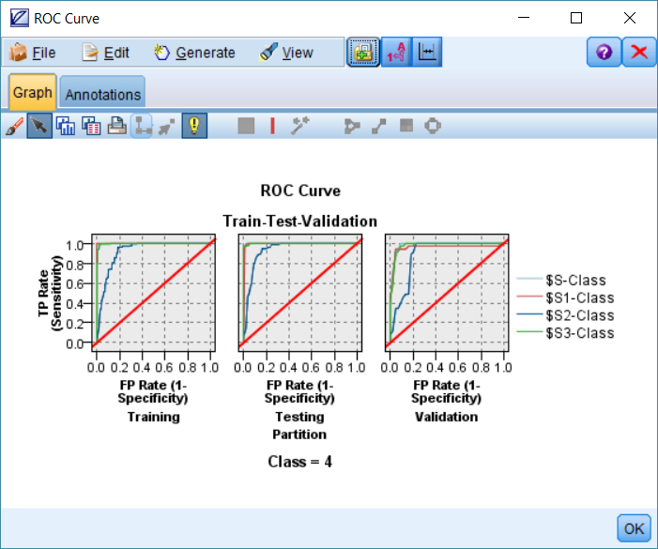
IBM SPSS ROC Curve

Slide 11
Model Results
Train (correct / incorrect)
Polynomial : 100% / 0%
Test (correct / incorrect)
Rbf (Radial basis function) : 96.89% / 3.11%
Validation (correct / incorrect)
Linear : 92.41% / 7.59%

Slide 12
Which one to choose
Test (correct / incorrect)
Rbf (Radial basis function) : 96.89% / 3.11%
The prediction accuracy obtained from the unknown set more precisely reflects the performance on classifying an independent data set. An improved version of this procedure is known as cross-validation.
http://www.csie.ntu.edu.tw/%7Ecjlin/papers/guide/guide.pdf

Slide 13
Questions and Contact
Greg Simpson
gsimpson@pobox.com
303.907.2233
linkedin.com/in/gregoryjsimpson
github.com/GregSimpson
SupportVectorMachine-CancerClassification

