Slide 1
NetraPi – Phase 1 Updates
Date: 4/1/2026

Slide 2
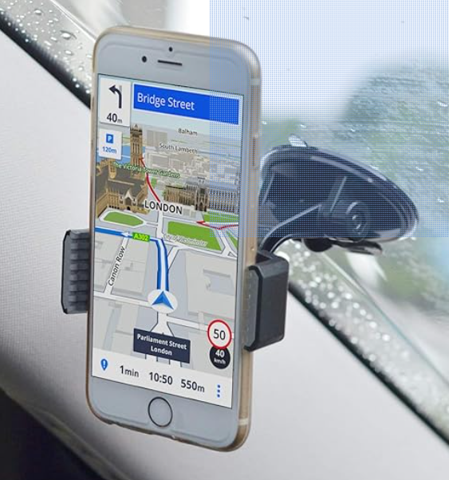
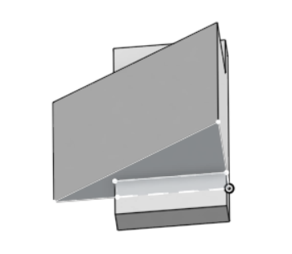
Redoing Physical Configuration
- Trying different approach for the system because the camera footage is shaky and there was wires in the frame
Bought a new mount that is more compact (doesn’t have lever arm)
Created & ordered 3D printed wedge mount so camera view could be level with ground
Will use the dual lock adhesive to attach the wedge to the windshield and then mount the camera on the rectangular base
The mount will hold the pi case
The mount and the wedge mount will be in close proximity
Hopefully this reduces shakiness
Got a library card and will attend maker space orientation on Saturday so I can start using the 3D printer for cheaper

Slide 3
Previous Progress
With the previous setup, the 3 hour driving test passed
All of the footage clips were saved no problem (no corruption, etc)
Will have to redo all of the tests once I have the new setup though

Slide 4
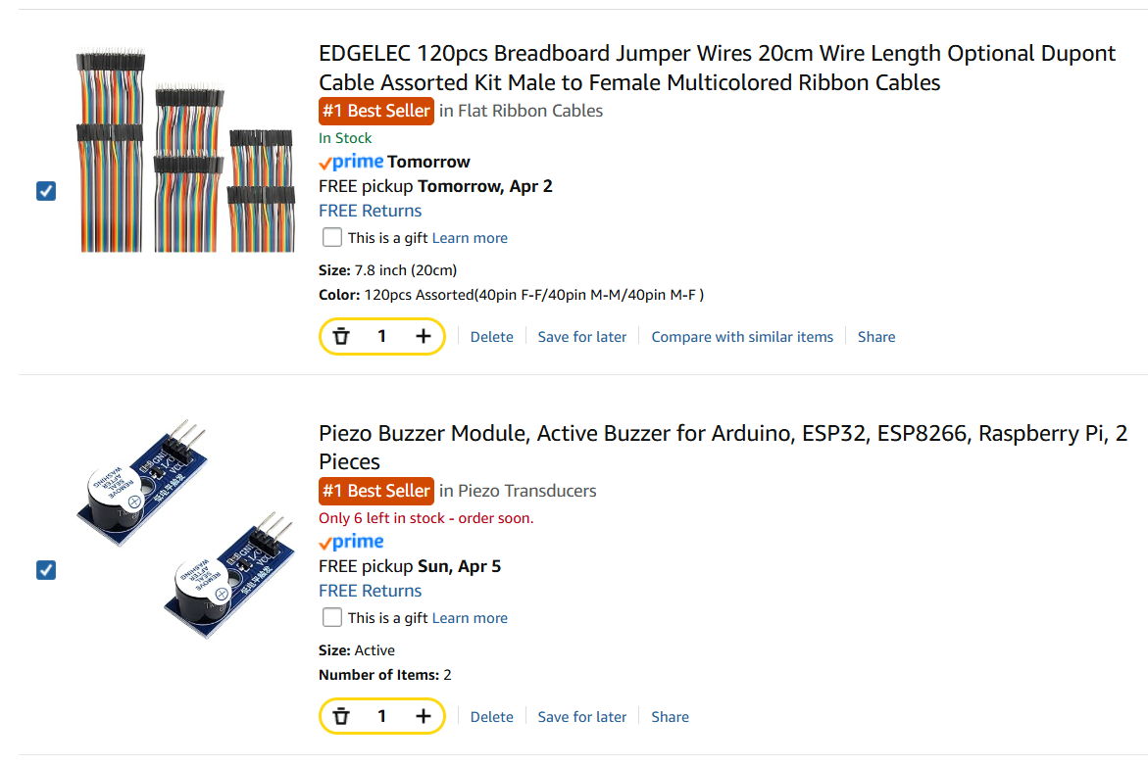
Real-time Audible Feedback
- Need to buy some speaker modules with wires so that when an event is detected, a sound will be played

