Slide 1
Sprint 4 – Documentation & Testing
June 10 – June 16 (2025)

Slide 2


Rough Timeline (6/11)
Sprint 4
Today
6/11

Slide 3
Agenda #1 – 6/11 Wednesday
Almost done with the documentation catch up backlog item
Retrospective 3
Completed Notion and .md files
Creating new backlog item to help me implement ideas
Plan on improving and using the previously designed motivational plan created last sprint
Introduce other backlog items that will be addressed this sprint
Intro to code review & testing
Documentation catchup
Stat card system
Retro3: Improved Reward System

Slide 4
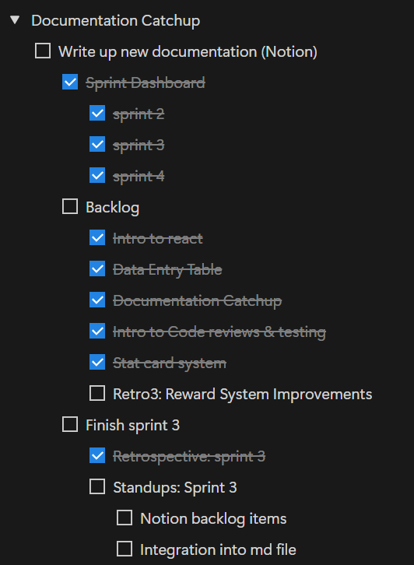
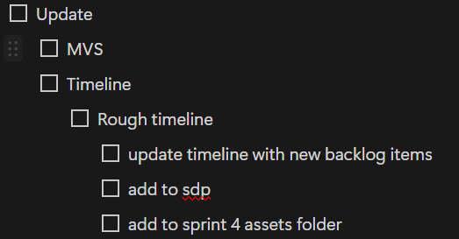
Previous Progress – Documentation Catchup
Need to create sprint 4 timeline
Need to reformat some files
Have a couple of new files to create
Need to finish sprint 3 standup documentation
Overall: Pretty close to being done

Slide 5
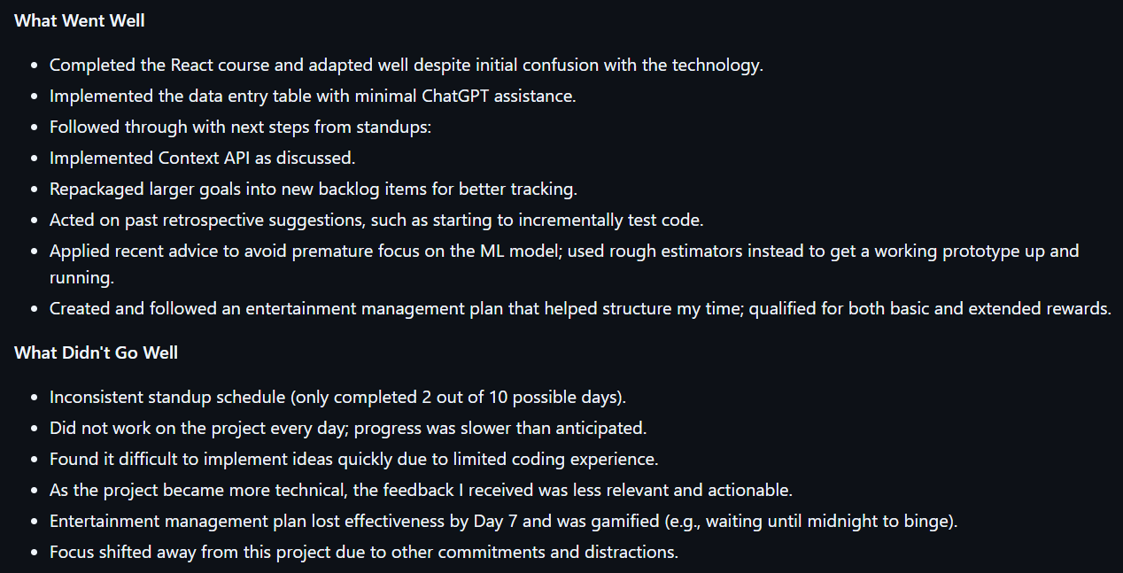
Previous Progress – Retrospective #3 p1

Slide 6
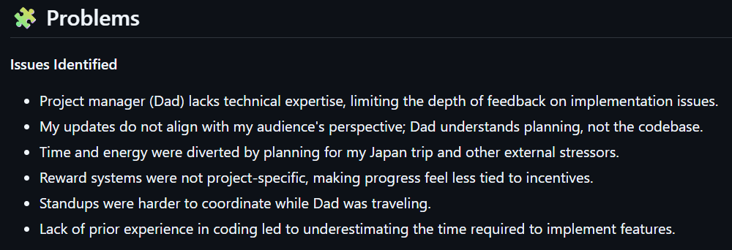
Previous Progress – Retrospective #3 p2

Slide 7
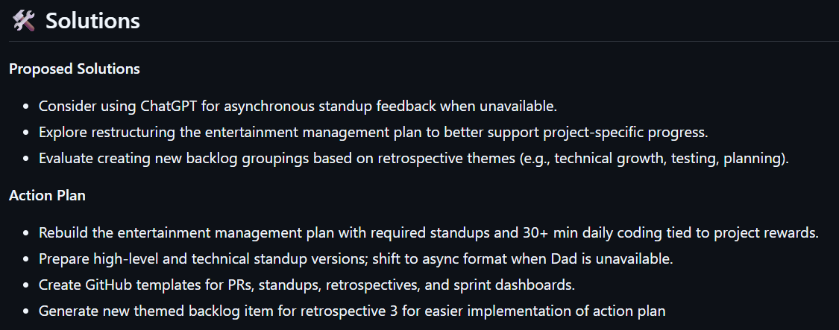
Previous Progress – Retrospective #3 p2

Slide 8
Problems & Blockers
There’s a lot to do in a short period of time
Probably will need to redistribute backlog items

Slide 9
Pending Actions
Finishing up documentation
Create timeline specific to sprint 4

Slide 10
Next Steps
Complete documentation catchup backlog item today
Start working on motivation/reward system document

Slide 11
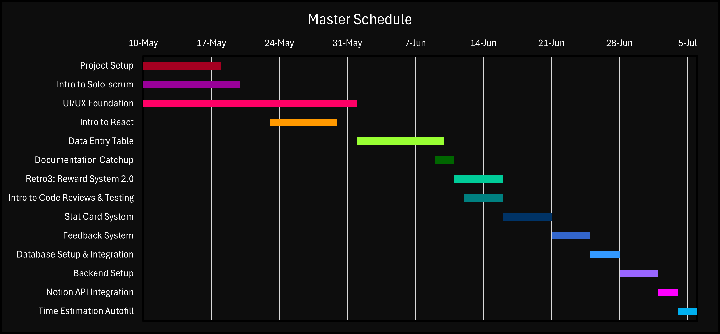
Master Schedule (Day #2 - 6/12)
Sprint 4
Today 6/12

Slide 12
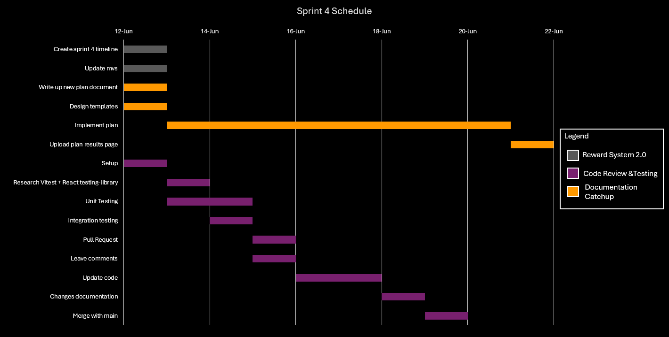
Sprint 4 Schedule
Today 6/12

Slide 13
Agenda (Day #2 - 6/12)

Slide 14
Previous Progress

Slide 15
Problems & Blockers

Slide 16
Pending Actions

Slide 17
Next Steps

