Slide 1
Sprint #3 – Data table setup
Monday June 2nd, 2025

Slide 2
Agenda
Discuss issues
ChatGPT reliance
Working on things outside of the timeline order due to laziness
Impulsive/Unfocused work – starting adding new features
Show DataTable implementation using ChatGPT assistance
Solutions
Redo table implementation without any chatgpt assistance
Start using documentation for Tailwind CSS and Shadcn/UI

Slide 3


Previous Progress – Rough Timeline

Slide 4
Previous Progress – Sprint 3 w/ ChatGPT

Slide 5
Previous Progress – No Assistance Timeline

Slide 6
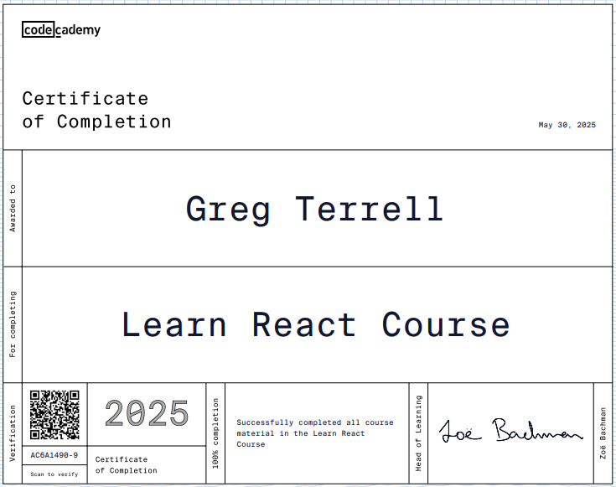
Previous Progress – Completed React Course

Slide 7
Quiz Progress
Backlog items: Intro to UI/UX + Intro to Scrum complete
Quiz #1, 86%
Quiz #2 – 45% (19/40) ----> 78% (31/40)
Quiz #3 – 80% (24/30)

Slide 8
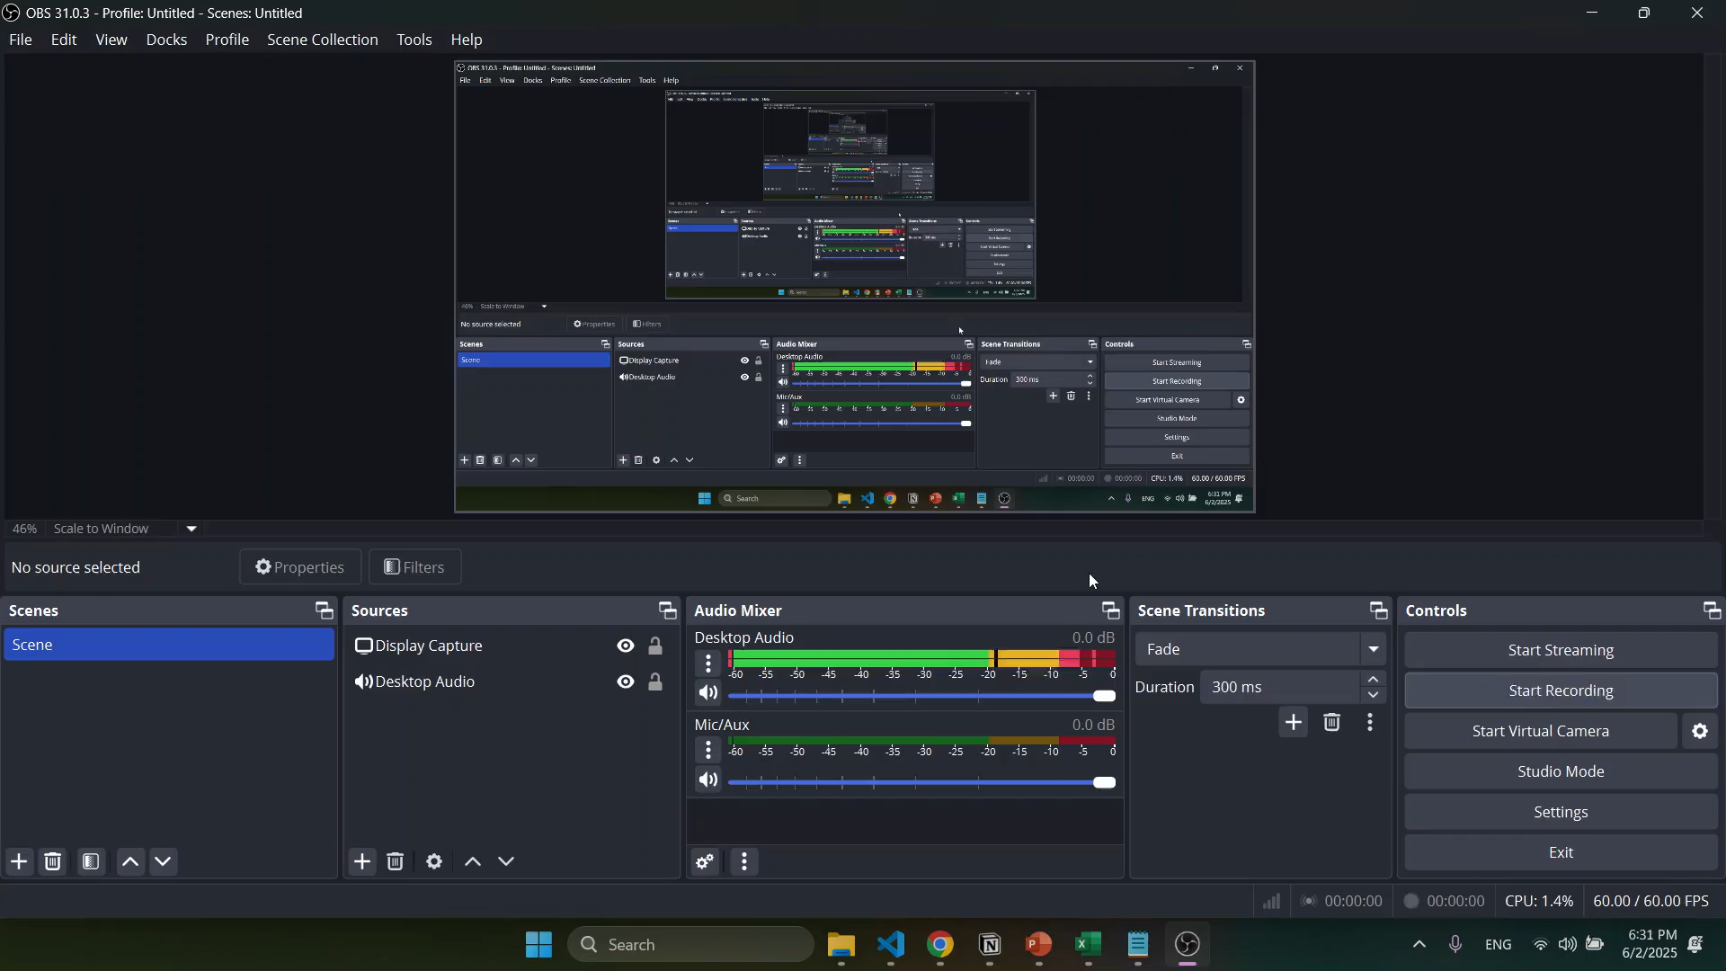
Task Table w/ ChatGPT

Slide 9
Problems & Blockers
Too much reliance on ChatGPT – not learning enough
Not implementing items in order of the timeline
Adding a bunch of new features impulsively
Put in the work to understand React better but I don’t have a super strong grasp on css and html principles
Theres a more advanced/flexible table component in shadcn’s library that I didn’t see previously

Slide 10
Pending Actions
Implement Data Table again
Calendar popup
Numeric column that restricts user inputs to solely positive numbers
Category drop selection menu
Use context API
Upload standup documentation to GitHub

Slide 11
Next Steps
Restart table development without any ChatGPT assistance
Learn how to use context api
Start using Tailwind CSS and Shadcn/ui documentation

