Slide 1
Sprint 8: Gluing Everything Together
Monday 9/1 – Tuesday 9/16

Slide 2
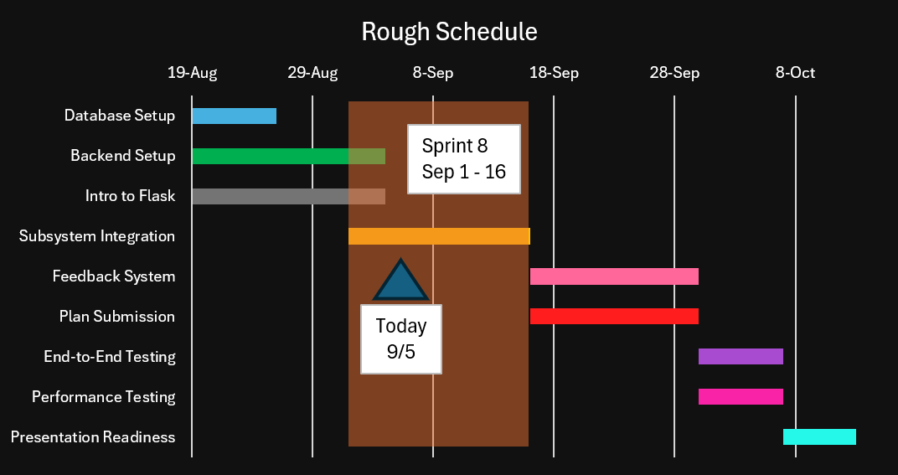
Timeline – Day 5, Sep 5

Slide 3
Agenda
Estimated end date: Oct 13 (~ 1 month)
Completed: Database Setup, Backend Setup, Intro to Flask
Progress feels slow
Rest of this sprint:
Finish Subsystem Integration (loosely connecting everything together)
Merge everything together (Pull Request)
6 Backlog items remain
1 is already being addressed (Subsystem Integration)
2 Main Features left to implement
Submitting Plan (sending data to productivity app Notion)
Feedback System
Last 3: testing, documenting, and making things presentable for employers

Slide 4
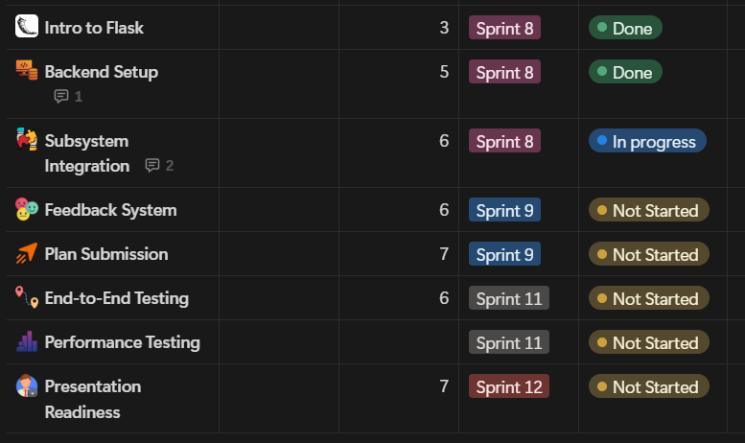
Final Stretch Snapshot

Slide 5
Previous Progress
Database is setup & with a more efficient design
Basic backend is setup
Two api endpoints developed
Checking flask’s status
Retrieving data and then calculating the statistical metrics
Designed + passed two basic quizzes covering concepts learned for Flask (score must be 70% or greater)
Course corrected: Subsystem Integration
Stopped scope creep, split new ideas into new backlog items
Labeled new backlog items as ‘extras’ in Notion
Redefined subtasks + Definition of Done
Completed two swimlane diagrams – helpful for designing subsystem interactions

Slide 6
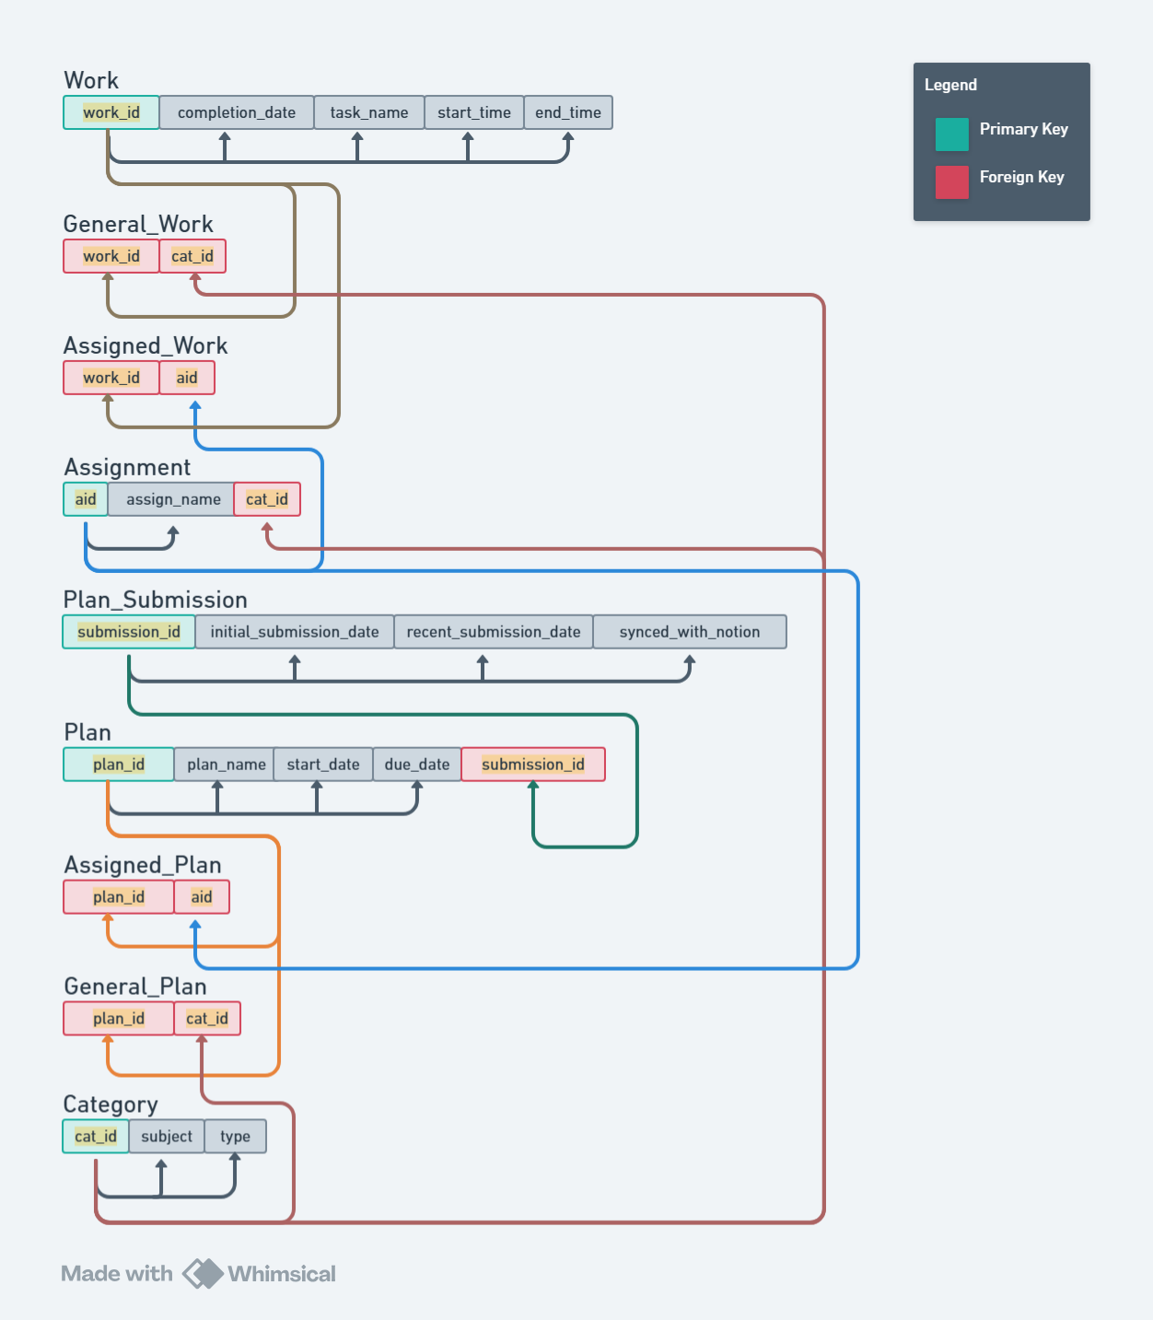
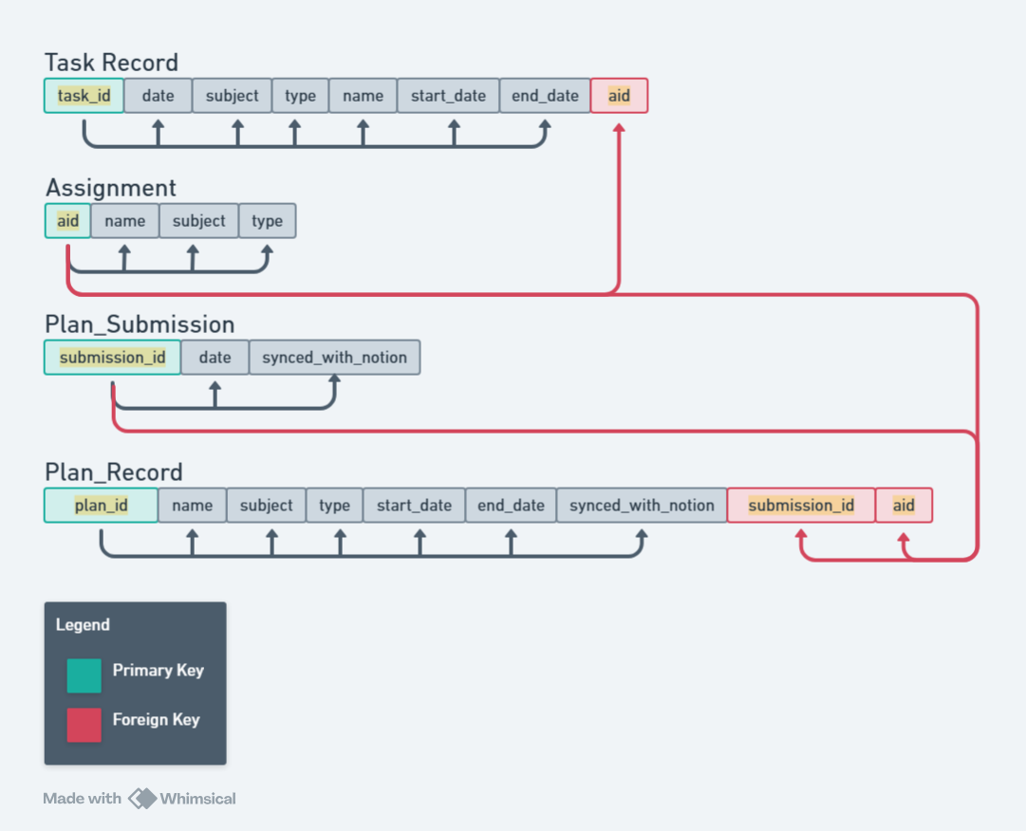
Database Schema Changes
New – BCNF (Good Design!)
Old – 2NF (Bad Design!)

Slide 7
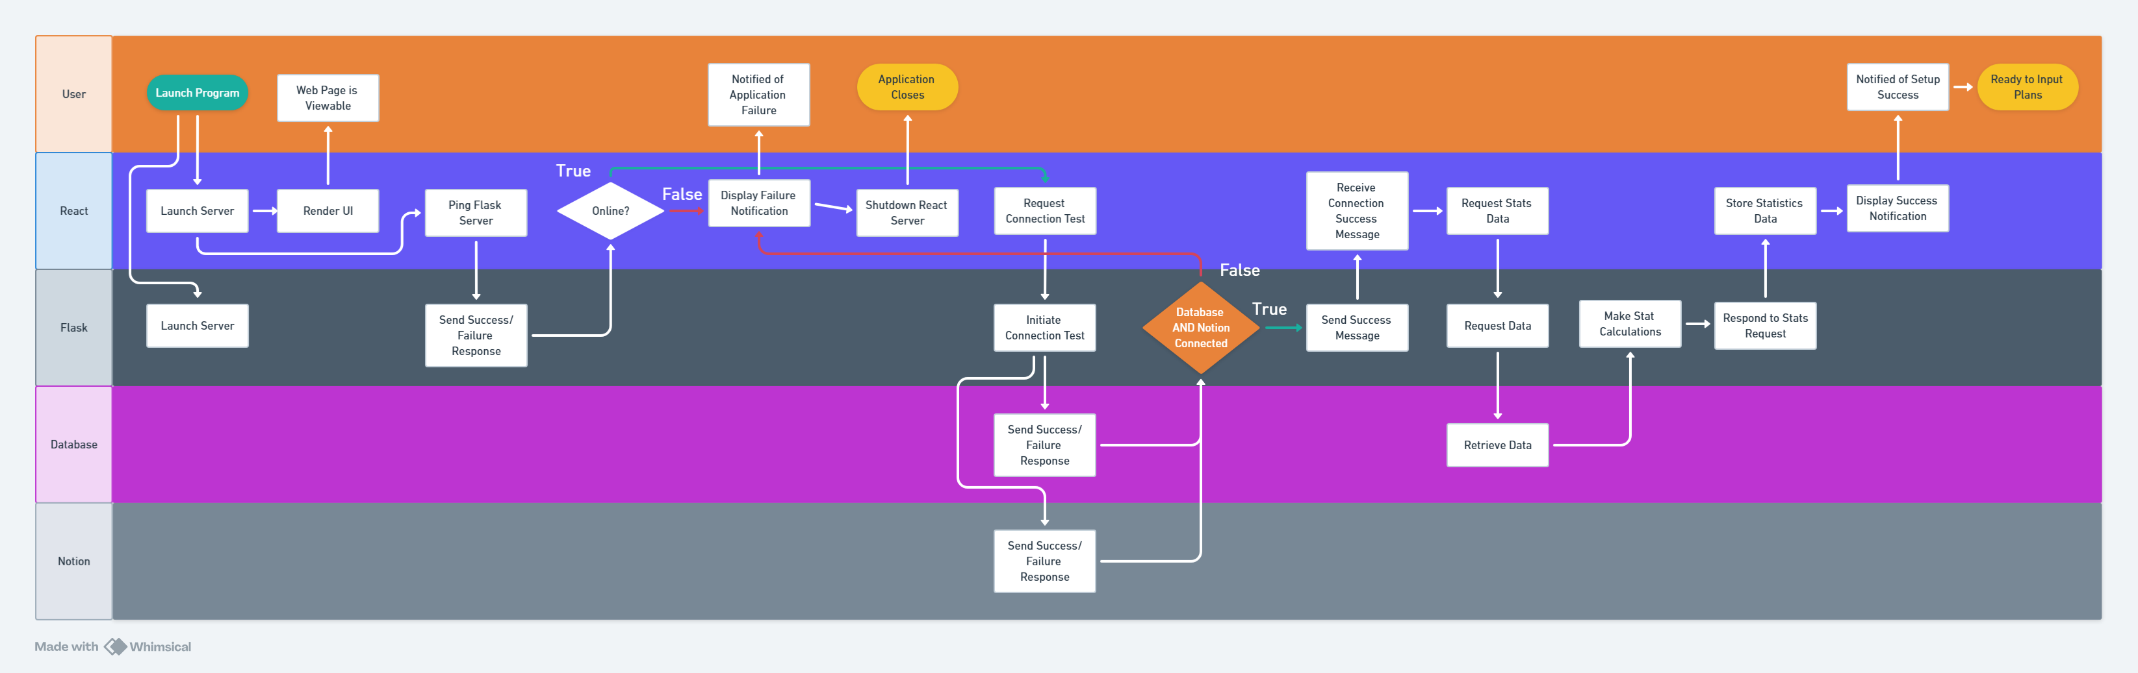
Swimlane: System Startup Process
https://whimsical.com/startup-swimlane-FXvXxEvpwPnJtbe8F2VApu

Slide 8
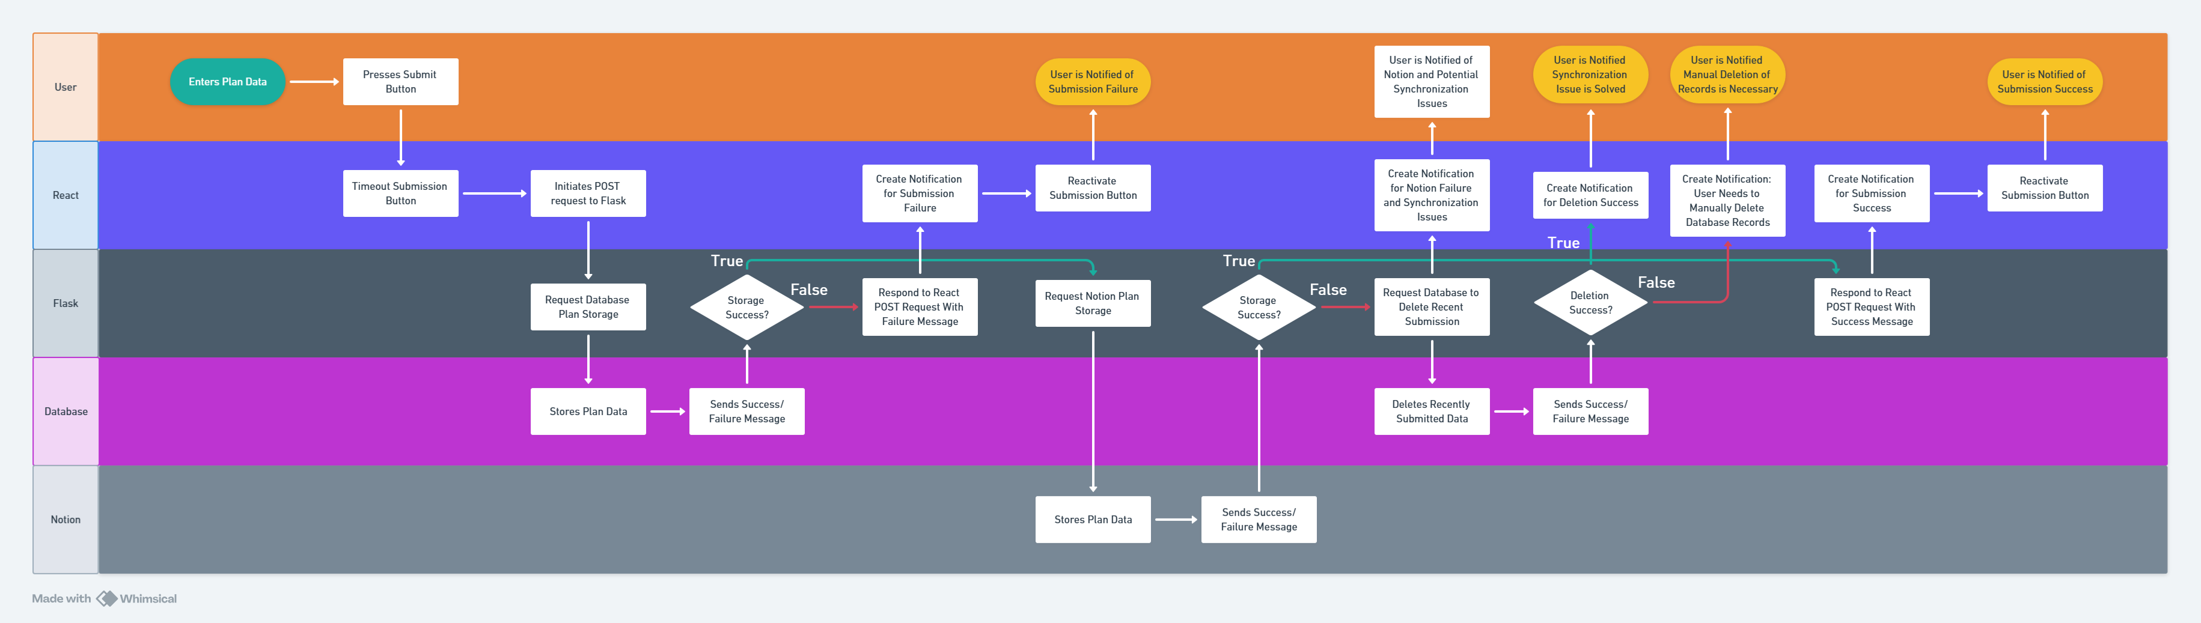
Swimlane: Submission Process
https://whimsical.com/plan-swimlane-VAsPmCAeFXky6vxRU3CTbn

Slide 9
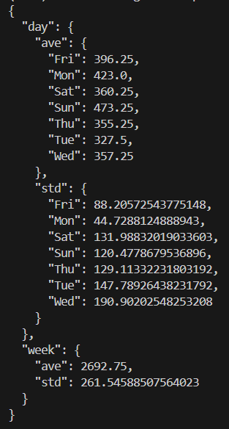
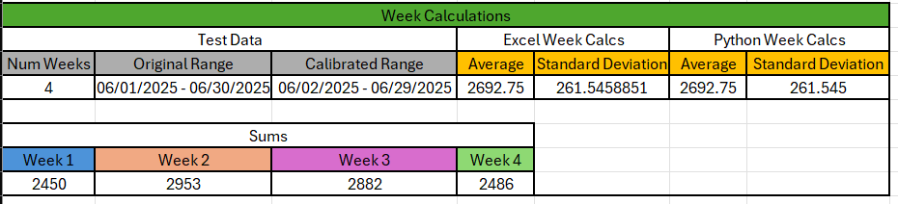
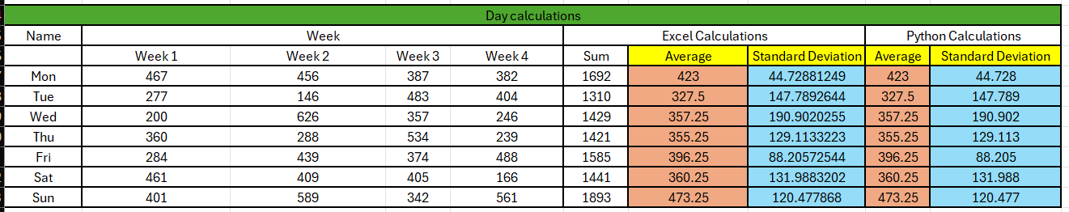
Statistic Calculation Script Verification

Slide 10
Problems & Blockers
Swimlane diagrams increased scope
Added a bunch of error handling logic, made things more complicated
Will take an entire month longer to complete

Slide 11
Pending Actions
Subsystem Integration

Slide 12
Next Steps
Further flask API design
Design endpoint schemas for checking the status of Notion and the DB (2 endpoints)
Update documentation
Implement endpoint schemas (Notion + DB)

