Slide 1
Sprint 6 – Intro to Backend
June 24 – June 29 (2025)

Slide 2
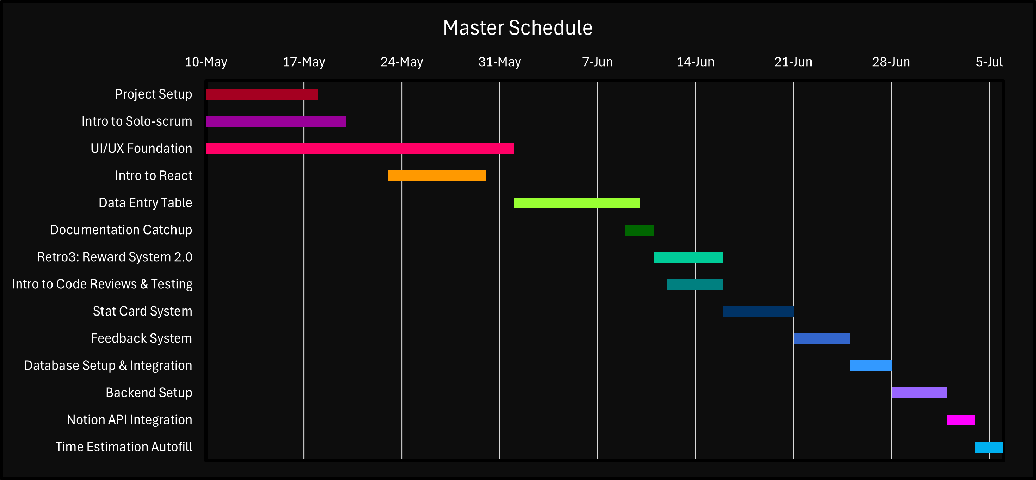
Master Schedule (Day #2 - 6/12)
Sprint 4
Today 6/12

Slide 3
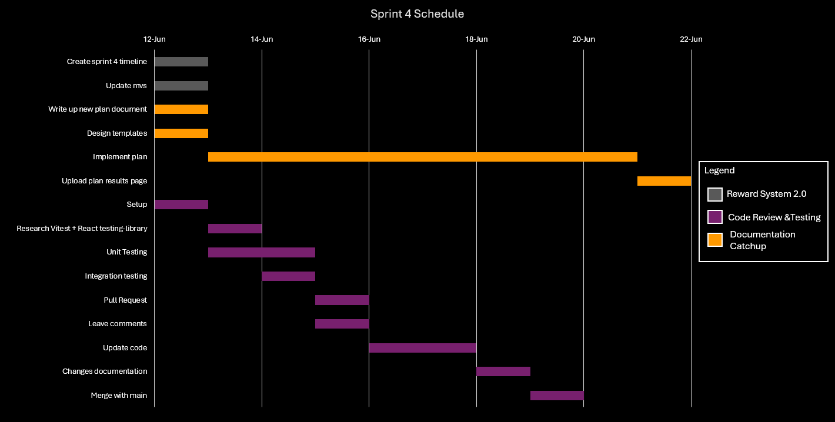
Sprint 4 Schedule
Today 6/12

Slide 4
Agenda #1 – 6/11 Wednesday

Slide 5
Previous Progress

Slide 6
Problems & Blockers

Slide 7
Pending Actions

Slide 8
Next Steps

