Slide 1
PlanGauge – Review so far
Wednesday 5/28/2025

Slide 2
Overview
Problem + Solution Introduced
Project Management Details
Questions

Slide 3

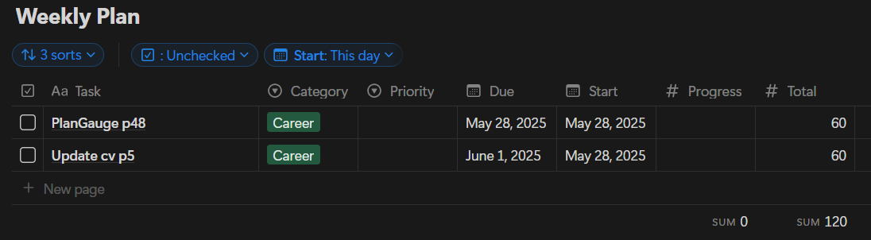
Problem
1
Notion – Productivity
Management Tool
Weekly Plan Database – How I manage my tasks for the week
2
Estimated Task Duration Sum
Securing an entry-level SWE position

Slide 4
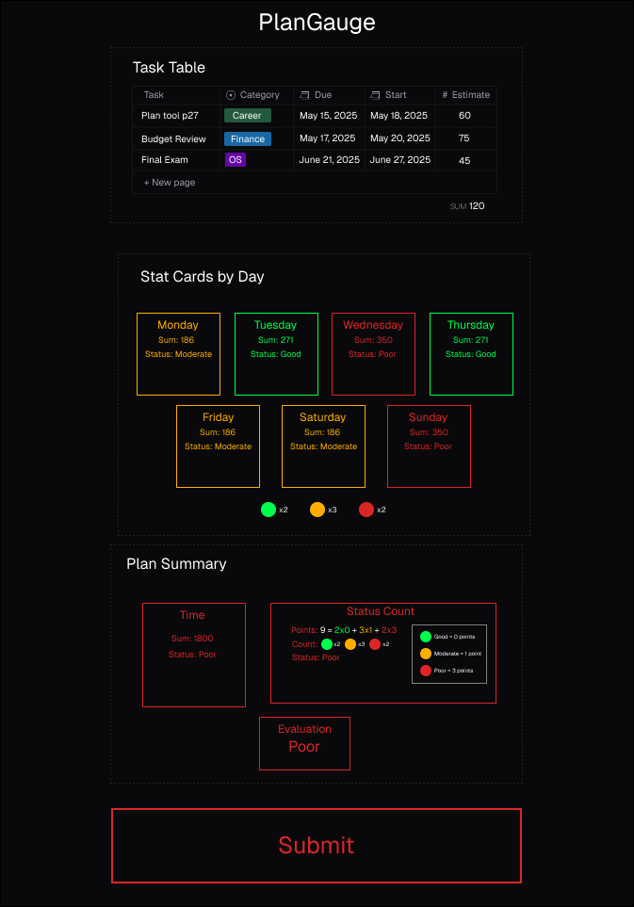
Solution p1

Slide 5
Solution p2

Slide 6
Solution p3 – Tech Stack
Frontend: React, Tailwind CSS, ui/shadcn (ui library)
Backend: Python, Scikit-learn, Flask, Notion API
Database: MongoDB Atlas
Containerization: Docker (maybe)

Slide 7
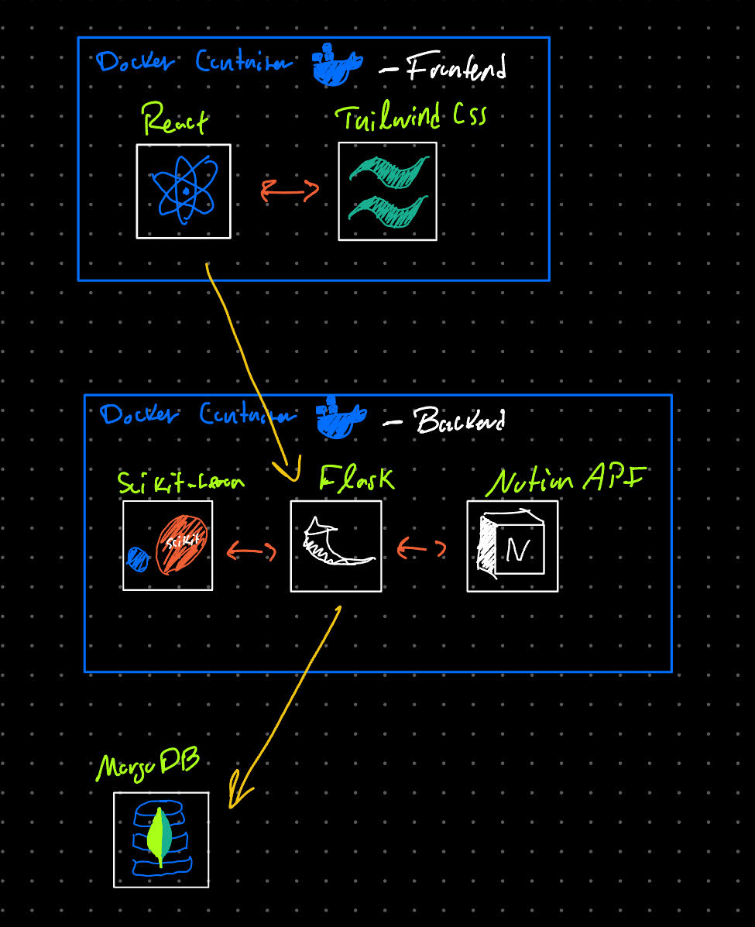

Slide 8
MVS
Core Features
Task Table
Time Prediction
Stat Cards (for each day of the week Mon-Sun)
Plan Summary
Submit Button (send data to Notion)
Non-functional Features
Works specific to my laptop’s specifications
Hide MongoDB/Notion API keys
Prevent Notion API misuse

Slide 9
Approach – Project Management
Project overview proposal
Software Development Plan
User Stories
Requirement Specifications
Design Specifications

Slide 10
Approach – “Agile” Methodology
“Solo-scrum”
Daily standup, Retrospectives, Sprints, Backlog, User Stories
Missing core-team element
Informal
Sprint Dashboard
- Name
- Date
- Objective
- Milestones
- Sprint Major Feedback
- Sprint Retrospective Notes
- Status
- Backlog References
Backlog
- Sprint #
- Story Points
- Status
- Dependencies
- Task Description
- Subtasks
- Definition of Done
- Expected Outcome
Retrospective
- Issues Identified
- Root Cause
- Proposed Solutions
- Action Plan
- Date
- What Didn't go Well
- What went well
Daily Standup
- Sprint Reference
- Backlog Reference
- Agenda
- Notes
- Key Decisions
- Actions

Slide 11
Data Schemas
Productivity Event
ID, Date, Subject, Type, Activity, Start, End
School Task
ID (FK), Comprehension, Focus, Content Difficulty, Motivation, Concepts
Assignment
aID, Class, Type, Name, Due, initial Difficulty, Ending Difficulty, Total Questions, Formats
Grades
aID (FK), Earned Points, Total Points
Linking
ID (FK), aID (FK)

Slide 12
Project Questions p1
Does the tech stack make sense, or does it look off?
Would docker implementation be valuable for this project (mainly considering it to beef up resume description of this project)
“Vibe” coding (Generative-Ai-produced code)
What degree of reliance is too much, how do employers view this?
Solution: extend timeline + take codeacademy courses
Almost finished with React course (80/100% completed)
ML model for task duration prediction
Gradient Boosting Regressor – ChatGPT written code
Is this feasible: MAE ≤ 15 min, R² ≥ 0.75 (355 school records, ~80 assignment records)
Any recommendations for how I process data? (New calculated metrics)
What additional metrics would have been helpful in predicting how long something would take
Are there any additional diagrams I should create to help the design process or prior to writing code?
Is there anything I could do to make “Solo-scrum” better or more official?
Does the solo-scrum methodology provide sufficient structure for employers to take seriously

Slide 13
Project Questions p2
What is the most error-prone part of my architecture in your opinion?
How can I validate my machine learning predictions are genuinely useful for planning?
Does the stat card system effectively communicate feedback at a glance?
Would you recommend simplifying or removing any features from my MVP?

Slide 14
Career Advice
How should I frame this project when talking to hiring managers or writing about it on my resume
Having trouble deciding on what career path to take
Data analyst, ML engineer, Full-stack SWE, Backend SWE, Cloud/DevOps
Does this solo project count towards “2 years experience”
Getting a PhD/Masters after joining the workforce

