Slide 1
Sprint #2
Monday 5/19 – Saturday 5/24

Slide 2
Agenda --- 5/19 Monday (Day #1)
Discuss small logistical progress I made yesterday and what I intend on finishing by the end of today

Slide 3
Previous Progress
Completed sprint 1 presentation
Uploaded backlog descriptions, standups, retrospective, and sprint documentation to GitHub
Emailed Dr. Raymer for presentation request
Started working on timeline

Slide 4
Problems & Blockers
React, html, css, tailwind css, ui/shadcn learning curve
Timeline is going to take a long time to make
Create subtasks for all backlog items (8 left)
Estimate duration of each subtask
Assign start/end dates
Research + implement gantt chart software

Slide 5
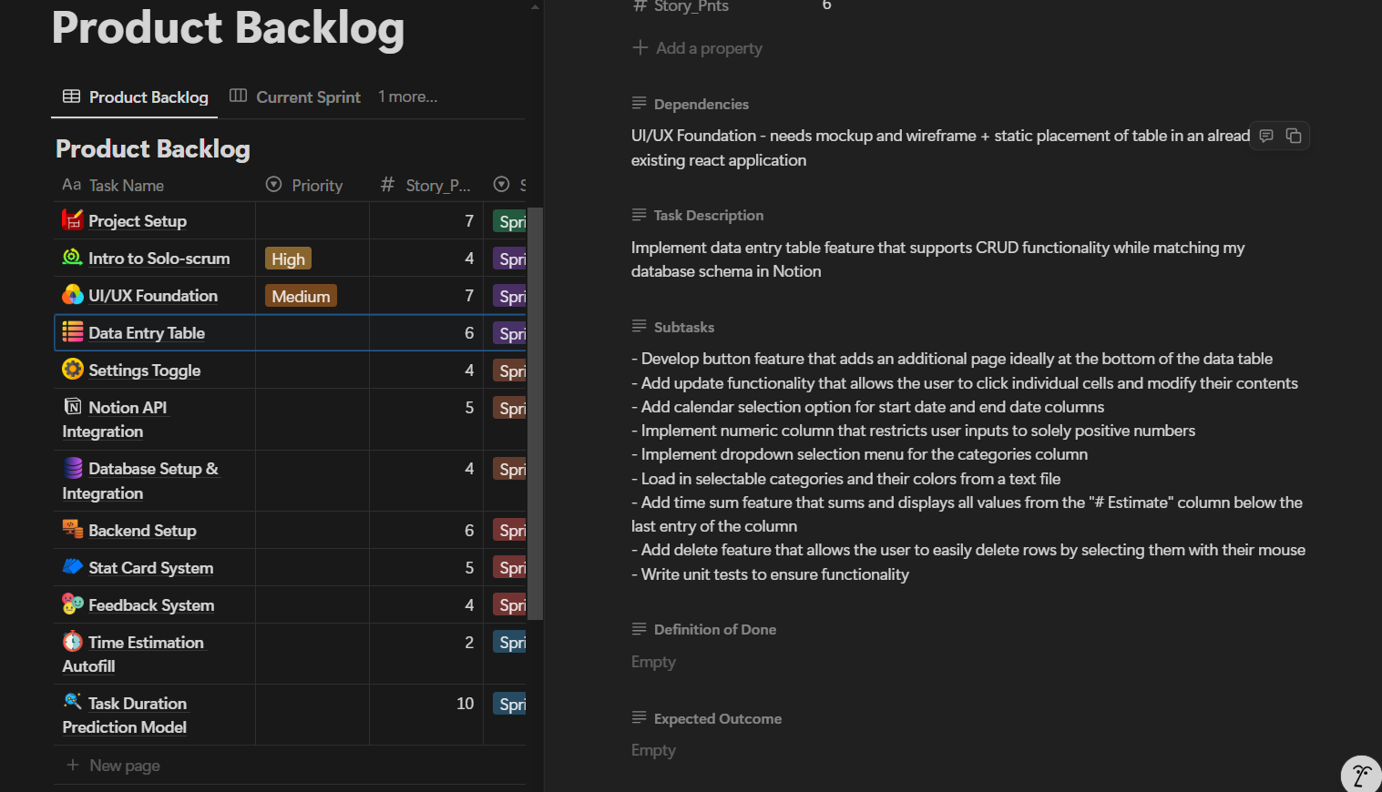
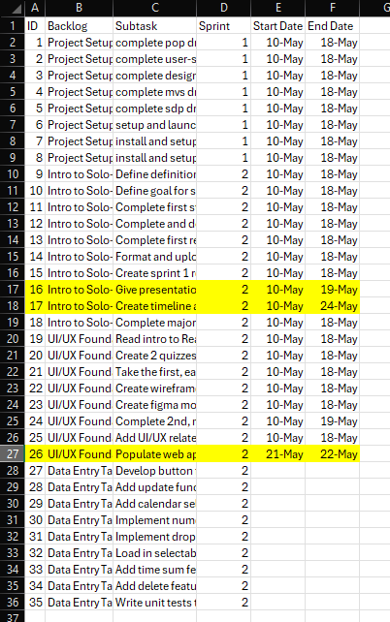
Timeline Issue

Slide 6
Pending Actions
Create rough timeline including Japan
Give sprint 1 presentation later on today
Complete and grade 1st and 2nd quiz
Implement static UI elements using React, html, tailwind css, JavaScript
Fix figma ui mockup
Version 1: make consistent + download (extra version)
Version 2: make consistent + remove status bar + download (mvs version ---- remove impulsive feature)

Slide 7
Next Steps
Create rough timeline including Japan
Give sprint 1 presentation later on today
Complete and grade 1st and 2nd quiz
Fix figma ui mockup
Version 1: make consistent + download (extra version)
Version 2: make consistent + remove status bar + download (mvs version ---- remove impulsive feature)

Slide 8
Agenda --- 5/20 Tuesday (Day #2)
Review poor understanding of react – show quiz scores
Introduce + review rough timeline
Promise immediate timeline will be created by tomorrow

Slide 9
Previous Progress
Fixed UI mockups (2 versions)
Took quiz 2 for first time (18/40 = 45%)
Retook quiz 1 (13/15 = 87%)
Finished Rough Timeline

Slide 10
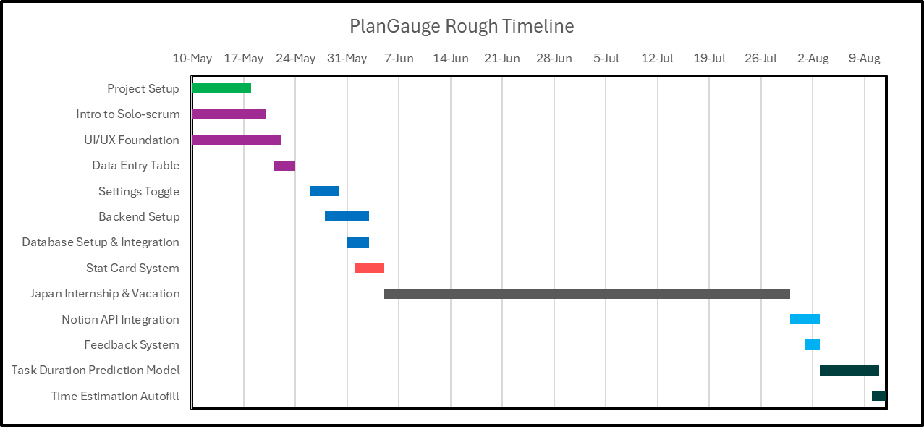
Rough Timeline

Slide 11
Problems & Blockers
Need to re-read the react article but head hurts and I have brainfog (more difficult to learn with these conditions)

Slide 12
Next Steps
Re-read react article for quiz 2
Retake + grade quiz 2
Review missed questions in quiz 1
Write up subtasks for backlog items in next sprint (sprint 3)
Create gantt chart for immediate timeline
Immediate timeline – subtasks of backlog items in the current sprint and the next sprint

Slide 13
Agenda --- 5/21 Wed + Thu (Day #3-4)
Discuss timelines created (rough/comprehensive timeline + immediate/detailed timeline)
Finally trying to implement the static ui elements to web page (actually coding)

Slide 14
Previous Progress
Completed rough and immediate timelines
Finished “Introduction to Solo-scrum” backlog item
2 items left to go

Slide 15
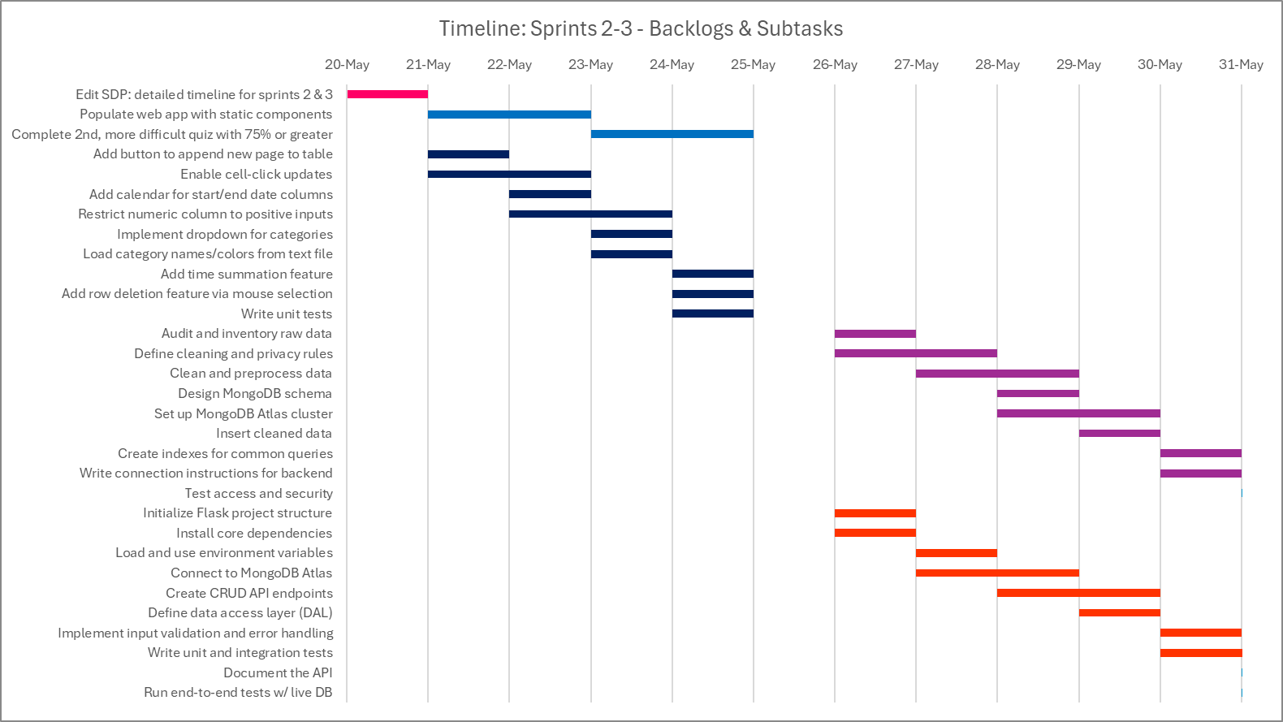
Immediate Timeline (Sprints 2 & 3)

Slide 16
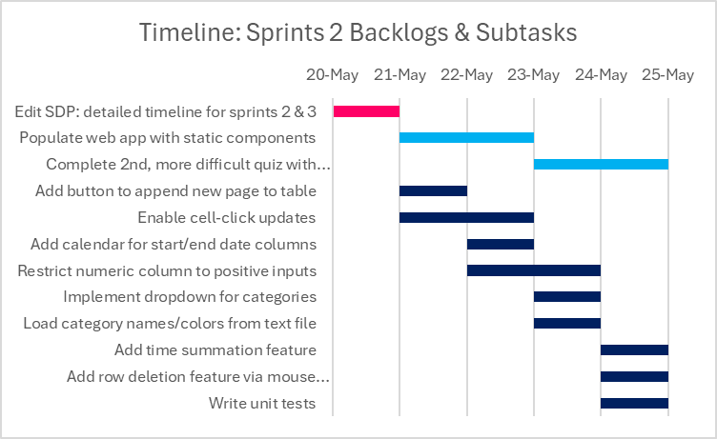
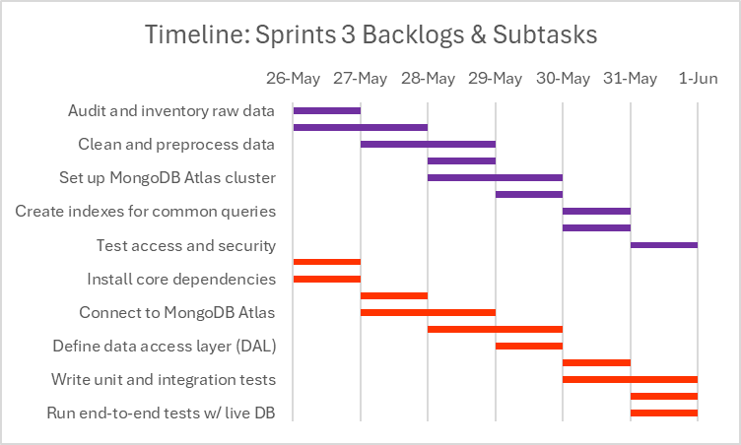
Sprints 2 & 3 Timeline (Untouched)

Slide 17
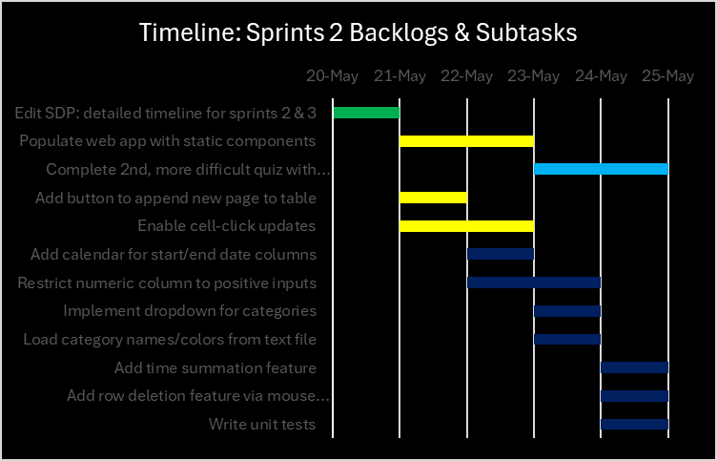


Timeline: Sprint 2 Progress

Slide 18
Problems & Blockers
Still don’t have a strong understanding of React
Timeline is a little tight so it might not work

Slide 19
Next Steps
Add static ui components to web app
Table
Stat cards
Major feedback section
Submit button

Slide 20
Agenda --- 5/24 Saturday (Day #5)
Introduce new backlog item: “Intro to React” (~13 hours work)
Discuss basic web app setup + reiterate over “vibe coding”
Shift in schedule
New backlog item: work on it this and next sprint
Finish ui/ux foundation for sprint 2
Push data entry table to the 4th sprint, move to third if “Intro to React” is finished early
Japan trip moved to July
Professor meeting on Wednesday
Meeting over zoom

Slide 21
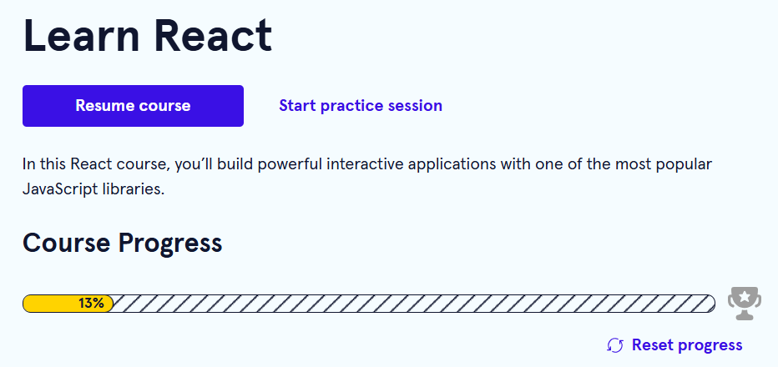
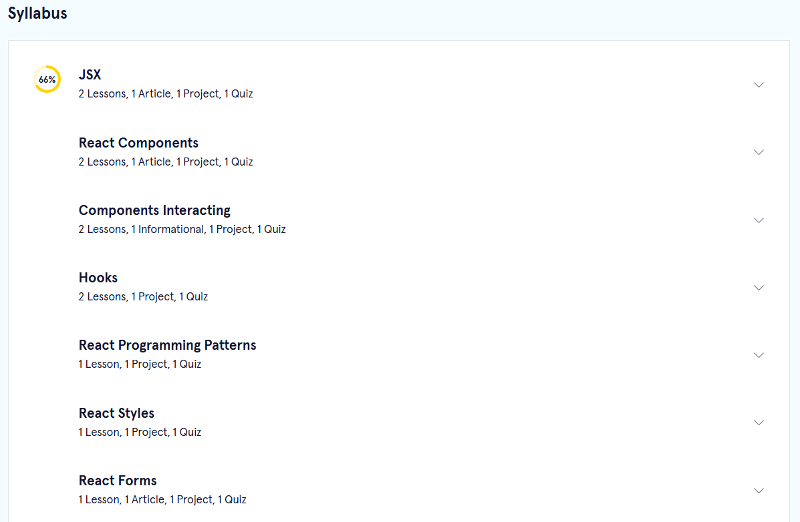
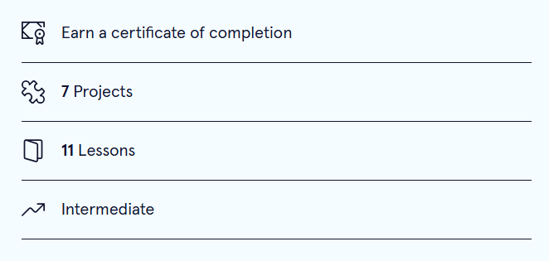
Previous Progress – Intro to React

Slide 22
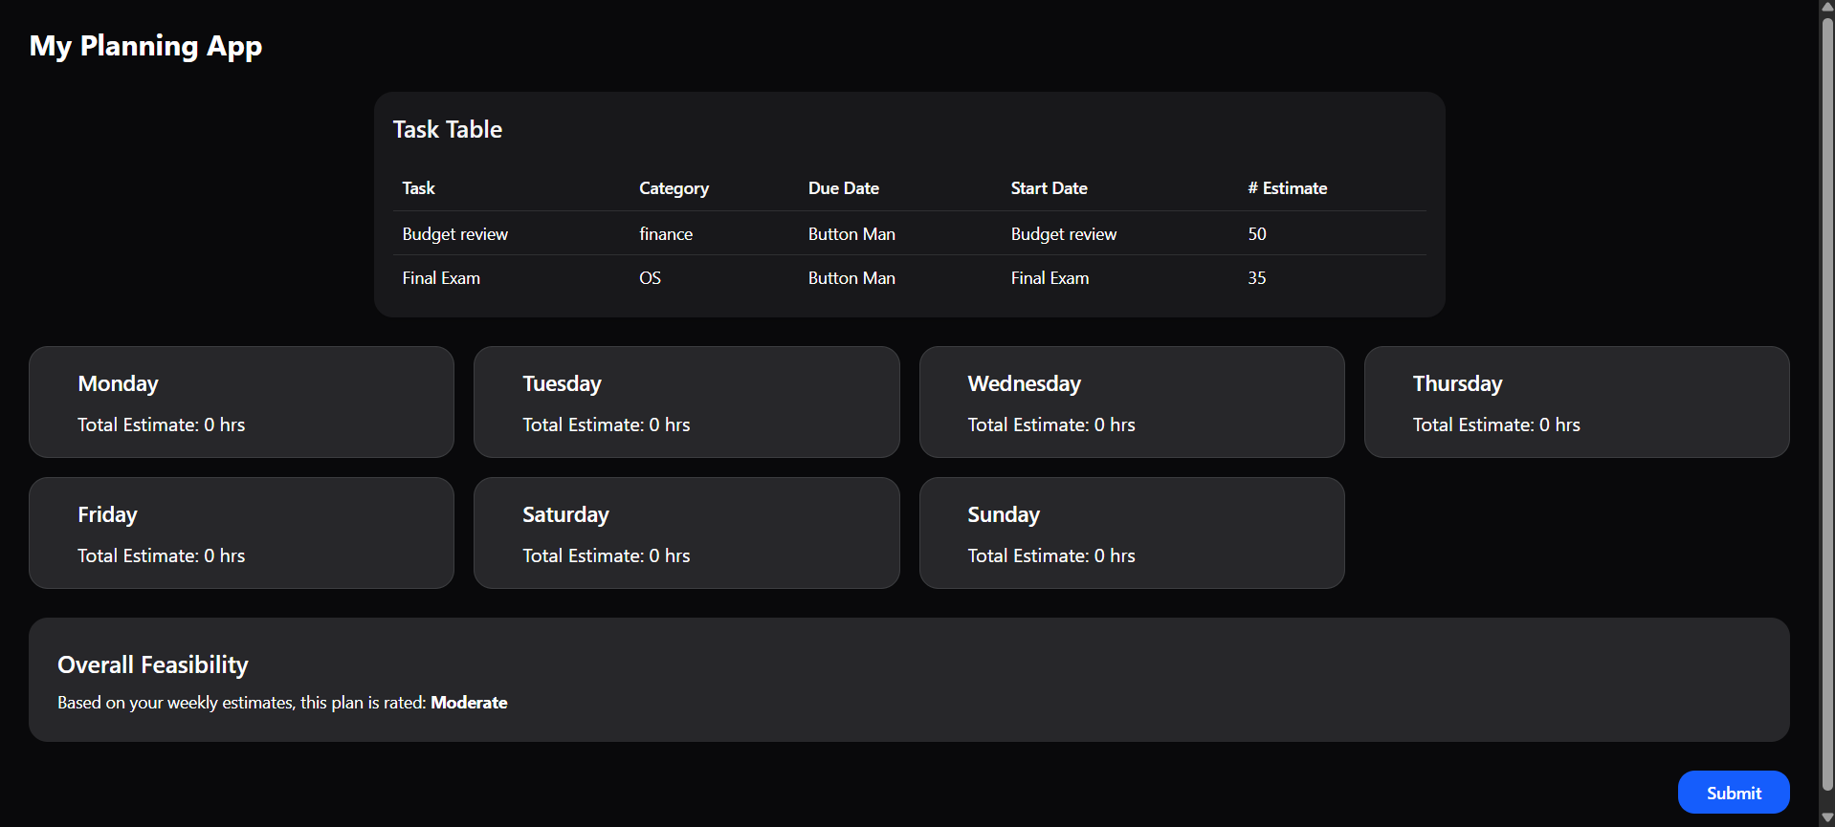
Previous Progress – Static Implementation

Slide 23
Problems & Blockers
Still wont finish project by July but will get much closer
Might need to pay for codeacademy subscription – not a big problem
There is the potential for me to not know how to implement the data table backlog item even after finishing the “Intro to React” backlog item
Annoying to manually update gantt chart and timeline every time

Slide 24
Next Steps

