Slide 1
Sprint #3 – Data table setup
Monday June 2nd, 2025 -

Slide 2
Agenda #1 (Monday June 2nd)
Discuss issues
ChatGPT reliance
Working on things outside of the timeline order due to laziness
Impulsive/Unfocused work – starting adding new features
Show DataTable implementation using ChatGPT assistance
Solutions
Redo table implementation without any chatgpt assistance
Start using documentation for Tailwind CSS and Shadcn/UI

Slide 3


Previous Progress – Rough Timeline

Slide 4
Previous Progress – Sprint 3 w/ ChatGPT

Slide 5
Previous Progress – No Assistance Timeline

Slide 6

Previous Progress – Completed React Course

Slide 7
Quiz Progress
Backlog items: Intro to UI/UX + Intro to Scrum complete
Quiz #1, 86%
Quiz #2 – 45% (19/40) ----> 78% (31/40)
Quiz #3 – 80% (24/30)

Slide 8
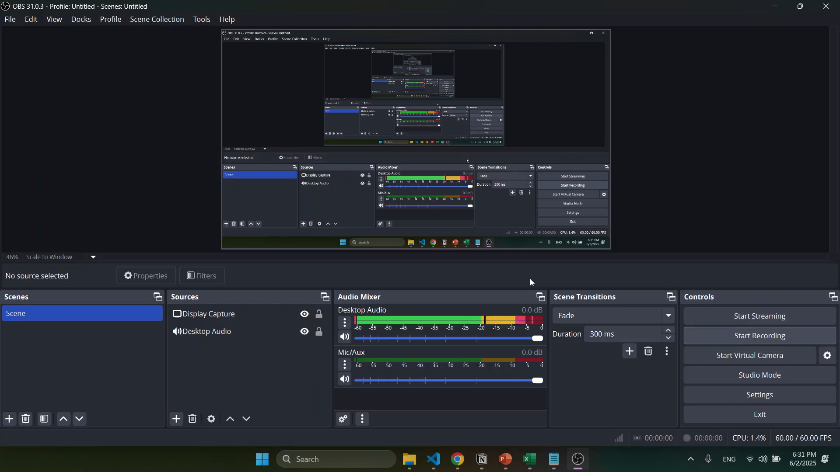
Task Table w/ ChatGPT

Slide 9
Problems & Blockers
Too much reliance on ChatGPT – not learning enough
Not implementing items in order of the timeline
Adding a bunch of new features impulsively
Put in the work to understand React better but I don’t have a super strong grasp on css and html principles
Theres a more advanced/flexible table component in shadcn’s library that I didn’t see previously

Slide 10
Pending Actions
Implement Data Table again
Calendar popup
Numeric column that restricts user inputs to solely positive numbers
Category drop selection menu
Use context API
Upload standup documentation to GitHub

Slide 11
Next Steps
Restart table development without any ChatGPT assistance
Learn how to use context api
Start using Tailwind CSS and Shadcn/ui documentation

Slide 12
Agenda #2 (Sunday June 7th)
Discuss problems:
Behind on documentation
MVS is not up to date or specific enough
Need to learn how to do unit testing and then write tests
Code review
Only completed two standups
Mostly finished the table component
Started looking into unit testing with React Testing Library and vitest

Slide 13
Timeline

Slide 14
Previous Progress
Finished data entry table draft
Used context API
Somewhat avoided using ChatGPT
Set up to start unit testing
Briefly refactorized code (broke code down into distinct components)

Slide 15
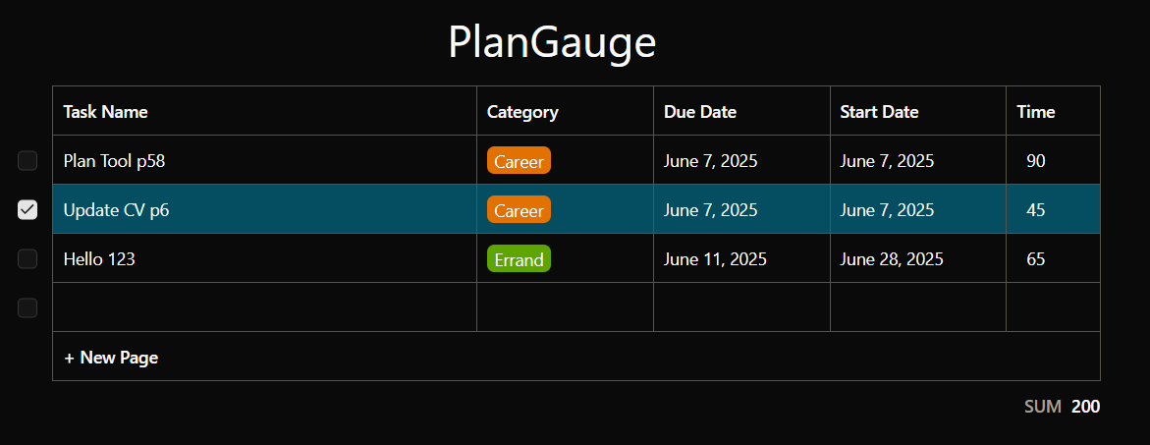
Previous Progress

Slide 16
Documentation Problems
Conversion (file.x --> file.md)
sprint3_standup.pptx
All files mentioned under here
Complete
Sprint dashboard
Sprint 2
Sprint 3
Sprint 4 (new)
Backlog
Intro to react
Data Entry Table
Sprint 3 retrospective
Sprint 3 standups (combine)
Add relevant documents to the sprint3 folder
Revise: MVS

Slide 17
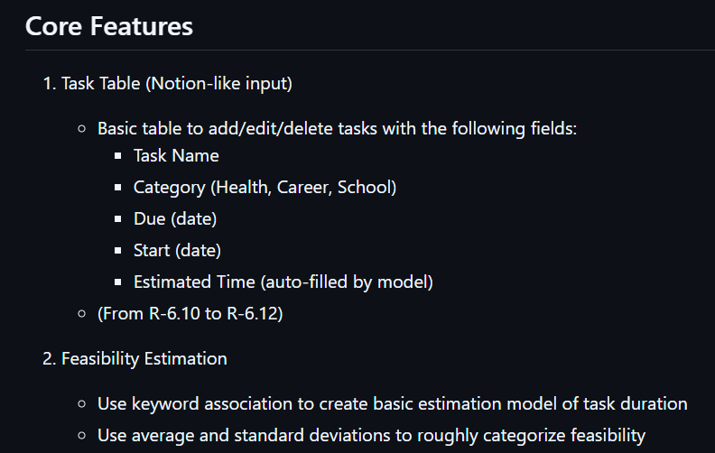
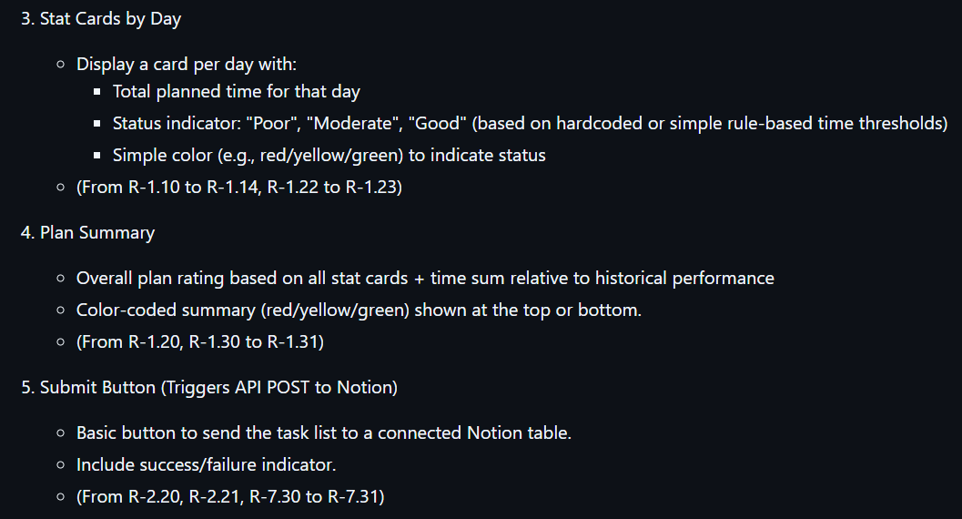
Problems and Blockers – poor mvs

Slide 18
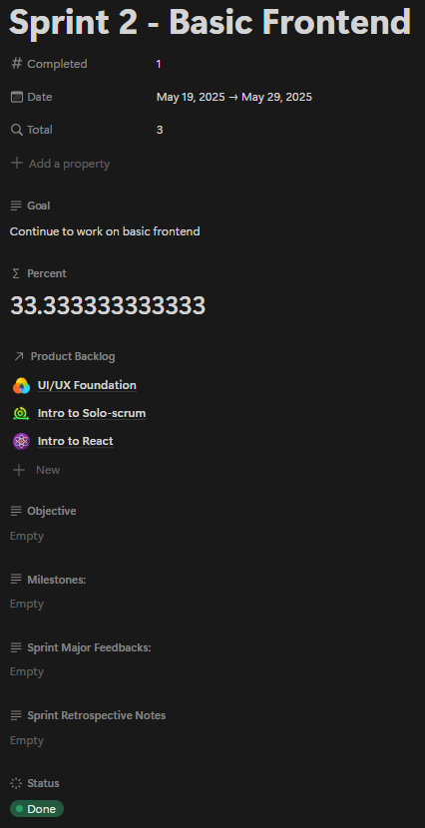
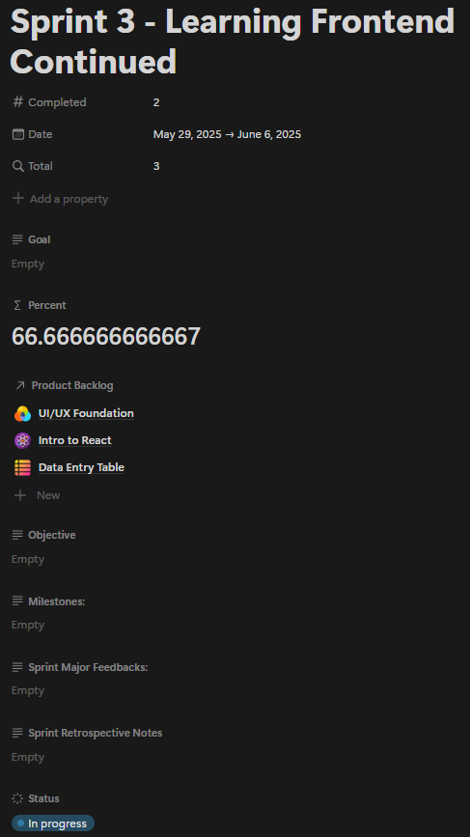
Problems and Blockers – poor documentation

Slide 19
Pending Actions
Unit testing
Documentation
Sprint 2 description page
Sprint 3 description page
Upload standups
Upload retrospective
Add any

Slide 20
Next Steps
Lump left over tasks into separate backlog items
(1) Documentation issues
(2) Testing Introduction
Complete retrospective

