Slide 1
Sprint 1 Review
May 10 – May 16 (7 days)

Slide 2
Objective
Establish the foundation of project including overall plan + documentation, ui/ux design, and methodology management

Slide 3
Milestones (Initial goals of sprint)
Finish documentation drafts (sdp, pop, mvs, user-stories)
Get basic web application up and running
Populate web page with static components using appropriate styling
Complete and upload documentation of first sprint to GitHub
Implement solo-scrum methodology

Slide 4
Backlog Items
Project Setup (100%)
Project management documents
Initial plans for the design
Setting up a basic web app
Intro to Solo-scrum (80%)
Daily standup, retrospectives, definition of done, sprints, backlogs
Upload documentation to github
Timeline and visual aid
UI/UX Foundation (78%)
Learn the front end technologies: React, Tailwind CSS, UI/Shadcn
Create wireframe and figma markups
Populate web app with components to match figma markup

Slide 5
Accomplishments
First sprint completion with documentation + presentations
UI wireframes and mockups
Setup of react, tailwind, ui/shadcn app
Completed drafts of detailed plan (mvs, pop, sdp, reqs, user-stories)

Slide 6
Left Over
Project Setup – Completed!
Intro to Solo-scrum (2/9 tasks)
Create timeline and visual aid
Give sprint review presentation
UI/UX Foundation (2/10 tasks)
Complete 2nd quiz
Populate web app with static components

Slide 7


Tech Stack Updates
The base project will not use docker compose
Possible implementation in future
UI/Shadcn library is added to the frontend
X

Slide 8
Solo-scrum Implementation
Daily standups with parents
Retrospective conducted at end of sprint
Documentation exported from Notion and uploaded to GitHub at end of sprint
Defined and used project management documents (pop, sdp, user-stories, reqs, mvs)
Using definition of done for backlog items
Sprint planning done at beginning of sprint (and updated as the sprint progresses)

Slide 9
Solo-scrum: Pros & Cons
Technical team is only one person
Required to act as all three: scrum master, product owner, development team
Without real life experience, it’s hard to know how a scrum master, product owner, and team would act
Doesn’t simulate real life interactions, leaves large blind spots in how the entire system operates normally
More difficult to complete tasks in parallel

Slide 10
Standup Evolution p1
Reached out to professor for professional feedback/help
Started organizing presentations for standups including visuals
Scheduled standup consistent and early in the day for at least 4 days per sprint (assuming a sprint is ~ 1 week long)
Reduced work schedule from working 7 days a week to 6 days a week
Emphasized I look more into Agile/Scrum implementation for solo-teams
Decided not to collect more data for prediction model if it doesn’t work too well

Slide 11
Standup Evolution p2
Deleted “water-scrum-fall” as my work methodology and replaced with the informal “solo-scrum” that I made up
Need to have detailed timeline with a visual aid to guide project towards end goal (satisfy mvs)
Include the timeline in every standup so its clear where I am at in the project
Need to implement testing each sprint
Reinforced scope creep avoidance: don’t impulsively implement new features (@figma mockup), stick to the mvs
Create a new sprint and redistribute backlog items; don’t kick the can further down the road (ie roll over backlog items and not change anything)
Continue to meet when separated using remote technology (zoom, etc)

Slide 12
Challenges
Need to figure out testing
Unfamiliar with React + Tailwind CSS + UI/Shadcn, also rusty with JavaScript/HTML/CSS
Solo-scrum learning curve
Managing many tasks at same time (backlog, daily standup, retrospectives)

Slide 13
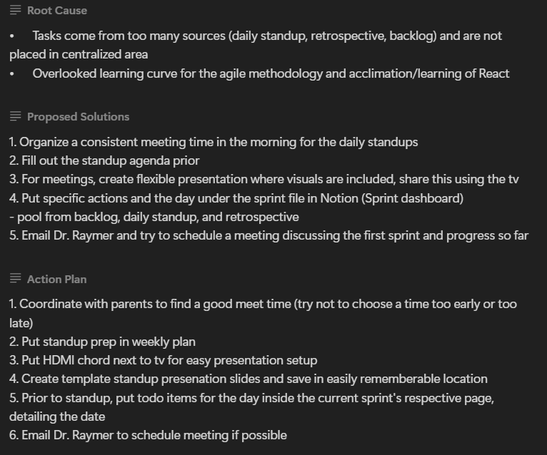
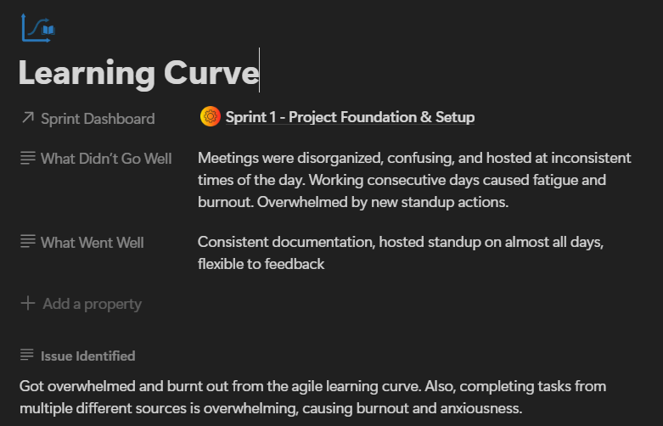
Retrospective

Slide 14
Implementation Details
UI/UX mockup + wireframe
Two Quiz documents created to learn react from articles and commonly used terms
Screenshots of react app running

Slide 15
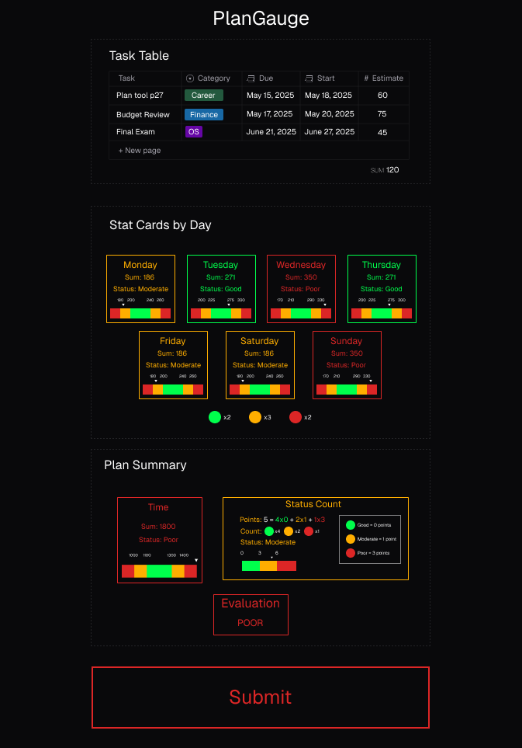
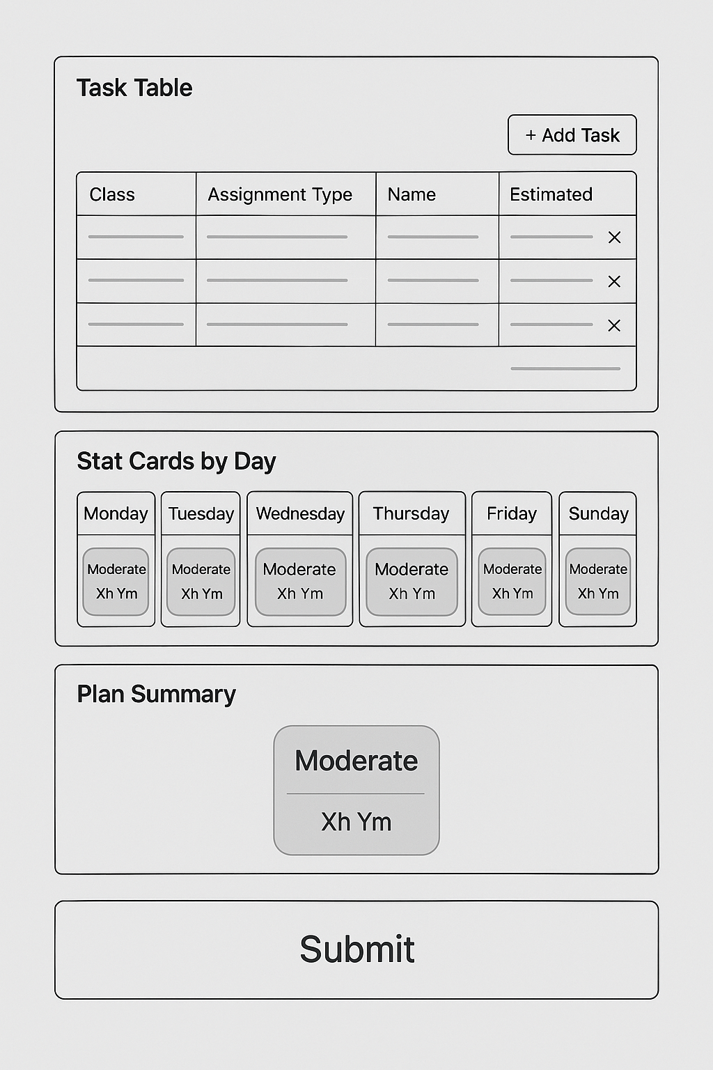
Design (wireframe, figma)

Slide 16
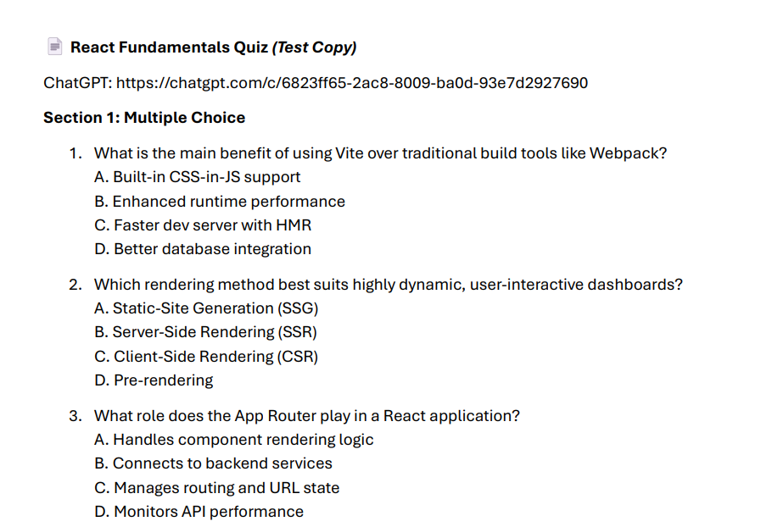
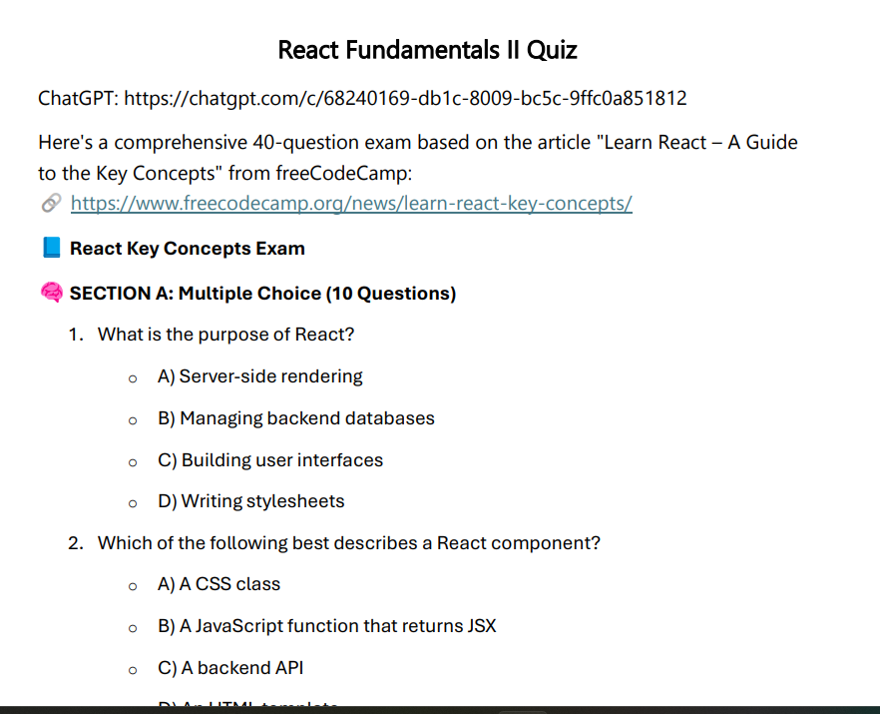
Quizzes
15 Questions
40 Questions

Slide 17
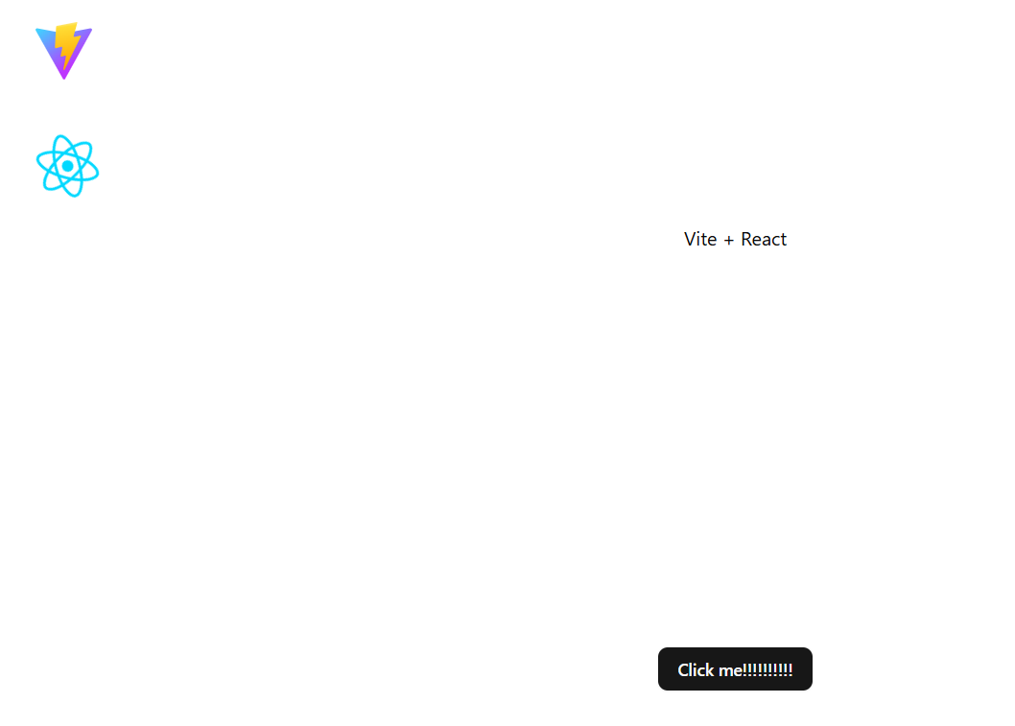
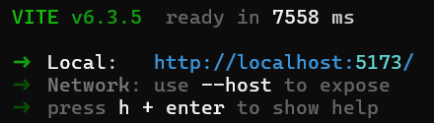
React App

Slide 18
Questions

