Slide 1
Sprint #2
Monday 5/19 – Saturday 5/24

Slide 2
Agenda --- 5/19 Monday (Day #1)
Discuss small logistical progress I made yesterday and what I intend on finishing by the end of today

Slide 3
Previous Progress
Completed sprint 1 presentation
Uploaded backlog descriptions, standups, retrospective, and sprint documentation to GitHub
Emailed Dr. Raymer for presentation request
Started working on timeline

Slide 4
Problems & Blockers
React, html, css, tailwind css, ui/shadcn learning curve
Timeline is going to take a long time to make
Create subtasks for all backlog items (8 left)
Estimate duration of each subtask
Assign start/end dates
Research + implement gantt chart software

Slide 5
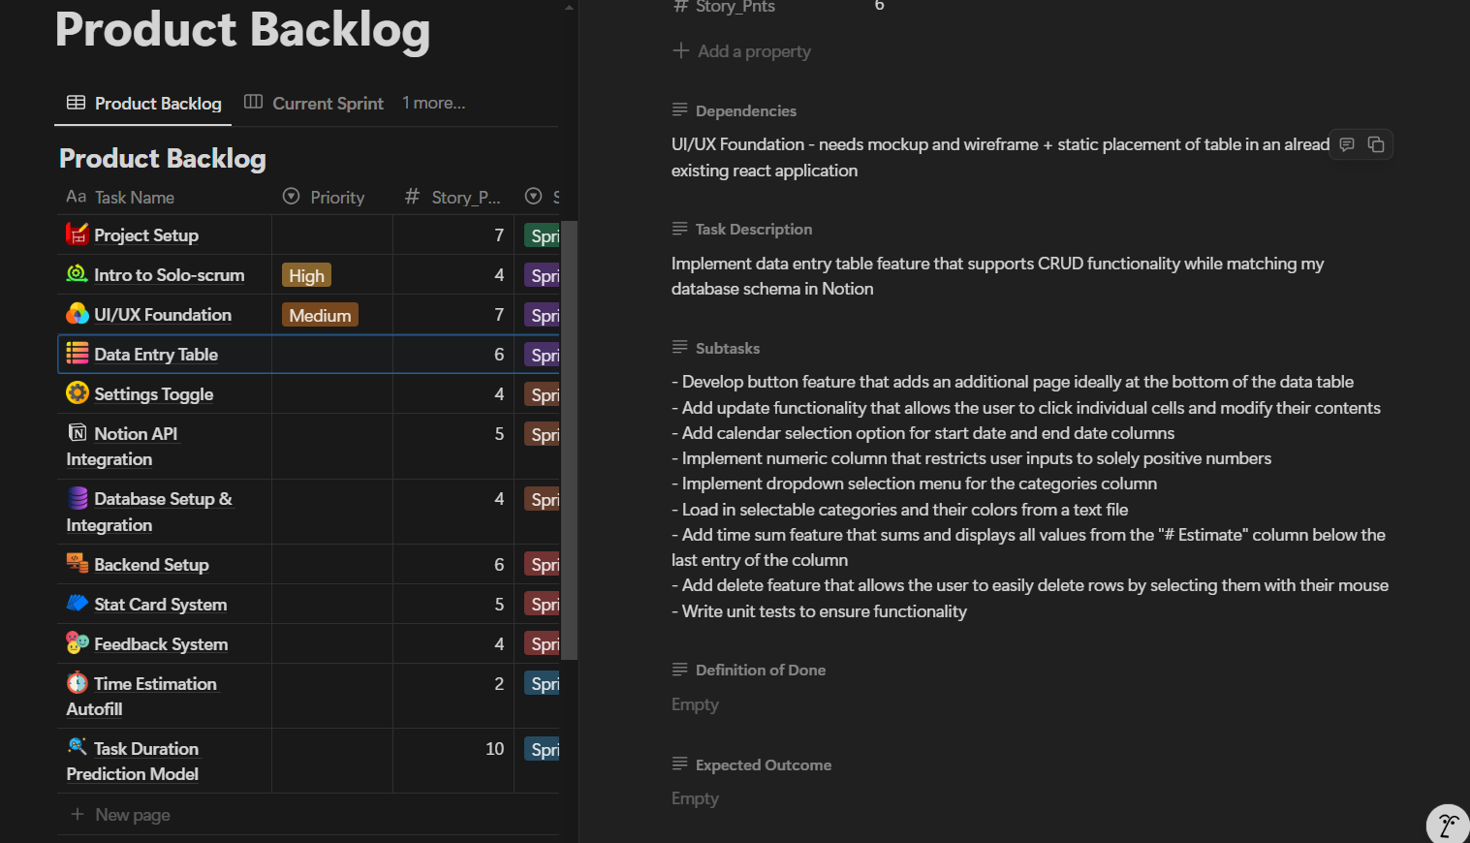
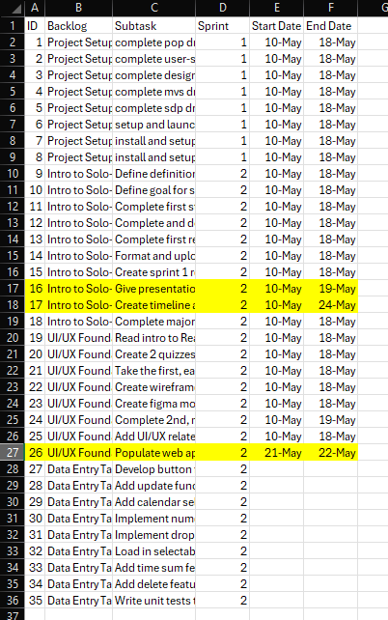
Timeline Issue

Slide 6
Pending Actions
Create rough timeline including Japan
Give sprint 1 presentation later on today
Complete and grade 1st and 2nd quiz
Implement static UI elements using React, html, tailwind css, JavaScript
Fix figma ui mockup
Version 1: make consistent + download (extra version)
Version 2: make consistent + remove status bar + download (mvs version ---- remove impulsive feature)

Slide 7
Next Steps
Create rough timeline including Japan
Give sprint 1 presentation later on today
Complete and grade 1st and 2nd quiz
Fix figma ui mockup
Version 1: make consistent + download (extra version)
Version 2: make consistent + remove status bar + download (mvs version ---- remove impulsive feature)

Slide 8
Agenda --- 5/20 Tuesday (Day #2)
Review poor understanding of react – show quiz scores
Introduce + review rough timeline
Promise immediate timeline will be created by tomorrow

Slide 9
Previous Progress
Fixed UI mockups (2 versions)
Took quiz 2 for first time (18/40 = 45%)
Retook quiz 1 (13/15 = 87%)
Finished Rough Timeline

Slide 10
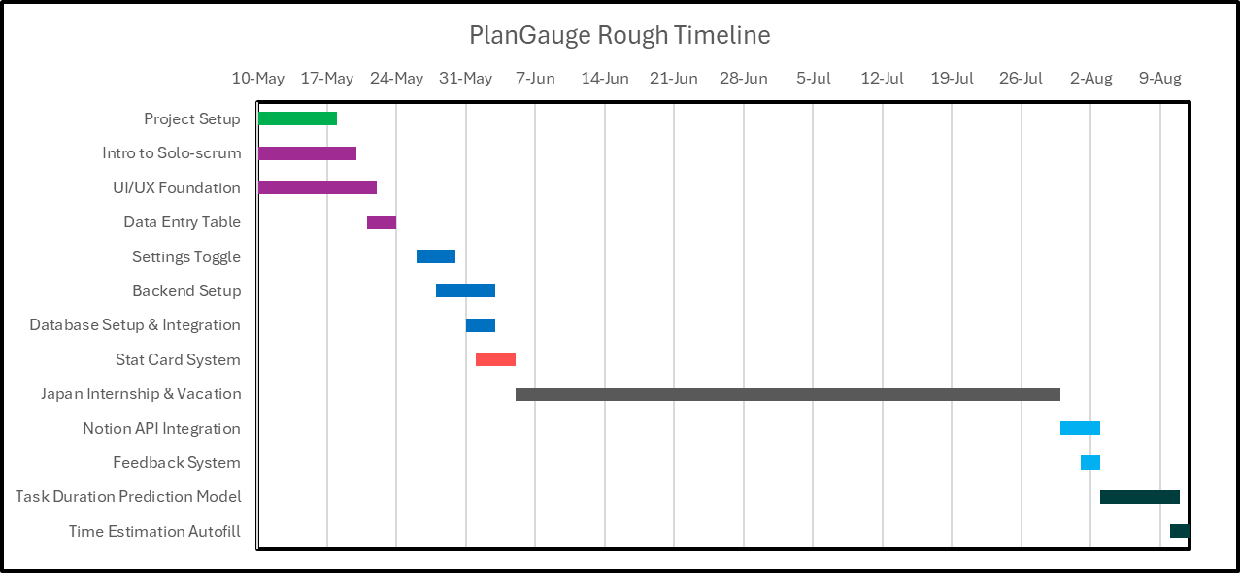
Rough Timeline

Slide 11
Problems & Blockers
Need to re-read the react article but head hurts and I have brainfog (more difficult to learn with these conditions)

Slide 12
Next Steps
Re-read react article for quiz 2
Retake + grade quiz 2
Review missed questions in quiz 1
Write up subtasks for backlog items in next sprint (sprint 3)
Create gantt chart for immediate timeline
Immediate timeline – subtasks of backlog items in the current sprint and the next sprint

Slide 13
Agenda --- 5/21 Tuesday (Day #3)

Slide 14
Previous Progress

Slide 15
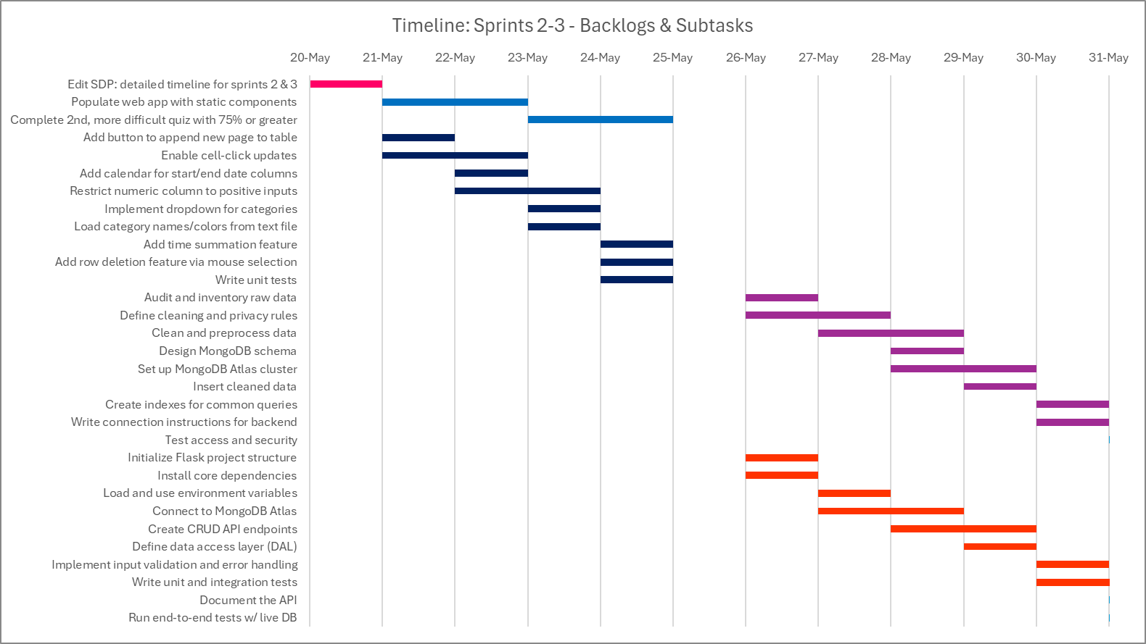
Immediate Timeline (Sprints 2 & 3)

Slide 16
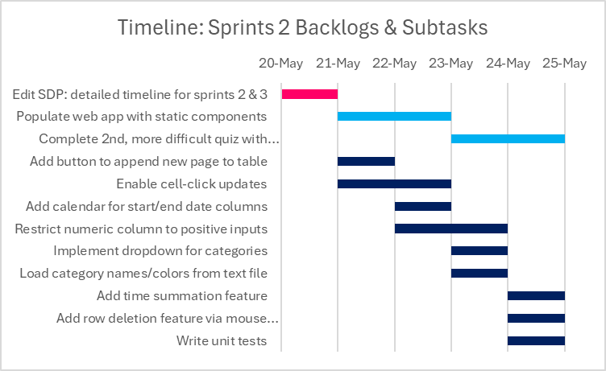
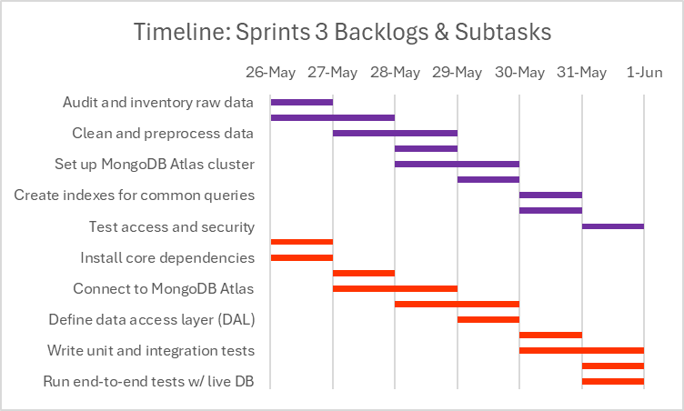
Sprints 2 & 3 Timeline (Untouched)

Slide 17
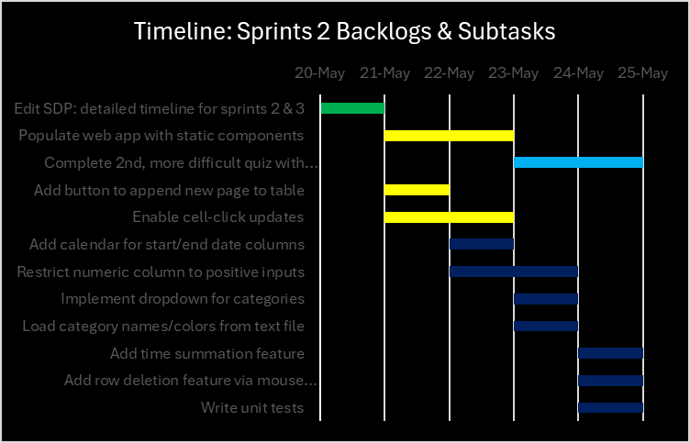


Timeline: Sprint 2 Progress

Slide 18
Problems & Blockers

Slide 19
Next Steps

