Slide 1
Final Standup – Sprint 1
Sunday 5/18

Slide 2
Agenda
Coordinate common meeting time
Discuss progress accomplished in first sprint and what needs to be completed to finish things up
Review retrospective
Assess what to do with impulsively added feature
Evaluate solutions to congested backlog load for sprint 2
Reiterate pending actions and what will be addressed today

Slide 3
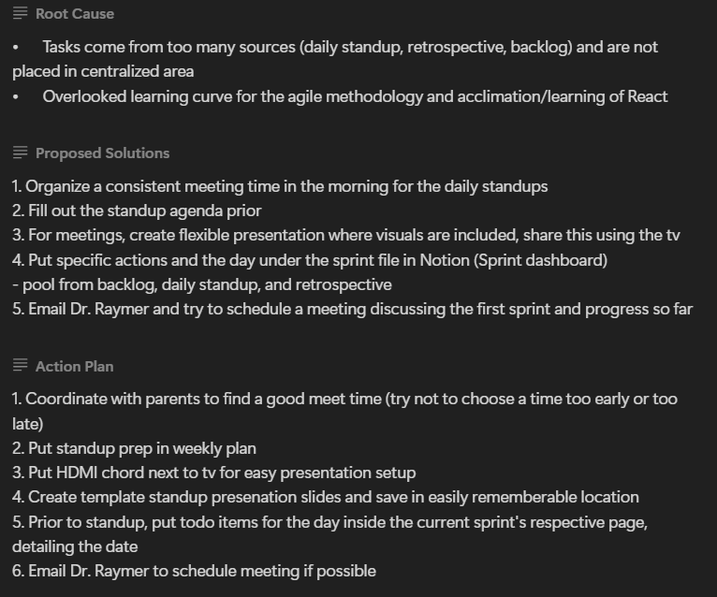
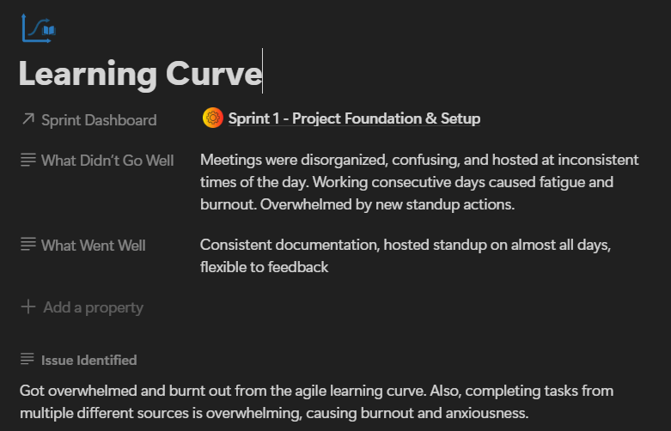
Previous Progress
Completed retrospective

Slide 4
Problems & Blockers
Getting overwhelmed by everything I need to manage
Sprint 2’s schedule is not feasible at all with rolled over backlog items
I impulsively added a new feature not previously planned for in the figma mockup ui
Getting lazy watching YouTube, TV shows, and movies

Slide 5
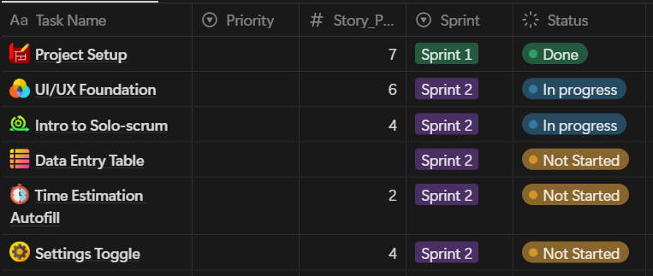
Problems: Sprint 2 Backlog is Too Big

Slide 6
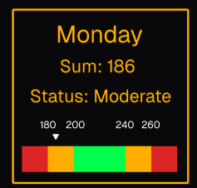
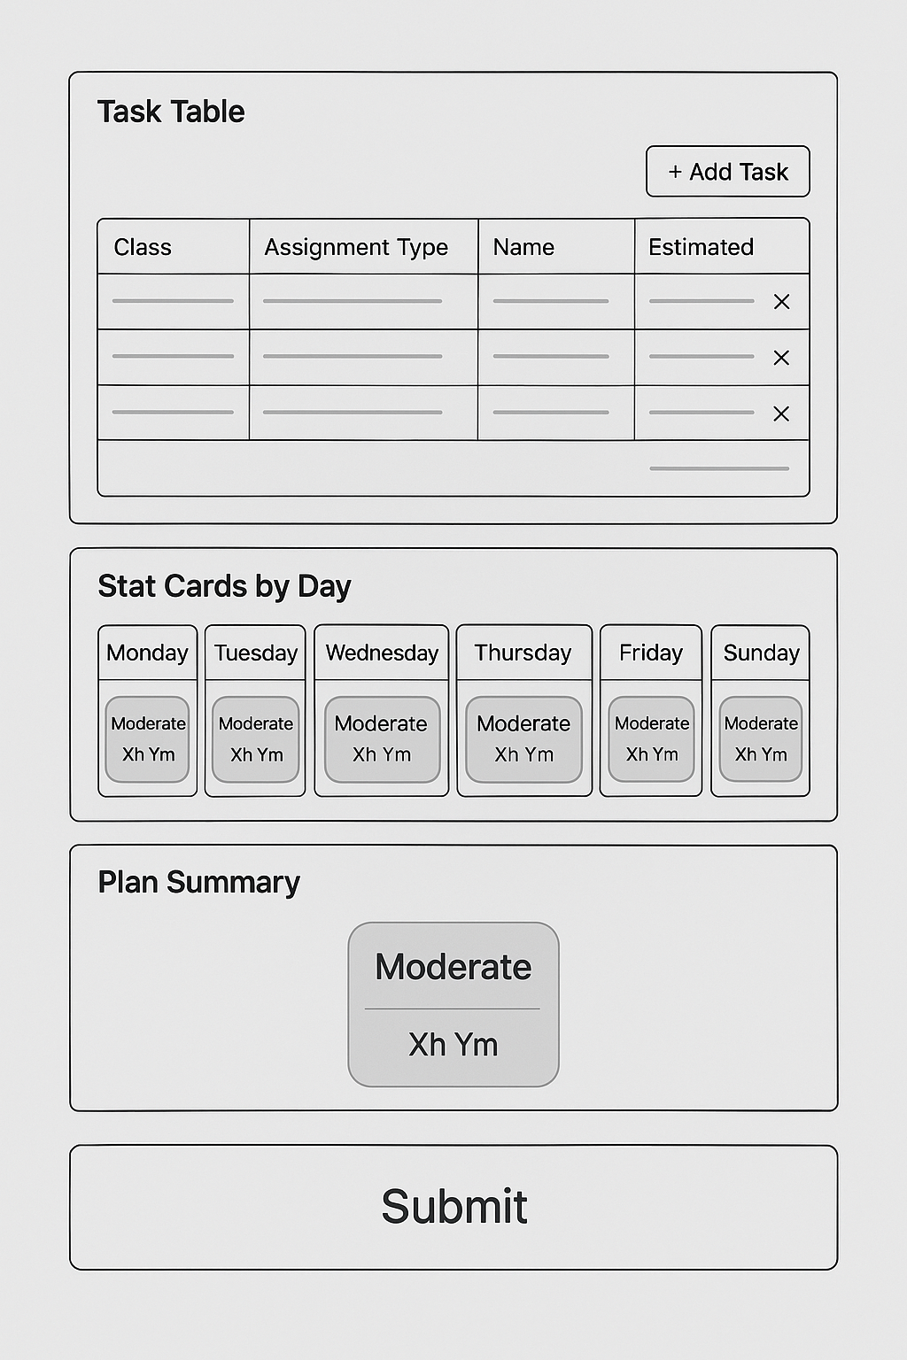
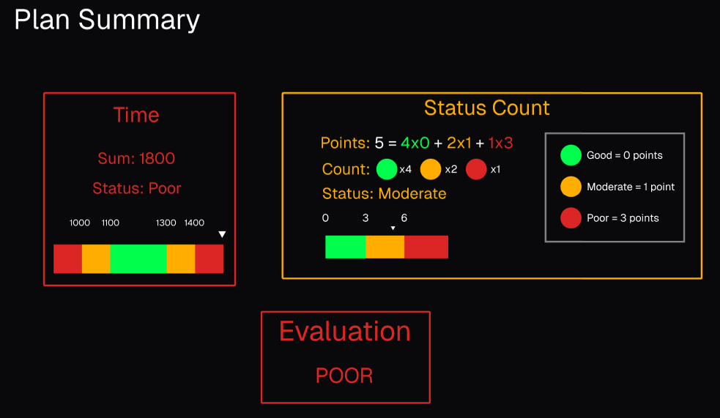
Scope Creep Visuals

Slide 7
Pending Actions
Create timeline chart and visual
Create basic instruction document for standup procedure (just a txt file)
Fill out sprint 1 presentation
Give presentation to parents & potentially Dr. Raymer
Format and upload documentation to GitHub
Fix figma UI mockup
Implement static UI elements using React, html, tailwind css, JavaScript

Slide 8
Next Steps
Finish up sprint 1 presentation
Email Dr. Raymer to schedule appointment
Write up rough standup process in txt file, then paste in Notion for tomorrow
Format and upload sprint 1 documents
Put meeting times in google calendar, setup timer on phone

