Slide 1
k8s glossary
Greg Thain

Slide 2
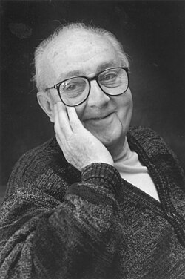
Ground rules!
"All models are wrong, some useful"
Um, actually rule in effect

Slide 3
K8s uses a central db
Thing description
Thing record
Thing

Slide 4

Pod Example
Pod is locus of work
Pod is incomplete (intentionally)
Pod cannot span machines
Pod only runs containers
Pod can have > 1 container
Pod is not like Condor Job
no "queue N"
pod picks its entity

Slide 5
K8s uses a central db
Pod description
metadata:
name: my_pod
spec:
container_image: fedora
resources_requests:
memory: "64M"
cpu: "2"
Pod record

Slide 6
Pod description
metadata:
name: my_pod
spec:
container_image: fedora
resources_requests:
memory: "64M"
cpu: "2"

Slide 7
K8s uses a central db
Pod description
metadata:
name: my_pod
spec:
container_image: fedora
resources_requests:
memory: "64M"
cpu: "2"
Pod record

Slide 8
Controller
Pod record
Name: my_pod
Spec:
Memory: 64M
cpus: 2
Status:
Host: ep1000.chtc.wisc.edu
State: Running
memory_usage: 32M
Controller
Works to make status match spec

Slide 9
K8s "Deployments"
1st class entity in k8s
Have a Deployment Language, Record
Deployments create pods
If pods =!= jobs,
  Deployments =!= dagman

Slide 10
Deployment description
metadata:
name: my_deployment
spec:
replicas: 3
template:
spec:
< a full pod PDL goes here>
Note: Pods have no name
deployment create 3 pods with name
my_deployment_randomstring

Slide 11
Deployment
Controller
deployment record
Name: my_deployment
Spec:
Replicas: 3
template:
<pod_template>
Status:
created_pods: 3
Depoyment controller
Creates pods
pod record
Name: my_deployment_123
Spec:
<pod_template>
Status:
memory_used: 32M
pod record
Name: my_deployment_456
Spec:
<pod_template>
Status:
memory_used: 32M
Pod
Controller
pod record
Name: my_deployment_679
Spec:
<pod_template>
Status:
memory_used: 32M

Slide 12
Other deployments
DaemonSet – one pod per machine
CronJob -- cronlike pod running
PodAutoscaler – on top of Deployment

Slide 13
Thank you

