Slide 1
Job Wrapper scripts: Problems and Alternatives
Greg Thain
Center for High Throughput Computing
University of Wisconsin - Madison
Notes:
Fri 30minut

Slide 2
Reliably running jobs (even on unreliable places)
Greg Thain
Center for High Throughput Computing
University of Wisconsin - Madison

Slide 3
Outline
A Very Short talk about "reliability"
Review of how HTCondor runs jobs
Problems with wrappers under HTCondor
Discuss solutions (some new, some old)
With the occasional simplification indicated by*

Slide 4
Reliabillity

Slide 5
What do we mean by running jobs reliably
Never having a problem?
No machine crashes
No network hiccups
No disk failures?
No machine running slower than it should?

Slide 6
Why do we accept the existence of failures?
We have to
We get more machines to use.
HTC should be happy to run on imperfect machines
e.g. gamer gpus

Slide 7
For us, reliability means
We can detect errors
We can classify errors
We can report errors
We can respond to errors
This one is beyond our scope of this talk

Slide 8
Review how HTCondor runs jobs

Slide 9
condor_starter runs the job on the EP*
Makes a scratch directory, e.g. /var/lib/execute/dir_1234
Starts the program named in the executable = line in the submit file

Slide 10
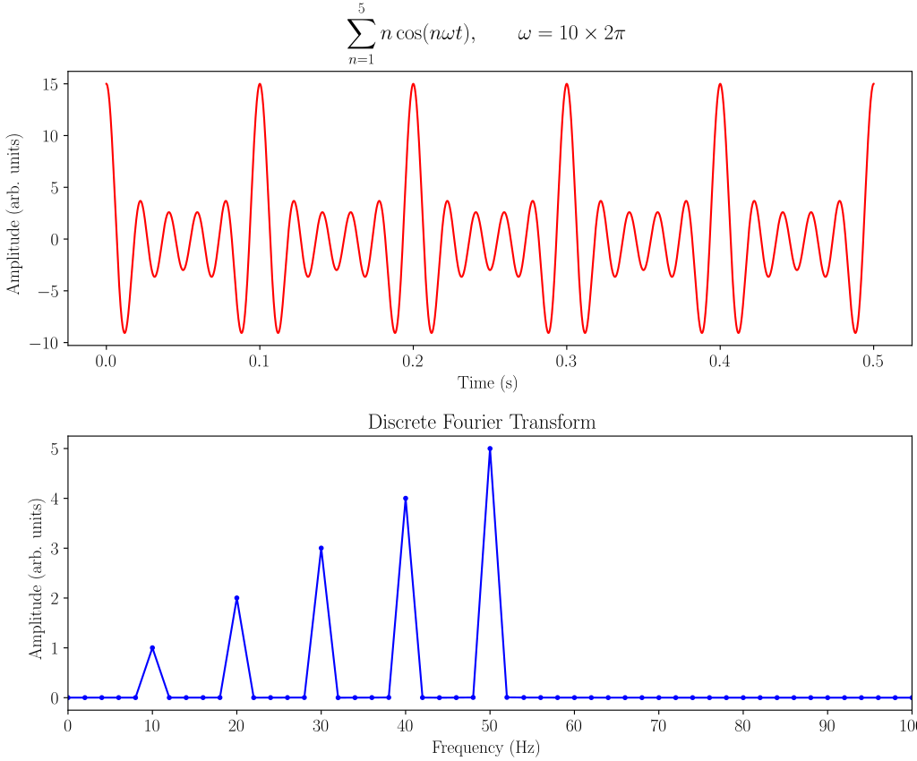
How you think of your program…
Makes a scratch directory, e.g. /var/lib/execute/dir_1234
Starts the program named in the executable = line in the submit file
By AkanoToE - Own work, CC BY-SA 4.0, https://commons.wikimedia.org/w/index.php?curid=86139361

Slide 11


How you think of your program…
Makes a scratch directory, e.g. /var/lib/execute/dir_1234
Starts the program named in the executable = line in the submit file

Slide 12

How you think of your program…
Makes a scratch directory, e.g. /var/lib/execute/dir_1234
Starts the program named in the executable = line in the submit file

Slide 13
How HTCondor sees your program*…
Makes a scratch directory, e.g. /var/lib/execute/dir_1234
Starts the program named in the executable = line in the submit file
Just an opaque box

Slide 14
But not quite perfectly opaque..
HTCondor knows…
Memory usage inside box
CPU/GPU usage inside box
Disk usage inside box
Wall clock time
and….
Exit code of job's main process (!)
(and some other stuff)
And sends this back to the AP!

Slide 15
Let's talk about exit codes…
Unix exit code is eight bits a program returns to parent at exit
ONLY WAY the program can communicate to the starter*
By convention "zero" (0) means "good", all else "bad"
But that's just a convention
TRIVIA: What's the exit code for the "grep" program?

Slide 16
HTCondor does what about exit codes?
Pure HTCondor doesn't do anything (just records them)
Should it – hold job with non-zero exit? Remove? Send email?
DAGMan has more options – can resubmit
By default, dagman assumes non-zero exit is failure, and blocks DAG
But HTCondor gives you knobs™
max_retries = 7
success_exit_code = 0

Slide 17
Wrapper scripts…

Slide 18
Ok, so what's all this about shell scripts?
Exit code of a script is either
Argument to exit shell builtin function
OR
Exit code of last command the script ran

Slide 19
Typical shell wrapper for a job looks like
#!/bin/sh
some_setup
some_more_setup
the_actual_executable
some_cleanup
some_more_cleanup

Slide 20
Pop Quiz: what's the exit code?
#!/bin/sh
some_setup
some_more_setup
the_actual_executable
some_cleanup
some_more_cleanup

Slide 21
Pop Quiz: how can we fix this?
#!/bin/sh
some_setup
some_more_setup
the_actual_executable
some_cleanup
some_more_cleanup

Slide 22
Doesn't seem to hard to fix at first…
#!/bin/sh
some_setup
some_more_setup
the_actual_executable
saved_exit = $?
some_cleanup
some_more_cleanup
exit $saved_exit

Slide 23
But to fix everything is tedious, and error-prone
#!/bin/sh
some_setup
some_more_setup
the_actual_executable
saved_exit = $?
some_cleanup
some_more_cleanup
exit $saved_exit
What if there is an error here?
Is this kind of error the same as a job error?
Do we want to respond the same way?

Slide 24
What's the bigger picture?
#!/bin/sh
some_setup
some_more_setup
the_actual_executable
some_cleanup
some_more_cleanup
Setup the environment
Cleanup the environment

Slide 25
Remember how HTCondor sees the job?
Fundamental Problem:
HTCondor can't differentiate a setup/cleanup problem
From a bona-fide job problem
(and we want to treat these differently)

Slide 26
That is to say…
Wrappers hide activity from HTCondor
Error codes are NOT sufficient!
And error codes belong to namespace
of the job – domain of the job
No Unix error for "failed to xfer sandbox"
Some Belong to the HTCondor domain

Slide 27
How to fix, and run more reliably

Slide 28
The proper fix
HTCondor EP
mkdirs scratch directory
Starts the job
some_setup
some_more_setup
the_job_itself
some_cleanup
some_more_cleanp

Slide 29
This is a common CS pattern
Separating initialization / teardown from main work
Object Oriented Constructors/Destructors do this
Two Phase commit "Prepare Tran"
And HTCondor knows all about errors in parts it manages
So it can send them back home to the AP to make decisions

Slide 30
The means translating shell into submit
Some work, worth it, not too hard.
Read submit man page for all possibilities
Some examples follow

Slide 31
Wrapper Env var
Submit language
#!/bin/sh
export MYVAR=hello
..
universe = vanilla
environment=MYVAR=hello
…
queue

Slide 32
Wrapper untar
Submit language
#!/bin/sh
tar xzf a.tgz
..
rm –fr a/
universe = vanilla
transfer_input_files = a/
…
queue

Slide 33
Wrapper wget
Submit language
#!/bin/sh
wget http://..
..
rm –fr a/
universe = vanilla
transfer_input_files = \
http://...
…
queue

Slide 34
We asked local facilitators "why wrappers?"
Four very common reasons
wget'ing file from 3rd party server
Or putting output files there
Setting an environment variable to point to scratch dir
Full description of inputs and outputs before and after job run
wget + untar

Slide 35
Wrapper wget
Submit language
#!/bin/sh
wget http://...
..
universe = vanilla
Transfer_input_files = \ http://example.com/foo/bar
queue

Slide 36
Wrapper ls -R
Submit language
#!/bin/sh
/bin/ls –CFR
my_real_job
/bin/ls -CFR
universe = vanilla
manifest = true
manifest_dir = some_directory
…
queue

Slide 37
Wrapper wget + untar
Submit language
#!/bin/sh
wget http://..
tar xzf a.tar
..
rm –fr a/
universe = vanilla
transfer_input_files = \
untar:http://.../foo.tar.gz
…
queue
Doesn't exist (yet)

Slide 38
Quiz time:
Which is faster –
HTCondor explicit file transfer ?
Or
Shared Filesystem?

Slide 39
What an expert will answer:
"It depends"

Slide 40
But what is a deeper answer?
What's the error domain of a shared file i/o error
Can the job report an shared file i/o error back to HTCondor?
NO!
Reliability can give better time-to-finish than something higher pref

Slide 41
Summary
The more we tell HTCondor to do, the better outcomes
A bit of work to translate familiar shell to submit, but worth it
But not all or nothing
What are we missing that you still need these kinds of wrappers?

Slide 42
Thank you and questions
Thank you – Questions?
This work is supported by the NSF under Cooperative Agreement OAC-2030508. Any options, findings,
conclusions or recommendations expressed in this material are those of the authors and do not
necessarily reflect the views of the NSF.

