Slide 1
Container Universe
Greg Thain
Center for High Throughput Computing
University of Wisconsin - Madison
Notes:
Fri 20 minutes

Slide 2
Overview
Quick definition of container world
Existing ways
Docker Universe
Singularity support
Differences between docker and singularity
Solution: Container universe
Future work

Slide 3

In the beginning, there was Docker
Docker runs processes …
In a chroot like virtualized filesystem
(with escapes to the host filesystem)
Where the filesystem is fetched from a remote hub, then locally cached, in a "stacked image" format
In cgroups that protect memory and CPU usage
Where the process runs as uid 0 by default
Using Linux capabilities to restrict most damage
Using the host's Linux kernel

Slide 4
A Mixed bag for HTC:
Docker runs processes …
In a chroot like virtualized filesystem
(with escapes to the host filesystem)
Where the filesystem is fetched from a remote hub, then locally cached, in a "stacked image" format
In cgroups that protect memory and CPU usage
Where the process runs as uid 0 by default
Using Linux capabilities to restrict most damage
These we like!

Slide 5
In the beginning, there was Docker
Docker runs processes …
In a chroot like virtualized filesystem
(with escapes to the host filesystem)
Where the filesystem is fetched from a remote hub, then locally cached, in a "stacked image" format
(and we are subject to network blocking if we pull too much…)
In cgroups that protect memory and CPU usage
Where the process runs as uid 0 by default
Using Linux capabilities to restrict most damage
These we Don't Like!

Slide 6
Solution: Docker Universe
Unrestricted Docker allows root access to host
HTCondor's Docker Universe limits docker options
To a "safe" subset
Translated from condor submit language
With the usual scratch directory mounted into the container from host
Allows the user to run an arbitrary container

Slide 7
Example submit file
universe = docker
docker_image = ubuntu:22
# Note that executable is optional
executable = run_me.sh
arguments = one two three
Output = output
queue

Slide 8
EP Process hierarchy in vanilla universe
condor_master
condor_startd
condor_starter
Users's job kids
Users's job
Users's job kids
Users's job kids

Slide 9
EP Process hierarchy in docker universe
Docker Daemon
Has root
condor_master
condor_master
condor_startd
Sends message to
Users's job
condor_starter
Users's job kids
Users's job kids
Docker run
Users's job kids

Slide 10
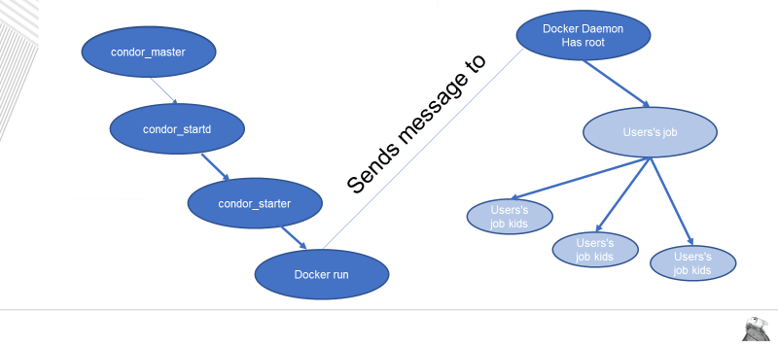
Problems with Docker Uni
Requires systemd-startd docker daemon
With root
(difficult for glideins)
User job not in same Unix process tree as starter
Ssh_to_job headaches
HTCondor doesn't see or control cgroups
Resources usage measurement works differently
We can't use condor file xfer to send image
Image must come from local cache

Slide 11
Enter … Singularity
Mainly added to HTCondor to support glideins
Singularity:
Needs setuid, but not daemon (changes happening now…)
Can run from image in a single file
Transferred by HTCondor
Doesn't contain with cgroups
No network isolation

Slide 12
Singularity support in HTCondor is different
Glidein folks wanted the EP Admin to be in charge
not the user
Singularity support in condor is a EP-side KNOB, e.g.
SINGULARITY_JOB = true SINGULARITY_IMAGE_EXPR = "/path/to/image"
Admin can wire expr to allow user to opt it, but site-specific
SINGULARITY_IMAGE_EXPR = Target.SingularityImage

Slide 13
Example singularity submit file
universe = vanilla
+SingularityImage = /path/to/ubuntu_22
executable = run_me.sh
arguments = one two three
Output = output
queue

Slide 14
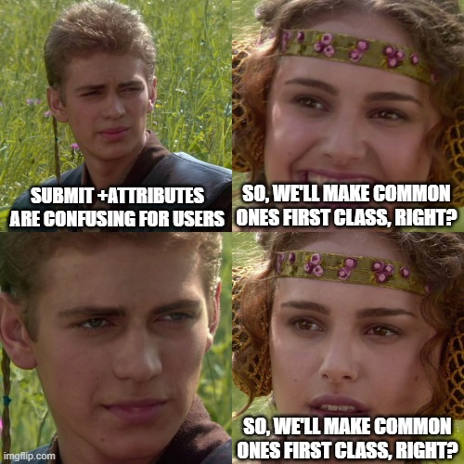

Slide 15
Problem
Most users don't care which container runtime they use
"Docker" is kind of generic name
But they do want to have the same submit file for glidein and local

Slide 16
And then things got even worse…
Singularity project forked into Singularity and Apptainer
Red Hat reimplemented most of docker as "podman"
Without a daemon, so we kind of like this..
Others wrote other container systems (Charlie cloud, etc.)
So what to do?

Slide 17
XKCD 127

Slide 18
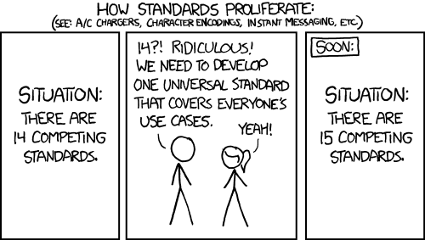

Slide 19
Enter … container universe
The startd detects if singularity or docker work
By running test jobs
And advertises attributes about those runtimes
HasSIF
HasDocker
HasSandbox

Slide 20
Users just ask for a container and image
universe = container
container_image = /path/to/ubuntu_22
executable = run_me.sh
arguments = one two three
Output = output
queue

Slide 21
And matchmaking does the rest
With new startd-side job transforms
That can mutate a vanilla job into a container job
Note docker universe and old singularity support will work
For foreseeable future

Slide 22
Assume container is on EP
universe = container
container_image = /path/to/ubuntu_22.sif
Should_transfer_image = false
executable = run_me.sh
arguments = one two three
Output = output
queue

Slide 23
But under the hood, same mechanisms
Just like saying Universe = docker when docker matches
Or SingularityJob = true when singularity matches

Slide 24
A container universe job is still a job…
Has a job log
Works with DAGMan
Condor_ssh_to_job (mostly) works
Condor_tail works
User level checkpointing works..

Slide 25
Future work
Add more container runtimes
Podman
Unprivileged docker
If job could run on multiple runtimes, who chooses?
Add automatic checkpoint / restore
Creates problems opportunities for checkpoint storage and migration

Slide 26
Thank you and questions
Thank you – Questions?
This work is supported by the NSF under Cooperative Agreement OAC-2030508. Any options, findings,
conclusions or recommendations expressed in this material are those of the authors and do not
necessarily reflect the views of the NSF.

