Slide 1
Scheduling at the Access Point
Greg Thain
Center for High Throughput Computing
University of Wisconsin - Madison
Notes:
Thu 20 minutes

Slide 2
Outline
Brief review of basic HTCondor architecture
All the ways to join or federate pools, and why so many?
Identities in a distributed environment
A new way with distributed identity

Slide 3
Simple, "Classic" HTCondor Architecture
Central Manager
(CM)
Execution Point
(EP)
Execution Point
(EP)
Reports to
Attaches to
Execution Point
(EP)
Access
Point
(AP)

Slide 4
Extending the classic – multiple APs
Central Manager
(CM)
Execution Point
(EP)
Execution Point
(EP)
Reports to
Attaches to
Attaches to
Execution Point
(EP)
Attaches to
Access
Point
(AP)
Access
Point
(AP)
Access
Point
(AP)

Slide 5
Another "Classic" HTCondor Architecture
Central Manager
(CM)
Execution Point
(EP)
Execution Point
(EP)
Reports to
Attaches to
Execution Point
(EP)
Access
Point
(AP)
Central Manager
(CM)
Execution Point
(EP)
Also attaches to

Slide 6
Degenerate, but useful HTCondor Architecture
Access
Point
(AP)
Not (yet) attached to anything

Slide 7
Now it is useful… HTCondor Architecture
Central Manager
(CM)
Execution Point
(EP)
Creates pool
Annex
Execution Point
(EP)
Execution Point
(EP)
Creates annex
Attaches to
Access
Point
(AP)

Slide 8
Another way to extend/attach the AP (as the CE does)
Execution Point
(EP)
Access
Point
(AP)
Access
Point
(AP)
Central Manager
(CM)
Sends jobs to

Slide 9
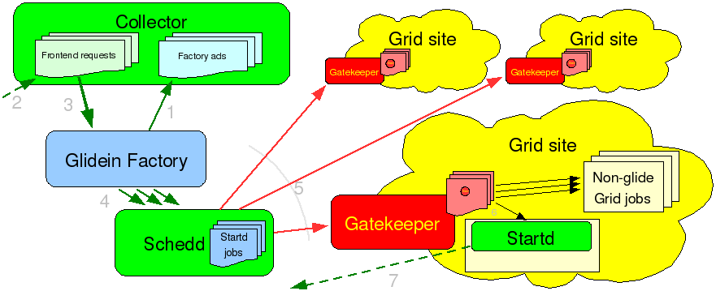
(and I don't even want to talk glidein…)

Slide 10

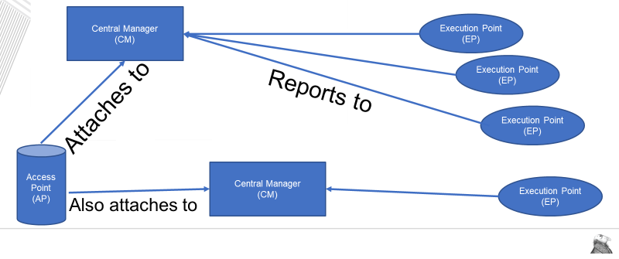
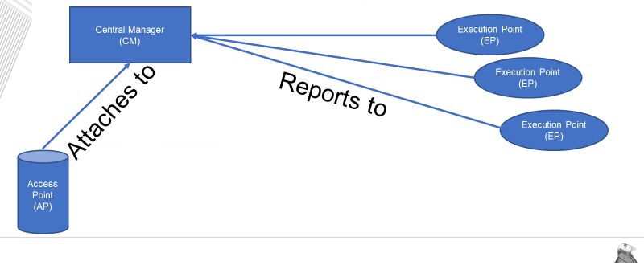
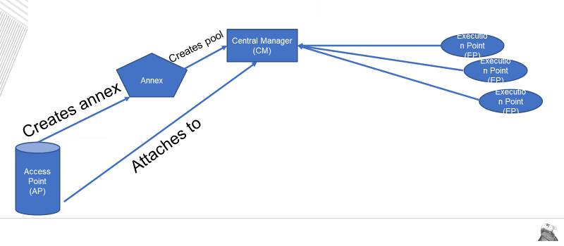
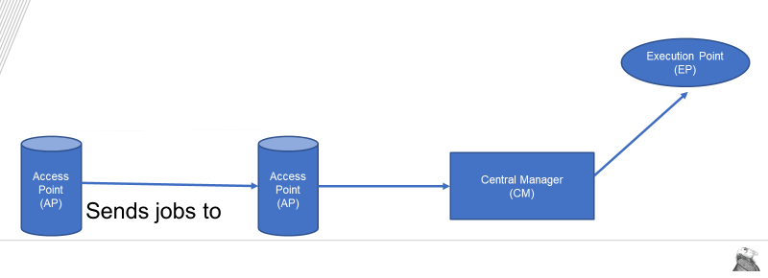
What is "A Condor Pool"

Slide 11
HTCondor Pool =?= CM + EP
Central Manager
(CM)
Execution Point
(EP)
Execution Point
(EP)
Reports to
Execution Point
(EP)
Access
Point
(AP)
This part is a "HTCondor Pool"

Slide 12
Distributed nature of HTCondor
Central Manager
(CM)
Execution Point
(EP)
Execution Point
(EP)
Reports to
Execution Point
(EP)
Access
Point
(AP)

Slide 13
Why distributed?
NOT (necessarily) because of performance
NOT (necessarily) because of throughput
But because human organizations are distributed
(like this meeting)
WAN distributed, not just LAN distributed
To succeed, we need to mirror our human organizations

Slide 14
Triune Identities of a HTCondor Job
Triune Identifiers of a HTCondor Job
Central Manager
(CM)
Execution Point
(EP)
Execution Point
(EP)
Owner
Submitter
User
Execution Point
(EP)
Access
Point
(AP)

Slide 15
The Owner of a HTCondor Job
Central Manager
(CM)
Execution Point
(EP)
Execution Point
(EP)
Owner: Authenticated id
who can submit or modify job in queue (in schedd)
Execution Point
(EP)
Access
Point
(AP)
Owner
Submitter
User

Slide 16
The Submitter of a HTCondor Job
Central Manager
(CM)
Execution Point
(EP)
Execution Point
(EP)
Execution Point
(EP)
Submitter: Account
who is charged for usage (in negotiator / accountant)
Access
Point
(AP)
Owner
Submitter
User

Slide 17
The User of a HTCondor Job
Central Manager
(CM)
Execution Point
(EP)
Execution Point
(EP)
Execution Point
(EP)
User: Unix uid the
Shadow runs as.
Used for file access on the AP.
Access
Point
(AP)
Owner
Submitter
User

Slide 18
The Identifier we shall not speak
Central Manager
(CM)
Execution Point
(EP)
Execution Point
(EP)
Execution Point
(EP)
Slot User: Unix uid the job runs as under starter. If file xfer off, does not matter.
Access
Point
(AP)
Slot user

Slide 19
Review: Distributed nature of HTCondor
Central Manager
(CM)
Execution Point
(EP)
Execution Point
(EP)
Execution Point
(EP)
Access
Point 1
(AP)
Access
Point 2
(AP)
Access
Point 3
(AP)

Slide 20
What if AP1,2,3 are distributed (wrt each)
Central Manager
(CM)
Execution Point
(EP)
Execution Point
(EP)
Execution Point
(EP)
Access
Point 1
(AP)
Access
Point 2
(AP)
Access
Point 3
(AP)

Slide 21
What if AP1,2,3 are distributed (wrt each)
Central Manager
(CM)
Execution Point
(EP)
Execution Point
(EP)
Execution Point
(EP)
Owner 1: 15 Jobs
Owner 2: 100 Jobs
Owner 3: 5 Jobs
Owner 4: 10 Jobs
Owner 5: 4 Jobs
Owner 6: 200 Jobs
Owner 7: 18 Jobs
Owner 8: 1,000 Jobs
Owner 9: 76 Jobs
Owner 10: 5 Jobs
Access
Point 1
(AP)
Access
Point 2
(AP)
Access
Point 3
(AP)
Owner 1: 100 Jobs
Owner 2: 200 Jobs
Owner 3: 300 Jobs
Owner 1: 4 Jobs
Owner 2: 200 Jobs

Slide 22
What we want
Central Manager
(CM)
Execution Point
(EP)
Execution Point
(EP)
Execution Point
(EP)
Owner 1: 15 Jobs
Owner 2: 100 Jobs
Owner 3: 5 Jobs
Owner 4: 10 Jobs
Owner 5: 4 Jobs
Owner 6: 200 Jobs
Owner 7: 18 Jobs
Owner 8: 1,000 Jobs
Owner 9: 76 Jobs
Owner 10: 5 Jobs
Access
Point 1
(AP)
Access
Point 2
(AP)
Access
Point 3
(AP)
Owner 1: 100 Jobs
Owner 2: 200 Jobs
Owner 3: 300 Jobs
Owner 1: 4 Jobs
Owner 2: 200 Jobs

Slide 23
Where we are going… (with per AP knob)
Computes per-AP demand
(can mix and match)
Central Manager
(CM)
Execution Point
(EP)
Execution Point
(EP)
Sends Anon summary of all demand
Execution Point
(EP)
Access
Point 1
(AP)
Access
Point 2
(AP)
Access
Point 3
(AP)

Slide 24
Where we are going… (with per AP knob)
Computes per-AP demand
(can mix and match)
Central Manager
(CM)
Execution Point
(EP)
Execution Point
(EP)
Sends Anon summary of all demand
Execution Point
(EP)
Access
Point 1
(AP)
The AP Itself
Schedules jobs to matches
Given to AP by central matchmaker

Slide 25
Who claims the EP?
Computes per-AP demand
(can mix and match)
Central Manager
(CM)
Execution Point
(EP)
Execution Point
(EP)
Execution Point
(EP)
Access
Point 1
(AP)
The AP claims the slot

Slide 26
Answer: BOTH!
Computes per-AP demand
(can mix and match)
Central Manager
(CM)
Execution Point
(EP)
Execution Point
(EP)
Execution Point
(EP)
Access
Point 1
(AP)
EP is claimed by 1) the Access Point (as AP)
2) On behalf of the job
The AP claims the slot

Slide 27
Summary
Distributed nature of HTCondor requires distribute identifiers
We don't support that well today
But we are working on it
Where else do we need to break non-distributed assumption

Slide 28
Thank you and questions
Thank you – Questions?
This work is supported by the NSF under Cooperative Agreement OAC-2030508. Any options, findings,
conclusions or recommendations expressed in this material are those of the authors and do not
necessarily reflect the views of the NSF.

