Slide 1
A Job's Journey
Greg Thain
Center for High Throughput Computing

Slide 2
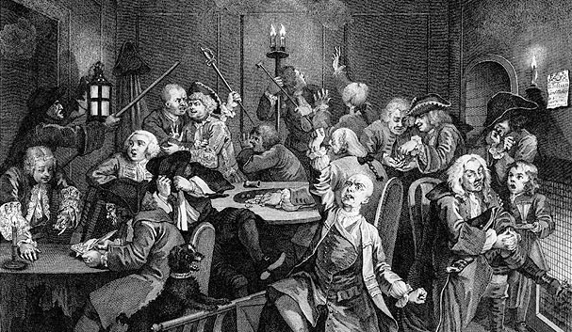
This Photo by Unknown Author is licensed under CC BY-SA-NC

Slide 3

What is a "Job"?
$ my_program arg1 arg2 > output_file

Slide 4

We need jobs to be reliable
$ my_program arg1 arg2 > output_file
Packing Label: Describes everything about the job

Slide 5
What is on the "packing label"?
Executable
Arguments
Environment vars
Input files
Output files
Resources needed
(memory, GPU, disk)
Credentials
Container Image
Microarchitecture
Environment vars
Retry?
Policies
Batch Name
Cron runtimes
Etc. etc. etc.

Slide 6
Submit file is packing label
Executable = program
Arguments = one two three
…
Warning: None of this is verified / checked

Slide 7

Full description of submit commands..
See previous talk… https://indico.cern.ch/event/1274213/contributions/5571142/

Slide 8
Submit file is job description, not the job!
Two ways to place a job: condor_submit, python
Or indirectly via dagman/Pegasus/portal, which call above

Slide 9
condor_submit command line tool
$ condor_submit
Good for interactive use (esp with condor_submit –i)

Slide 10
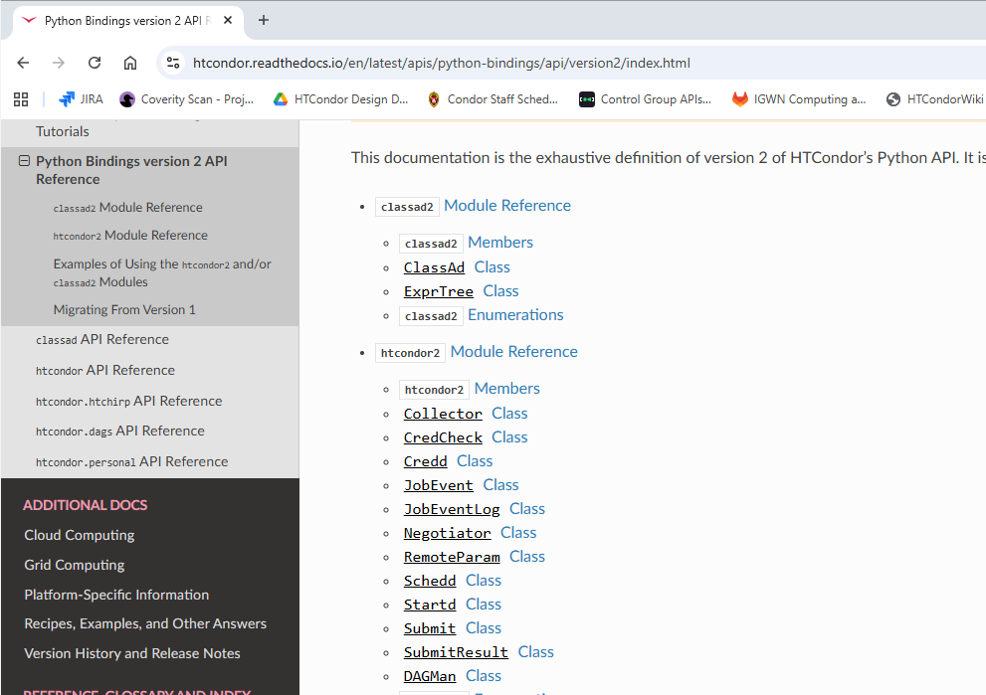
Consider python bindings for other uses
Python bindings around job placement better for portals, APIs

Slide 11
Submit file is job description, not the job!
One the job is placed in schedd, it truly exists
It exists because the AP gives it a name
Really a number cluster.proc
You can give it a BATCH_NAME, but the id is schedd-assigned
When the job exists, it has (is?) a job classad
Except in one case…

Slide 12
Late materialization
Executable = program
Arguments = one two three
max_idle = 100
…
AP is responsible for creating the job as needed
Not on by default today, but soon (?)
Vital for placing large clusters (say > 10,000)

Slide 13
How do you know a job exists?
Entry in job event log
Entry in global event log
$ htcondor job status <job id>
$ condor_q job_id
035 (7.-01.000) 2025-01-01 15:44:31 Cluster submitted from host:<1.2.3.4:38087>
...
000 (7.000.000) 2025-01-01 15:44:31 Job submitted from host: <1.2.3.4:38087>
...
000 (6.000.000) 2025-01-01 13:45:12 Job submitted from host:<1.2.3.4:38087>
…

Slide 14
Once job exists, AP finds matching slot
(Except for Grid/Local/Scheduler universes)

Slide 15
A word about states…
Idle
Job is created in the "idle" state
(unless hold = true in submit file)
We don't really have enough states
We'd like to add more, but that is … difficult
So, the states are overloaded more than we would like
Don't read too much into the state diagrams we will show later

Slide 16
Once job exists, AP finds matching slot
AP tries to (re) use an unused match it already has
Or may ask negotiator for a new match
Or may be able to get a match from a directly connected EP
If it doesn't match, condor_q –better

Slide 17
Even when matched, may not start right away
Job start delay queue
Transfer queue

Slide 18
JOB_START_DELAY and surprises
Idle??
JOB_START_DELAY = 2 JOB_START_COUNT = 10
During the delay, condor_q will say job is "R"unning
Condor_status will be claimed/idle
Be careful when looking at "states"

Slide 19
Surprises with transfer queueing
Run??
Jobs with file transfer go through a queue
MAX_CONCURRENT_UPLOADS
MAX_CONCURRENT_DOWNLOADS
FILE_TRANSFER_DISK_LOAD_THROTTLE
"Small" transfers skip the queue
By default, plugin transfer also skip queue

Slide 20
Surprises with transfer queueing
Run??
When in the queue, waiting for go-ahead
$ condor_q
Where '<' means input, and has been in the queue for two seconds
1.0 gthain 1/1 09:31 0+00:00:02 < 0 run.sh

Slide 21
Finally! Actually running the job
Run!
After file xfer, file xfer queueing, job finally runs on slot!
UNLESS docker universe, and docker needs to pull the image

Slide 22
Unless, the activation fails…
If a typo in list of input files
If permission error in input file
If EP has changed before the AP starts job…
Then activation fails…

Slide 23

How do you know a job is running?
Entry in job event log
Entry in global event log
$ htcondor job status <job id>
$ condor_q job_id (may be lying)
001 (2.000) 2025-09-10 15:44:33 Job executing on host: <1.2.3.4>
SlotName: slot1@machine
CondorScratchDir = "/execute"
Cpus = 1
Disk = 1500
GPUs = 0
Memory = 3981

Slide 24
Another way to learn a job is running
Run!
condor_ssh_to_job (-retry)

Slide 25
Things that can happen when running
Run!

Slide 26
HOLD state
Run!
Explicitly via condor_hold
Via policy via periodic_hold
or via system_periodic_hold
Or by condor if bad things happen
e.g. input file doesn't exit
memory exceeded

Slide 27
SUSPEND state
Run!
Explicitly via condor_suspend
via WANT_SUSPEND in startd
Released explicit via condor_continue

Slide 28
User checkpointing and the run state
checkpoint_exit_code = 85
When job exits with this code:
HTCondor sends the output/checkpoint files back to AP
When transfer is complete, restarts the job from scratch
Job stays in the "R"unning state the whole time

Slide 29
Eviction / Preemption

Slide 30
A job can go back to "I"dle
condor_vacate / condor_vacate_job
periodic_vacate is true (in newer htcondor versions)
PREEMPT is true in the startd (and time > MaxJobRetirementTime)
Startd machine crashes
Network is broken

Slide 31
A job can never get out of "I"dle
When activation fails early
Nothing in the event log
NumShadowStarts is incremented

Slide 32
"Epochs"
job placed
xfer input
Starts running
exit
xfer output
complete

Slide 33
"Epochs"
xfer input
job placed
xfer input
Starts running
evicted
starts

Slide 34
"Epochs"
epoch
epoch
epoch
epoch
epoch
epoch

Slide 35
Viewing epochs
condor_history –epoch
Condor_adstash -epoch

Slide 36
End of life of a job
When exits of it's own accord (by default …)
"There's a knob for that…"
At the end of the last epoch..
When condor_rm's by a human
When Periodic_Remove is true (or SYSTEM…)
After than, the job is HISTORY
- copy of job ad goes to AP's history
- also a copy goes to the startd's history
Both can be read by condor_adstash -> opensearch

Slide 37
This Photo by Unknown Author is licensed under CC BY-SA-NC

Slide 38

Thank you!
This work is supported by NSF under Cooperative Agreement OAC-2030508 as part of the PATh Project. Any opinions, findings, and conclusions or recommendations expressed in this material are those of the author(s) and do not necessarily reflect the views of the NSF

