Slide 1
Federating HTCondor pools
Greg Thain

Slide 2

Agenda
Ways to send jobs from one pool to another
or… machines from one pool to another
Advantages and Disadvantages to every way
Merging
Flocking
Startd flocking
Condor-C
Job Router
Glidein, in general
GlideinWMS
Condor CE

Slide 3


One HTCondor pool..
Execute
Submit
Machines
Central Manager

Slide 4
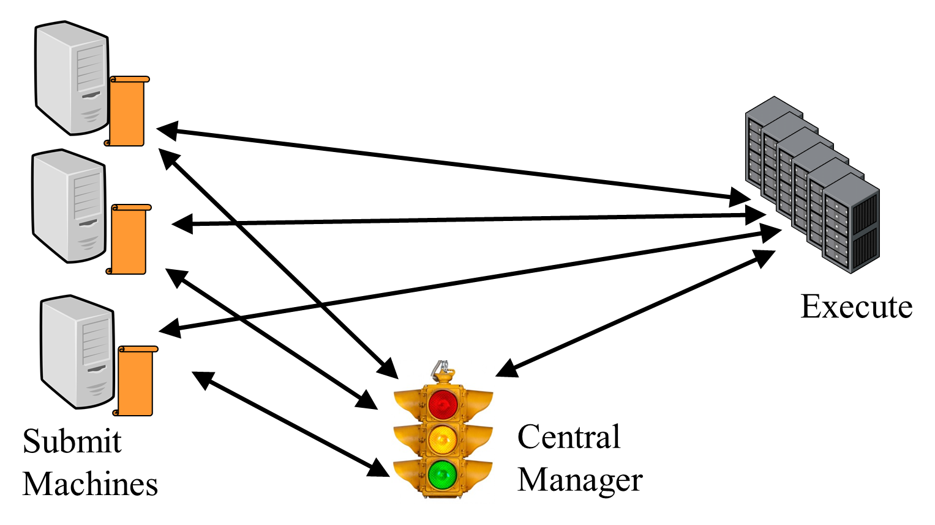
Two pools
Forward jobs from here to ….. here

Slide 5
Many Policy Questions
From just one schedd?
For all jobs?
To all startds?
Who decides to send jobs?
When to decide?
What about firewalls?
Who is the Administrator?
Accounting and fair share

Slide 6
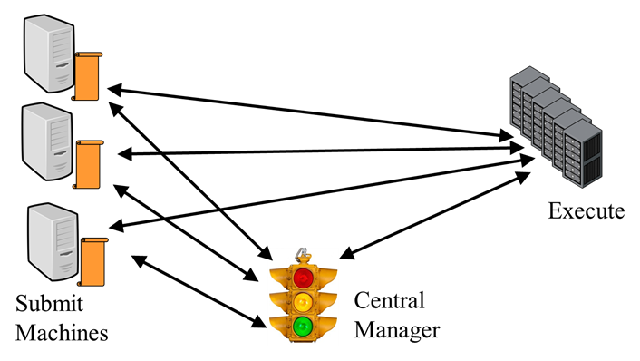
Merging: Just one 1 big pool
CONDOR_HOST = OTHER_CM_MACHINE
Change right hand condor pool’s config file

Slide 7
Merging: Pros
Easy to implement
All jobs go to all machines
Single fair share and accounting records

Slide 8
Merging: Cons
Requires one central manager – one accountant
May have firewall and networking problems
Can’t keep pools separate

Slide 9
Flocking
Flocking is a relationship from ONE SCHEDD to another CM

Slide 10
Flocking
FLOCK_FROM = \
ip.addr.from.sched
FLOCK_TO = ip.addr.to.cm
From schedd config
To cm config
From
schedd
To
cm

Slide 11
Flocking: Pros
Easy to set up
Policy is fixed
Works for many uses
From
schedd
To
cm

Slide 12
Flocking: Cons
Difficult when many scheds
Or many cms
Policy is fixed
Requires trust between pools
Requires good networks
From
schedd
To
cm

Slide 13
Selective Flocking
By default, ALL jobs eligible to flock
May want users to opt in via job submission
JOB_TRANSFORM_NAMES = REQUIREMENTS
JOB_TRANSFORM_REQUIREMENTS @= end
REQUIREMENTS JobUniverse == 5 && !(MY.WantGlidein?:0 )
SET requirements ( TARGET.PoolName == “MyHomePool" ) &&\
$(MY.requirements)
@end
New schedd config

Slide 14
Selective Flocking
STARTD_ATTRS = PoolName, $(STARTD_ATTRS)
PoolName = “MyHomePool”
New startd config
Executable = foo
Arguments = 1 2 3
Log = log
+WantGlidein = true
queue
New submit file

Slide 15
Startd (reverse) Flocking
Startd flocking allows one startd to appear in > 1 pool

Slide 16
Startd Flocking Config
ALLOW_ADVERTISE_STARTD = \
from.startd.addr
COLLECTOR_HOST = \
my.cm, your.cm
To cm config
From startd config

Slide 17
Startd Flocking: Pros
Per startd control
Easy to set up
Policy is fixed
Good for friendly pools

Slide 18
Startd Flocking: Cons
Difficult when many pools
Accounting may be tricky
Policy is mostly fixed
Requires trust between pools
Requires good networks
No user mapping

Slide 19
Condor-C
Condor-c is a job that runs on foreign schedd
grid_resource = condor joe@remotesched.example.com\ remotecm.example.com
+remote_jobuniverse = 5
+remote_requirements = True
+remote_ShouldTransferFiles = "YES"
+remote_WhenToTransferOutput = "ON_EXIT"
Executable = foo
Arguments = 1 2 3
Log = log
queue

Slide 20
Condor-C: Pros
Per job forwarding
No policy
Useful as a base for other systems
After job sent, network can be broken
Good scalability
User is in charge
Good for submitting pilots

Slide 21
Condor-C: Cons
Requires GSI or SSL authentication – tough to set up
Job policy is fixed at submit time

Slide 22
Job Router: config
JOB_ROUTER_DEFAULTS = \
[ \
requirements = WantJobRouter;\
MaxJobs = 10;\
delete_requirements = true;\
]
JOB_ROUTER_ENTRIES = \
[ GridResource = “condor”;\
name = “some”;\
…
]
Job1
Job2
Job3
Job4
Job5
Job6
Job7
Job5
Job5’
Job5’
Schedd
with jobs
Job router

Slide 23
Job Router
JobRouter is a condor daemon…
Grabs jobs from schedd, “I’ve got this one”
Uses rules to transform into new job
Submits new job to new schedd
Mirrors job status to 1st sched
Job1
Job2
Job3
Job4
Job5
Job6
Job7
Job5
Job5’
Job5’
Schedd
with jobs
Job router

Slide 24
Job Router: pros
Works over slow WAN
Submitters don’t need to know their jobs are moved
Easy for admin to mutate previously submitted jobs
Job router supports > 1 route, can timeout and resubmit
Job1
Job2
Job3
Job4
Job5
Job6
Job7
Job5
Job5’
Job5’
Schedd
with jobs
Job router

Slide 25
Job Router: cons
Requires GSI, SSL, for remote auth
Early binding – Jobs can wait ‘in line’ when startds idle
Job1
Job2
Job3
Job4
Job5
Job6
Job7
Job5
Job5’
Job5’
Schedd
with jobs
Job router

Slide 26
Glidein, HobbleIn, the idea
Like merging, but dynamic
Create Overlay pool

Slide 27
Glidein, HobbleIn, the idea
Like merging, but dynamic
Submit jobs, startds reporting home

Slide 28
Glidein, HobbleIn
Executable = condor_master
Arguments = -f –t
Output = out
Queue 100

Slide 29
Glidein, HobbleIn
Startd running as job

Slide 30
Glidein, HobbleIn, pros:
Late binding
Easy to merge lots of pools

Slide 31
Glidein, HobbleIn, cons:
Startd runs as non-root, some feature gone
Need good networking
Debugging can be tricky

Slide 32
Annex
What if we could:
Pay for a new standalone pool in AWS
Flock to that pool
condor_annex makes this easy

Slide 33
GlideinWMS
Implementation of Glidein idea for OSG
Very sophisticated
Needs GSI security
Requires lot of work to setup, run

Slide 34

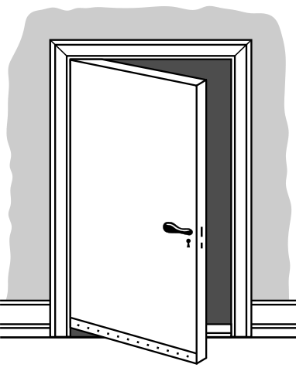


Condor-CE
Combines condor-c, job router
“Door” to non-condor remote pools
Condor-ce

Slide 35
Conclusion

