Slide 1
Negotiator Policy and Configuration
Greg Thain

Slide 2
Fairness in HTCondor and how to avoid it

Slide 3
Agenda
Understand role of negotiator
Learn how priorities work
Learn how quotas work
Encourage thought about possible policies!

Slide 4
After this talk, you should know..
Have a user get 2x slots of another
Have an upper limit on # slots of a group
Schedule multicore jobs before single
Guarantee every job gets one hour runtime
Put a limit on licensed jobs in the pool
Four Truths and one Lie!

Slide 5


Overview of condor 3 sides
Execute
Submit
Central Manager

Slide 6
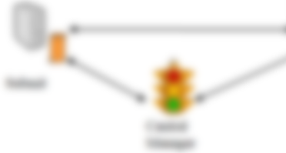

Startd Mission Statement
Near sighted
3 inputs only:
Machine
Running Job
Candidate Running Job
Knows nothing about the rest of the system!

Slide 7
Schedd mission
Run jobs on
slots the negotiator
has assigned to submitters.
Inputs:
All the jobs in that schedd
All the slots given to it by the negotiator

Slide 8
Schedd mission
Schedd Can:
Re-use a slot for > 1 job (in succession)
Pick which job for a user goes first
Schedd cannot:
Reassign slots from one submitter to other

Slide 9
Submitter vs User
Submitters: what are they?
User: an OS construct
Submitter: Negotiator construct
condor_userprio output
submitters used in accounting and schedudling
root:x:0:0:root:/root:/bin/bash
daemon:x:1:1:daemon:/usr/sbin:/usr/sbin/nologin
bin:x:2:2:bin:/bin:/usr/sbin/nologin
sys:x:3:3:sys:/dev:/usr/sbin/nologin
sync:x:4:65534:sync:/bin:/bin/sync

Slide 10
1 Owner: 1 submitter
Executable = somejob
Universe = vanilla
…
queue
Submit UID | “Owner” | “Submitter”
gthain | gthain | gthain@UID_DOMAIN

Slide 11
1 Owner: 2 submitters
Executable = somejob
Universe = vanilla
nice_user = true
queue
Submit UID | “Owner” | “Submitter”
gthain | gthain | nice-user.gthain@UID_DOMAIN

Slide 12

Negotiation Mission
Assign the slots of the whole pool
to users
based on some policy that’s ‘fair’
Notes:
What term is missing here? Negotiation knows nothing of “jobs”

Slide 13
Negotiator Inputs
All the slots in the pool
All the submitters in the pool
All the submitters’ priorities and quotas
One request per submitter at a time

Slide 14
How the Negotiator Works
Periodically tries to:
Rebalance % of slots assigned to users
Via preemption, if enabled
Via assigning empty slots if not
Negotiator is always a little out of date

Slide 15
Concurrency Limits
Simplest Negotiator (+ schedd) policy
Useful for pool wide, across user limits

Slide 16
Useful Concurrency Limits:
> 100 running NFS jobs crash my server
License server only allows X concurrent uses
Only want 10 database jobs running at once

Slide 17
Concurrency Limits: How to Configure
add to negotiator config file (condor_reconfig needed):
NFS_LIMIT = 100
DB_LIMIT = 42
LICENSE_LIMIT = 5

Slide 18
Concurrency Limits: How to use
Add to job ad
Executable = somejob
Universe = vanilla
…
ConcurrencyLimits = NFS
queue

Slide 19
Concurrency Limits: How to use
OR
Executable = somejob
Universe = vanilla
…
ConcurrencyLimits = NFS:4
queue
Notes:
Your units are 4, not condor’s

Slide 20
Concurrency Limits: How to use
Add to job ad
Executable = somejob
Universe = vanilla
…
ConcurrencyLimits = NFS,DB
queue

Slide 21
Part of the picture
Concurrency limits very “strong”
Can throw off other balancing algorithms
No “fair share” of limits

Slide 22
Main Loop of Negotiation Cycle
Get all slots in the pool
Get all jobs submitters in pool
Compute # of slots submitters should get
In priority order, hand out slots to submitters
Repeat as needed

Slide 23
The Negotiator as Shell Script
Get all slots in the pool
Get all jobs submitters in pool
Compute # of slots submitters should get
In priority order, hand out slots to submitters
Repeat as needed

Slide 24
1: Get all slots in pool

Slide 25
1: Get all slots in pool
$ condor_status

Slide 26
1: Get ‘all’ slots in pool
NEGOTIATOR_SLOT_CONSTRAINT = some classad expr
NEGOTIATOR_SLOT_CONSTRAINT
Defaults to true:
Defines what subset of pool to use
For sharding, etc.

Slide 27
1: Get all slots in pool
$ condor_status –af Name State RemoteOwner
slot1@... Claimed Alice
slot2@... Claimed Alice
slot3@... Claimed Alice
slot4@... Unclaimed undefined
slot5@... Claimed Bob
slot6@... Claimed Bob
slot7@... Claimed Charlie
slot8@... Claimed Charlie

Slide 28
1: Get all slots in pool
$ condor_status –af Name RemoteOwner

Slide 29
2: Get all submitters in pool
$ condor_status -submitters

Slide 30
2: Get all submitters in pool
$ condor_status -submitters
Name Machine RunningJobs IdleJobs
Alice submit1 4 4
Bob submit1 2 100
Charlie submit1 2 0
Danny submit1 0 50

Slide 31
2: Get all submitters in pool
$ condor_status -submitters
Name Machine RunningJobs IdleJobs
Alice submit1 4 4
Bob submit1 2 100
Charlie submit1 2 0
Danny submit1 0 50

Slide 32
3: Compute per-user “share”
Tricky
Based on historical usage

Slide 33
3a: Get historical usage
$ condor_userprio -all

Slide 34
3a: Get historical usage
$ condor_userprio -all
UserName Effective Real Priority Res
Priority Priority Factor in use
Alice 3100 3.1 1000 4
Bob 4200 4.2 1000 2
Charlie 1500 1.5 1000 2
Danny 8200 8.2 1000 0

Slide 35
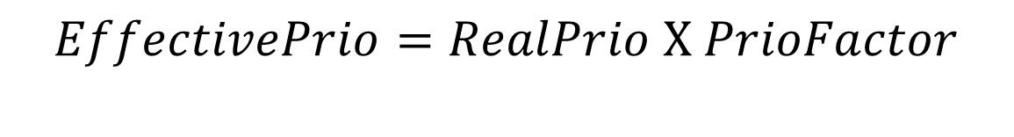
3a: Get historical usage
$$EffectivePrio=RealPrio \text{X} PrioFactor$$
UserName Effective Real Priority Res
Priority Priority Factor in use
Alice 3100 3.1 1000 4
Bob 4200 4.2 1000 2
Charlie 1500 1.5 1000 2
Danny 8200 8.2 1000 0

Slide 36
So What is Real Priority?
Real Priority is smoothed historical usage
Smoothed by PRIORITY_HALFLIFE
PRIORITY_HALFLIFE defaults 86400s (24h)

Slide 37
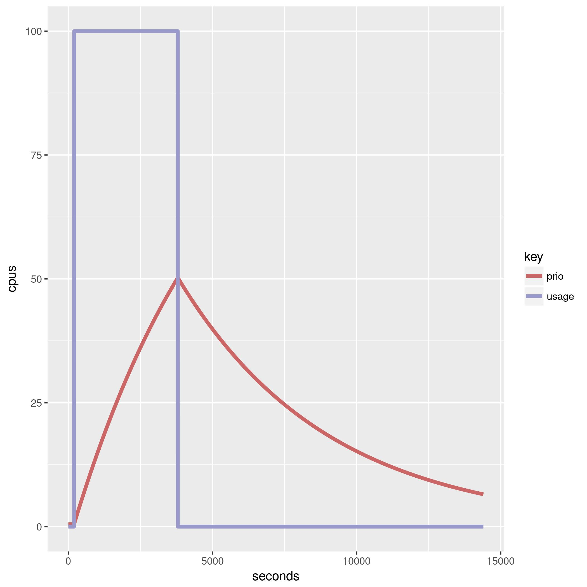
Actual Use vs Real Priority

Slide 38
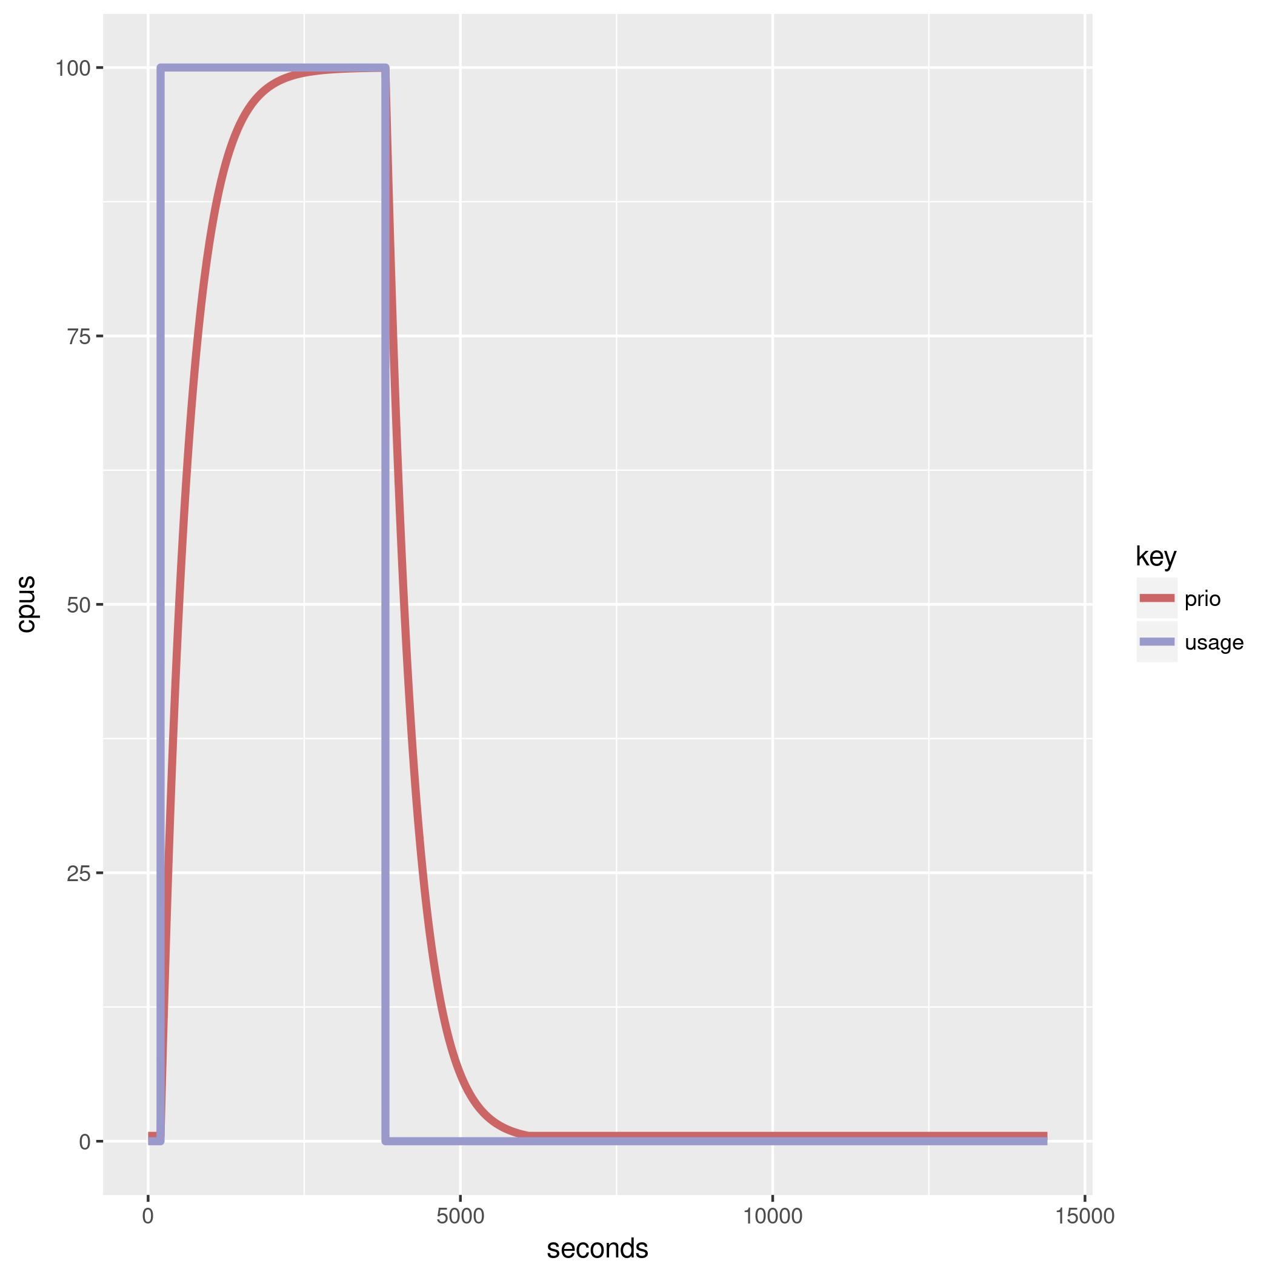
Another PRIORITY_HALFLIFE
PRIORITY_HALFLIFE = 1

Slide 39
3a: Get historical usage
$ condor_userprio -all
UserName Effective Real Priority Res
Priority Priority Factor in use
Alice 3100 3.1 1000 4
Bob 4200 4.2 1000 2
Charlie 1500 1.5 1000 2
Danny 8200 8.2 1000 0

Slide 40
Effective priority:
Effective Priority is the ratio of the pool
that the negotiator tries to allot to submitters
Lower is better, 0.5 is the best real priority

Slide 41
UserName Effective Real Priority Res
Priority Priority Factor in use
Alice 1000 1.0 1000 4
Bob 2000 2.0 1000 2
Charlie 2000 2.0 1000 2
Alice deserves 2x Bob & Charlie
Alice: 4
Bob: 2
Charlie: 2 (Assuming 8 total slots)

Slide 42
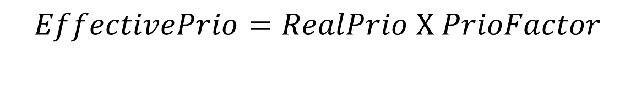
So What is Priority Factor?
UserName Effective Real Priority Res
Priority Priority Factor in use
Alice 1000 1.0 1000 4
Bob 2000 2.0 1000 2
Charlie 2000 2.0 1000 2
$$EffectivePrio=RealPrio \text{X} PrioFactor$$
Priority factor lets admin say If equal usage, User A gets 1/nth User B
$ condor_userprio –setfactor alice 5000

Slide 43
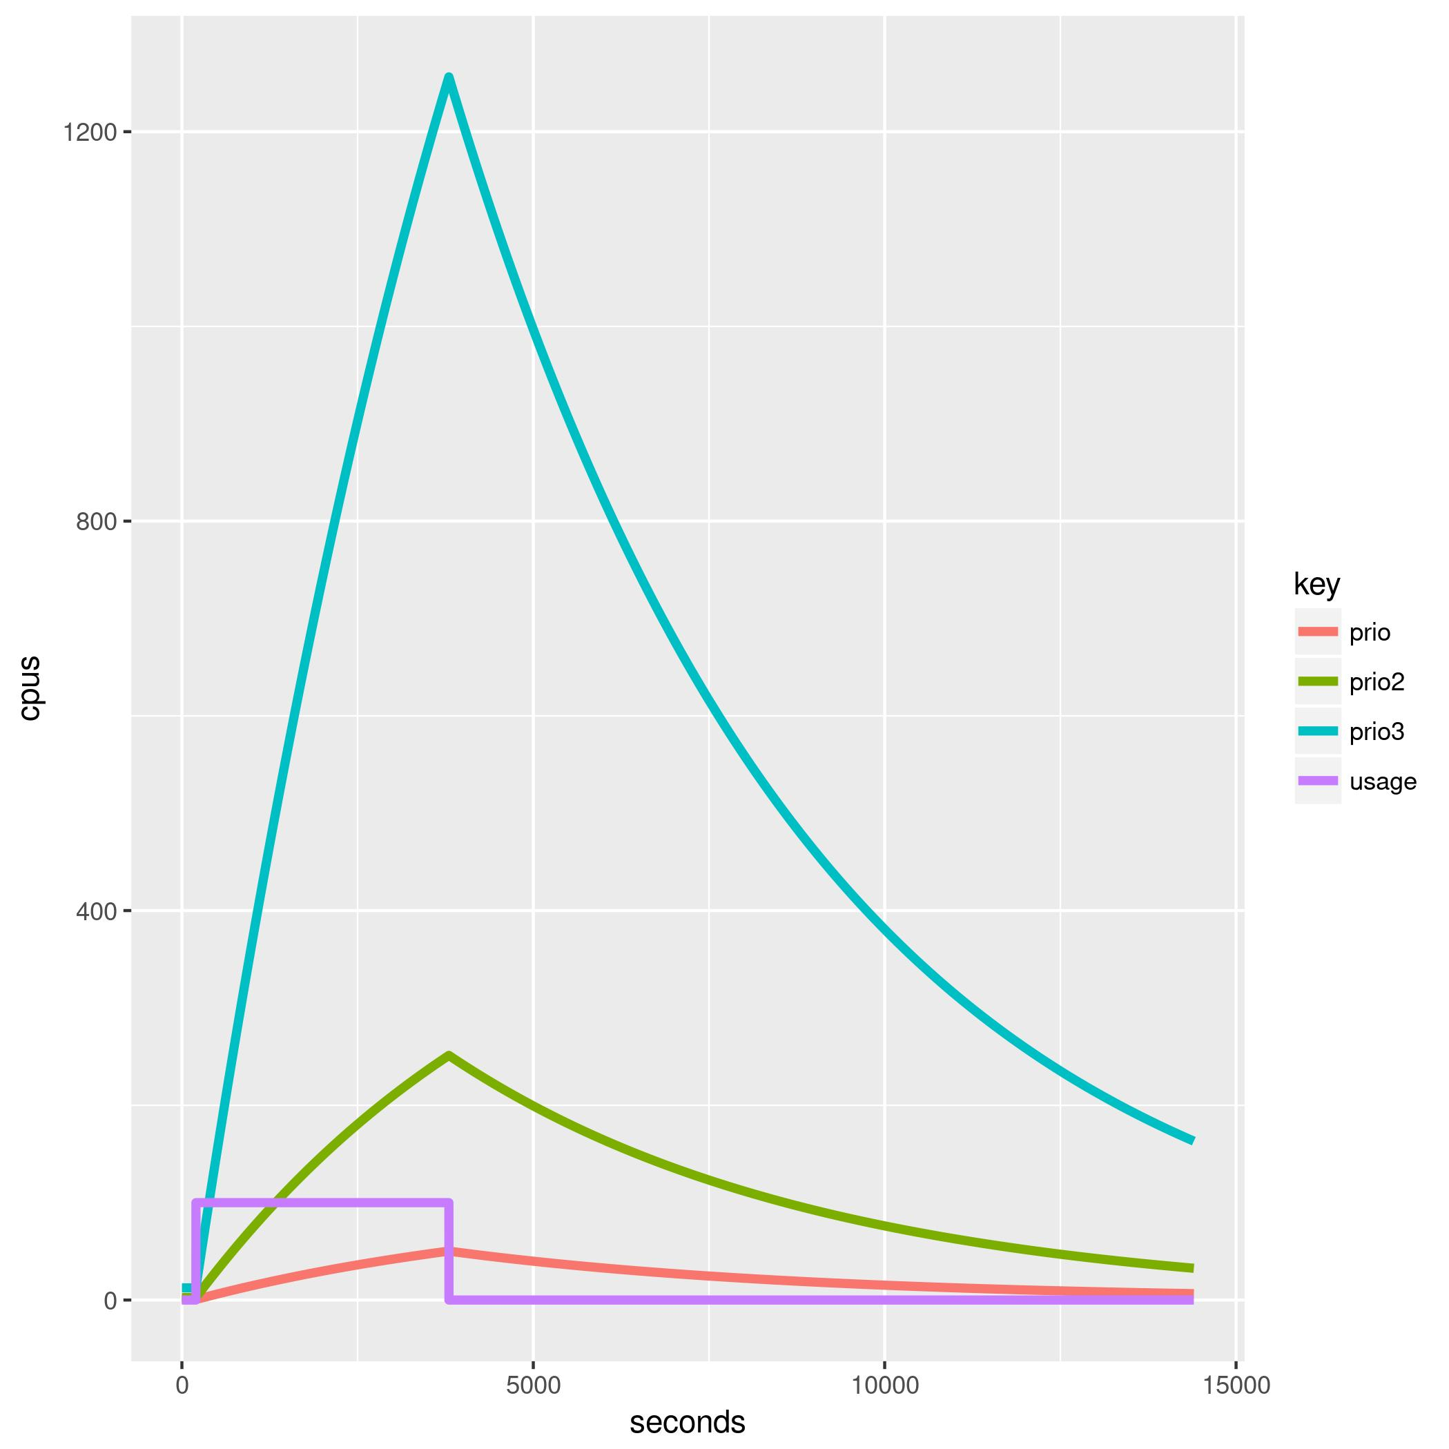
3 different PrioFactors

Slide 44
Priority Factor pop quiz
$ condor_userprio –setfactor alice 500
$ condor_userprio –setfactor bob 1000
Gives Alice 2x Bob
When both have jobs
Either Alice or Bob can use whole pool when other is gone

Slide 45
Whew! Back to negotiation
Get all slots in the pool
Get all jobs submitters in pool
Compute # of slots submitters should get
In priority order, hand out slots to submitters
Repeat as needed

Slide 46
Target allocation from before
User | Effective Priority | Goal
Alice | 1,000.00 | 4
Bob | 2,000.00 | 2
Charlie | 2,000.00 | 2
Assume 8 total slots (claimed or not)

Slide 47
Look at current usage
User | Effective Priority | Goal | Current Usage
Alice | 1,000.00 | 4 | 3
Bob | 2,000.00 | 2 | 1
Charlie | 2,000.00 | 2 | 0

Slide 48
Diff the goal and reality
User | Effective Priority | Goal | Current Usage | Difference (“Limit”)
Alice | 1,000.00 | 4 | 3 | 1
Bob | 2,000.00 | 2 | 1 | 1
Charlie | 2,000.00 | 2 | 0 | 2

Slide 49
“Submitter Limit” per user
User | Effective Priority | Goal | Current Usage | Difference (“Limit”)
Alice | 1,000.00 | 4 | 3 | 1
Bob | 2,000.00 | 2 | 1 | 1
Charlie | 2,000.00 | 2 | 0 | 2

Slide 50
Limits determined, matchmaking starts
In Effective User Priority order,
Find a schedd for that user, get the request
User | Effective Priority | Difference (“Limit”)
Alice | 1,000.00 | 1
Bob | 2,000.00 | 1
Charlie | 2,000.00 | 2

Slide 51
“Requests”, not “jobs”
$ condor_q –autocluster Alice
Id Count Cpus Memory Requirements
20701 10 1 2000 OpSys == “Linux”
20702 20 2 1000 OpSys == “Windows”

Slide 52
Match all machines to requests
Id Count Cpus Memory Requirements
20701 10 1 2000 OpSys == “Linux”
slot1@... Linux X86_64 Idle 2048
slot2@... Linux X86_64 Idle 2048
slot1@... Linux X86_64 Idle 1024
slot2@... Linux X86_64 Claimed 2048
slot1@... WINDOWS X86_64 Claimed 1024

Slide 53
Sort All matches
By 3 keys, in order
NEGOTIATOR_PRE_JOB_RANK
RANK
NEGOTIATOR_POST_JOB_RANK

Slide 54
Why Three?
NEGOTIATOR_PRE_JOB_RANK
Strongest, goes first over job RANK
RANK
Allows User some say
NEGOTIATOR_POST_JOB_RANK
Fallback default

Slide 55
PRE_JOB_RANK use case
Policy:
“I want all my fast machines filled first”
NEGOTIATOR_PRE_JOB_RANK = mips

Slide 56
Finally, give matches away!
slot1@... Linux X86_64 Unclaimed 2048
slot2@... Linux X86_64 Unclaimed 2048
slot1@... Linux X86_64 Claimed 2048
Up to the limit specified earlier
If below limit, ask for next job request

Slide 57
Done with Alice, on to Bob
User | Effective Priority | Difference (“Limit”)
Alice | 1,000.00 | 1
Bob | 2,000.00 | 1
Charlie | 2,000.00 | 2

Slide 58
But, it isn’t that simple…
Assumed every job matches every slot
And infinite supply of jobs!
… But what if they don’t match?
There will be leftovers – then what?

Slide 59
Lather, rinse, repeat
This whole cycle repeats with leftover slots
Again in same order…

Slide 60
Big policy question
Preemption: Yes or no?
Tradeoff: fairness vs. throughput
(default: no preemption)

Slide 61
Preemption: disabled by default
PREEMPTION_REQUIREMENTS = false
Evaluated with slot & request ad. If true,
Claimed slot is considered matched, and
Subject to matching

Slide 62
Example PREEMPTION_REQs
PREEMPTION_REQUIREMENTS=\
RemoteUserPrio > SubmitterPrio * 1.2

Slide 63
PREEMPTION_RANK
Sorts matched preempting claims
PREEMPTION_RANK = -TotalJobRunTime

Slide 64
MaxJobRetirementTime
Can be used to guarantee minimum time
E.g. if claimed, give an hour runtime, no matter what:
MaxJobRetirementTime = 3600
Can also be an expression

Slide 65
Quiz Time!
Want jobs with big RequestCpus to go 1st?

Slide 66
Whew!
Now, on to Groups.

Slide 67
First AccountingGroup
AccountingGroup as alias
Accounting_Group_User = Ishmael
“Call me Ishmael”
With no dots, and no other configuration
Means alias: Maps “user” to “submitter”
Complete trust in user job ad (or xform)
Viz-a-vis SUBMIT_REQUIREMENTs

Slide 68
Submitter | Effective Priority | Accounting Group
Alice | 1,000.00 | “Alice”
Bob | 2,000.00 | “Alice”
Charlie | 2,000.00
Merged to one
submitter
No fair share between old Alice and old Bob!

Slide 69
Accounting Groups With Quota
Only way to get “quotas” for users or groups

Slide 70
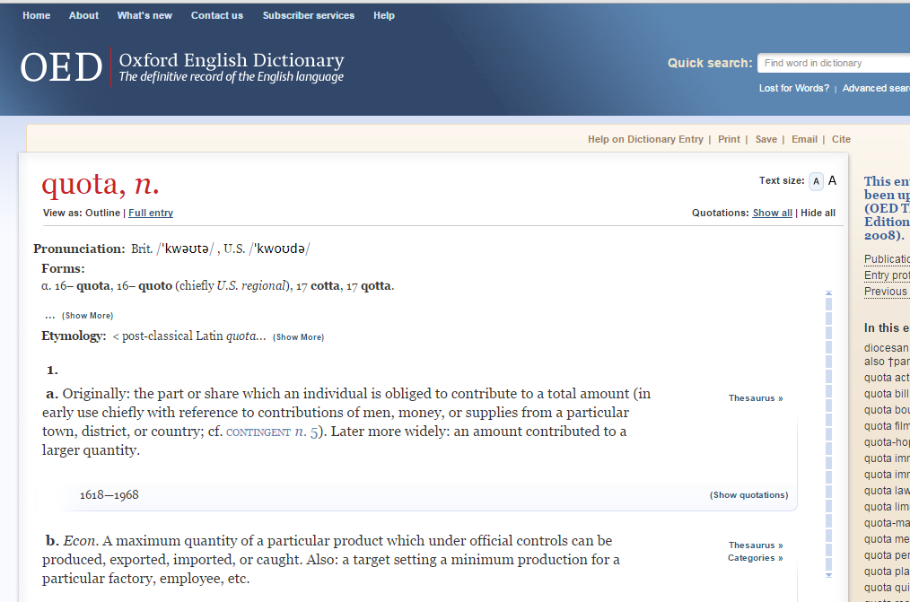
Maximum

Slide 71
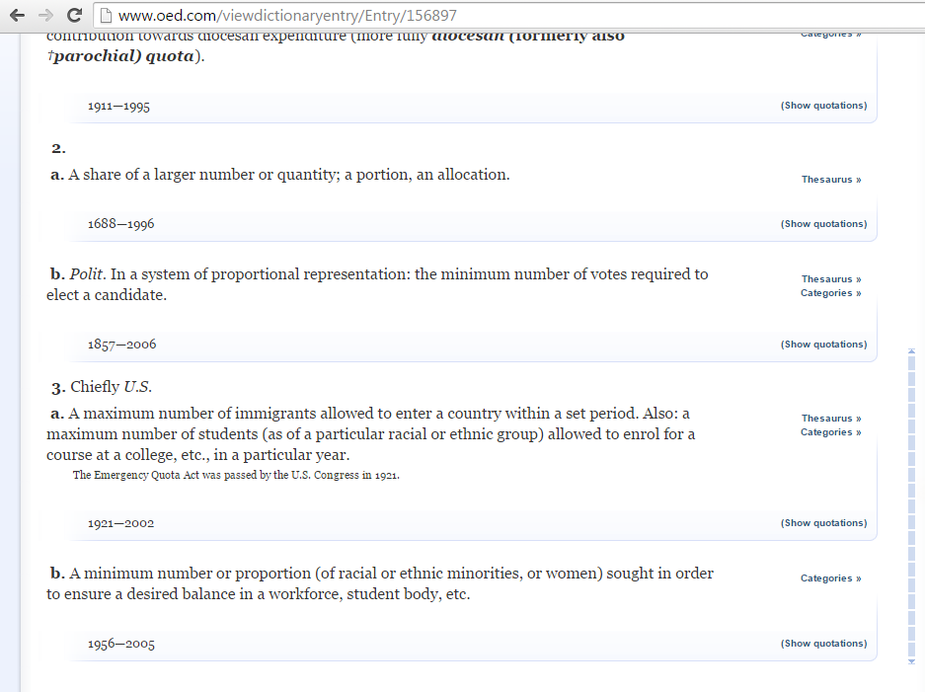
Minimum

Slide 72
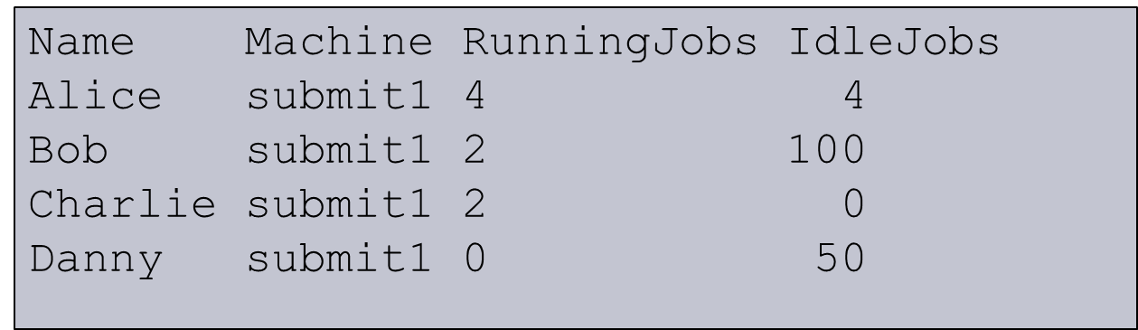
Group Quotas: Big Picture
w/o quotas: Assign submitters

Slide 73
Group Quotas: Big Picture
To the whole pool

Slide 74
Submitters opt into Groups
Name Machine RunningJobs Idle
Alice submit1 4 4
Bob submit1 2 100
Charlie submit1 2 0
Danny submit1 0 50
Group A
Group B
Group C

Slide 75
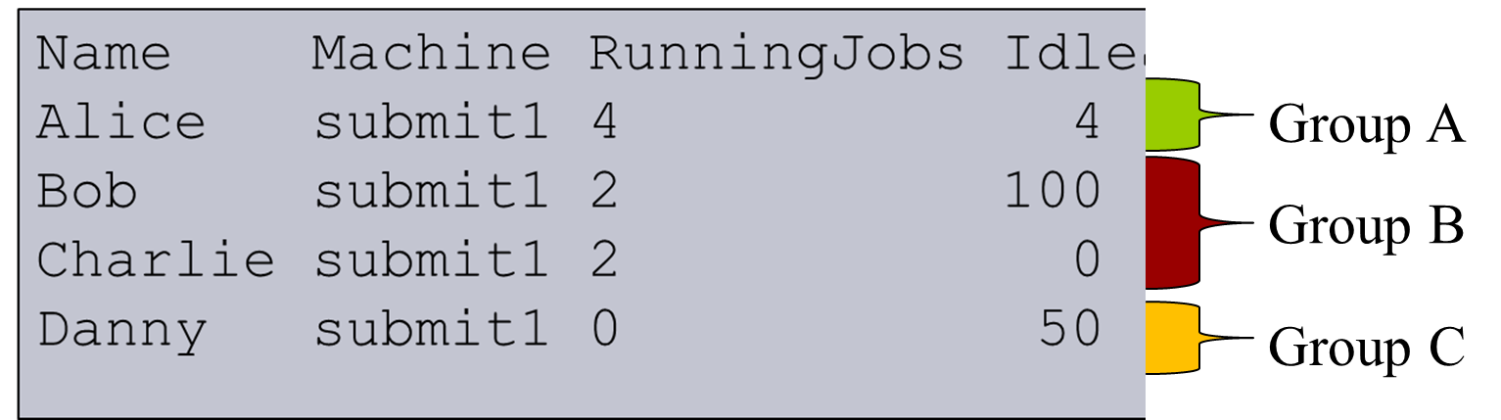
1st: Each group gets a “Quota”
Group | Quota
Group A | 200 slots
Group B | 100 slots
Group C | 500 slots
(How? We’ll get to that)

Slide 76
2nd: Make virtual sub-pool per group
Group | Quota
Group A | 200 slots
Group B | 100 slots
Group C | 500 slots

Slide 77
3rd: Do fair share with each sub-pool in group turn
Group | Quota
Group A | 200 slots
Group B | 100 slots
Group C | 500 slots
Groups with > 1 submitter get fair share with prios as usual, but total size of the pool is the quota size

Slide 78
Accounting Groups with quotas
Must be predefined in config file
GROUP_NAMES = group_a, group_b
GROUP_QUOTA_GROUP_A = 10
GROUP_QUOTA_GROUP_B = 20
Slot weight is the unit – default cpus

Slide 79
Or, with Dynamic quotas
Can also be a percentage
GROUP_NAMES = group_a, group_b
GROUP_QUOTA_DYNAMIC_GROUP_A = 0.3
GROUP_QUOTA_DYNAMIC_GROUP_B = 0.4
If sum != 1.00 (= 100 %), scaled

Slide 80
And jobs opt in (again)
Accounting_Group = group_a
But you retain identity within your group.

Slide 81
AcctGroups w/quota
Reruns the whole cycle as before
But with pool size constrained to quota
And fair share, between users in group

Slide 82
Order of groups?
By default, in starvation order
Creates overprovisioning trick for strict fifo:
GROUP_QUOTA_HIPRIO = 100000000
Means this group always most starving
GROUP_SORT_EXPR overrides

Slide 83
Quotas can leave slots idle
If Group’s demand < quota
Slots left idle
Can we go over quota in this case?

Slide 84
Going over quota, slots available
One way is:
GROUP_AUTO_REGROUP = true
After all groups go, one last round with no groups, every user outside of their group.

Slide 85
2nd way to over quota
“Surplus”
Assumes a hierarchy of groups:
GROUP_NAMES = group_root, group_root.a, group_root.b, group_root.c
GROUP_QUOTA_GROUP_root = 60
GROUP_QUOTA_GROUP_root.a = 10
GROUP_QUOTA_GROUP_root.b = 20
GROUP_QUOTA_GROUP_root.b = 30
GROUP_ACCEPT_SURPLUS = true

Slide 86
60
root
accept_surplus = true
10
20
30
Group A
Group B
Group C
3 slots of demand at A
7 quota slots moved to B & C
Proportional to B & C quota

Slide 87
60
root
accept_surplus = true
10 3
20 23
30 34
Group A
Group B
Group C

Slide 88
Gotchas with quotas
Quotas don’t know about matching
Assuming everything matches everything
Surprises with partitionable slots
Managing groups not easy

Slide 89
In summary
Negotiator is very powerful, often ignored
Lots of opportunity to tune system
Many ways to peek under the hood

Slide 90
Four Truths and one Lie!
Have a user get 2x slots of another
Have an upper limit on # slots of a group
Schedule multicore jobs before single
Guarantee every job gets one hour runtime
Put a limit on licensed jobs in the pool

Slide 91
Thank you
Questions?
Talk to us
htcondor-users
manual

