Slide 1

AP Scheduling
Greg Thain

Slide 2
3 new mechanisms
Owner Capacity Units (OCUs)
Slot Bundles
AP Controllers

Slide 3
CM
AP
EP
CLAIM_WORKLIFE

Slide 4
All three mechanisms leverage claims
We’ve always had claims
We don’t use them as much as we good
Often hidden under the hood
Useful mechanism, trying to get more out them

Slide 5
OCUs..

Slide 6
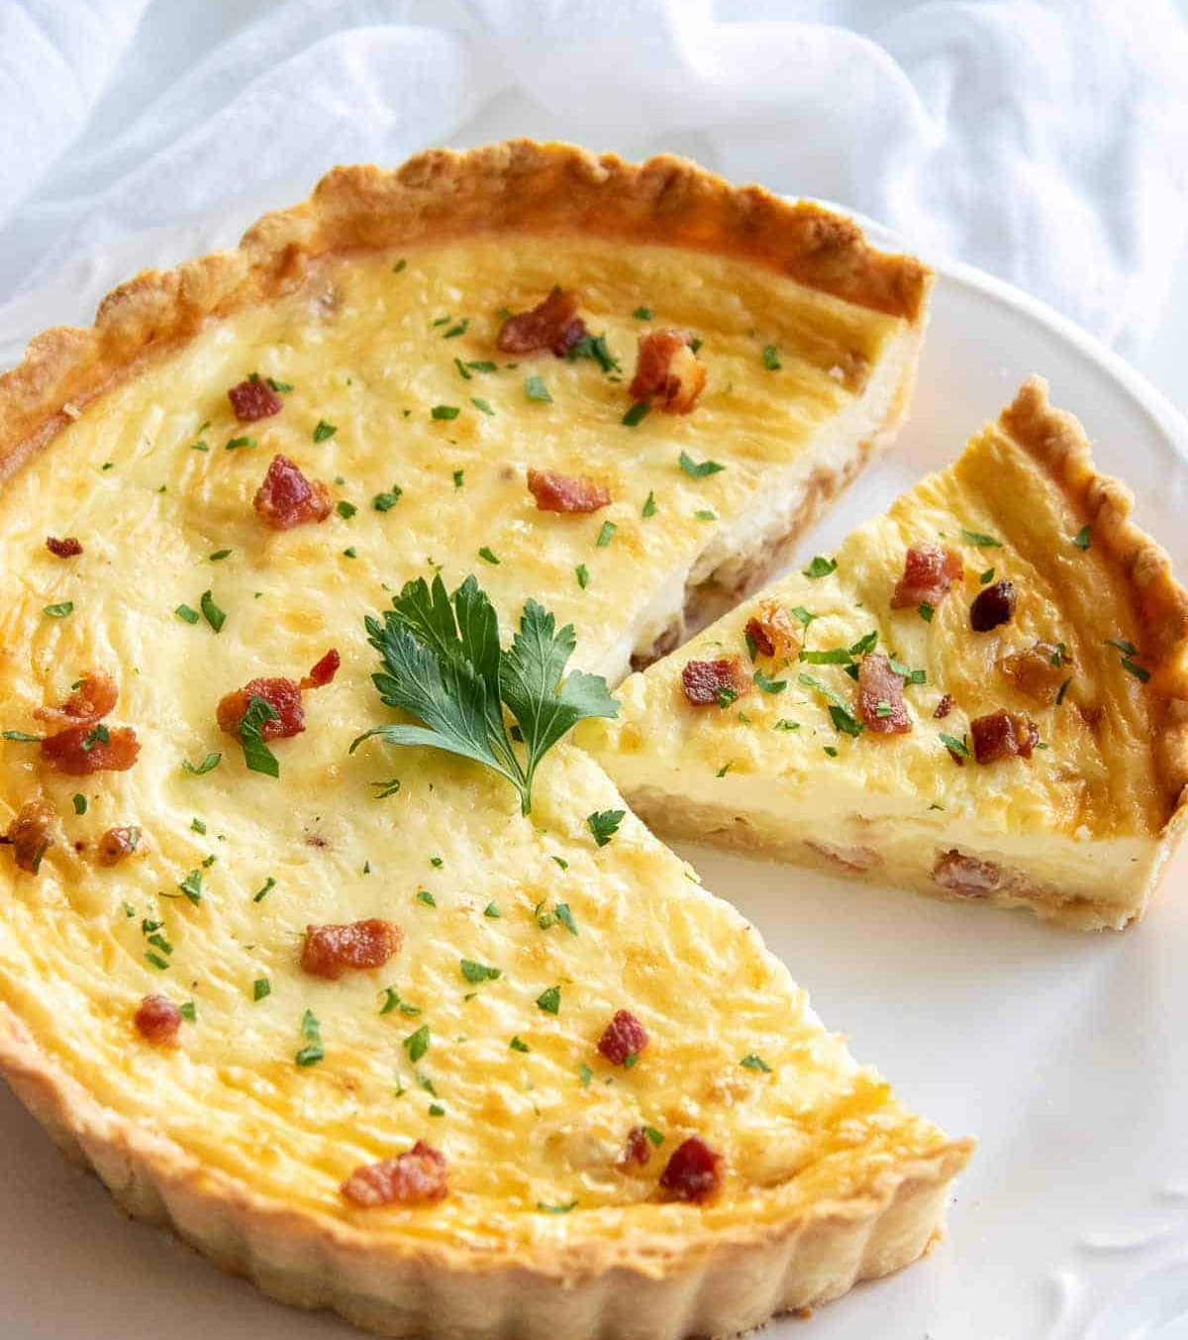
Problems with existing approach
Hard to “reserve” capacity without locking to a single machine
Admin may want some resources out of the negotiator
Fair share is a weak promise about averages over a long time

Slide 7
OCU – Parking spot with your name
Special command to grab claim, in the “htcondor” tool
Claim is negotiated for the first time in the usual way for someone
AP holds the claim forever, or until EP crashes/evicts
  In which case it grabs another one
Can be explicitly “borrowed”

Slide 8
Creating an OCU
$ htcondor ocu create ocu-request.txt
OCU created with Id 1729
OCU Id is not a jobid, but we use the same namespace for it
OCU durable in schedd, survives reboot
May reconnect on restart
# ocu-request.txt
Owner = "alice"
RequestCpus = 4
RequestMemory = 16384
RequestDisk = 10485760

Slide 9
Watching OCUs
$ htcondor ocu query
OCUId OCUName Owner State CPUs Memory Activations
101 OCU-101 alice I 8 32768 42
102 OCU-102 alice R 8 32768 38
$ htcondor ocu status
Owner OCUClaimed OCUClaimedBorrowed OCUWantedJobs OCURunningJobs
alice 10 7 15 3
State: U unclaimed, I idle, R running. htcondor ap claims: source = OCU
Notes:
Watching OCUs
- htcondor ocu query: each OCU's id, name, owner, state (U unclaimed, I idle, R running), size, and activations.
- htcondor ocu status: per owner, OCUClaimed, OCUClaimedBorrowed, OCUWantedJobs, OCURunningJobs.
- The submitter ad carries OCUClaimsClaimed, OCUClaimsBorrowed, OCURunningJobs and OCUWantedJobs.
- htcondor ap claims shows the source of each claim: Negotiator, DirectAttach or OCU.

Slide 10
Using OCUs
Add +OCUWanted = true
  Will only run on *your* OCUs
  Assuming size of OCU claim matches your request
  Will never run on non-OCU claims
  Will start very quickly

Slide 11
Using other peoples’ OCUs
Add +OCUWilling = true
  Will only run on *your* OCUs
  Assuming size of OCU claim matches your request
  Will never run on non-OCU claims
  Will start very quickly

Slide 12
Removing an OCU
$ htcondor ocu remove 1729
OCU removed with Id 1729
Removes the OCU (durably)
Evicts the job running on the OCU
If the job was an OCUWanted job, will need to wait for another OCU

Slide 13
Who may run on an OCU
Claim | Job | Runs?
my OCU | +OCUWanted = True | yes
my OCU | ordinary job | no
someone else's OCU | +OCUWilling = True | yes, as a borrower
someone else's OCU | ordinary job | no
ordinary slot | +OCUWanted = True | never
qmgmt.cpp: owner is RemoteOwner, or the job's project
Notes:
Who may run on an OCU (qmgmt.cpp matching rules)
- Your own OCU runs only your jobs marked +OCUWanted = True.
- Someone else's OCU runs only jobs marked +OCUWilling = True.
- An OCUWanted job never runs on an ordinary slot.
- Ownership check: RemoteOwner equals the job's owner, or the job's project matches the OCU's project.

Slide 14
Slot Bundles

Slide 15
What’s the problem
Need > 1 machine (or slot) all at once
Can’t run a job with < N
E.g. some AI training models
Client / Server testing
Maybe MPI
Some Master – Worker workloads
Synchronization and startup is the responsibility of the job!

Slide 16
Can’t we do this already?
Parallel Universe?
  Request setup to dedicate EP to some AP, even when there’s one AP
  Always been a bump on the side of the schedd
  Parallel Universe assumes preemption
What about just queue N and wait
  Almost works
  Causes deadlocks with multiple submitters

Slide 17
Enter the slot bundle
Unlike OCUs, UX is entirely in the job description language
Bundle implies a certain priority
Negotiator negotiates for bundles FIFO, before anyone else
# bundle.sub
Executable = gonkulate
RequestCpus = 4
RequestMemory = 16384
RequestDisk = 10485760
+IsBundle = true
queue N

Slide 18
Reminder: table based submit
# bundle.sub
Executable = gonkulate
Arguments = $(ProcId)
RequestCpus = 4
RequestMemory = 16G
RequestDisk = 2G
+IsBundle = true
queue N

Slide 19
Reminder: table based submit
# bundle.sub
Executable = gonkulate
Arguments = --start $(start) –-end $(end) $(f)
RequestCpus = 4
RequestMemory = 16G
RequestDisk = 2G
+IsBundle = true
queue start end num from (
0, 10, “file1”,
11, 200, “file2”,
)

Slide 20
Table based submit from file
# bundle.sub
Executable = gonkulate
Arguments = --start $(start) –-end $(end) $(f)
RequestCpus = 4
RequestMemory = 16G
RequestDisk = 2G
+IsBundle = true
queue start end num table_file.txt

Slide 21
Where table_file.txt looks like
# Sadly, table format does not support comments
0, 10, “file1”,
11, 200, “file2”,
201, 400, “file3”,
…

Slide 22
CM
Start!
Bundle
1
2
3
AP
autocluster
EP
EP
EP
EP

Slide 23
Bundle jobs are just jobs…
Have a user log
Can be (most any) universe: docker, container, vm, etc.
  (not parallel, local, scheduler or grid)
Can be removed, etc.
When the last job in the bundle exits, the bundle is destroyed

Slide 24
Bundle gotchas
Gated by ENABLE_SLOT_BUNDLES in AP
Implemented in 26.2, needs AP and CM to work
If one slot is evicted, others stay running (bug? Feature?)

Slide 25
Detour --- startd rehoming

Slide 26
CM
AP
EP

Slide 27
AP
EP

Slide 28
Startd Direct Connect
Require admin config on EP
AP
EP

Slide 29
EP “rehoming”
Allows admin to do this in one command
htcondor ep rehome [-reboot] ep ap
htcondor ep rehome -cancel
AP
EP

Slide 30
Slot controllers
Work in progress, not available yet…

Slide 31
CM
AP
EP

Slide 32
EP
“Owner”
“Job Owner”
violates the computer science 0 ,1, or N guideline

Slide 33
“Owner”
EP
“Controller”
“Job Owner”

Slide 34
What is a controller?
Relationship an admin of both AP and EP can set
Is a relationship on a WHOLE EP, not a slot
The AP that “controls” an EP can preempt everyone at any time
But the EP otherwise still works as normal

Slide 35
OCUs, Bundles, Controllers
All three use the existing claim abstraction
Claims have worked well for us for years, but time for new things
Expect more in the future…

Slide 36
Conclusion…
Negotiation provisions
Schedd schedules
This material is based upon work supported by the National Science Foundation under Grant Nos. 2030508. Any opinions, findings, and
conclusions or recommendations expressed in this material are those of the author(s) and do not necessarily reflect the views of the
National Science Foundation.

