Slide 1
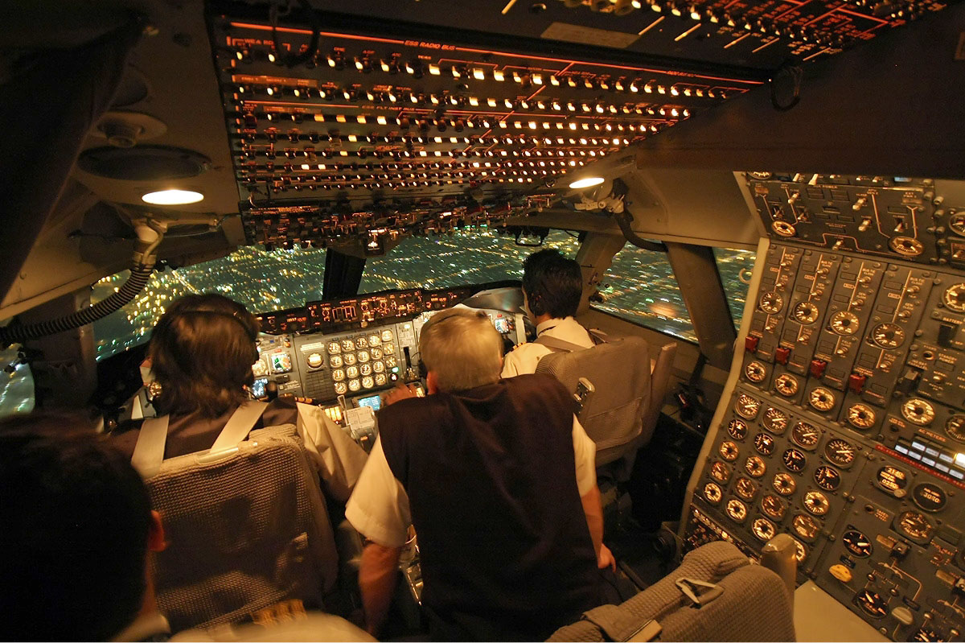
Scheduling: The Many Ways
Greg Thain

Slide 2
Scheduling
vs
Planning

Slide 3
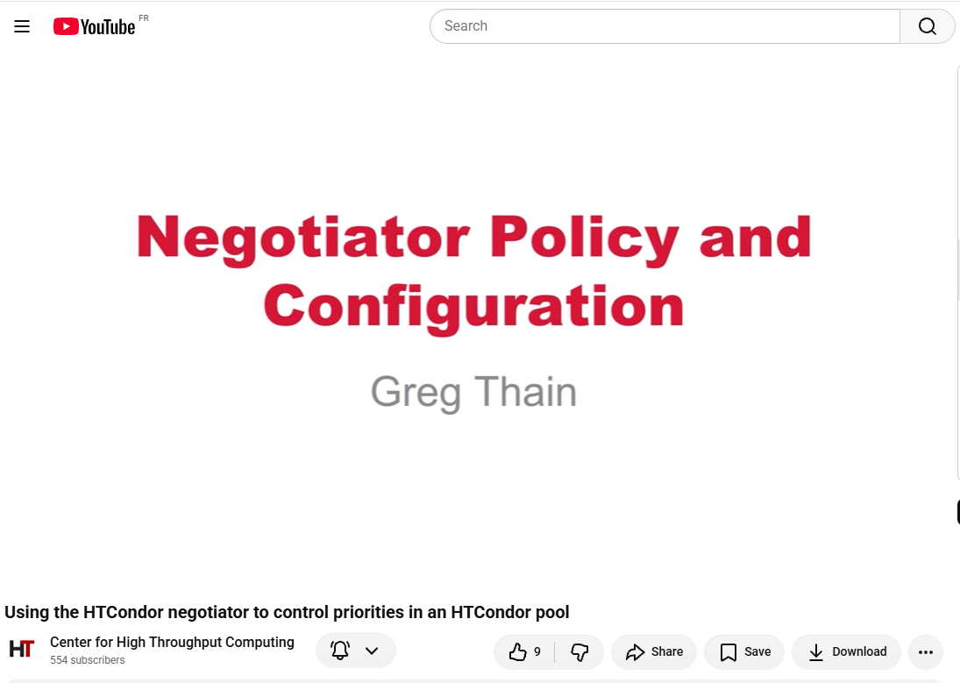
Not “the negotiator” talk
https://www.youtube.com/watch?v=NNnrCjFV0tM

Slide 4
CM
AP
EP

Slide 5
EP
EP has many scheduling controls
Often overlooked by admins
Can be tricky to manage, puppet, etc.

Slide 6
What the EP can and can not do…
Can | Can not
Accept offered job to run | Select a job not offered to it
Reject offered job to run | Pick which job runs next
Evict running job | Move slot to a new submitter
Preempt running job for offered job

Slide 7
START expression is biggest stick
condor_submit -interactive sets InteractiveJob = True
# on the interactive EPs
IsInteractiveNode = True
STARTD_ATTRS = $(STARTD_ATTRS) IsInteractiveNode
START = $(START) && (TARGET.InteractiveJob =?= True)
Batch jobs never match: no batch-side change
Always need to think about reverse matching
This is one way to emulate slurm partitions
Could be

Slide 8
START expression can be dynamic
DRAIN_DELAY = 20*60
AllowOneCoreJobs = time() >= (MY.LastDrainStopTime ?: 0) + $(DRAIN_DELAY)
START = $(START) && ( TARGET.RequestCpus > 1 || $(AllowOneCoreJobs) )
By adding current time, can express policy after a drain or restart to allow big jobs to get in

Slide 9
First class backfill
# Normal p-slot: 100% of the machine
use FEATURE : PartitionableSlot(1, 100%)
# Backfill p-slot: ALSO 100% of the machine. Backfill slots are provisioned
# from a shadow copy of the resources, so both slots start with everything.
use FEATURE : PartitionableSlot(2, 100%)
SLOT_TYPE_2_BACKFILL = true
# Keep the two job populations apart
SLOT_TYPE_2_PREEMPT = size(ResourceConflict ?: "") > 0
# Give the resources back fast: no retirement, and a short vacate grace SLOT_TYPE_2_MaxJobRetirementTime = 0
SLOT_TYPE_2_MachineMaxVacateTime = 60

Slide 10
MaxJobRetirementTime
preemption requested
job running
retirement: job keeps running
vacate
MaxJobRetirementTime
MaxVacateTime
MAXJOBRETIREMENTTIME = 3600 → one hour guaranteed
Worst named knob in all of HTCondor
  Also note case and lack of underscores
Should be “minimum guaranteed execution time”
Some things (WANT_HOLD) do not obey
C.f. with MachineMaxVacateTime

Slide 11
CLAIM_WORKLIFE
1200s: CLAIM_WORKLIFE expires
back to the
negotiator
claim
job 1
job 2
job 3
Job 3 finishes normally: nothing is evicted
Checked only between jobs
-1 = never expires 0 = one job per claim
Without preemption, the only thing that moves slots between users

Slide 12
The CLAIM_WORKLIFE balance
Time to rebalance ≈ min(job runtime, CLAIM_WORKLIFE) + negotiation interval
Short or 0
Long or -1
+ follows fair share closely
+ best throughput for a big user
− more negotiation load
+ least negotiator work
− new claim, security session per start
− whoever filled the pool first keeps it
− gap between jobs

Slide 13
Custom resources
request_gpus = 1
require_gpus = Capability >= 8.0
container_image = pytorch
request_licenses = 1 # custom machine resource
MACHINE_RESOURCE_licenses = 16

Slide 14
Condor_drain
Condor_drain is a *command* the admin can run against an EP
Puts machine into “drained [sic]” state
No new job start*
Graceful | Quick | Fast
MaxJobRetiremementTime | Vacate, not retirement | Jobs Immediately killed

Slide 15
DEFAULT_DRAINING_START_EXPR
However, if
DEFAULT_DRAINING_START_EXPR
AND graceful draining,
New jobs can start that match DEFAULT_DRAINING_START_EXPR

Slide 16
CM
AP
EP

Slide 17
AP
DIRECT_ATTACH
EP

Slide 18
CM
AP
EP

Slide 19
Policy in the CM
CM
Can | Can not
Pick a submitter to go next | Pick a job to go next
Pick which slot job gets | Pick size of job to go next

Slide 20
Some CM policy in config files, some in tools
We are not very consistent here
“generally” RCFs run the tool, admins control the config file
Let’s start with the config file knobs…

Slide 21
Defrag daemon runs on the cm
Off by default
Automates the calling of condor_drain
Doesn’t look at demand

Slide 22
Defrag knobs
# Rate limit: how many machines to start draining per hour.
DEFRAG_DRAINING_MACHINES_PER_HOUR = 2.0# How many to start DEFRAG_MAX_CONCURRENT_DRAINING = 4 # Stop draining new machines once this many DEFRAG_MAX_WHOLE_MACHINES = 10
# What counts as "defragmented enough
DEFRAG_WHOLE_MACHINE_EXPR = Cpus >= min({8, TotalSlotCpus}) && PartitionableSlot
DEFRAG_REQUIREMENTS = PartitionableSlot && Offline =!= true
DEFRAG_WHOLE_MACHINE_EXPR = Cpus >= min({8, TotalSlotCpus}) && PartitionableSlot
DEFRAG_REQUIREMENTS = PartitionableSlot && Offline =!= true && \ TotalCpus >= 8 && \
Cpus < min({8, TotalSlotCpus}) && \ Draining =!= true
DEFRAG_DRAINING_SCHEDULE = graceful

Slide 23
NEGOTIATOR_PRE_JOB_RANK
1. NEGOTIATOR_PRE_JOB_RANK (admin)
2. Job Rank (user)
3. NEGOTIATOR_POST_JOB_RANK (tie-break)
4. No preemption > startd RANK > priority
5. PREEMPTION_RANK

Slide 24
Group quotas
physics 700
1. Each group gets a quota
2. Virtual sub-pool per group
string_theory 100
particle 600
3. Fair share inside each
Group quota comes first!
cms 200
atlas 200
cdf 100
GROUP_NAMES = physics, physics.particle, physics.particle.cms, ...
GROUP_QUOTA_physics = 700 # or GROUP_QUOTA_DYNAMIC_<g> = 0.4

Slide 25
Quota with Surplus
root 60
A: 10
B: 20
C: 30
A only has 3 jobs
3
23 (+3)
34 (+4)
Spare quota is lent to groups that accept surplus, in proportion to their quotas

Slide 26
GROUP_AUTOREGROUP
GROUP_AUTOREGROUP
"Last chance, wild-west round, every submitter for themselves"
Groups go in starvation order
GROUP_SORT_EXPR overrides
# Strict priority, fair share within each level
GROUP_QUOTA_HIPRIO = 100000000
NEGOTIATOR_ALLOW_QUOTA_OVERSUBSCRIPTION = True

Slide 27
Concurrency limits
# config # submit file
MATLAB_LIMIT = 100 concurrency_limits = matlab:3
Cap running jobs that use a named shared thing
licenses, a database, a file server
Enforced in the negotiator:
Each cycle, add up ConcurrencyLimits of claimed slots
Refuse matches that would go over
24.7: limited jobs can reuse claims

Slide 28
Concurrency units can starve
500-unit job
Never 500 free at once: small jobs refill every gap
No fair share of a limit: first matched takes the units
Counts rebuilt from slot ads: stale, can overshoot
Never enforced by killing jobs
Rejection skips the rest of the autocluster

Slide 29
The many powers of condor_userprio
Talks to the negotiator
Sets priority factor for a submitter
  condor_userprio –setfactor 100 gthain
Sets ceiling for a submitter
  condor_userpiro –setceil 5 tannenba
Sets floor for a submitter
  Condor_userprio –setfloor 10 someuser

Slide 30
Cloudbursting with the rooster
$ condor_advertise UPDATE_STARTD_AD ghost-c7g.ad
MyType = "Machine"
Name = "slot1@ghost-c7g-16xlarge"
Offline = True
OpSys = "LINUX“
Arch = "aarch64“
Cpus = 64
Memory = 131072
Start = TARGET.WantCloudBurst =?= True
Requirements = START
CloudInstanceType = "c7g.16xlarge"
GhostMultiplier = 50
WantAdRevaluate = True

Slide 31
# central manager
DAEMON_LIST = $(DAEMON_LIST) ROOSTER
ROOSTER_UNHIBERNATE = Offline && MachineLastMatchTime > time() - 600
ROOSTER_WAKEUP_CMD = "/usr/local/libexec/burst_to_cloud"
ROOSTER_MAX_UNHIBERNATE = 5
Script gets the ad on stdin. Make it idempotent: rooster fires every interval

Slide 32
CM
AP
EP

Slide 33
Finally, policy in the AP!
AP
Not much scheduling policy knobs in the AP (!)
See yesterdays talk for changes
Can | Can not
Pick which job of a user goes first | Pick user to go next
Reuse a claim

Slide 34
AP has lots of admission control knobs
SUBMIT_REQUIREMENT_NAMES = NeedMem, MaxCpus
SUBMIT_REQUIREMENT_NeedMem = JOB.RequestMemory =!= undefined
SUBMIT_REQUIREMENT_NeedMem_REASON = "request_memory is required"
SUBMIT_REQUIREMENT_MaxCpus = JOB.RequestCpus <= 64
SUBMIT_REQUIREMENT_MaxCpus_IS_WARNING = true
Cheapest place for policy: never queued, never negotiated
JOB_TRANSFORM_NAMES: rewrite instead of reject
MAX_JOBS_SUBMITTED, MAX_JOBS_PER_OWNER, MAX_JOBS_PER_SUBMISSION
condor_qusers -disable alice -reason "runaway submit"

Slide 35
Condor_qusers: operating on AP users
Disable user
Keep track of disk usage
Etc.
$ condor_qusers -name north.cs.wisc.edu -pool condor.cs.wisc.edu
Print users from AP north.cs.wisc.edu in the condor.cs.wisc.edu pool
$ condor_qusers -disable todd -reason "talk to admin"
Disable user bob in the local AP with the reason "talk to admin"
$ condor_qusers -user bob -edit 'Department="Math"'
Add a Department attribute that has the value "Math" to user bob

Slide 36
Schedd job throttles
JOB_START_COUNT / JOB_START_DELAY
JOB_IS_FINISHED_COUNT
MAX_JOBS_RUNNING
MAX_JOBS_PER_OWNER, MAX_JOBS_PER_SUBMISSION
CURB_MATCHMAKING
stop matching when the schedd is too busy

Slide 37
File xfer throttling
10,000 matched slots
100 transfers at a time
MAX_CONCURRENT_UPLOADS / _DOWNLOADS (default 100)
Next transfer: the user with the fewest active transfers
_PER_USER (20%): stop asking the negotiator for that user

Slide 39


Slide 40
Discussion
CHTC finds it tricky to implement the policy they want
HTCondor doesn’t separate mechanism from policy
What are the policies you want?
What do you find it hard to implement with these knobs?

Slide 41
Conclusion…
Many, many scheduling knobs
Help us do better.
This material is based upon work supported by the National Science Foundation under Grant Nos. 2030508. Any opinions, findings, and
conclusions or recommendations expressed in this material are those of the author(s) and do not necessarily reflect the views of the
National Science Foundation.

