Slide 1
HTCondor Administration Basics Greg Thain Center for High Throughput Computing

Slide 2
Overview
HTCondor Architecture Overview
Classads, briefly
Configuration and other nightmares
Setting up a personal condor
Setting up distributed condor
Minor topics

Slide 3


Two Big HTCondor Abstractions
Jobs
Worker nodes – Execution Points (EP)s
execute
execute
execute

Slide 4
Life cycle of HTCondor Job
Held
Idle
Xfer In
Running
Xfer out
Complete
Submit
file
Suspend
History file
Notes:
Suspend is not boxed

Slide 5
Life cycle of HTCondor Slot
negotiator
collector
schedd
startd
Schedd may “split”
shadow
Config file
Notes:
Add starter

Slide 6
“AP (Access Point)” Side
Held
Idle
Xfer In
Running
Xfer out
Complete
Submit
file
Suspend
Suspend
Suspend
History file

Slide 7
“EP Side”
Held
Idle
Xfer In
Running
Xfer out
Complete
Submit
file
Suspend
Suspend
Suspend
History file

Slide 8
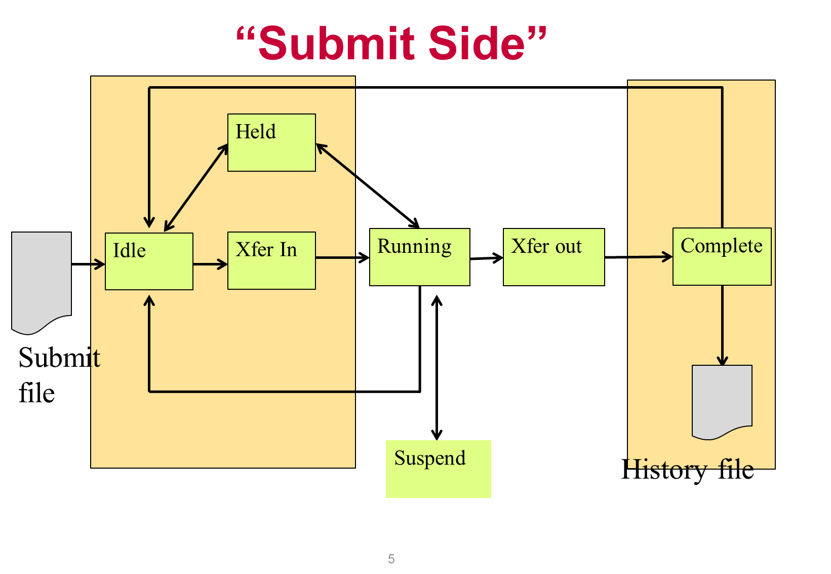
The AP side
AP managed by 1 condor_schedd process
And one shadow per running job
condor_shadow process
The Schedd is a database
Submit points can be performance bottleneck
Usually a handful per pool

Slide 9
What we start from…
universe = vanilla
executable = compute
arguments = $(ProcID)
request_memory = 70M
Request_disk = 1G
output = out.$(ProcID)
error = error.$(ProcId)
+IsVerySpecialJob = true
Queue
HTCondor Submit file

Slide 10
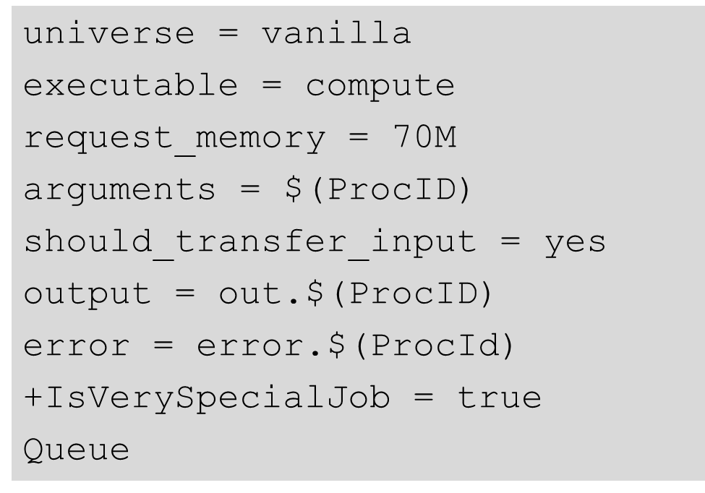
From submit to schedd
JobUniverse = 5
Cmd = “compute”
Args = “0”
RequestMemory = 70000000
Requirements = Opsys == “Li..
DiskUsage = 0
Output = “out.0”
IsVerySpecialJob = true
condor_submit submit_file
Submit file in, Job classad out
Sends to schedd
man condor_submit for full details
Other ways to talk to schedd
Python bindings, managers (like DAGman)

Slide 11
Condor_schedd holds all jobs
JobUniverse = 5
Owner = “gthain”
JobStatus = 1
NumJobStarts = 5
Cmd = “compute”
Args = “0”
RequestMemory = 70000000
Requirements = Opsys == “Li..
DiskUsage = 0
Output = “out.0”
IsVerySpecialJob = true
One pool, Many schedds
condor_submit –name
chooses
Owner Attribute:
need authentication
Schedd also called “q”
not actually a queue

Slide 12
Condor_schedd has all jobs
In memory (big)
condor_q expensive
And on disk
Fsync’s often
Monitor with linux
Attributes in manual
condor_q -l job.id
e.g. condor_q -l 5.0
JobUniverse = 5
Owner = “gthain”
JobStatus = 1
NumJobStarts = 5
Cmd = “compute”
Args = “0”
RequestMemory = 70000000
Requirements = Opsys == “Li..
DiskUsage = 0
Output = “out.0”
IsVerySpecialJob = true

Slide 13
What if I don’t like those Attributes?
Write a wrapper to condor_submit
SUBMIT_ATTRS
condor_qedit
+Notation
Schedd transforms

Slide 14

ClassAds: The lingua franca of HTCondor

Slide 15
Classads for people admins

Slide 16
What are ClassAds?
ClassAds is a language for objects (jobs and machines) to
Express attributes about themselves
Express what they require/desire in a “match” (similar to personal classified ads)
Structure : Set of attribute name/value pairs, where the value can be a literal or an expression. Semi-structured, no fixed schema.

Slide 17
Example
Pet Ad
Type = “Dog”
Requirements =
DogLover =?= True
Color = “Brown”
Price = 75
Sex = "Male"
AgeWeeks = 8
Breed = "Saint Bernard"
Size = "Very Large"
Weight = 27
Buyer Ad
AcctBalance = 100
DogLover = True
Requirements =
(Type == “Dog”) &&
(TARGET.Price <=
MY.AcctBalance) &&
( Size == "Large" ||
Size == "Very Large" )
Rank =
100* (Breed == "Saint Bernard") - Price
. . .

Slide 18
ClassAd Values
Literals
Strings ( “Alma9” ), integers, floats, boolean (true/false), …
Expressions
Similar look to C/C++ or Java : operators, references, functions
References: to other attributes in the same ad, or attributes in an ad that is a candidate for a match
Operators: +, -, *, /, <, <=,>, >=, ==, !=, &&, and || all work as expected
Built-in Functions: if/then/else, string manipulation, regular expression pattern matching, list operations, dates, randomization, math (ceil, floor, quantize,…), time functions, eval, …
18
Notes:
18

Slide 19
Four-valued logic
ClassAd Boolean expressions can return four values:
True
False
Undefined (a reference can’t be found)
Error (Can’t be evaluated)
Undefined enables explicit policy statements in the absence of data (common across administrative domains)
Special meta-equals ( =?= ) and meta-not-equals (=!=) will never return Undefined
[
HasBeer = True
GoodPub1 = HasBeer == True
GoodPub2 = HasBeer =?= True
]
[
GoodPub1 = HasBeer == True
GoodPub2 = HasBeer =?= True
]

Slide 20
ClassAd Types
HTCondor has many types of ClassAds
A "Job Ad" represents a job to Condor
A "Machine Ad" represents a computing resource
Others types of ads represent other instances of other services (daemons), users, accounting records.

Slide 21
The Magic of Matchmaking
Two ClassAds can be matched via special attributes: Requirements and Rank
Two ads match if both their Requirements expressions evaluate to True
Rank evaluates to a float where higher is preferred; specifies which match is desired if several ads meet the Requirements.
Scoping of attribute references when matching
MY.name – Value for attribute “name” in local ClassAd
TARGET.name – Value for attribute “name” in match candidate ClassAd
Name – Looks for “name” in the local ClassAd, then the candidate ClassAd

Slide 22
Example
Pet Ad
Type = “Dog”
Requirements =
DogLover =?= True
Color = “Brown”
Price = 75
Sex = "Male"
AgeWeeks = 8
Breed = "Saint Bernard"
Size = "Very Large"
Weight = 27
Buyer Ad
AcctBalance = 100
DogLover = True
Requirements =
(Type == “Dog”) &&
(TARGET.Price <=
MY.AcctBalance) &&
( Size == "Large" ||
Size == "Very Large" )
Rank =
100* (Breed == "Saint Bernard") - Price
. . .

Slide 23
Back to configuration…

Slide 24
Configuration File
(Almost)all configure is in files, “root” CONDOR_CONFIG env var
/etc/condor/condor_config
This file points to others
All daemons share same configuration
Might want to share between all machines (NFS, automated copies, puppet, etc)
Notes:
All daemons on same machine share configuration

Slide 25
Configuration File Syntax
# I’m a comment!
CREATE_CORE_FILES=TRUE
MAX_JOBS_RUNNING = 50
# HTCondor ignores case:
log=/var/log/condor
# Long entries:
collector_host=condor.cs.wisc.edu,\
secondary.cs.wisc.edu

Slide 26
Other Configuration Files
LOCAL_CONFIG_FILE
Comma separated, processed in order
LOCAL_CONFIG_FILE = \
/var/condor/config.local,\
/shared/condor/config.$(OPSYS)
LOCAL_CONFIG_DIR
Files processed IN LEXIGRAPHIC ORDER
LOCAL_CONFIG_DIR = \
/etc/condor/config.d

Slide 27
Configuration File Macros
You reference other macros (settings) with:
A = $(B)
SCHEDD = $(SBIN)/condor_schedd
Can create additional macros for organizational purposes

Slide 28
Configuration File Macros
Can append to macros:
A=abc
A=$(A),def
Don’t let macros recursively define each other!
A=$(B)
B=$(A)

Slide 29
Configuration File Macros
Later macros in a file overwrite earlier ones
B will evaluate to 2:
A=1
B=$(A)
A=2

Slide 30
Config file defaults
CONDOR_CONFIG “root” config file:
/etc/condor/condor_config
Local config file:
/etc/condor/condor_config.local
Config directory
/etc/condor/config.d

Slide 31
Config file recommendations
For “system” condor, use default
Global config file read-only
/etc/condor/condor_config
All changes in config.d small snippets
/etc/condor/config.d/05some_example
All files begin with 2 digit numbers
Personal condors elsewhere

Slide 32
condor_config_val
condor_config_val [-v] <KNOB_NAME>
Queries config files
condor_config_val -dump
Environment overrides:
export _condor_KNOB_NAME=value
Over rules all others (so be careful)
Notes:
-dump includes defaults

Slide 33
condor_reconfig
Daemons long-lived
Only re-read config files on condor_reconfig command
Some knobs don’t obey re-config, require restart
DAEMON_LIST, NETWORK_INTERFACE
condor_restart

Slide 34
Got all that?

Slide 35
Configuration of AP
Not much policy to be configured in schedd
Mainly scalability and security
MAX_JOBS_RUNNING
JOB_START_DELAY
MAX_CONCURRENT_DOWNLOADS
MAX_JOBS_SUBMITTED

Slide 36
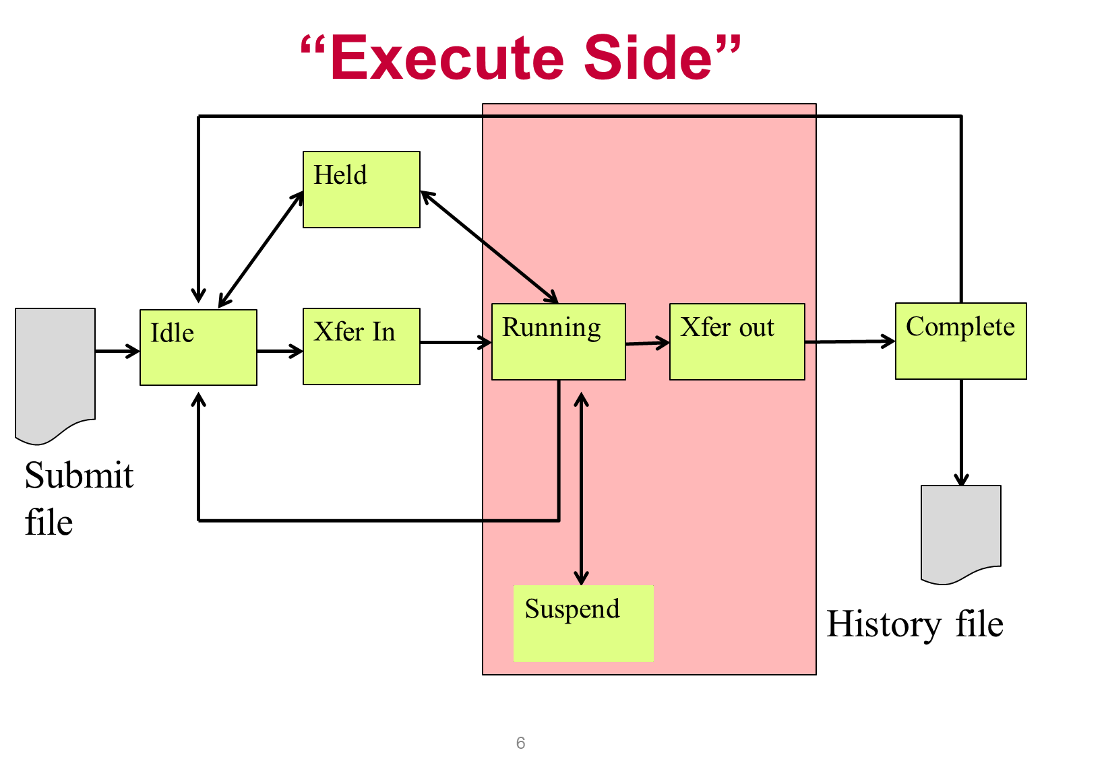
The EP
Primarily managed by
condor_startd process
With one condor_starter
per running jobs
Sandboxes the jobs
Usually many per pool
(support 10s of thousands)

Slide 37
Startd also has a classad
Condor creates it
From interrogating the machine
And the config file
And sends it to the collector
condor_status [-l]
Shows the ad
condor_status –direct daemon
Goes to the startd

Slide 38
Condor_status –l machine
OpSys = "LINUX“
CustomGregAttribute = “BLUE”
OpSysAndVer = "RedHat6"
TotalDisk = 12349004
Requirements = ( START )
UidDomain = “cheesee.cs.wisc.edu"
Arch = "X86_64"
StartdIpAddr = "<128.105.14.141:36713>"
RecentDaemonCoreDutyCycle = 0.000021
Disk = 12349004
Name = "slot1@chevre.cs.wisc.edu"
State = "Unclaimed"
Start = true
Cpus = 32
Memory = 81920

Slide 39
One Startd, Many slots
HTCondor treats multicore as independent slots
Slots: static vs. partitionable
Startd can be configured to:
Only run jobs based on machine state
Only run jobs based on Resources (GPUs)
Preempt or Evict jobs based on policy
…

Slide 40
3 types of slots
Partitionable (e.g. leftovers) [[default]]
Dynamic (useable ones)
Dynamically created
But once created, static
Static (e.g. for unusual situations)

Slide 41
Configuration of startd
Mostly policy,
Several directory parameters
EXECUTE – where the sandbox is
COLLECTOR_HOST – where the cm is
CLAIM_WORKLIFE
How long to reuse a claim for different jobs
Notes:
Turn on GPUs

Slide 42
The “Middle” side
There’s also a “Middle”, the Central Manager:
A condor_negotiator
Provisions machines to schedds
A condor_collector
Central nameservice: like LDAP
condor_status queries this
Please don’t call this “Master node” or head
Not the bottleneck you may think: stateless

Slide 43
Responsibilities of CM
Pool-wide scheduling policy resides here
Scheduling of one user vs another
Definition of groups of users
Definition of preemption
Whole talk on this – check on youtube: https://www.youtube.com/watch?v=NNnrCjFV0tM&list=PLO7gMRGDPNunnRsfI5xGSTPxlSzli8Fvd

Slide 44
Defrag daemon
Optional, but usually on the central manager
One daemon defragments whole pool
Scan pool, try to fully defrag some startds
Only looks at partitionable machines
Admin picks some % of pool that can be “whole”

Slide 45
The condor_master
Every condor machine needs a master
Like “systemd”, or “init”
Starts daemons, restarts crashed daemons
Tunes machine for condor

Slide 46
Quick Review of Daemons
condor_master: runs on all machine, always
condor_schedd: runs on submit machine
condor_shadow: one per job
condor_startd: runs on execute machine
condor_starter: one per job
condor_negotiator/condor_collector
one per pool
Notes:
Also responsibilities of each daemon

Slide 47
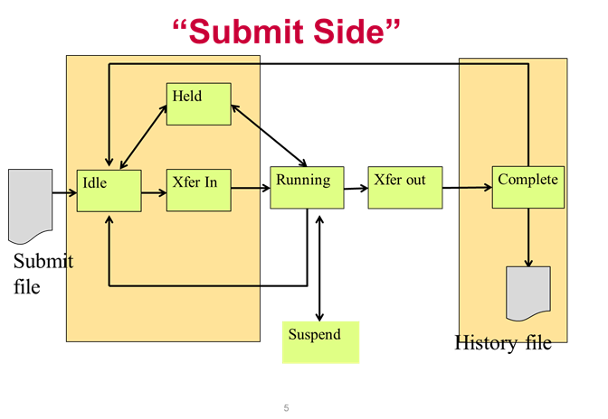
Process View
condor_master
(pid: 1740)
condor_procd
shared_port
fork/exec
“Condor Kernel”
condor_schedd
condor_q
condor_submit
“Tools”
fork/exec
condor_shadow
condor_shadow
condor_shadow
“Condor Userspace”

Slide 48
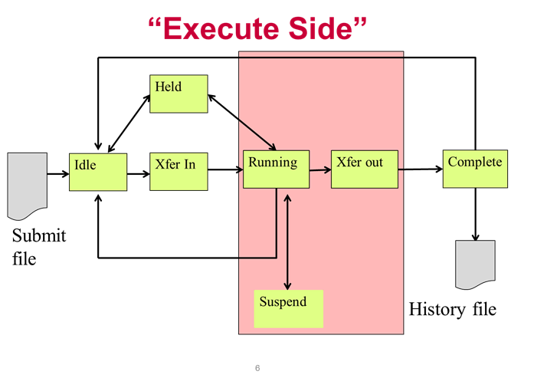
Process View: Execute
condor_master
(pid: 1740)
condor_procd
fork/exec
“Condor Kernel”
condor_startd
condor_status -direct
“Tools”
condor_starter
condor_starter
condor_starter
“Condor Userspace”
Job
Job
Job

Slide 49
Process View: Central Manager
condor_master
(pid: 1740)
“Condor Kernel”
condor_procd
fork/exec
condor_collector
condor_negotiator
condor_userprio
“Tools”

Slide 50
Condor Installation Basics

Slide 51
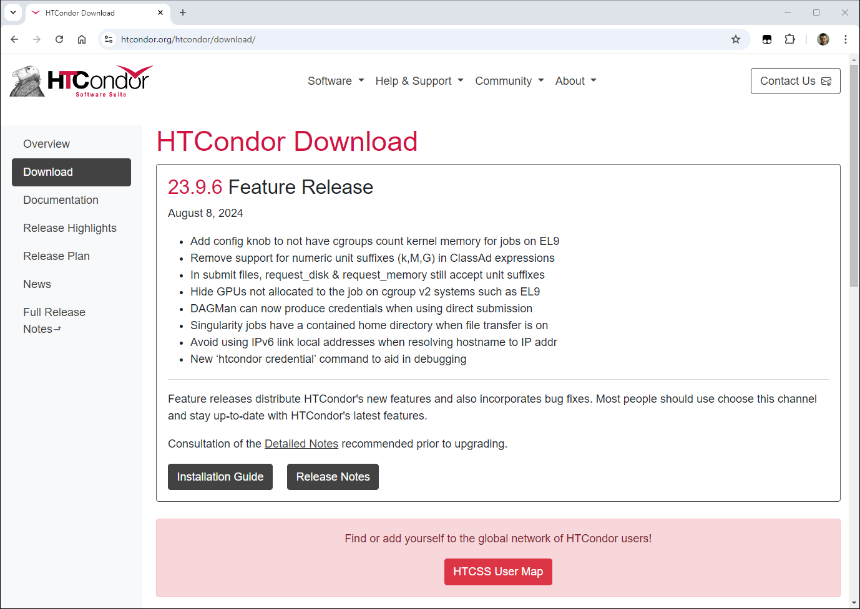
http://htcondor.org/htcondor/download

Slide 52
Version Number Scheme
Major.minor.release
If minor is zero (a.b.c): Stable series
Very stable, mostly bug fixes
Current: 23.0.12
Examples: 23.0.1,
24.0.1 coming soon to a repo near you
If minor is non-zero (a.b.c): Developer series
New features, may have some bugs
Current: 23.10.1
Major.minor.release
Represents Year (we hope)

Slide 53
The Guarantee
All minor releases in a stable series interoperate
E.g. can have pool with 23.0.1, 23.0.9, etc.
But not WITHIN A MACHINE:
Only across machines
The Reality
We work really hard to do better
8.9 with 24.0, etc.
Part of HTC ideal: can never upgrade in lock-step
We document when we break this.

Slide 54
Let’s Install HTCondor
Either with tarball (usually for non-root installs)
Or native packages (for Linux)
curl -fsSL https://get.htcondor.org |
sudo GET_HTCONDOR_PASSWORD="$htcondor_password" /bin/bash -s -- --no-dry-run --minicondor $central_manager_name
curl -fsSL https://get.htcondor.org |
sudo GET_HTCONDOR_PASSWORD="$htcondor_password" /bin/bash -s -- --no-dry-run --execute $central_manager_name

Slide 55
Let’s Make a Pool
First need to configure HTCondor
1100+ knobs and parameters!
Don’t need to set all of them…

Slide 56
Default file locations
BIN = /usr/bin
SBIN = /usr/sbin
LOG = /var/condor/log
SPOOL = /var/lib/condor/spool
EXECUTE = /var/lib/condor/execute
CONDOR_CONFIG = /etc/condor/condor_config

Slide 57
Let’s make a pool!
“Personal Condor”
All on one machine:
submit side IS execute side
Jobs always run
Use defaults where ever possible
Very handy for debugging and learning

Slide 58
Minimum knob settings
Role
What daemons run on this machine
CONDOR_HOST
Where the central manager is
Security settings
Who can do what to whom?
Notes:
What’s a metaknob

Slide 59
Other interesting knobs
LOG = /var/log/condor
Where daemons write debugging info
SPOOL = /var/spool/condor
Where the schedd stores jobs and data
EXECUTE = /var/condor/execute
Where the startd runs jobs

Slide 60
Minimum knobs for personal Condor
In /etc/condor/config.d/50PC.config
# All daemons local
Use ROLE : Personal
CONDOR_HOST = localhost
ALLOW_WRITE = localhost

Slide 61
Does it Work?
$ condor_status
Error: communication error
CEDAR:6001:Failed to connect to <128.105.14.141:4210>
$ condor_submit
ERROR: Can't find address of local schedd
$ condor_q
Error:
Extra Info: You probably saw this error because the condor_schedd is not running on the machine you are trying to query…

Slide 62
Checking…
$ ps auxww | grep [Cc]ondor
$

Slide 63
Starting Condor
# service start condor
# condor_master –f

Slide 64
$ ps auxww | grep [Cc]ondor
$
condor 19534 50380 Ss 11:19 0:00 condor_master
root 19535 21692 S 11:19 0:00 condor_procd -A …
condor 19557 69656 Ss 11:19 0:00 condor_collector -f
condor 19559 51272 Ss 11:19 0:00 condor_startd -f
condor 19560 71012 Ss 11:19 0:00 condor_schedd -f
condor 19561 50888 Ss 11:19 0:00 condor_negotiator -f
Notice the UID of the daemons
Notes:
condor_procd: explain

Slide 65
Quick test to see it works
$ condor_status
# Wait a few minutes…
$ condor_status
Name OpSys Arch State Activity LoadAv Mem
slot1@chevre.cs.wi LINUX X86_64 Unclaimed Idle 0.190 20480
slot2@chevre.cs.wi LINUX X86_64 Unclaimed Idle 0.000 20480
slot3@chevre.cs.wi LINUX X86_64 Unclaimed Idle 0.000 20480
slot4@chevre.cs.wi LINUX X86_64 Unclaimed Idle 0.000 20480
-bash-4.1$ condor_q
-- Submitter: gthain@chevre.cs.wisc.edu : <128.105.14.141:35019> : chevre.cs.wisc.edu
ID OWNER SUBMITTED RUN_TIME ST PRI SIZE CMD
0 jobs; 0 completed, 0 removed, 0 idle, 0 running, 0 held, 0 suspended
$ condor_restart # just to be sure…

Slide 66
Some Useful Startd Knobs
NUM_CPUS = X
How many cores condor thinks there are
MEMORY = M
How much memory (in Mb) there is
STARTD_CRON_...
Set of knobs to run scripts and insert attributes into startd ad (See Manual for full details).

Slide 67
Brief Diversion into daemon logs
Each daemon logs mysterious info to file
$(LOG)/DaemonNameLog
Default:
/var/log/condor/SchedLog
/var/log/condor/MatchLog
/var/log/condor/StarterLog.slotX
Experts-only view of condor
If there's a problem, we will ask for them

Slide 68
Let’s make a “real” pool
Distributed machines makes it hard
Different policies on each machines
Different owners
Scale

Slide 69
Most Simple Distributed Pool
Requirements:
No firewall
Full DNS everywhere (forward and backward)
We’ve got root on all machines
HTCondor doesn’t require any of these
(but easier with them)

Slide 70
What UID should jobs run as?
Three Options (all require root):
Nobody UID
Safest from the machine’s perspective
The submitting User
Most useful from the user’s perspective
May be required if shared filesystem exists
A “Slot User”
Bespoke UID per slot
Good combination of isolation and utility

Slide 71
UID_DOMAIN SETTINGS
UID_DOMAIN = \ same_string_on_submit
TRUST_UID_DOMAIN = true
SOFT_UID_DOMAIN = true
If UID_DOMAINs match, jobs run as user, otherwise “nobody”

Slide 72
Slot User
SLOT1_USER = slot1
SLOT2_USER = slot2
…
STARTER_ALOW_RUNAS_OWNER = false
EXECUTE_LOGIN_IS_DEDICATED=true
Job will run as slotX Unix user

Slide 73
FILESYSTEM_DOMAIN
HTCondor can work with NFS
But how does it know what nodes have it?
WhenSubmitter & Execute nodes share
FILESYSTEM_DOMAIN values
e.g FILESYSTEM_DOMAIN = domain.name
Or, submit file can always transfer with
should_transfer_files = yes
If jobs always idle, first thing to check

Slide 74
3 Separate machines
Central Manager
Execute Machine
Submit Machine

Slide 75
Central Manager
curl -fsSL https://get.htcondor.org |
sudo GET_HTCONDOR_PASSWORD="$htcondor_password" /bin/bash -s -- --no-dry-run –central-manager $central_manager_name

Slide 76
Access Point
curl -fsSL https://get.htcondor.org |
sudo GET_HTCONDOR_PASSWORD="$htcondor_password" /bin/bash -s -- --no-dry-run --submit $central_manager_name

Slide 77
Execution Point
curl -fsSL https://get.htcondor.org |
sudo GET_HTCONDOR_PASSWORD="$htcondor_password" /bin/bash -s -- --no-dry-run --execute $central_manager_name

Slide 78
Now Start them all up
Does order matter?
Somewhat: start CM first
How to check:
Every Daemon has classad in collector
condor_status -schedd
condor_status -negotiator
condor_status -any

Slide 79
condor_status -any
MyType TargetType Name
Collector None Test Pool@cm.cs.wisc.edu
Negotiator None cm.cs.wisc.edu
DaemonMaster None cm.cs.wisc.edu
Scheduler None submit.cs.wisc.edu
DaemonMaster None submit.cs.wisc.edu
DaemonMaster None wn.cs.wisc.edu
Machine Job slot1@wn.cs.wisc.edu
Machine Job slot2@wn.cs.wisc.edu
Machine Job slot3@wn.cs.wisc.edu
Machine Job slot4@wn.cs.wisc.edu

Slide 80
Debugging the pool
condor_q / condor_status
condor_ping ALL –name machine
Or
condor_ping ALL –addr ‘<127.0.0.1:9618>’

Slide 81
Whew!

Slide 82
Condor statistics
condor_status –direct –schedd –statistics 2
(all kinds of output), mostly aggregated
NumJobStarts, RecentJobStarts, etc.
See manual for full details

Slide 83
DaemonCoreDutyCycle
Most important statistic
Measures time not idle
If over 95%, daemon is probably saturated

Slide 84
Disaggregated stats
SCHEDD_COLLECT_STATS_FOR_Gthain = (Owner==“gthain")
Schedd will maintain distinct sets of status per owner, with name as prefix:
GthainJobsCompleted = 7
GthainJobsStarted = 100

Slide 85
Even better
SCHEDD_COLLECT_STATS_BY_Owner = Owner
For all owners, collect & publish stats:
gthainJobsStarted = 7
tannenbaJobsStarted = 100

Slide 86
Speeds, Feeds, Rules of Thumb
HTCondor scales to 100,000s of machines
With a lot of work
Contact us, see wiki page
…
Notes:
Add wiki

Slide 87
Without Heroics:
Your Mileage may vary:
Shared File System vs. File Transfer
WAN vs. LAN
Strong encryption vs none
Good autoclustering
A single schedd can run at 50 Hz
Schedd needs 500k RAM for running job
50k per idle jobs
Collector can hold tens of thousands of ads
Notes:
Mention autocluster…
Mention Hz

Slide 88
Tools for admins

Slide 89
condor_off
Three kinds for submit and execute
-fast:
Kill all jobs immediate, and exit
-gracefull
Give all jobs 10 minutes to leave, then kill
-peaceful
Wait forever for all jobs to exit

Slide 90
condor_restart
Restarts all daemons on a given machine
Can be run remotely – if admin priv allows

Slide 91
condor_status
-collector
-submitter
-negotiator
-schedd
-master

Slide 92
condor_userprio
Condor_userprio –allusers
Whole talk on this,

Slide 93
condor_fetchlog
Remotely pulls a log file from remote machine
condor_fetchlog execute_machine STARTD

Slide 94
Thank you -- For more info
http://htcondorproject.org
htcondor-users email list
Talk to us!
Notes:
Add user

Slide 95
But one more thing…

Slide 96
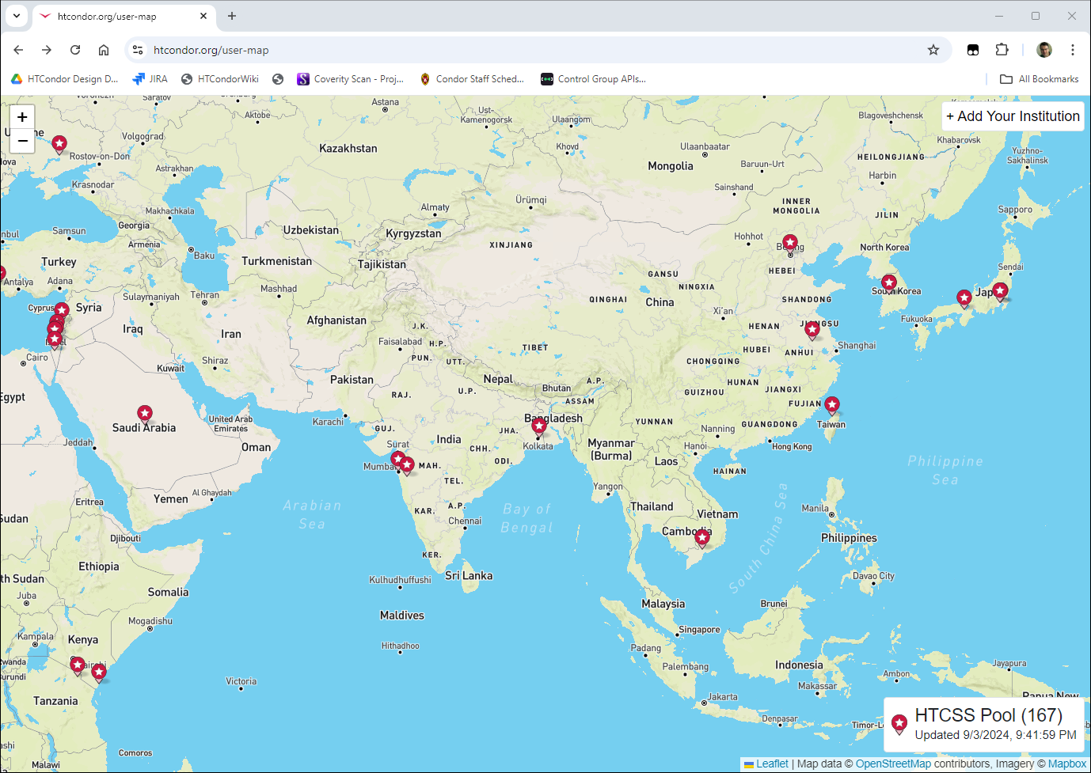
http://htcondor.org/user-map

