Slide 1
Classad Tutorial
Greg Thain

Slide 2
Classads: 3 uses
Description of entities in Condor
describes machines, jobs, services
Query language to select entities in Condor
“show me all the busy machines”
“show me idle jobs needing > 32 Gb ram”
2 way matching
Given jobs & machines, find matches

Slide 3
Classads describe all Entities
Jobs
Machines
Users
Accounting
Etc.

Slide 4
Sometimes behind the scenes…
“Send me all my jobs as classads”
$ condor_q
“Here’s classads for jobs 95, 96, 98 and 99”
No options, so
pretty-print
Job1
Job2
Job3
ID OWNER SUBMITTED RUN_TIME ST PRI SIZE CMD
95 gthain 4/25 14:31 0+00:00:11 R 0 0.0 calculate
96 gthain 4/25 14:31 0+00:00:11 R 0 0.0 calculate
98 gthain 4/25 14:31 0+00:00:11 R 0 0.0 calculate
99 gthain 4/25 14:31 0+00:00:00 I 0 0.0 calculate
Job Scheduler
(schedd)

Slide 5
Sometimes behind the scenes…
“Send me all machines as classads”
$condor_status
“Here’s machine slot classads”
No options, so
pretty-print
Name OpSys Arch State Activit Mem ActvtyTime
s1@c LINUX X86_64 Claimed Busy 2048 0+00:30:23
s2@c LINUX X86_64 Claimed Busy 2048 0+00:30:23
s3@c LINUX X86_64 Claimed Busy 2048 0+00:30:23
Classad database
(collector)

Slide 6
Other times, explicitly…
“In addition to the usual stuff, add to the machine description classad the following site-specific information…”

Slide 7
Classads Describe all entities
Entity | How to display full classad
Active Jobs | $ condor_q –l
Terminated Jobs | $ condor_history –l
Machines (slots) | $ condor_status –l
Finished jobs on machine | $ condor_history –l –file $(condor_config_val STARTD_HISTORY)
Active submitters | $ condor_status -submitter -l
Accounting records | $ condor_userprio -l
Schedd service | $ condor_status –schedd -l
All services | $ condor_status –any -l

Slide 8
Classads as Job Description
Set of Attributes
Attribute:
Key = Value
Key is a name
Value has a type
$ condor_q –l 180.0
ClusterId = 180
Cmd = "sleep"
DiskUsage = 100
ExitBySignal = false
QDate = 1535384632
RemoteUserCpu = 12.7
RequestDisk = DiskUsage
… (many attributes removed)

Slide 9
Classads as Job Description
Units by context
$ condor_q –l 180.0
ClusterId = 180
Cmd = "sleep"
DiskUsage = 100
ExitBySignal = false
QDate = 1535384632
RemoteUserCpu = 12.7
RequestDisk = DiskUsage
… (many attributes removed)
Seconds
Kilobytes

Slide 10
Manual lists all* attributes
http://htcondor.readthedocs.io
Appendix:
Lists all HTCondor-defined attributes
And Units (if any) and how used
*Admins and users can add their own!**
**(Classads was No-SQL before it was cool)

Slide 11
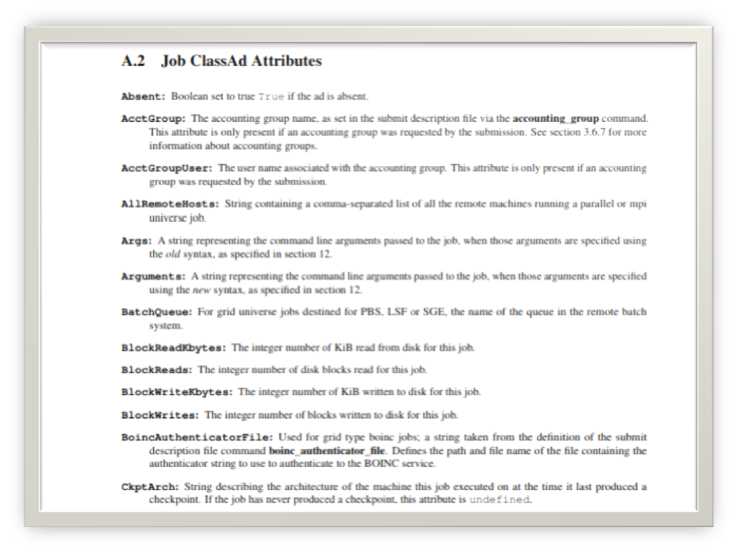

Slide 12
Attribute Names (before the =)
AttributeName = AttributeValue
Are like “C” (Python, R, Matlab…) identifiers
Must start with letter, then letters, numbers, _
No limit on length, but be reasonable
Case insensitive, but CamelCase is traditional

Slide 13
Attribute Values (after the =)
AttributeName = AttributeValue
Are like “C” (Python, R,Matlab…) identifiers
Must start with letter, then letters, numbers, _
No limit on length, but be reasonable
Case insensitive, but CamelCase is traditional

Slide 14
Main ClassAd types
Type | Description
Boolean | true, false
Integers | 64 bit signed
Reals | 64 bit IEEE 754 Double
Strings | "quoted"
Reference | Lookup another attribute

Slide 15
Booleans
Booleans can be
true
false
Case-insensitive
(True, TRUE)
Note – NO QUOTES
$ condor_q –l 180.0
ClusterId = 180
Cmd = "sleep"
DiskUsage = 100
ExitBySignal = false
QDate = 1535384632
RemoteUserCpu = 12.7
RequestDisk = DiskUsage
… (many attributes removed)

Slide 16
ClassAd Integers
64 bit
Even on 32 bit binaries
Always signed
Overflow -> wrap quietly
$ condor_q –l 180.0
ClusterId = 180
Cmd = "sleep"
DiskUsage = 100
ExitBySignal = false
QDate = 1535384632
RemoteUserCpu = 12.7
RequestDisk = DiskUsage
… (many attributes removed)

Slide 17
ClassAd Reals
IEEE 64 bit
And all the oddities
Scientific Notation
-5.6e-5
Overflow -> Infinity
1e990 -> real("INF")
NaNs -> real("Nan")
$ condor_q –l 180.0
ClusterId = 180
Cmd = "sleep"
DiskUsage = 100
ExitBySignal = false
QDate = 1535384632
RemoteUserCpu = 12.7
RequestDisk = DiskUsage
… (many attributes removed)

Slide 18
ClassAd Strings
Must be quoted with "
Escape with backslash:
"foo\"bar"
No Other Escapes!
Hard to get newlines in strings
$ condor_q –l 180.0
ClusterId = 180
Cmd = "sleep"
DiskUsage = 100
ExitBySignal = false
QDate = 1535384632
RemoteUserCpu = 12.7
RequestDisk = DiskUsage
… (many attributes removed)

Slide 19
ClassAd References
Like variable lookup
What is RequestDisk?
Lookup DiskUsage
Return 100
$ condor_q –l 180.0
ClusterId = 180
Cmd = "sleep"
DiskUsage = 100
ExitBySignal = false
QDate = 1535384632
RemoteUserCpu = 12.7
RequestDisk = DiskUsage
… (many attributes removed)

Slide 20
Undefined
Very Important to Grok
Anything can be undefined
Like null in SQL
Rarely explicit
ExitBySignal -> undefined
MissingAttr -> undefined
Means “Don’t Know”
Could mean “missing”
$ condor_q –l 180.0
ClusterId = 180
Cmd = "sleep"
DiskUsage = 100
ExitBySignal = undefined
QDate = 1535384632
RemoteUserCpu = 12.7
RequestDisk = DiskUsage
… (many attributes removed)

Slide 21
More Undefined
Allows decisions when information missing
Context determines trueness or falseness:
*Missing vs undefined*
No difference!
$ condor_q –l 180.0
ClusterId = 180
Cmd = "sleep"
DiskUsage = 100
ExitBySignal = undefined
QDate = 1535384632
RemoteUserCpu = 12.7
RequestDisk = DiskUsage
… (many attributes removed)
ClusterId = 180
Cmd = "sleep"
DiskUsage = 100
QDate = 1535384632
RemoteUserCpu = 12.7
RequestDisk = DiskUsage
… (many attributes removed)

Slide 22
More Undefined
What does missing
ExitBySignal mean?
Neither true nor false
Job hasn’t exited (yet)?
Remote Site didn’t tell us?
???
$ condor_q –l 180.0
ClusterId = 180
Cmd = "sleep"
DiskUsage = 100
ExitBySignal = undefined
QDate = 1535384632
RemoteUserCpu = 12.7
RequestDisk = DiskUsage
… (many attributes removed)
ClusterId = 180
Cmd = "sleep"
DiskUsage = 100
QDate = 1535384632
RemoteUserCpu = 12.7
RequestDisk = DiskUsage
… (many attributes removed)

Slide 23
ClassAd Expressions
Expressions combine values
C/Java/Python-like:
Logical: evaluate to boolean
Math: +, -, /, *, <<, >>, % evaluate to number
Functions (builtins) depends on function

Slide 24
Logical Expressions
Expression | Meaning
> | Greater Than
< | Less Than
>= | Greater Than or equal
<= | Less Than or equal
&& | Logical And (short circuited)
|| | Logical Or (short circuited)
== | Equality Test
!= | Inequality Test

Slide 25
Examples with Logicals
IsASleepJob
-> true
$ condor_q –l 180.0
ClusterId = 180
Cmd = "sleep"
DiskUsage = 100
ExitBySignal = undefined
QDate = 1535384632
RemoteUserCpu = 12.7
RequestDisk = DiskUsage
… (many attributes removed)
ClusterId = 180
Cmd = "sleep"
DiskUsage = 100
ExitBySignal = undefined
QDate = 1535384632
RemoteUserCpu = 12.7
IsASleepJob =Cmd == “sleep”
… (many attributes removed)

Slide 26
Examples with Logicals
UsesSomeDisk
-> false
$ condor_q –l 180.0
ClusterId = 180
Cmd = "sleep"
DiskUsage = 100
ExitBySignal = undefined
QDate = 1535384632
RemoteUserCpu = 12.7
RequestDisk = DiskUsage
… (many attributes removed)
ClusterId = 180
Cmd = "sleep"
DiskUsage = 100
ExitBySignal = undefined
QDate = 1535384632
RemoteUserCpu = 12.7
UsesSomeDisk = DiskUsage >
100

Slide 27
Examples with Logicals
ExitBySignal == true
-> undefined
$ condor_q –l 180.0
ClusterId = 180
Cmd = "sleep"
DiskUsage = 100
ExitBySignal = undefined
QDate = 1535384632
RemoteUserCpu = 12.7
RequestDisk = DiskUsage
… (many attributes removed)
ClusterId = 180
Cmd = "sleep"
DiskUsage = 100
ExitBySignal = undefined
QDate = 1535384632
RemoteUserCpu = 12.7
RequestDisk = DiskUsage
… (many attributes removed)

Slide 28
Examples with Logicals
(cmd == "sleep") &&
(RemoteUserCpu > 1) &&
((DiskUsage < 100))
-> false
$ condor_q –l 180.0
ClusterId = 180
Cmd = "sleep"
DiskUsage = 100
ExitBySignal = undefined
QDate = 1535384632
RemoteUserCpu = 12.7
RequestDisk = DiskUsage
… (many attributes removed)
ClusterId = 180
Cmd = "sleep"
DiskUsage = 100
ExitBySignal = undefined
QDate = 1535384632
RemoteUserCpu = 12.7
RequestDisk = DiskUsage
… (many attributes removed)

Slide 29
Math Expressions
Expression | Meaning
+ | Addition
- | Subtraction (or unary minus)
/ | Division
% | Modulus
* | Multiplication

Slide 30
Examples with Math
DiskInBytes
-> 102400
$ condor_q –l 180.0
ClusterId = 180
Cmd = "sleep"
DiskUsage = 100
ExitBySignal = undefined
QDate = 1535384632
RemoteUserCpu = 12.7
RequestDisk = DiskUsage
… (many attributes removed)
ClusterId = 180
Cmd = "sleep"
DiskUsage = 100
ExitBySignal = undefined
QDate = 1535384632
RemoteUserCpu = 12.7
DiskInBytes = DiskUsage * 1024
… (many attributes removed)

Slide 31
Math + Logical for sorting
Need Single Number for sorting
Have several sort criteria:
All jobs with small disk requests high prio
Otherwise, sort by ClusterId

Slide 32
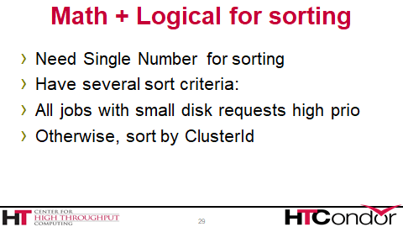
Booleans expand to integers
((DiskUsage < 100) * 1000000) + ClusterId
Common HTCondor paradigm!

Slide 33
Bitwise Expressions
Expression | Meaning
| | Bitwise or
& | Bitwise and
^ | Bitwise xor
>> | Bitwise shift right
<< | Bitwise shift left

Slide 34
Classad Builtin Functions
Expression | Returns
time() | Current time in seconds from epoch
substr(str, offset, len) | Extract substring
regexp(pattern, str) | Regexp match (pcre based)
random(x) | Random number from 0 to x
IsUndefined(expr) | True if expr is undefined
StringListMember(s, l) | Is s in list l, where l like "a, b, c"
toUpper(s) | Upper-case s

Slide 35
Examples with Functions
(QDate + 3600) > time()
-> true (maybe)
regexp("^s", Cmd)
-> true
IsUndefined(foo)
-> true
$ condor_q –l 180.0
ClusterId = 180
Cmd = "sleep"
DiskUsage = 100
ExitBySignal = undefined
QDate = 1535384632
RemoteUserCpu = 12.7
RequestDisk = DiskUsage
… (many attributes removed)
ClusterId = 180
Cmd = "sleep"
DiskUsage = 100
ExitBySignal = undefined
QDate = 1535384632
RemoteUserCpu = 12.7
RequestDisk = DiskUsage
… (many attributes removed)

Slide 36
Replace Examples
New in 8.9!
replace("[A-Z]",
Args, "C")
-> "Cob Bob”
replaceall("[A-Z]",
Args, "C")
-> "Cob Cob”
$ condor_q –l 180.0
ClusterId = 180
Cmd = "sleep"
DiskUsage = 100
ExitBySignal = undefined
QDate = 1535384632
RemoteUserCpu = 12.7
RequestDisk = DiskUsage
… (many attributes removed)
ClusterId = 180
Cmd = "names"
Args = "Rob Bob"
DiskUsage = 100
ExitBySignal = undefined
RemoteUserCpu = 12.7
RequestDisk = DiskUsage
… (many attributes removed)

Slide 37

Eval/Unparse: Jedi Level
Requirements = WantGluster
Does WantGluster appear in Reqs?
Req’mts is Expression, not string
So regexp, etc. don’t work

Slide 38
Unparse: expr to string
Requirements = WantGluster
Unparse(Requirements) ->
“WantGluster”
regexp("Gluster", unparse(Req))
-> True

Slide 39
Control Flow
Expr ? tExpr : fExpr
If expr evals to True, use tExpr, else fExpr
IfThenElse(expr, tExpr, fExpr)
ditto
(Expr ?: UseThisIfExprWasUndefined)

Slide 40
Greg’s Favorite Function: Debug()
Debug(anyExpression) -> anyExpression
Thus Debug is a no-op
Has a side effect:
DaemonLog traces expression evaluation

Slide 41
Requirements = WantGluster && (1024 > Memory)
Requirements = debug(WantGluster && (1024 > Memory))
Negotiator Log shows:
13:32:12 Classad debug: WantGluster --> UNDEFINED
13:32:12 Classad debug: 409600 --> 409600
13:32:12 Classad debug: [0.01001ms] Memory --> 409600
13:32:12 Classad debug: [0.03791ms] WantGluster && (1024 > Memory) --> FALSE

Slide 42
ClassAd Lists and Nesting
childCpus[1]
-> 2
childCpus[SlotId]
-> 4
Size(childCpus)
-> 4
$ condor_status –l a_pslot
ClusterId = 180
Cmd = "sleep"
DiskUsage = 100
Name = "fastmachine"
ChildCpus = {1, 2, 3, 4}
slotId = 3
… (many attributes removed)

Slide 43
Nested ClassAd (not used (yet!))
childSlot.Name
-> "slot1"
childSlot.Cpus
-> 4
childSlot["name"]
-> "slot1"
$ condor_status –l a_pslot
ClusterId = 180
Cmd = "sleep"
DiskUsage = 100
Name = "fastmachine"
ChildSlot =[
Name = "slot1"
Cpus = 4
]
Cpus = 40
… (many attributes removed)

Slide 44
condor_status -json
Name = "fastmachine"
ChildSlot =[
Name = "slot1"
Cpus = 4
]
Cpus = 40
ChildCpus = {1, 2, 3, 4}
slotId = 3
{
"Name": "fastmachine",
"ChildSlot": {
"Name": "slot1”
"Cpus": 4,
},
"Cpus": 40,
"ChildCpus": [
1, 2, 3, 4 ],
"slotId": 3
}

Slide 45
Classad user-defined function
Can be done with a .dll
Only in a dire emergency
Portability, compatability, etc.
See manual for details

Slide 46
Testing and debugging exprs
$ condor_status –limit 1
<just one ad>
$ condor_status –limit 1 –af “1+1”
2
$ condor_status –limit 1 –af ‘regexp(“foo”,”f.*”)

Slide 47
Classads: On to 2nd use
Description of entities in Condor
describes machines, jobs, services
Query language to select entities in Condor
“show me all the busy machines”
“show me idle jobs needing > 32 Gb ram”
2 way matching
Given jobs & machines, find matches

Slide 48
Query language
Users can write expressions as queries
These select a subset of ads from a larger set
If condor evaluates expression to TRUE

Slide 49
Query Language example
$ condor_status -const 'some classad expr'
$ condor_q -const 'some classad expr'

Slide 50
Classad expression in a submit file
Universe = vanilla
Executable = gronkulate
Requirements = has_avx && FloorNumber > 4
queue

Slide 51
Classad expression in a config file
EXECUTE = /var/condor/execute
START = cmd == “foo”
PREEMPT = EnteredCurrentState > 600
queue

Slide 52
Example query
$ condor_status –const 'Activity == "Busy"'
$ condor_status –const 'Activity != "Busy"'
MachineName = "Machine1"
Activity = "Busy"
MemoryUsage = 1024
***
MachineName = "Machine2"
Activity = "Idle"
***
MachineName = "Machine3"
Activity = "Busy"
MemoryUsage = 2048

Slide 53
Example query
$ condor_status –const 'Activity == "Busy"'
$ condor_status –const 'Activity != "Busy"'
MachineName = "Machine1"
Activity = "Busy"
MemoryUsage = 1024
***
MachineName = "Machine2"
Activity = "Idle"
***
MachineName = "Machine3"
Activity = "Busy"
MemoryUsage = 2048

Slide 54
Example query
$ condor_status –const 'Activity == "Busy"'
$ condor_status –const 'Activity != "Busy"'
MachineName = "Machine1"
Activity = "Busy"
MemoryUsage = 1024
***
MachineName = "Machine2"
Activity = "Idle"
***
MachineName = "Machine3"
Activity = "Busy"
MemoryUsage = 2048

Slide 55
Example query
$ condor_status –const 'MemoryUsage > 2000'
MachineName = "Machine1"
Activity = "Busy"
MemoryUsage = 1024
***
MachineName = "Machine2"
Activity = "Idle"
***
MachineName = "Machine3"
Activity = "Busy"
MemoryUsage = 2048

Slide 56
Example query
$ condor_status –const 'MemoryUsage > 2000'
MachineName = "Machine1"
Activity = "Busy"
MemoryUsage = 1024
***
MachineName = "Machine2"
Activity = "Idle"
***
MachineName = "Machine3"
Activity = "Busy"
MemoryUsage = 2048

Slide 57
Strict Equality Operators
What does the expression
"Some String" == undefined
Or
"Some String" == MissingAttribute
Evaluate to?

Slide 58
"foo" == undefined -> undefined
"foo" != undefined -> undefined
Sometimes you want
"foo" != undefined to mean false.

Slide 59
Strict Equality Operators
=?= and =!= are Strict Equality comparisons
“exactly equal” or “exactly not equal”
And NEVER return undefined:
"Some String" =?= undefined -> false
"Some String" =!= undefined -> true

Slide 60
Example Strict Equality
$ condor_status –const 'Activity != "Busy"'
$ condor_status –const 'Activity =!= "Busy"'
MachineName = "Machine1"
Activity = "Busy"
MemoryUsage 1024
***
MachineName = "Machine2"
***
MachineName = "Machine3"
Activity = "Busy"
MemoryUsage = 2048

Slide 61
Example Strict Equality
$ condor_status –const 'Activity != "Busy"'
$ condor_status –const 'Activity =!= "Busy"'
MachineName = "Machine1"
Activity = "Busy"
MemoryUsage 1024
***
MachineName = "Machine2"
***
MachineName = "Machine3"
Activity = "Busy"
MemoryUsage = 2048

Slide 62
Example Strict Equality
$ condor_status –const 'Activity != "Busy"'
$ condor_status –const 'Activity =!= "Busy"'
MachineName = "Machine1"
Activity = "Busy"
MemoryUsage 1024
***
MachineName = "Machine2"
***
MachineName = "Machine3"
Activity = "Busy"
MemoryUsage = 2048

Slide 63
More On Strict Equality
Undefined is just another value
Undefined == undefined -> undefined
Undefined =?= undefined -> true

Slide 64
More On Strict Equality
String == is case INsensitive
String =?=, =!= is case sensitive (!)
No conversion between types
42 == 42.0 -> true
42 =?= 42.0 -> false

Slide 65
Classads: 3rd use
Description of entities in Condor
describes machines, jobs, services
Query language to select entities in Condor
“show me all the busy machines”
“show me idle jobs needing > 32 Gb ram”
2 way matching
Given jobs & machines, find matches

Slide 66
Matchmaking
Requires TWO ads, returns true or false
“In the context of ad1 and ad2”
With a selection expression in the
Requirements value of both ads
Commonly used to match jobs and machines

Slide 67
For 2 ads to match, both Requirements -> true
Evaluate Requirements of one, if true
Evaluate Requirements of other.
Note My and Target are relative

Slide 68
Job Ad
Type = "Job"
Requirements =
HasMatlabLicense
=?= True
Cmd= "/bin/sleep"
Args = "3600"
Owner = "gthain"
NumJobStarts = 8
Slot Ad
Type = "Machine"
Cpus = 40
Memory = 2048
Requirements =
(Owner == "gthain") &&
(TARGET.NumJobStarts <=
MY.MaxTries)
HasMatlabLicense = true
MaxTries = 4

Slide 69
References when matching
Reference: lookup
e.g. SomeName -> "Foo"
IsGood = true
IsNotGood = false
RunTime = 123
Name = "Foo"
SomeName = Name
Price = 23.45
Foo = undefined
U = Missing

Slide 70
References when matching
Reference: lookup
e.g. SomeName -> "Foo"
IsGood = true
IsNotGood = false
RunTime = 123
Name = "Foo"
SomeName = Name
Price = 23.45
Foo = undefined
U = Missing

Slide 71
References when matching
IsGood = true
RunTime = 123
Name = "Foo"
SomeName = Name
Price = 23.45
Foo = undefined
U = Missing
IsGood = true
RunTime = 123
Name = "Bar"
Price = 23.45
Foo = undefined
U = Missing
What does SomeName return now?

Slide 72
References when matching
IsGood = true
RunTime = 123
Name = "Foo"
SomeName = Name
Price = 23.45
Foo = undefined
U = Missing
IsGood = true
RunTime = 123
Name = "Bar"
Price = 23.45
Foo = undefined
U = Missing
What does SomeName return now?

Slide 73
References when matching
Ads are checked in order
Lookup first in the local ad
Then the other ad

Slide 74
References with My and Target
Prefix reference with “My.” or “Target.”
To force lookup in one side or the other
Rarely used, but good idea

Slide 75
References when matching
IsGood = true
RunTime = 123
Name = "Foo"
SomeName = TARGET.Name
Price = 23.45
Foo = undefined
U = Missing
IsGood = true
RunTime = 123
Name = "Bar"
Price = 23.45
Foo = undefined
U = Missing
What does OldName return now?

Slide 76
References when matching
IsGood = true
RunTime = 123
Name = "Foo"
SomeName = TARGET.Name
Price = 23.45
Foo = undefined
U = Missing
IsGood = true
RunTime = 123
Name = "Bar"
Price = 23.45
Foo = undefined
U = Missing
What does OldName return now?

Slide 77
References when matching
IsGood = true
RunTime = 123
SomeName = Name
Price = 23.45
Foo = undefined
U = Missing
IsGood = true
RunTime = 123
Name = "Bar"
SomeName = Name
Price = 23.45
Foo = undefined
U = Missing
What does SomeName return now?

Slide 78
References when matching
IsGood = true
RunTime = 123
SomeName = Name
Price = 23.45
Foo = undefined
U = Missing
IsGood = true
RunTime = 123
Name = "Bar"
SomeName = Name
Price = 23.45
Foo = undefined
U = Missing
What does SomeName return now?

Slide 79
Questions? Thank You!

