Slide 1

Pointers to other HTCondor References (*HtCondor &)
Greg Thain
Center for High Throughput Computing
University of Wisconsin - Madison
Notes:
Tue 10 minutes

Slide 2
Welcome!
We're very happy to see everyone in person again!

Slide 3
Special Thanks to ….
Gabriele Fronzè – without whom we would not be here

Slide 4
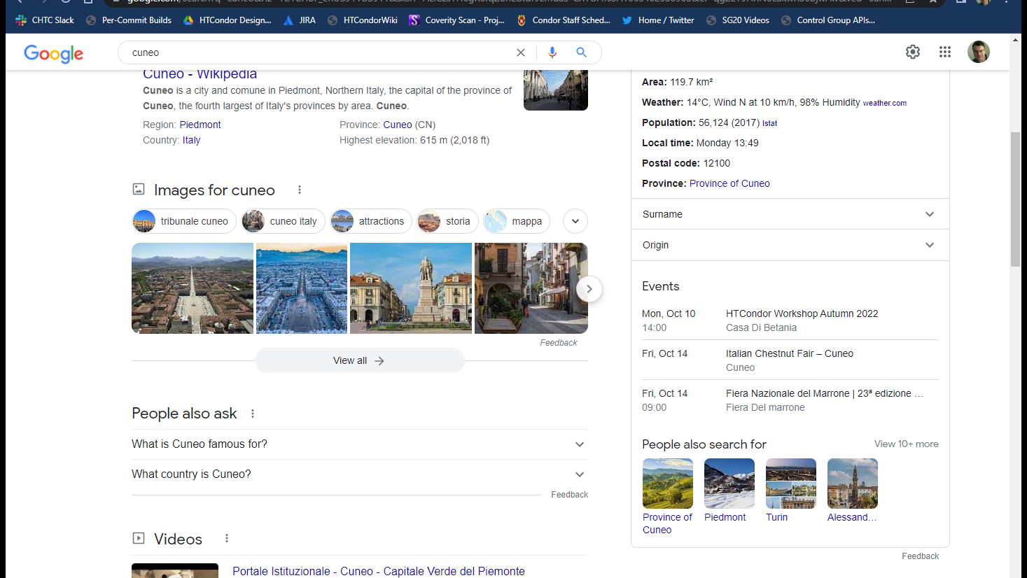

Slide 5
Second special Thanks to ….
Peter Couvares
Who taught me how to say in Italian: "I am an American"
Non capisco niente

Slide 6
Good news, Bad News
Good News: HTCondor is powerful, and can do a lot of things
Bad news: Getting HTCondor to do what want may be tricky
Good News: The Internet has lots of information about HTCondor
Bad News: The Internet!

Slide 7
Good sources of Information
Please come talk to us! That's why we are here!
No question too small
Office hours:
Wednesday 11:45 & Thursday @ 11:40
But need not wait:
Or Lunch?
Or Before / After talks.
"Us" → means whole community, not just few developers

Slide 8
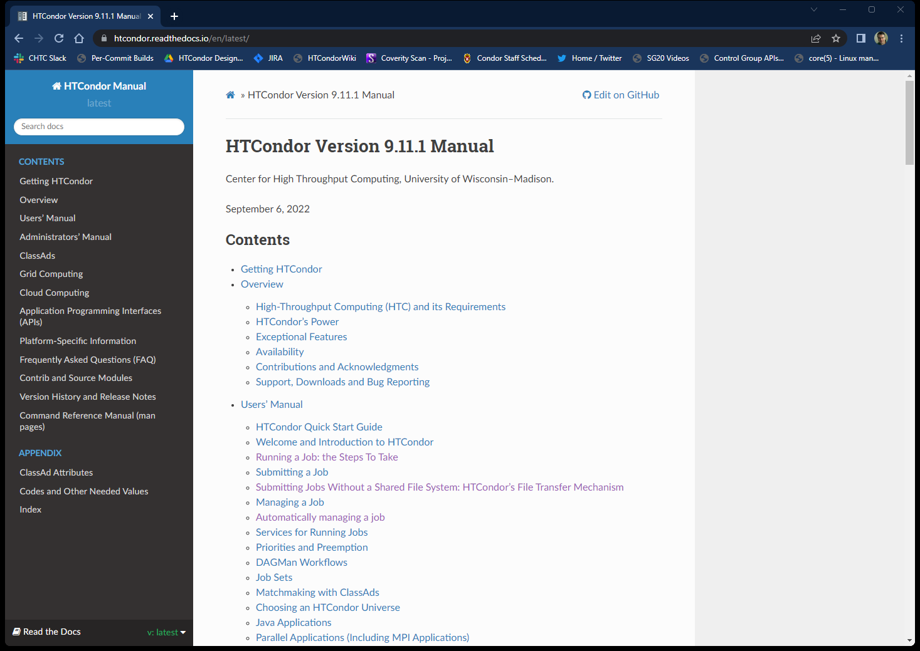
When all else fails…. Read the manual
Getting better
If confusing, let us know
We take github PRs…
https://htcondor.readthedocs.io

Slide 9
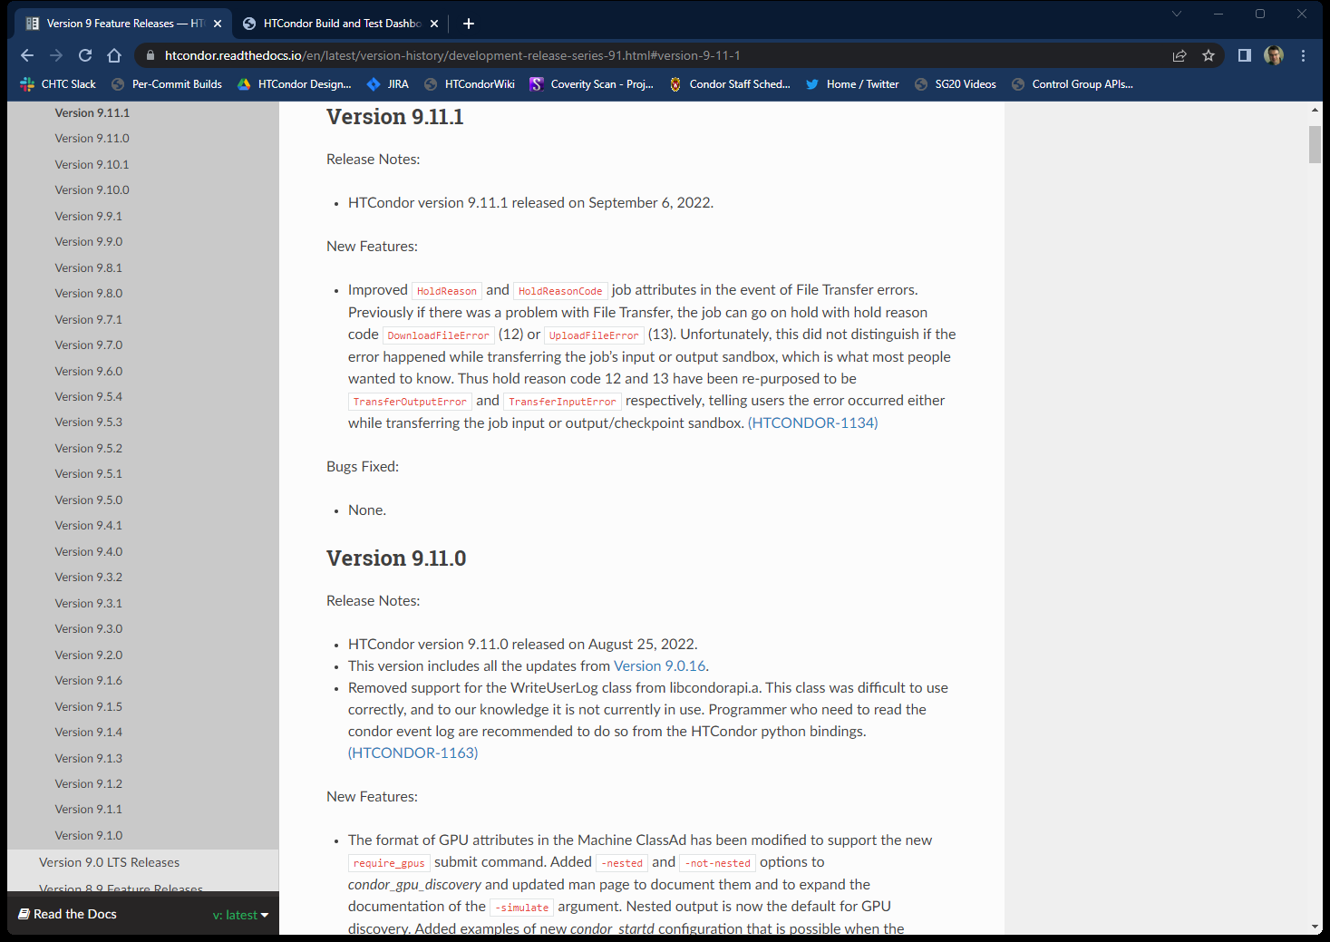
What if I've read the whole manual?
Release notes and Version History

Slide 10
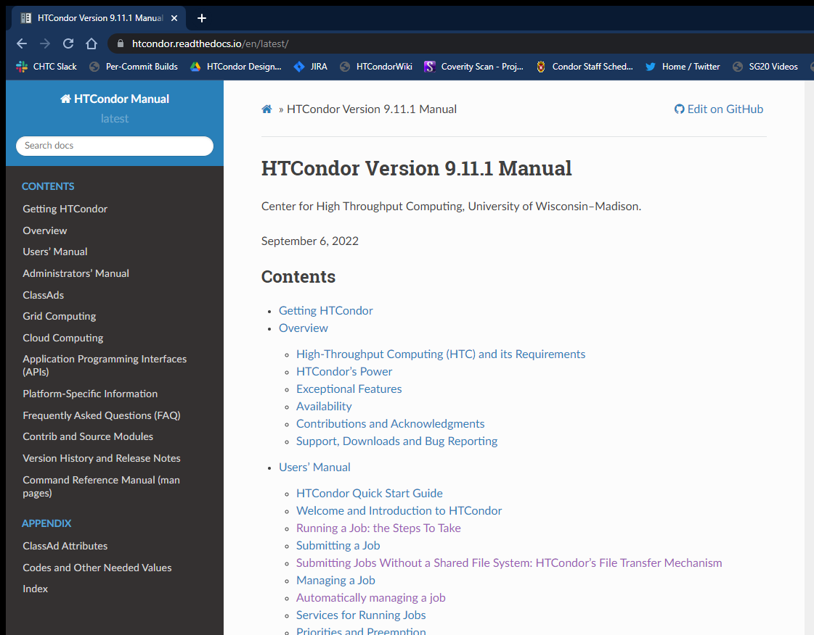
What if I can't read the whole manual?
Command Reference Manual

Slide 11
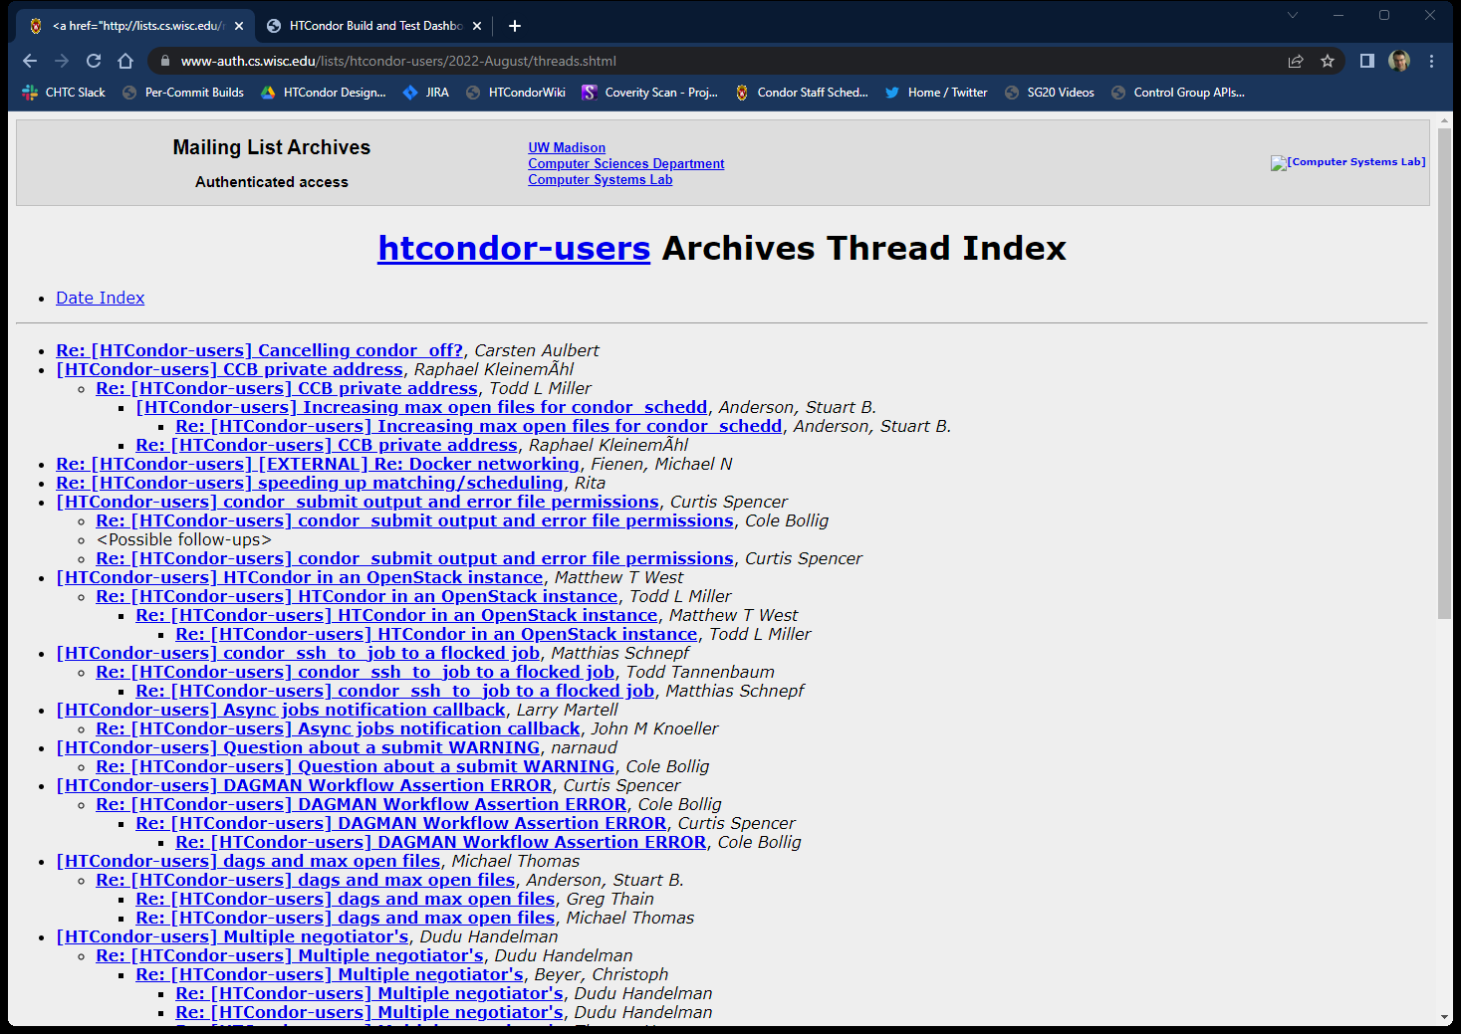
Htcondor-users email list
https://htcondor.org/mail-lists/#user

Slide 12
Command line help options
man condor_submit condor_submit --help

Slide 13
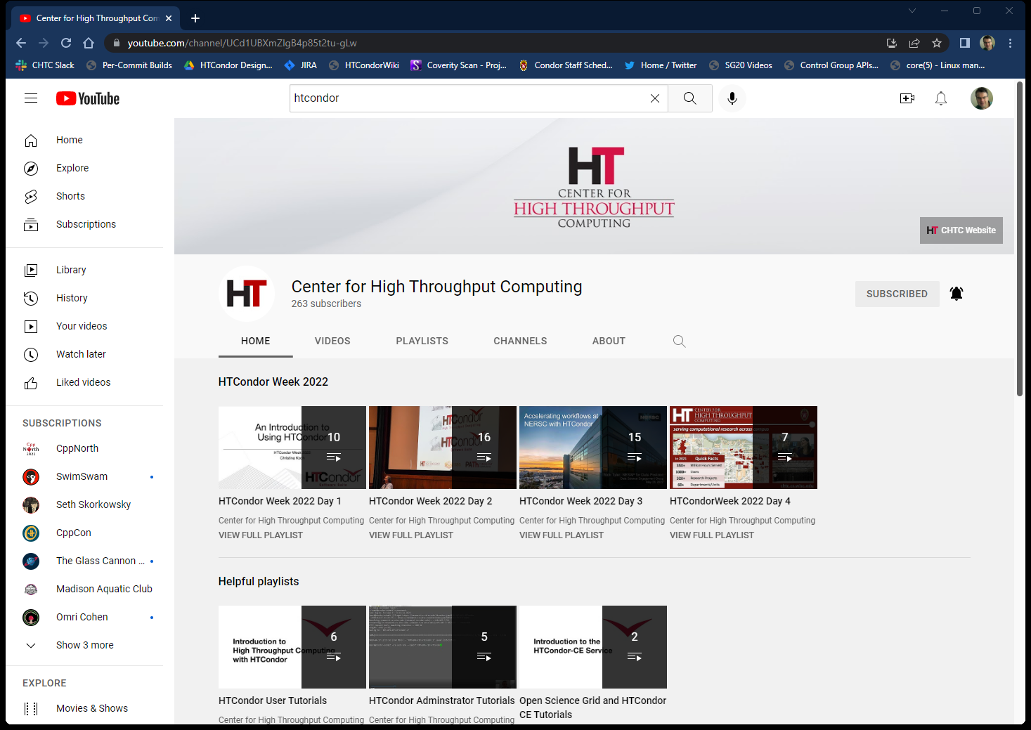
YouTube!
Center for High Throughput Computing

Slide 14
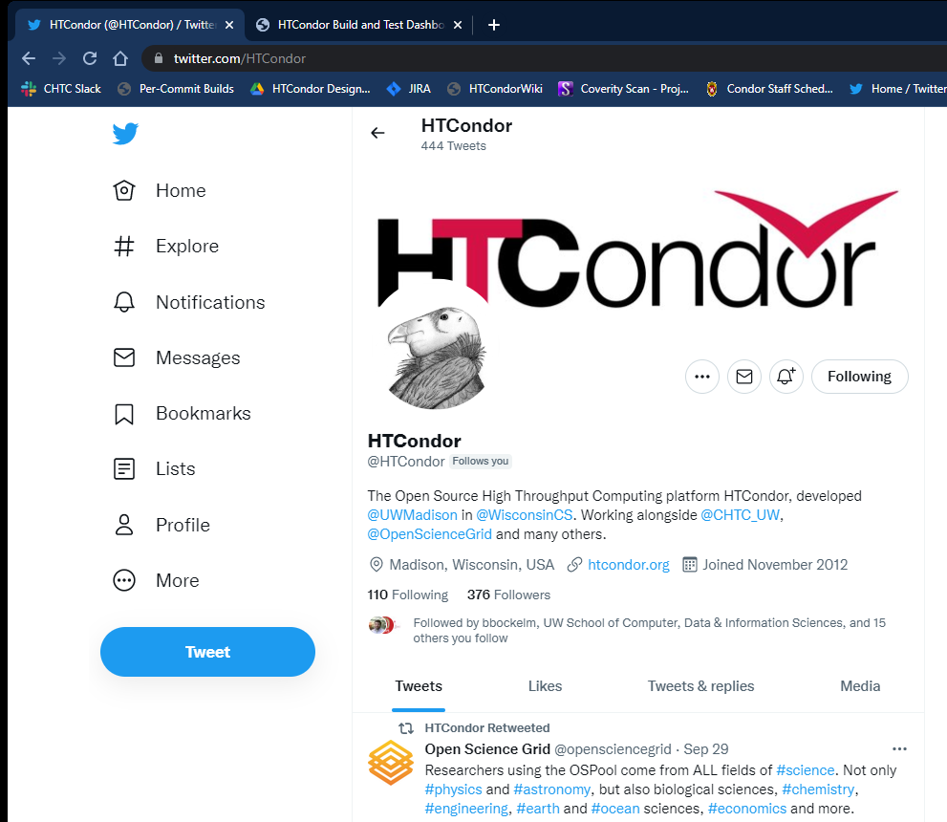
HTCondor Twitter feed: twitter.com/HTCondor

Slide 15
Places NOT to look for information
Stack overflow
Random internet searchs
Often out of date..

Slide 16
Thank you and questions
Thank you – Questions?
But remember:
Non Capisco Niente
How do you want to get information?
This work is supported by the NSF under Cooperative Agreement OAC-2030508. Any options, findings,
conclusions or recommendations expressed in this material are those of the authors and do not
necessarily reflect the views of the NSF.

