Slide 1
HTCondor in K8s
Center for High Throughput Computing

Slide 2
In the Beginning…

Slide 3
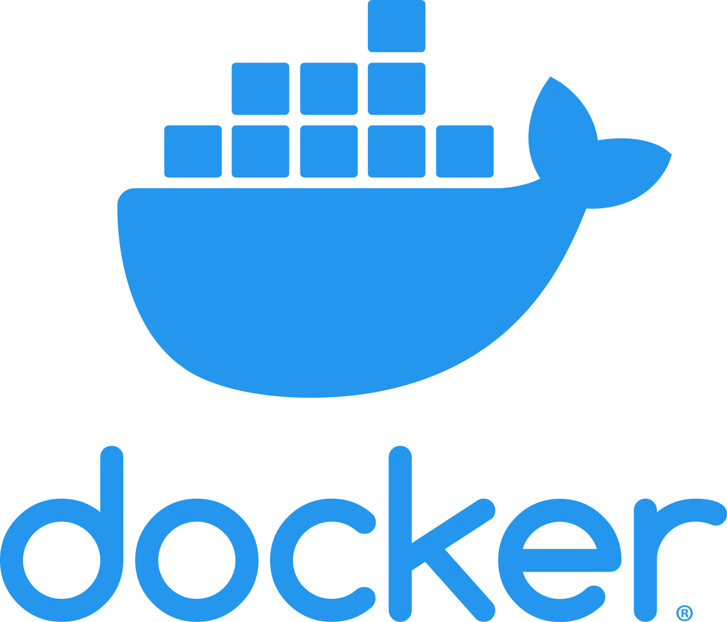
In the Beginning…

Slide 4
…and it was good

Slide 5
Until it was an unmanaged mess

Slide 6

Enter Kubernetes (k8s)
Tames the mess of containers on clusters
And their networks
And the storage

Slide 7
Kubernetes
Many users are here or working to getting here
K8s as distributed operating system
in an abstract way – like the schedd is db
Can k8s do some management things that
admins have to roll by hand today?

Slide 8
Summary of Kubernetes
Container Orchestrator
Sets of containers as pods
Sets of pods as deployments, etc.
Manages network and storage

Slide 9
Kubernetes architecture
Central database holds all objects
Pods, services, storage, nodes
Note difference from condor – tightly coupled
All objects described in yaml
One command kubectl interacts with k8s

Slide 10
Deploying Kubernetes
Local or in the cloud
Most deployments are cloud based
could be universal cloud interface bespoke, ephemeral condor pools
Local deployment is a lot of work
many distros

Slide 11
Cloud deployment easy…
$ eksctl create –name mine –region us-west-2
$ gcloud container cluster create –name mine

Slide 12


K8s and HTCondor worldview:
k8s assumes you have… A finite number of services*
each of which run for an unlimited time *mostly stateless
HTCondor assumes you have
An unlimited number of jobs
each of which run for a finite time

Slide 13
NOT k8s VS HTcondor…
K8s manages services HTCondor is composed of services .. So, can k8s manage the HTCondor services?

Slide 14
Review of HTCondor services
CM
collector
neogtiator
ep
ep
ep
ep
AP

Slide 15
This requires docker images
So, we built some…
$ docker run htcondor/cm
$ docker run htcondor/execute
$ docker run htcondor/submit
(Excuse the old naming scheme…)

Slide 16
This requires docker images
$ docker run htcondor/cm:23.9.6-el9
And we'll be releasing with HTCondor release
You can rebase on your own distro favs
Note that the OS is coupled with the HTCondor
Operating System
HTCondor
version

Slide 17
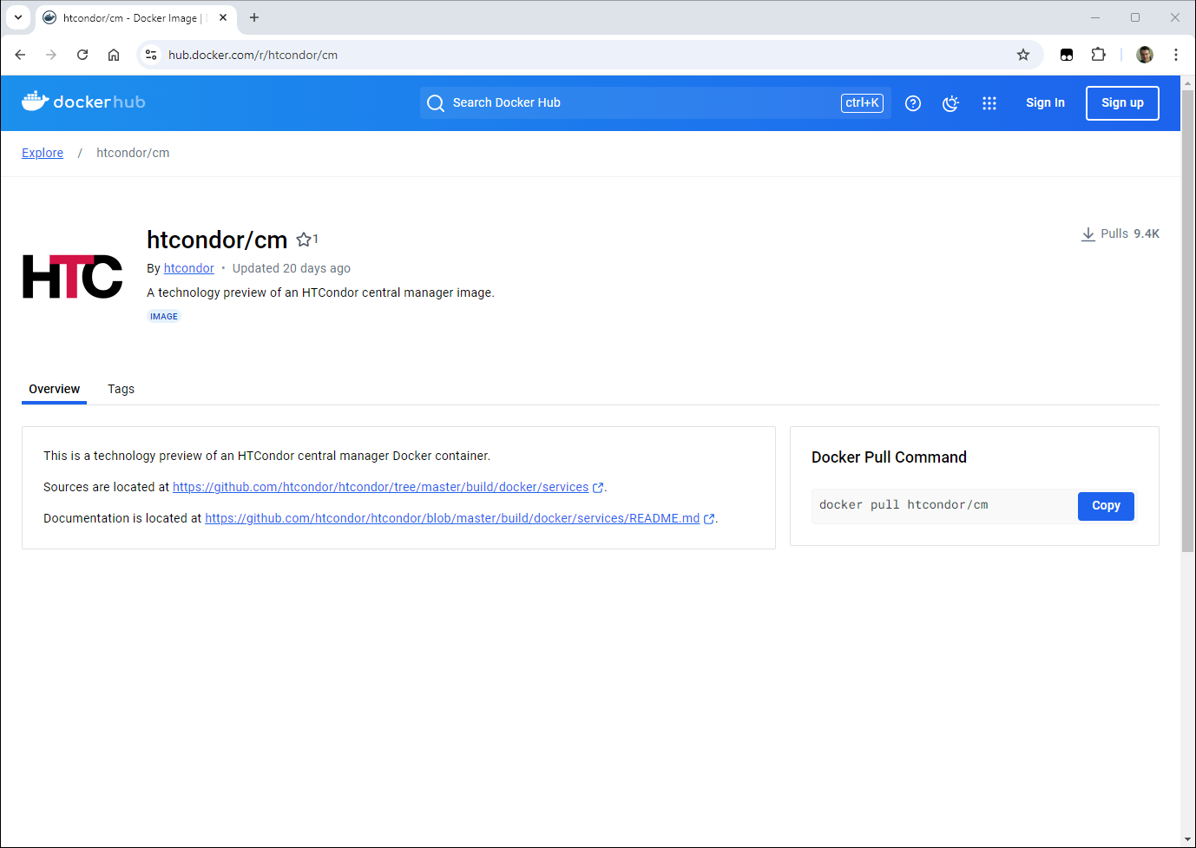
http://hub.docker.com/htcondor/cm
9.4k pulls
See sources!

Slide 18
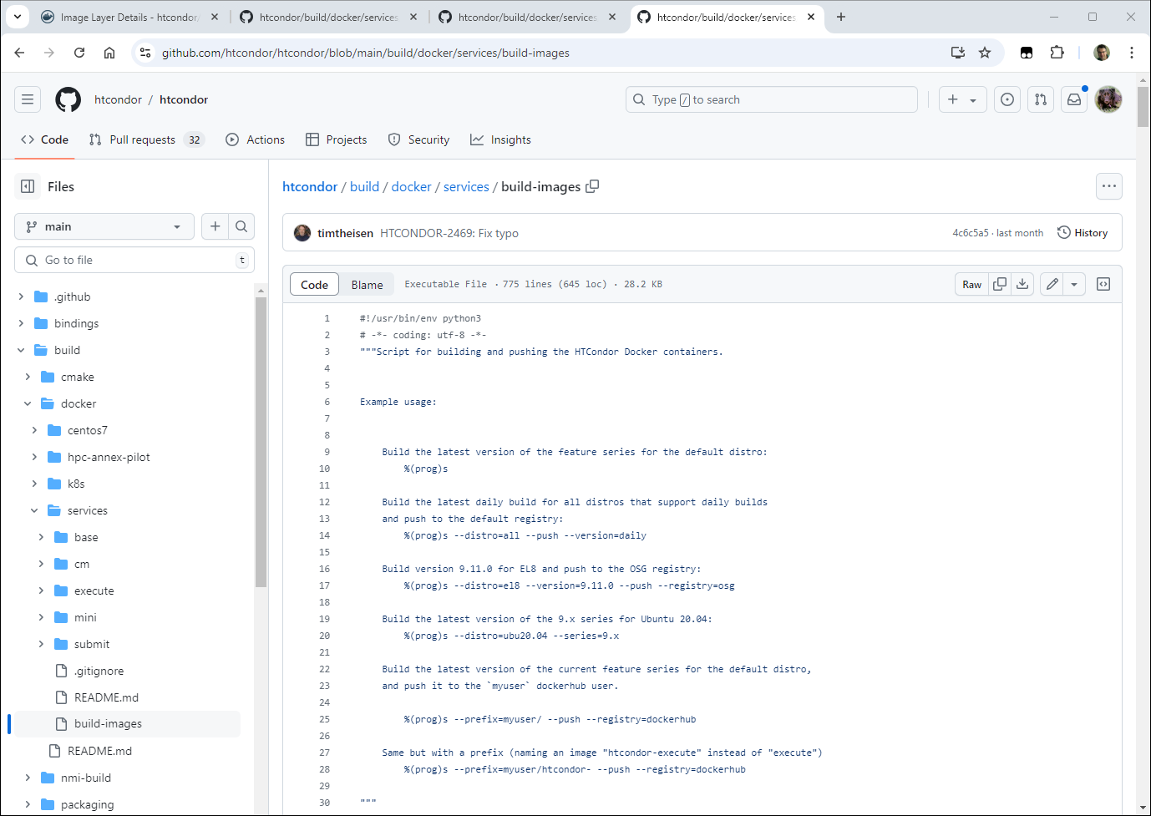
http://github.com/htcondor/htcondor/blob/main/build/docker/services/build-images

Slide 19
Start with the CM
Best example of stateless* service
Needs port 9618 everywhere
Configure to restart with same hostname
clients need reconfig to pick up new IP
* Mostly stateless – AccountantNew.log file
CM

Slide 20
And some example yaml
# This is the service that names the ip address of the collector
# All pods get an environment variable with this ip in it
apiVersion: v1
kind: Service
metadata:
name: condor
spec:
selector:
htcondor-role: cm
ports:
- protocol: TCP
port: 9618
targetPort: 9618
---
# This is pod yaml to describe the single htcondor central manager
apiVersion: v1
kind: Pod
metadata:

Slide 21
Debugging the CM
Kubectl exec (or maybe ssh)
Is a MUST!
/var/log/condor/*Log files very very useful
Offline ads? Gangliad? More state

Slide 22
Next step: EP
ep
ep
EPs – where jobs run
Also mostly stateless
But – how to size? Pslots help, but…?
Like CM, logs, ssh v useful, port 9618 helpful
ep
ep

Slide 23
Consequence of an EP pod
EP is running inside docker container
OS of EP is OS job sees
Usually means job can't also be a docker
(singularity/apptainer OK, though)
Also means not privileged
No cgroups, priv switching, etc. etc. etc.

Slide 24
Provisioning via Rooster
Can use offline ads to automatically provision
Create "fake" ads, if they match, submit pod to create real capacity
PATh Fac works this way, better support for 1st class coming with Glidein Manager

Slide 25
Final step: AP
AP – 100 % state
Does it even make sense to put in k8s?
May want to keep it outside k8s If so, home directories, /var/spool/condor
Login sessions, etc. etc.
AP

Slide 26
Post final step -- CE
CEs make a lot of sense in k8s
Most OSG CEs are "managed CEs", and run in k8s
We can reuse OSG scripts to run your CE

Slide 27
CHTC Experience w k8s
Generally good, but …
Everything has consequences
Debugging inside is tricky
k8s moves fast – prepare to upgrade a lot
Need to live with immutable image mindset

Slide 28
Thank you
Questions?
Center for High Throughput Computing

