Slide 1


A Game by Greg VanKampen

Slide 2

What is a “Pibblie Pum”?
A Pibblie Pum is a virtual pet that you must care for.
You will need
to feed them
play with them
and care for them
Watch your pet grow older in real time.
If you treat your pet well enough, they may even evolve.

Slide 3


You and your Pibblie Pum
Raising a healthy Pibblie Pum can be a challenge.
Your pet has three stats:
Fullness
Happiness
Weight
Fullness and happiness decrease over time
Playing feeding and playing games with your pet will raise these stats
Letting these stats go too high or too low can make your pet sick

Slide 4

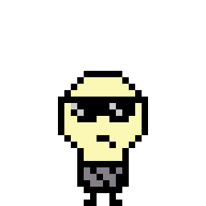

Pet Evolution
As your pet gets older, it will evolve.
Each pet has 3 stages of evolution
Baby
Child
Adult
Each stage will be longer than the previous one.
Each stage also has a larger max happiness and fullness than the previous one.
Each pet has a branching tree of possible evolutions
How you treat your pet determines which path it will go down.
After your pet has grown old enough, it will leave you a special egg and leave to explore

Slide 5


Games
Playing games with your pet will lower their fullness and weight while raising their happiness.
Games change based on age
Baby: Rock Paper Scissors
Child: High Jump
Adult: Asteroid Blaster
If you win, you receive money to buy items from the shop

Slide 6

Items and Shopping
The money you earn from games can be used to buy items from the store
Items are always 2 random food items and 1 medicine
Buying food items makes shop keeper Tubba restock his goods with something new
Tubba also restocks occasionally as time passes
Tubba

Slide 7
Code Concepts

Slide 8
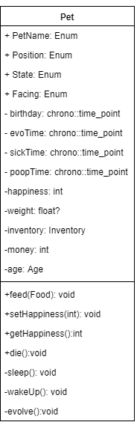
Pet Class
Idle animation functionality
Time functionality
Stats
Inventory
Feeding Method
Die
Sleep and Wake up
Evolve

Slide 9
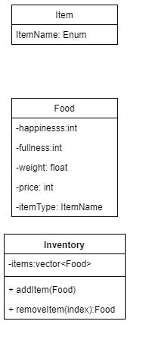
Inventory
Inventory is used both by Pet and ShopState
Item IDs
Food Stats
Inventory Management

Slide 10
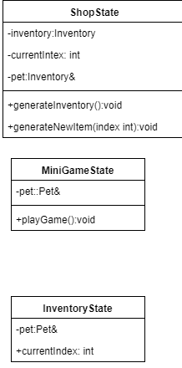
States
Shop State & Inventory State navigation and interaction
Mini Game state plans
Rock Paper Scissors mechanics
High Jump Mechanics
Astro Blaster Mechanics

Slide 11
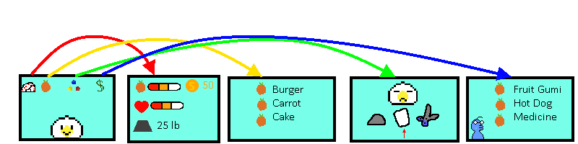
Screen Flow

Slide 12

Thanks for Listening!

