Slide 1


A game by Greg VanKampen

Slide 2
Introduction
PibbliePums is a real time virtual pet game
The game is made using the SFML GEX engine in C++
You can feed, play, and shop with your pet
As you raise your pet, it evolves into multiple other forms

Slide 3
Lore
Planet Pum has had a sudden infestation of Pibblies, a creature that multiplies and evolves quickly. The Pums see these creatures as vermin and have studied ways to prevent their rampant growth. In their research, the Pums notice that Pibblie’s growth rate is greatly stunted by large amount of oxygen. The Pums found a lone planet with large amount of oxygen, Earth. They quickly begin a project to warp the Pibblie eggs to this planet.

Slide 4
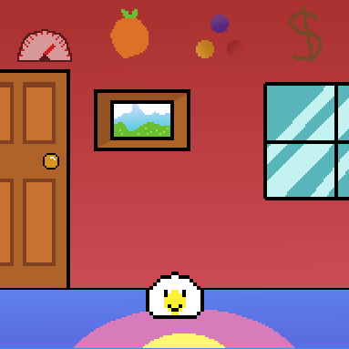
Game Features
Pets
Evolve
Get sick
Die
Get hungry
Minigames
Earn money
Shop
Generate random stock
Maintain stock for a period
Multiple Food items
Stats
Effect pet status
Update over time
Change based on pet age
Inventory
Transfer food stats to pet on use

Slide 5
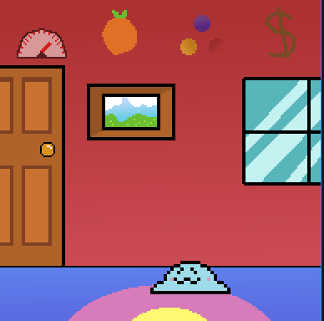
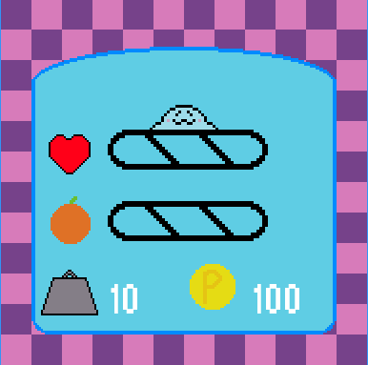
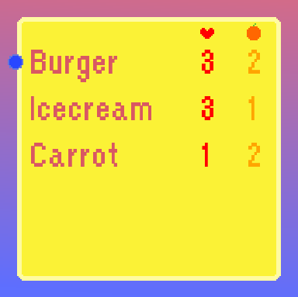
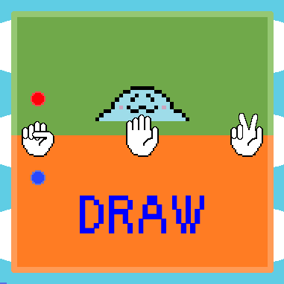
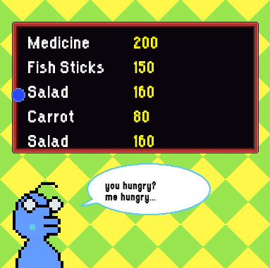
Game Screens

Slide 6

Challenges
Making my own assets
Sprites
1 pet has 5 states (idle, happy, walking, sick, and upset)
Each state has 2 frames
Every icon and background
The amount of sprite art was a lot more work than I was expecting
Sounds
I created all the sounds
Music
Required specialized hardware and skills
State Interaction
Passing data without using parameters
Learning singleton design

Slide 7

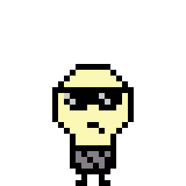
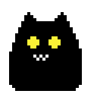
Possible Future Features
General
Saving and Loading
Pets
More Pets
Branching Evolution
Evolution Animation
Advanced Status Effects
Minigames
Age specific Minigames
Win/Lose pet animations
Shop
Food Icons
Stats
Animated pet icon
Inventory
Eating animation

Slide 8
Game Demo

