Slide 1
DSR Mini Competition Predicting university grants
Adam & Greg
February 14th, 15th, 16th 2017

Slide 2
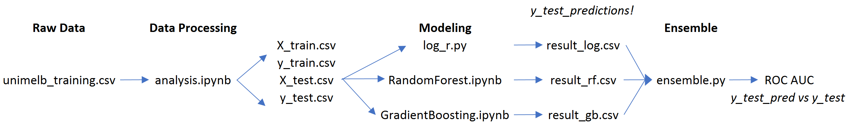
Workflow
All files (.csv, .ipynb, .py) saved to Github
Iterative process of:
Data processing
Training models to highlight important features
Data processing to improve important features

Slide 3
Features engineering (1/3)
1. Non-person specific rows:
Imputed Contract-Value-Band, hard-coded it to “A”. Tried to do something clever, but trying to guess with Random Forest led to predicting A all the time
Split date into three columns: Year, month, day
Created dummy variables for all categorical fields. Adding dummy_na=True made a real difference
Totally ignore RFCD and SEO

Slide 4
Features engineering (2/3)
2. Aggregated person rows:
Melted the person specific data from (row=7808, col=15x15) to (row=7808x15, col=15)
Converted to numeric number of years at uni (e.g. “ >5 to 10” -> 7.5)
Aggregated data by team (avg, std, min, max) for most field, including those whose meaning is unknown (A..1, A.1, B.1, C.1)
Computed % of successful application
3. First person row
Added non-aggregated data for 1st person (assumption it is very important)

Slide 5
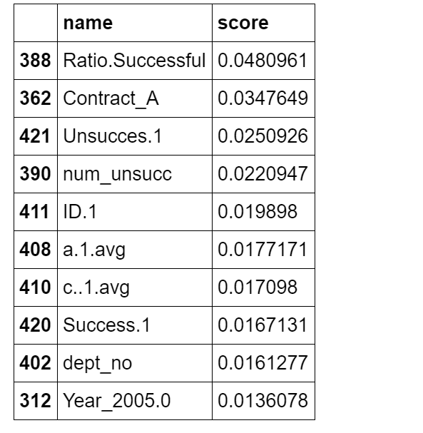
Features engineering (3/3)
4. Final steps
Impute all remaining missing to 0
Split train/test based on provided indices
Save to csv for later reuse in multiple machine learning algorithms
5. Iteration
Made use of a RandomForest during
data processing to understand
feature importances
Focus on further processing
important features

Slide 6
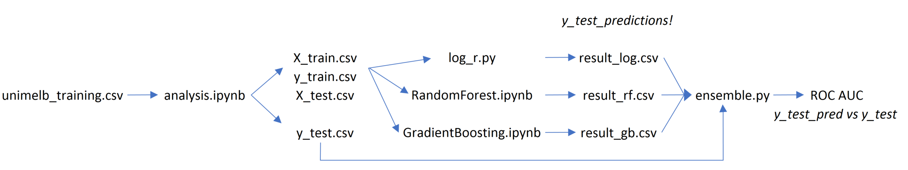
Workflow
Iterative process of:
Data processing
Training models to highlight important features
Data processing to improve important features

Slide 7
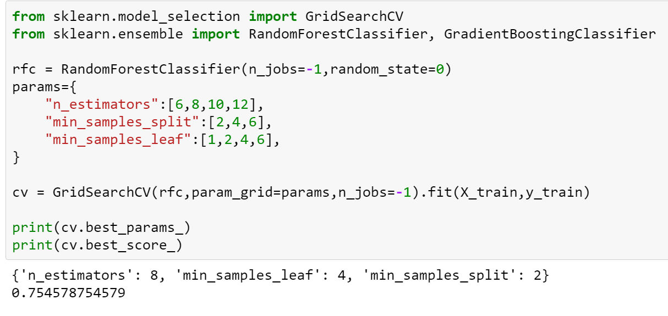
Random Forest Grid Search

Slide 8
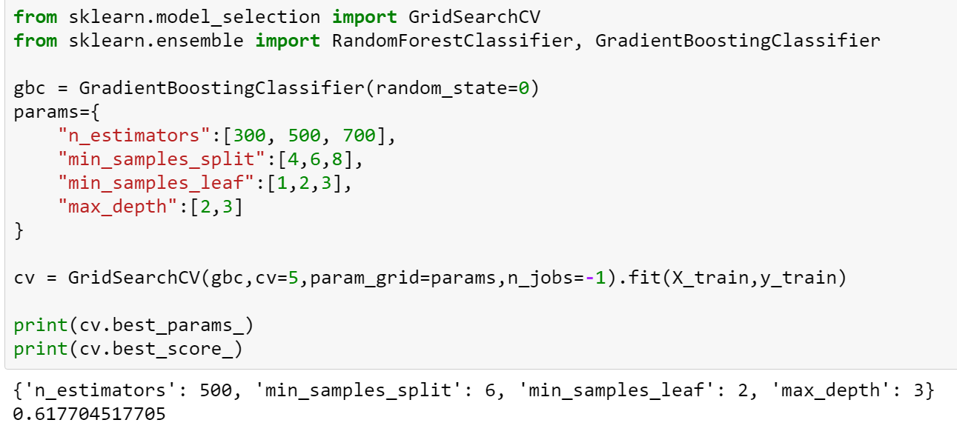
Gradient Boosted RF Grid Search

Slide 9
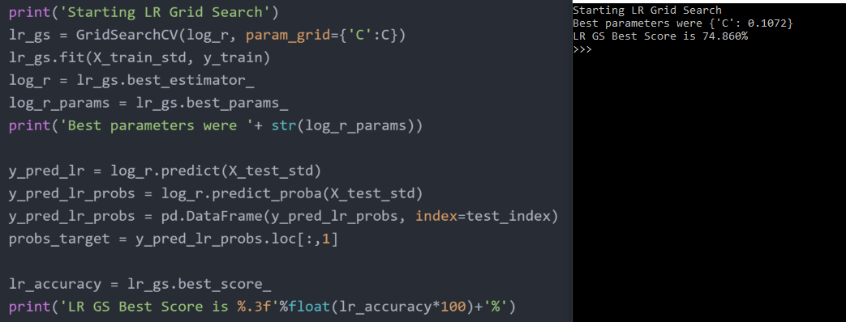
Logistic Regression Grid Search
Search across parameter inverse of regularization strength (C)
Tune using cross validation mean accuracy
Also pull out prediction probabilities (same for RF & GB RF)

Slide 10
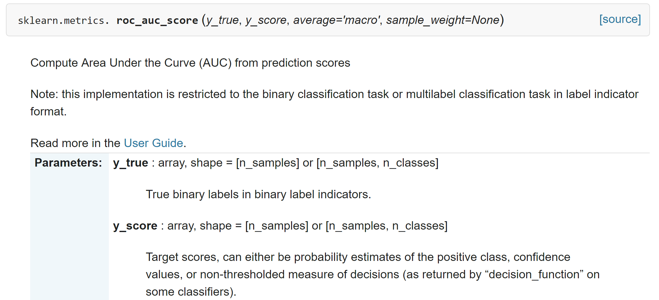
ROC AUC Calculation
Can use either the prediction (0,1) or the probabilities in calculation of AUC
Use of probabilities gives a much higher AUC value (gain of roughly 6%)

Slide 11
Ensemble
Final prediction is an ensemble of our three models
Looked at two methods for final prediction:
Average probability
Voting

Slide 12
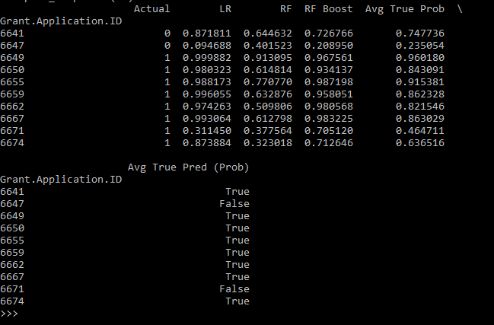
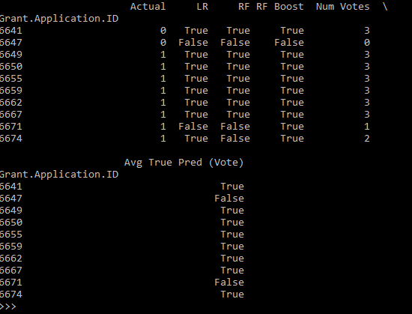
Ensemble
No significant difference
Only 6 times did methods disagree (for test data predictions)
Should really be comparing
on training data predictions!
Voting
Probabilistic

Slide 13
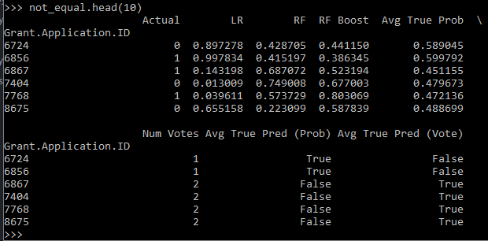
Samples where Probabilistic disagrees with Voting
Methods disagree on only 6 samples out of 518 (1.2%)
Both are very similar

Slide 14
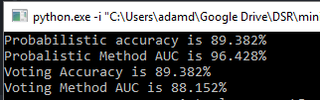
Ensemble Results (on test data)
Final results for our two ensemble methods (using both methods for calculating AUC)
Probabilistic method shows similar accuracy but much higher AUC (due to use of probabilities in probabilistic AUC calculation)

Slide 15
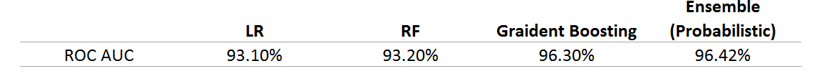
Final Results
All versus test data
ROC AUC = calculated using probabilities (not predictions)

