Slide 1
Getting Started with RIS at WashU
Welcome!

Slide 2
Agenda for the day!
Introductions
What is the RIS?
Connect to the RIS
Upload some code/data to the RIS
Where can I go for help?
Learning outcomes:
Be able to put data on the RIS and run Rstudio/Stata

Slide 3
Code of Conduct
Let’s keep this a constructive and supportive environment
We’re all learning
I very much appreciate feedback

Slide 4
Introductions!
My name is Gregory Porter. I am a software engineer for the Transdisciplinary Institute in Applied Data Sciences.
Let’s go around the room:
Name and software of choice

Slide 5
Task 1 – Connecting to the RIS
We’re going to access it using SSH.
ssh <wustl-key>@compute1-client-<N>.ris.wustl.edu
where <key> is your official WUSTL key, and <N> can be any number from 1 to 4
Windows users – Download Putty
https://tinyurl.com/mgyxbev

Slide 6
Task 2 - Globus
What is Globus?
A way to transfer data
Why Globus?
It’s great for large files
It’s a consistent experience between Mac and Linux

Slide 7
Task 2 - Globus
Installing Globus - https://tinyurl.com/23p39mth
Connecting it to the RIS - https://tinyurl.com/2d7clpdh

Slide 8
Task 3 – Open On Demand
Navigate to:
https://ood.ris.wustl.edu

Slide 9
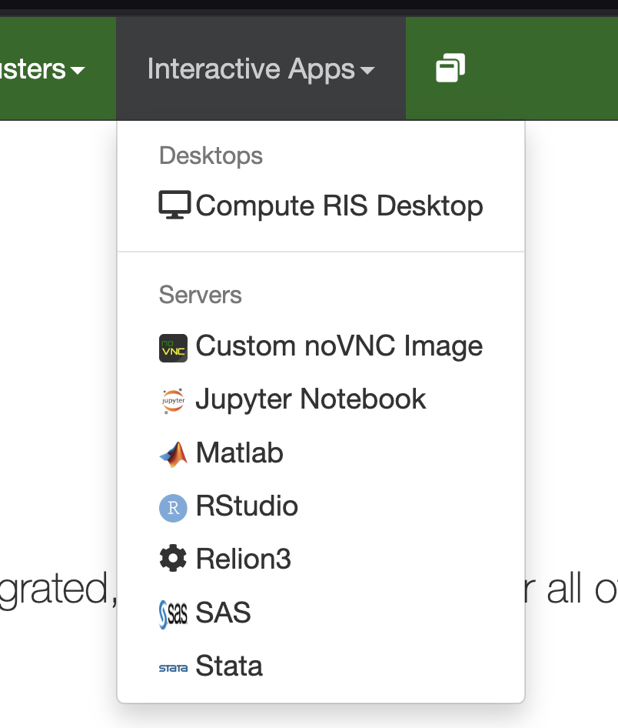
Select the app we want to use
Hover over Interactive Apps
Select the App you want to use
For this example, we’ll use RStudio

Slide 10
Modify the form as needed
Mounts:
/storage1/fs1/artsci/Active/g.porter:/storage1/fs1/artsci/Active/g.porter
Note, this path “/storage1/fs1/artsci/Active/g.porter” will be different for you.
It will probably be something like “/storage2/fs1/<your_wustl_key>/Active”

Slide 11
Modify the form as needed part 2
Memory (GB)
Number of hours
Number of processors
GPUs to Allocate
GPU Model Type

Slide 12
Modify the form as needed part 3
Take aways – the more resources you request, the more time it will take for those resources to become available.

Slide 13
In sum
Now you can run Rstudio and Stata on the RIS!
And you know one way to transfer data to the RIS!
Where can I go for help?
https://ris.wustl.edu/support/service-desk/
Note, you’ll need to make an account to use this. You can use your wustl email as the username to make things easier

Slide 14
Thank you very much!
Contact info:
Gregory Porter
G.porter@wustl.edu

