Slide 1
Getting Started with HPC at WashU
Welcome!

Slide 2
Agenda for the day!
Introductions
SSH into the RIS
What is the RIS?
Upload some code to the RIS
Where can I go for help?
Learning outcomes:
Be able to put data on the RIS

Slide 3
Code of Conduct
Let’s keep this a constructive and supportive environment
We’re all learning
I very much appreciate feedback

Slide 4
Introductions!
My name is Gregory Porter. I am a software engineer for the Transdisciplinary Institute in Applied Data Sciences.
Let’s go around the room:
Name and software of choice

Slide 5
Task 1 – Connecting to the RIS
We’re going to access it using SSH.
ssh <wustl-key>@compute1-client-<N>.ris.wustl.edu
where <key> is your official WUSTL key, and <N> can be any number from 1 to 4
Windows users – Download Putty
https://tinyurl.com/mgyxbev
https://ood.ris.wustl.edu

Slide 6
Task 2 – Open On Demand
Navigate to:
https://ood.ris.wustl.edu/pun/sys/dashboard

Slide 7
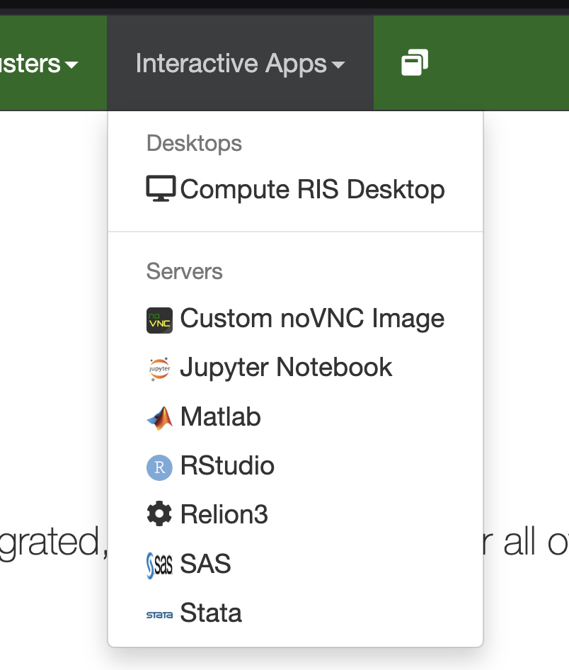
Select the app we want to use
Hover over Interactive Apps
Select the App you want to use
For this example, we’ll use RStudio

Slide 8
Modify the form as needed
Mounts:
/storage1/fs1/artsci/Active/g.porter:/storage1/fs1/artsci/Active/g.porter
Note, this path “/storage1/fs1/artsci/Active/g.porter” will be different for you.
It will probably be something like “/storage2/fs2/<your_wustl_key>/Active”

Slide 9
Modify the form as needed part 2
Memory (GB)
Number of hours
Number of processors
GPUs to Allocate
GPU Model Type

Slide 10
Modify the form as needed part 3
Take aways – the more resources you request, the more time it will take for those resources to become available.

Slide 11
Task 3 - Globus
Installing Globus - https://tinyurl.com/23p39mth
Connecting it to the RIS - https://tinyurl.com/2d7clpdh

Slide 12
In sum
Now you can run Rstudio and Stata on the RIS!
And you know one way to transfer data to the RIS!
Where can I go for help?
https://ris.wustl.edu/support/service-desk/
Note, you’ll need to make an account to use this. You can use your wustl email as the username to make things easier

Slide 13
Thank you very much!
Contact info:
Gregory Porter
G.porter@wustl.edu

